Slide 1
Western Settlement and the Rise and Fall of Populism
Mr. Daniel Lazar

Slide 2
Important Themes in this Lecture
Jeffersonian vs. Hamiltonian Visions
The Ideal and Symbolic Appeal of The West
Role of Government in Economic Stimulus
Class Consciousness and Class Antagonism
Liberty vs. Equality
Balance the economy
Challenges in organizing a movement of the people
Effects of a 3rd Party Challenge
Populism as a theme in US History

Slide 3
Lecture Outline
Settling on the Great Plains: The Ideal and the Spirit of the West
Rise and Evolution of Farmers’ Organizations
Farmers Unite
The Currency Conundrum
Election of 1896
Legacy of Farmers Alliances & Populist Party

Slide 4
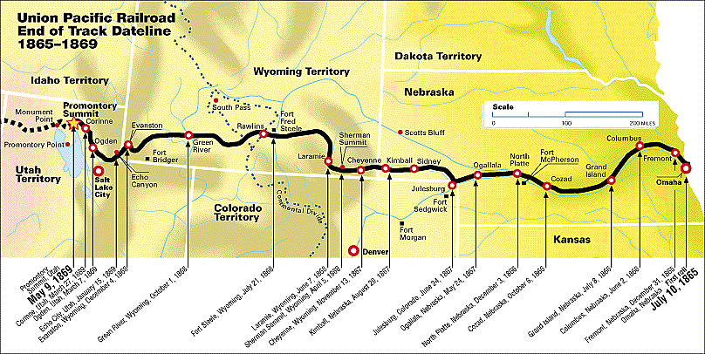
Settling on the Great Plains: The Ideal and the Spirit of the West
Railroads
Underclass Labor (Irish, Chinese, Black, Mexican)
Government Subsidies!
Central Pacific – CA→UT
Union Pacific – IA → UT (Pacific RR Act of 1862)

Slide 5
Government Support for Settlement
Homestead Act of 1862
160 free acres for 5 years of cultivation
1:9 Ratio of bona fide farmers: speculators + RxR
Only applied to Union members
Southern Homestead Act of 1866
Oklahoma Sooners (2 million acre land rush)
G.T.T.

Slide 6
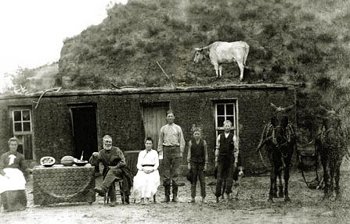
Challenges of the Plains
Self-Sufficiency
Dugouts and Soddies

Slide 7
Morrill Land Grant Acts of 1862, 1890
Goal: Maximize productivity of Western farms
barbed wire, steel plow, reaper, steel windmill
Est. Agricultural Colleges to research and disseminate information
Each state received a total of 30,000 acres of federal land for each member of Congress the state in 1860.
Cornell, MIT, Iowa State

Slide 8
Farmers in Debt
Invested in land (necessity)
Invested in machinery (necessity)
Rising shipping costs (railroad oligopolies)
Dependent on market prices. Thus dependent on:
Weather
Insects
Luck
Capitalist speculation

Slide 9
Farmers in Debt
Crop lien system: Farmers became tenants
Farmer needs technology, seed, more land, etc.
A banker/speculator would possess the title to the farmer’s crop before the farmer harvested it.
Farmer often unable to pay off the debts for his mortgage
Even in the best of years, the farmer would not see dollar one for his labors

Slide 10
Farmers in Debt
Two tier system: goods bought on interest would cost more that goods paid in full
Ex - 10 cent bag of seed, sold for 14 cents at 40% interest
The farmer was contractually obliged to not buy goods from any other merchants unless he paid cash in full.

Slide 11
Farmers in Debt
Panic of 1873
Post-war inflation
Rampant speculative investments (esp. in railroads)
Large trade deficit
Tumult in Central Europe = bank failures
Called The Great Depression, until…

Slide 12
Farmers in Debt
Panic of 1893
Basically same causes as 1873. Plus:
Sherman Silver Purchase Act of 1890
1890 McKinley Tariff (50% on imported industrial goods!)
Unemployment rate in PA hit 25%, NY 35%, MI 43%
15,000 businesses and 6,000 banks closed
By 12/94, 1 in 5 unemployed
Railroads busted
Gilded Age: Starvation in the Midst of Surplus
Coxey's Army, the first populist "march on Washington“. Led by OH businessman, land speculator, and politician Jacob Coxey
Farmers NEED government assistance (a critical issue)

Slide 13
The farmers, desperate, needed to unite and organize…

Slide 14
The Farmers Unite
Jeffersonian Farming Ideal vs. Realities of Modern American Life
Moral Redemption of the Nation: Farming as a Moral Crusade
Dual Character of the American Farmer
Hard and Soft Sides:
Money driven capitalist speculators
Lovers of land and freedom
A Fight Against the Conspiracy of Power Control

Slide 15
The Farmers Unite
The Evolution…
The Grange (1867)
National Labor Union (1871)
The Greenback Party (1876-84)
The Union Labor Party (1888)
The Populist Party (1892)
Farmers’ Alliances: 1887 = 200,000 members, 1892 = 2 million members
“The Alliance is the People and the People are together.”

Slide 16
The Farmers Unite
Oliver Kelley founded The Grange in 1867
Teachers, Preachers, Writers, and Organizers
Educate: Banks, Railroads, Money, Tariffs
Enemy No. 1: Railroads
RxR oligopolies
Railroad dealt exclusively with grain brokers
Farmers paid more for shipping than they received from product
Farmers in debt…ask for loans (from whom?)

Slide 17
The Farmers Unite
Five Key Theme of Populism
A Golden Age
Natural Harmonies Among the Producing Classes
Social Struggle b/w the Robbers and the Robbed
A Conspiracy of History
The Primacy of Money / Lift debt burden

Slide 18
The Farmers Unite
Demands
Increase the Money Supply
Graduated Income Tax
Federal Loan Program
Eight Hour Workday
Immigration Restriction (nativist, anti-Semite, racist, jingoistic and anti-European)
Why 4 and 5?

Slide 19
The Farmers Unite
The conditions which surround us best justify our co-operation; we meet in the midst of a nation brought to the verge of moral, political and material ruin. Corruption dominates the ballot-box...The people are demoralized...public opinion silenced... homes covered with mortgages, labor impoverished, and the land concentrating in the hands of capitalists…We seek to restore the government of the Republic to the hands of the "plain people”.
--Populist Party Platform (1892)

Slide 20
The Farmers Unite
“Wall street owns the country. It is no longer a government of the people, by the people and for the people, but a government of Wall Street, by Wall Street, and for Wall Street…Our laws are the output of a system which clothes rascals in robes and honesty in rags…We want money, land and transportation…we want the accursed foreclosure system wiped out…we stand by our homes and stay by our firesides by force if necessary, and we will not pay our debts to the loan-shark companies until the Government pays its debts to us.”
--Mary Ellen Lease (Zinn, 282)

Slide 21
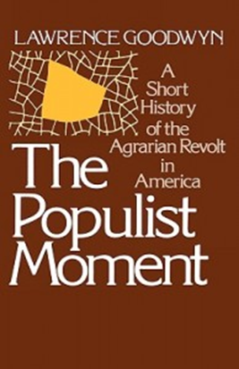
The Farmers Unite
Four stages of Democratic Movement Building (Goodwyn):
Formation and Agenda Setting
Recruitment
Education
Politicization

Slide 22
The Farmers Unite
“Democratic politics hinge fundamentally on these sequential relationships. Yet, quite obviously, the process is extremely difficult for human beings to set in motion and even more difficult to maintain—a fact that helps explain why genuinely democratic cultures have not yet been developed by mankind.”
--Goodwyn

Slide 23
The Farmers Unite
People do not feel that they can do much in politics” to affect substantively either their own daily lives or the inherited patterns of power and privilege within their society…[this] has engendered escapist modes of private conduct that focus on material acquisition. The young seek to “plug into” the system, the better to reap the private awards. Public life is much lower on the scale of priorities.
(Goodwyn)

Slide 24
The Farmers Unite
“Raise less corn and more hell!”
-Mary Ellen Lease, 1895

Slide 25
Farmers Unite: Currency Conundrum
Money Questions: how money is created and on what basis it should be circulated?
The answers to these questions determine who controls the rules of commerce and, accordingly, who shall reap the benefits of increasing American production.
We are talking about defining the basic economic ground rules for the American society.
Producers vs. consumers: in general, the less we paid for goods, the poorer the producers are

Slide 26
Farmers Unite: Currency Conundrum
Bimetallism—government give gold or silver in exchange for currency
Silver is More Plentiful than Gold (more $...less value)
The Civil War necessitated the issuance of Greenbacks. By war’s end there were $450 million in circulation.

Slide 27
Farmers Unite: Currency Conundrum
Bankers wanted monometallism and hard money (“Goldbugs”)
they wanted the nation to return to the gold standard.
Greenbacks are soft and corrupt, whereas gold has intrinsic value and is more civilized and stable.
Yes, this will hit the debtors hard, but that is the painful cleaning of the wound that is necessary for true recovery.

Slide 28
Farmers Unite: Currency Conundrum
Farmers wanted bimetallism and soft money desired to keep the nation’s currency accessible. Illustrative example:
10 Farmers, 10 Dollars, 10 Bushels of Wheat = Bushel = $1.00
If population (immigration), money (inflation) and production (technology) double over generations, the farmer maintains his stake in the economy.
BUT, if population and production double, but money stays the same…the price of wheat will drop to 50 cents.
Moreover, with money so scarce, interest rates would rise and the farmer will have to produce 2x as much wheat to pay his mortgage (or be foreclosed on)
Debtor Solution
Reduce the content of the dollar to ½ its pre-war figure and accept the fact that currency was devalued during the war.
This will not please the elite bondholders (they would have broken even, sort of), but it will save the farmers.

Slide 29
 | Gold Bugs Consumers | Silverites/Greenbackers Producers
Who | Bankers/Businessmen | Farmers and Laborers
Where | NE | S and W
Wanted | --Gold Standard --Tight Money | --Bimetallism --Cheap Money
Why | Loan would be repaid in stable money | Products will be sold at higher prices
Effects | Deflation --Prices fall --Value of Money Increases --Fewer People with Money | Inflation --Prices Rise --Value of Money Decreases --More People Have Money

Slide 30
Farmers Unite: Currency Conundrum
The Greenback issue fell prey to sectionalism. Politicians were more interested in waving the bloody flag than trying to debate this complex issue.
Futile to employ economic arguments admidst sectional crises.
Stump speeches based on complicated monetary arguments were simply not enough to effect the way people acted politically.

Slide 31
Farmers Unite: Currency Conundrum
The “Crime of ‘73”
In 1873, without even a roll call in the Senate, silver was rendered obsolete as a viable currency (it was “demonetized”).
Much of the Western world was doing the same
Unemployment and wage cuts swept though the country. Causation/Correlation?
The crime begat an uproar

Slide 32
The Election of 1896
One of the most dramatic in American history.
Realigning election: sharp changes in issues, party leaders, the regional and demographic bases of power, etc.
voting alignments changed. No more Waving Bloody Flag
McKinley's tactics in beating William Jennings Bryan (as developed by Mark Hanna) marked a sea change in the evolution of the modern campaigning

Slide 33
The Election of 1896
Dems met in Chicago
No obvious successor to Cleveland
Some Populists believed that they could replace the Democrats as the main opposition party to the Republicans.
Bryan delivered one of the greatest political speeches in American history, the "Cross of Gold" Speech.
Bryan only 36. Youngest nominee ever.

Slide 34
The Election of 1896
"You come to us and tell us that the great cities are in favor of the gold standard. We reply that the great cities rest upon our broad and fertile prairies. Burn down your cities and leave our farms, and your cities will spring up again as if by magic. But destroy our farms, and the grass will grow in the streets of every city in the country... Having behind us the producing masses of the nation … we will answer their demands for a gold standard by saying to them: ‘You shall not press down upon the brow of labor this crown of thorns, you shall not crucify mankind upon a cross of gold."
--Bryan’s Cross of Gold speech given at Democratic Convention in Chicago

Slide 35
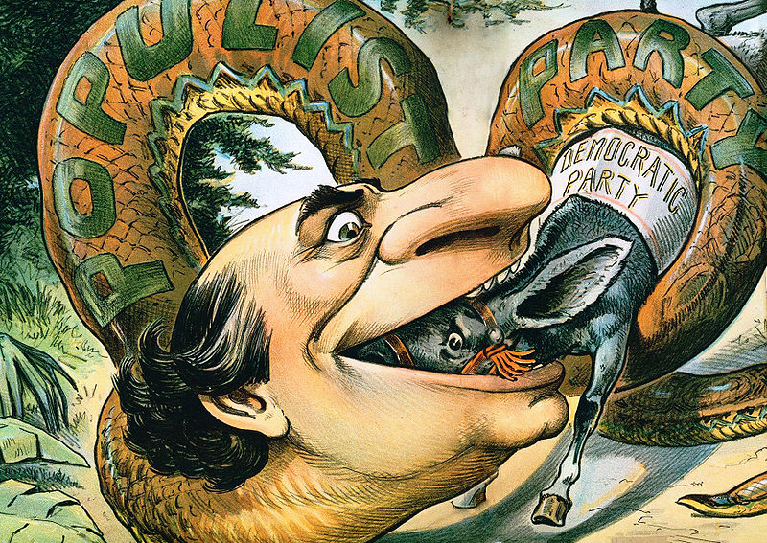

Slide 36
The Election of 1896
Mark Hanna - McKinley's campaign manager, wealthy OH businessman
Coopted support of Big Business by playing on fears of Bryan and populism
Raised a staggering $3.5 million for the campaign, outspending the Democrats by an estimated 5-to-1 margin.
As a per cent of GDP, this is equivalent to $3 billion today!

Slide 37
The Election of 1896
Outspent, Bryan went on national speaking tour by train
First presidential candidate to travel across the nation and meet voters in person; prior to 1896 it was undignified (it kind of is)
In 100 days, Bryan gave 500+ speeches to millions

Slide 38
The Election of 1896
Nominee | William McKinley | William J. Bryan
Party | Republican | Democratic
Home state | Ohio | Nebraska
Electoral vote | 271 | 176
States carried | 23 | 22
Popular vote | 7,102,246 | 6,492,559
Percentage | 51.0% | 46.7%

Slide 39
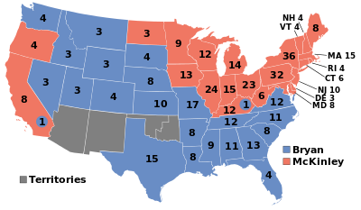
The Election of 1896

Slide 40
Legacy of Farmers Alliances & Populist Party
1870
Total pop 38,558,371; farm pop: 18,373,000; farmers 53% of labor force
1900
Total pop 75,994,266; farm pop: 29,414,000; farmers 38% of labor force
1950
Total pop 151,132,000; farm pop: 25,058,000; farmers 12.2% of labor force
Today
2.2 million farms dot America’s rural landscape
Farm and ranch families comprise just 2 percent of the U.S. pop
7:1 = ratio of farmers >65:<35 (Harper’s Index)
Numbers ≠ Influence

Slide 41
Legacy of Farmers Alliances & Populist Party
Despite the active & principled crusade Populism failed to:
organize the Old Northwest (the Midwest)
connect to the urban workers movement
organize black sharecroppers
develop a moneyed interest
survive: lacked experience and connected leadership

Slide 42
Legacy of Farmers Alliances & Populist Party
The Defeat of the American farmer, but the birth of a movement
The small farmer perished, but the agricultural interest flourished
Set the stage for Agrarian organization

Slide 43
Legacy of Farmers Alliances & Populist Party
Ideas that carry forward during the Progressive Era (1900-1920):
railroad legislation
income tax
expanded currency and credit structure
direct election of Senators
initiative and referendum
postal savings banks

Slide 44
Legacy of Farmers Alliances & Populist Party
The birth of the farmer as a skilled professional
Federal Farm Loan Act of 1916
Smith-Lever Act of 1916—federally subsidized farmer education
…Successes of the Progressive Movement

Slide 45
Legacy of Farmers Alliances & Populist Party
Third parties are like bees, once they’ve stung, they’ve died
Populist Rhetoric: ideals, symbols, and language
Brought attention to the common man

Slide 46
Postscript
‘America’s angriest white men: Up close with racism, rage and Southern supremacy’
Up close with small-town white rage, with bitter, scary men who feel left behind by economic and cultural change
Michael Kimmel in Salon

Slide 47
Postscript
One woman, speaking at a town meeting in Tonkawa, Oklahoma, in 1991, provided an eloquent narrative of this process:
I am a 46-year-old mother of three children. We have lost two farms since 1980, my mother in law’s farm as well as our own. We were forced to sell 160 acres of land that was very special to us. It was homesteaded by my husband’s great grandfather and for years had served as home to our cow and calf operation which we were forced to sell just a few months before we sold the land.
My husband became completely consumed by our circumstances caused by the farm crisis. He left me. Our family continued to deteriorate and our marriage ended in divorce. We had been through natural crises before—drought, flood, crop failure—these we accepted and went on.
But when the threat of losing everything comes to your doorstep because of the bad economy, low commodity prices and high interest on your base notes has left you hopelessly in debt, your faith is sometimes shaken. No one likes to consider that their life has been pointless.

Slide 48
Postscript
Others direct this seething rage outward. “Many debt ridden farm families will become more suspicious of government, as their self-worth, their sense of belonging, their hope for the future deteriorates,” predicted Oklahoma psychologist Glen Wallace presciently in 1989. “The farms are gone,” writes Dyer, “yet the farmers remain. They’ve been transformed into a wildfire of rage, fueled by the grief of their loss and blown by the winds of conspiracy and hate-filled rhetoric.”
“It is hardly surprising, then, that American men—lacking confidence in the government and the economy, troubled by the changing relations between the sexes, uncertain of their identity or their future—began to dream, to fantasize about the powers and features of another kind of man who could retake and reorder the world. And the hero of all these dreams was the paramilitary warrior.” The contemporary white supremacist movement is the embodiment of these warrior dreams.

Slide 49
