Slide 1
Greece in the Classical Age and the Roman Republic
Agnes Cofalla
Clara Hartling
Melina Lange
Joan Scherdel

Slide 2
Key Theme Questions

Slide 3
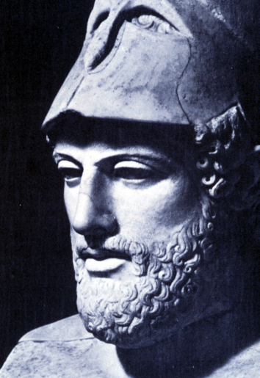
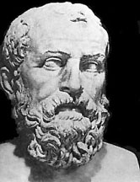
Pericles and Athens:
How could Pericles gain so much power in
a “democratic“ society?
Democracy and Empire:
Who is the true father of democracy?
→Pericles vs. Solon

Slide 4
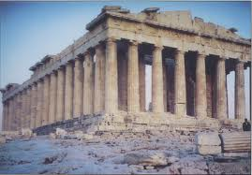
Spartan vs. Athenian Politics:
In what ways could Athens gain the power
to rise as the hegemon of Greece?
What linked the fall of Sparta and the rise
of Athenian imperialistic democracy?
Were the Athenians democratic?

Slide 5
Roman Republicanism
The screen and sham of Roman
Republicanism?
Checks and Balances: a perfectly mixed
Constitution?
A (fair) rest of a republic system?

Slide 6
Most Important Lessons

Slide 7
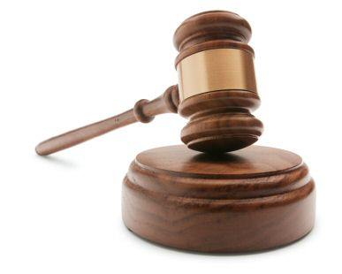
#5 The sustainability of Scripture
Dracos Code of Laws 621
-gives every citizen the same chance
-fair
-everyone is subjected to the law
=order

Slide 8
#4 People keep falling into the “dictatortrap“
Oratory skills/charisma/popularity/chance
Best Example : Gaius Julius Caesar
-popularity trough costly games and
good warfare
-great orator/charisma
-Having made his way up to being a Consul
→Hitler/Napoleon

Slide 9
#3 The Oppressed will Get Back at You
Sparta in constant fear of Helot revolt
-comparable to slave revolts in other
countries
Athens fear of rebellious subjected States
-some groups support Sparta during Ionian
war!
Plebians vs. Patricians (Roman Republic
-first Plebian Secession (494 B.C.)
-Twelche Tables (Plebian demand for
codification of law)
→Tribal Assembly 471 B.C: Equal representation

Slide 10
#2 The inevitability of empires
Athen‘s Dealian League
vs.
Spartan Peloponnese League
→Constant battle of hegemony of Greece
Roman Expansion
There will be no country who will not try to get a bigger peace of the cake

Slide 11
#1
#1
The complexity of democracy
The different reformers of Greece and later the Roman Republic laid a based foundation for democracy as we know it today
Their experimentation with reforms, councils, different kingships, made it possible for us to inherit a plausible foundation for our democracy today.
It is very interesting why it took us so long, and in some parts in the world we are still not there.

Slide 12
Connections

Slide 13
Dictators
Caesar compared to Hitler/Stalin/Bismarck
Fall of Sparta and the fall of the Third Reich
The complexity of democracy
Screen and Sham of Constitutional Law
Weimar and Athens
Hybrid rule
Napoleon and Caesar

Slide 14
Timeline

Slide 21
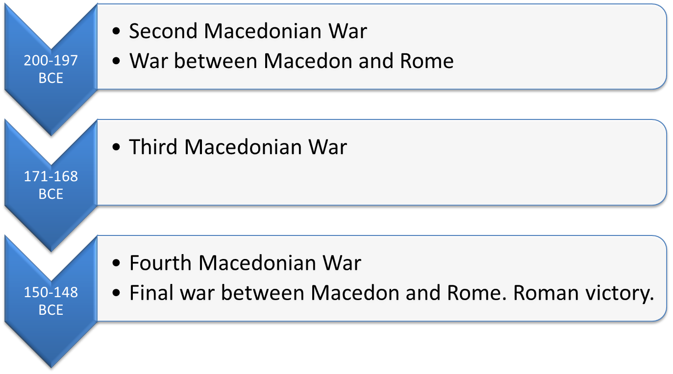

Slide 22
ROME

Slide 25
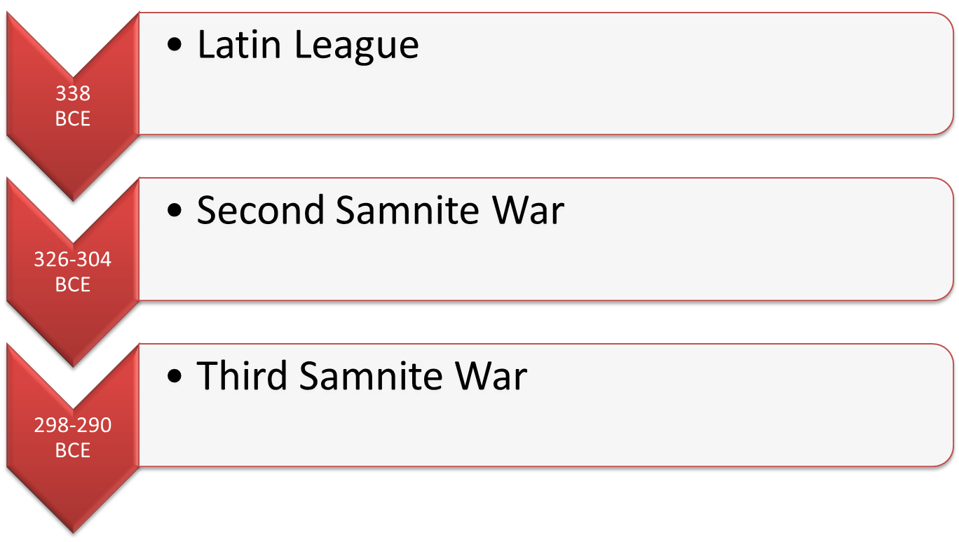

Slide 26
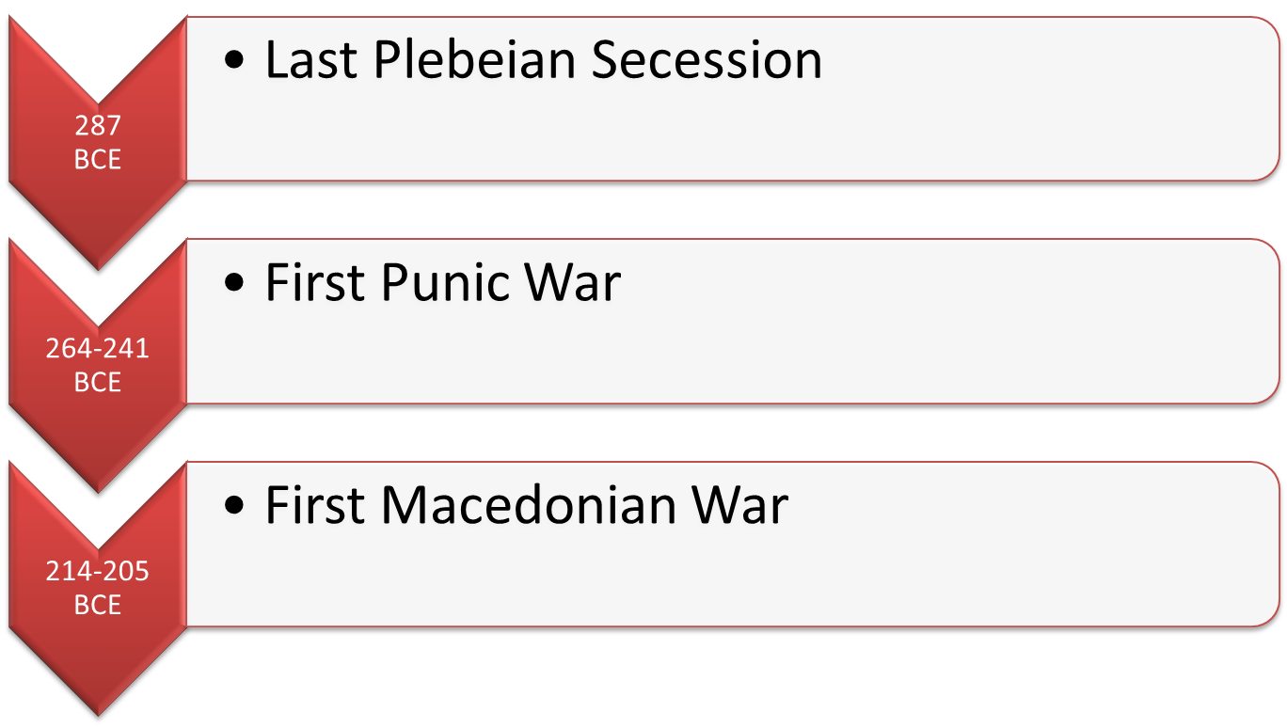

Slide 27
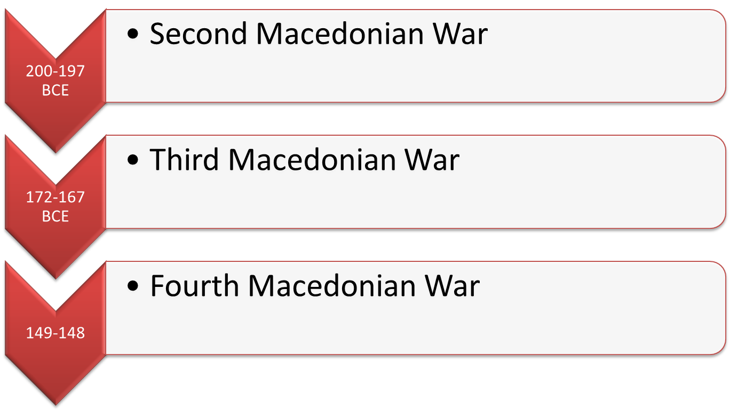

Slide 28
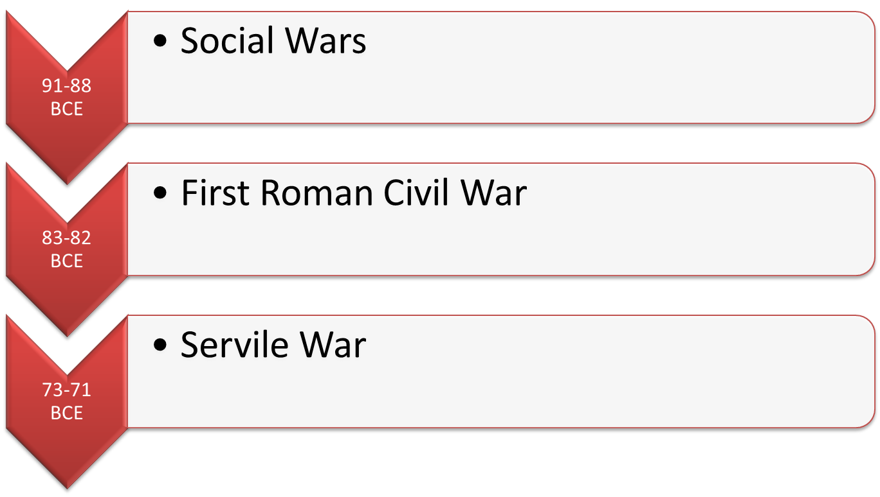

Slide 29
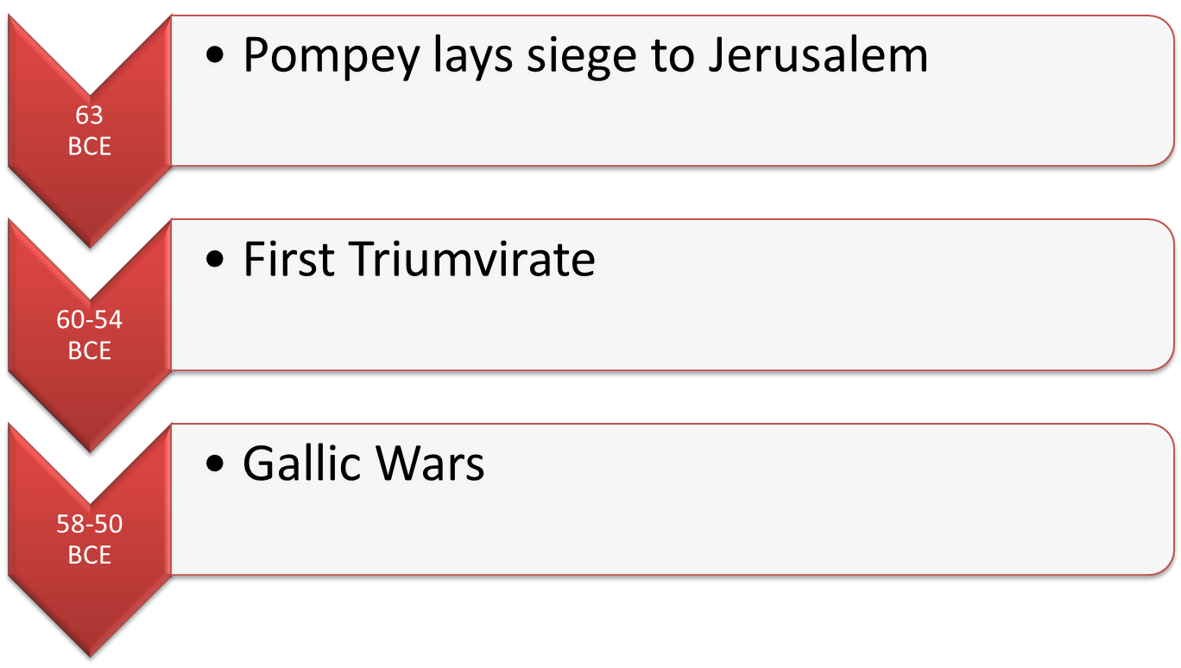

Slide 31
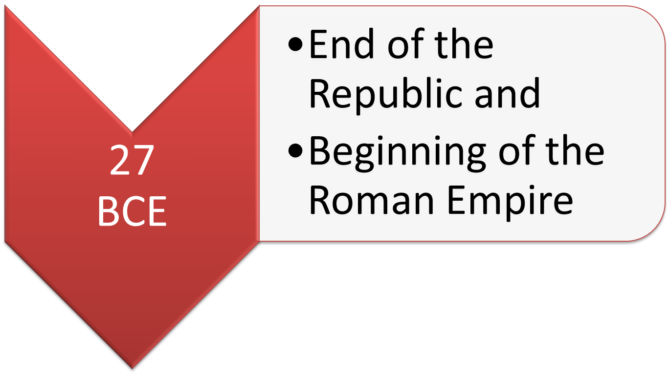

Slide 32
Bibliography
http://www.mitchellteachers.org/WorldHistory/AncientRome/Images/GreekMonumentBuildingTrans.jpg
http://www.schillerinstitute.org/graphics/photos/hist_other/Solon.jpg
http://2.bp.blogspot.com/-RB7k7fxIwg0/TgopjeFcLpI/AAAAAAAAAV0/_MF-ZT-Oc1A/s1600/pericles.jpg
http://dthsg.com/wp-content/uploads/2011/08/AhaEffekt-1024x938.jpg
http://www.hundeschule-strohbach.de/files/65d6-6eobdw8tbc8v-bze4j.jpg
http://www.shsu.edu/~his_ncp/Greece.html
http://en.wikipedia.org/wiki/Julius_Caesar

