Slide 1
Semester 4
Discussing a Century of Self-Determination and Political Experiments
ge2
ND, JK, LD, ME

Slide 3
Theme Questions
Was Stalin a hero or a villain? Reformer or terrorist?
To what extent was the Russian Revolution radical or successful?
Got rid of absolute monarch, but installed a dictator
Introduction of new economic plans (which failed for the most part)
What marked the beginning of the end of the Soviet Union?
Prague Spring 1968
Gorbachev‘s liberal policies
Fall of the Berlin Wall 1989
To what extent was the Cold War a cold war?

Slide 4
Lessons Learned
Impossibility of human equality
first thoughts of absolute human equality → realization of its impossibility
Communism classified as simply an unreachable ideology
Increasing size of empire = decreasing stability of empire
The more cultures are being governed by one government, the harder it is to please all and the probability of revolution grows
Especially seen in Soviet Union

Slide 5
Connections
Terror as a means to maintain power (Stalin, Hitler, Robespierre)
Power through unifying regions (Soviet Union, League of Nations, Delian League)
Separation of Church and State continues to spread (begins in enlightenment and reaches Russia in 1918)
Elimination of old to start new (Execution of Louis XVI in FR, and Tzar Nicholas II in RR. Cultural Revolution in China)
Scorched Earth Policy (France vs Russia in Napoleonic Wars and Germany vs Russia in WWII)
Thrill of new frontiers (Napoleon's invasion of Egypt, Space Race, United States)

Slide 7
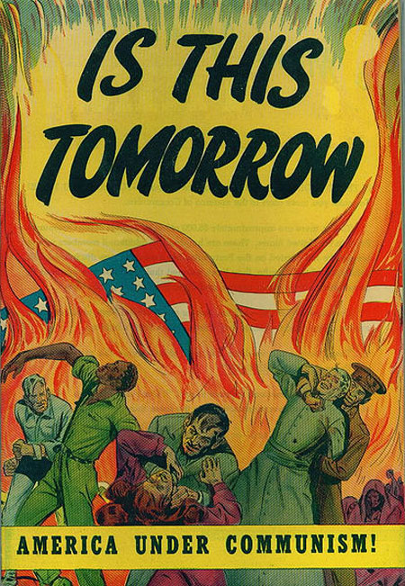
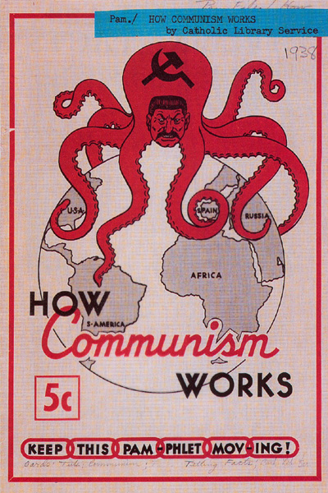

Slide 8
Theme Questions
Did America react so radically to the emerging communist regimes and its developments in atomic energy out of fear of losing a war?
The USA was used to winning in combat
What characterizes disloyalty?
Distinction between Communist Party member and disloyal sabotager
Red Scare, McCarthyism H.U.A.C. etc. in contrast to the freedom of speech?
Was the anti-communism approach justified or overly reactionary?
Truthfulness of „domino theory“

Slide 9
Lessons Learned
Capitalism supports ingenuity and progress
Although it remains unfair
Exploitation needed to begin system of capitalism
Land of the Native Americans stolen
Ignazio Silone's Bread and Wine, a character says: "The government has two arms of varying length. The long one is for taking—it reaches everywhere. The short one is for giving—it reaches only to those nearest."
Individualism is key!

Slide 10
Connections
Fear of terrorists
Enemy is unknown now
Soviet Union and Russia still opposed
Containment
Limit the spread of communism, containment in regards to the demographic expansion in the USA (through tests and checking passports e.g. Alabama)
Individualism and egotism leads to squalor and necessitates civil society to keep the wretchedness under control: a cycle

Slide 11
Connections
Rivalry and fear of losing power
Sparta vs. Athens
Rome vs. Carthage
Great Britain vs. Germany vs. France

Slide 14
Theme Questions
To what extent is a dictatorship possible on a long-term basis? From democratic despotism to tyrannical totalitarianism...
Hitler‘s rise to power – preventable or utterly inevitable? What were its primary causes?
Brecht: Der aufhaltsame Aufstieg des Arturo Ui
Why was Hitler and the NSDAP that successful at effectively using propaganda? Naiveté en masse?
If the Russian Revolution of 1917 would not have taken place, would Hitler have been able to rise to power this easily? (If-grandpa-had-boobs-we‘d-call-him-grandma-question)

Slide 15
Theme Questions
After the demise of communism, why did ex-communist states turn to liberalism?
Return to enlightened ideas combined with modern politics
Were the “revolutions” of 1989 inevitable or could they have been avoided?
Could the GDR have survived the post-communist era without the need to unify with the West?
Does the fall of the Berlin Wall (Revolutions in 1989) represent the beginning, the end, or the transition of a socio-political movement? Were they literally revolutions?

Slide 16
Lessons Learned
From totalitarianism to political moralism (what decisions are just to human rights, etc.?)
Extremism → Moderate politics (fear of the radicals)
In times of socio-economic despair, a people tends to drift to the fringes of parliament
Leaders use this economic misery to justify their radical, undemocratic policies
Believe actions, not words. (Propaganda, rhetoric talent, appearance)
Ex. “Arbeit macht frei”
Do not trust utopian visions
Cynicism in propaganda to mass-mobilize

Slide 17
Lessons Learned
The “Machine” - mechanism for control
Cult of personality - image of the superhuman (Hitler, Stalin)
Truth vs. truth - distortion of truth, unclear reality, pretension (ex. Hundred Flowers Campaign)
Secret Police - decisive facet of totalitarian regimes, intervention in socio-cultural issues (ex. Gestapo, KGB, Stasi)
Use of media - mass mobilization with the help of modern technology #spreadtheword

Slide 18
Lessons Learned
How do totalitarian dictators rise?
Masses, political radicals (criminals), machines and control mechanisms, ideological master plans
Dangerous mélange of politics and romanticism
Do not combine your personal sentiments with your state policies (Hitler → personal problem with Jewry)
Rise of isms (to find shelter, to find comfort, categorization)
Marxism, Nazism, Socialism, Communism, Imperialism, Capitalism
Berlin: an ideological and military battlefield

Slide 19
Lessons Learned
Innovation can be counterproductive
Aerial bombing, atom bomb, poison gas, targeting of civilians
Redefinition of terrorism
Assassinations and massacres with radical prospect
“Alles oder nichts” (Everything or nothing) - ex. Final Solution, Total War, Total Revolution, Total Mobilization, genocides (Armenia 1915, Jews)
The pendulum swings ruthlessly
Germany: Rise of Nazism (1933), Rise of Soviet Communism in the East (1945), movement toward socialism and later moderate politics
Two entities opposing each other (Untermenschen vs. Übermenschen, Nazis vs. Sozis, Caps vs. Commies)
Self-definition by what one is not

Slide 20
Connections (#throwback)
French Revolution - consideration of mass politics, utopian socialism
Theory of Social Reorganization by Charles Fourier
Industrial Revolution - economic confidence, progress in engineering; set the basis for a technocratic structure
Dictator Trap (Julius Caesar ←→ Adolf Hitler)
Romantic visions, charisma, rhetoric talent
Revolution (literal meaning) in times of despair (American Revolution, French Revolution,...)

Slide 21
Connections (#tbf)
Juxtaposition of Hitler and Bismarck
“Bismarck was a rationalist, Hitler a romantic nihilist” - Henry Kissinger
Bismarck had limits, Hitler had no restraints
Bismarck influenced contemporary politics, Hitler left a vacuum
Eugenics in Japan (19th and 20th century)
Racial purity; Rassenschande
Semitic Genocide
Armenian Genocide 1915
Gleichschaltung
Sparta – all aspects of life should be brought into line to one specific goal → military and imperial might

Slide 22
Connections (#tbf)
Oswald Spengler (“Der Untergang des Abendlandes”, 1922): “The masses will accept with resignation the victory of the Caesars, the strong men, and will obey them. Life will descend to a level of general uniformity, a new kind of primitivism, and the world will be better for it...”
Naive to compare Julius Caesar with Adolf Hitler
Adolf Hitler sought a return to a certain “primitivism”, but abused and misinterpreted to an extent that he massacred and segregated people from society
Hitler: not a Caesar, not a strong man
A man with many weaknesses, who let out his frustration and utter rage at millions of innocents and had a perverse vision of a racially pure society

Slide 23
Conclusion
20th century – Melting pot of all lessons learned
Century formed of experimental politics
From moderate democracy to totalitarianism
Utopian visions ended in senseless violence
Formation of political religions
Fanaticism, commitment, and sacrifice in return for an ultimate reward in this life rather than the next
Gangsters and machines – awful combination
Exposes the attitude toward human nature
Can we learn from our lessons?
20th century cursed from the totalitarianism but blessed from their resistors
Future of terror – Al-Qaida and the Taliban?

