Slide 1
Semester II
From Feudalism to Liberalism
-
The World as a Product of its Past

Slide 2
Theme Question
The High Middle Ages (1000-1299)
How did the feudal order emerge out of the Roman Empire?
Describe the role of the kings in the High Middle Ages and how this role manifested in the “Age of Absolutism”?
What criticisms were made of the Catholic Church during this period?
How did social, political, and economic conditions change for peasants in the High Middle Ages?
How did nobles and kings interact in this period? How did rulers in England, France and Germany cope with the challenges of centralization?
In what ways did Europeans in the High Middle Ages build upon the achievements of the Early Middle Ages?

Slide 3
Lesson Learned
The High Middle Ages (1000-1299)
Transitions cause strain (Roman Empire to Feudalism)
Strains surface in the years to follow

Slide 4
Connections
The High Middle Ages (1000-1299)
State Building, Expansion, and Conflict
Creation, Expansion, and Interaction of Economic Systems
Development and Transformation of Social Structures
Interaction between people and their environment

Slide 5
Theme Question
The American Revolution
Was the American Revolution Politically Radical?
Subjects to Citizens
Home rule
Natural order redefined

Slide 6
Lesson Learned
The American Revolution
The American Revolution was Enlightened
Declaration of independence
Locke, Voltaire, Hobbes etc
Power to the people
Seperation of church and state

Slide 7
Connections
The American Revolution
Am. & French Rev. → reclamation of old (Rome & Athens)
Modern state
Patricans & Plebians → Gentlemen & Commoners

Slide 8
Theme Questions
French Revolution and Napoleon Bonaparte
Was the French or American Revolution more enlightened?
French Revolution: just a myth?
Paradox: How can the French Revolution instill secular human rights, while violating them in practice?
Human Right vs. Human Might
Was the brutality of the French Revolution necessary?
Did the French Revolution grant power to the common man?
Rule fell back to the monarchs
Napoleon: Enlightened Ruler or Tyrannical Despot?
Only a bourgeoisie revolution?
French Revolution coincidental? Right dangerous mixture? Or predetermined?

Slide 9
Theme Questions
What is man (echoed during Industrialization)
Are humans ultimately evil?
Enlightened concerns
Is it possible to reinvent/reconstruct society?
Can you change its foundation without it collapsing?
Libertarianism or Egalitarianism?
Difference between liberty and equality
Human Rights: A purely western affair?
Universalism vs. Pluralism
Truly the “Era of Reason” - Paine

Slide 10
Lessons Learned
The thrill of revolution and anarchy
Intrinsic?
From Theology to Ideology
Building a castle on sand
Foundation shatters the entire construct
French Rev.: revolution or reform?
Pendulum of History: You can’t erase the past
Fear the dissatisfied masses
Proletariat, GDR etc. etc.
The Enlightenment was/is crucial
Love of man = Humanism = progress
Sociology, Medicine, Anthropology etc.
Free development of self = Free development of society

Slide 11
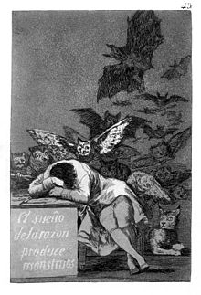
Lessons Learned
French Revolution and Napoleon Bonaparte
“Schlaf/Traum der Vernunft birgt Ungeheuer” –Goya
Love of rationality!
Cult of the Supreme Being
Temple of Science and Reason instead of church

Slide 12
Connections
Lack of God and religious fervor translated into nationalism
Identity rooted in country not God
Bismarck and Germany’s “Bewusstseins” issue – Maybe religion needed?
Crusades (religious fervor needed for a cause)
French Revolution: new notion of time, space, language and fashion
precursor to accepting multiple cultures?
French Revolution laid basis of modern consumerism and social structure
Privileged class vs. the rest of the citizens
Socialdumping and Globalization
Failure to introduce reforms in time
Reforms beneficial for government and not the people
Herdprämie vs. High Taxes
Chain of events (economically speaking)
Chain of events: Pendulum of History
“Baby Boomerang” example in Iran

Slide 13
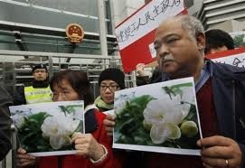
Connections
“Bias blind spots” (Princeton University’s social psychologist Emily Pronin)
The Reign of Terror and Committee of Public Safety
Berlusconi and Forza Italia (his party)
Liberal-conservative, democratic party
Launched in the name of democracy, then leaders forget soon after they capture power
Despotic tendencies
Justice cannot be defined, but people want to reduce injustice (Gandhi, Martin Luther King Jr.)
Fight injustice instead of establishing justice
Different desires of the estates
According to Plutarch: “how best may a man make himself beloved?” Dandamis’ reply has been that “one is beloved if he has enormous powers but if he does not instill fear in others”
Alexander the Great and Napoleon
China‘s Jasmine Movement
tricolored flag and fraternity, liberty and equality
Ask for democracy and gov. becomes more repressive to maintain the agitation
Revolutions of 1848
Arab Spring
Social unrest through economy
Human rights and dignity

Slide 14
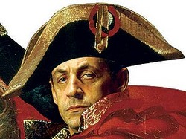
Connections
The “others” are in the wrong
French Revolution generated a new ideology: nationalism
Common enemy increase patriotism/nationalism
Wars against Napoleon in Germany
Middle East and the West
Global Governance instead of Global Governance needed now?
Back then: Empires + nationalism
May lead to ethnic cleansing? (From civic to ethnic nationalism)
People used to be linked by serving one king, but broken into many regions
Regionalism still prevails? → Natural?
Napoleon, France and later the revolutionary spirit were feared/hated across Europe –now Germany that figure
Sarkozy- the new Napoleon?
Need for hero figures such as Napoleon
Paradox: Humanitarian efforts through military force
NATO?
Napoleon’s secret:
Acts for society as a whole, while pursuing own agenda
Bismarck – Germany and Prussia

Slide 15
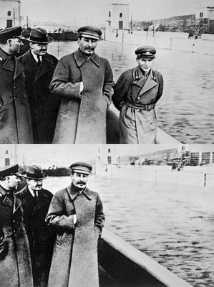
Connections
Bourgeoisie Revolutions that follow
Not necessarily brutality, but simply social change
Destroy class priviliges
Enlightenment: seize your future in your own hands
What we preach at graduations etc.
Napoleon‘s doctrine: „careers open to talent“
Yeoman farmer, who pulls himself up by his bootstraps
American Dream?
Violent measures of the state: elimination of political opposition
Stalin and Great Purge
Reign of Terror
Cult of Supreme Being: Religions used to stabilize revolutions?
Rousseaus Emile and the education of children
Play in nature instead of`with computers

Slide 16
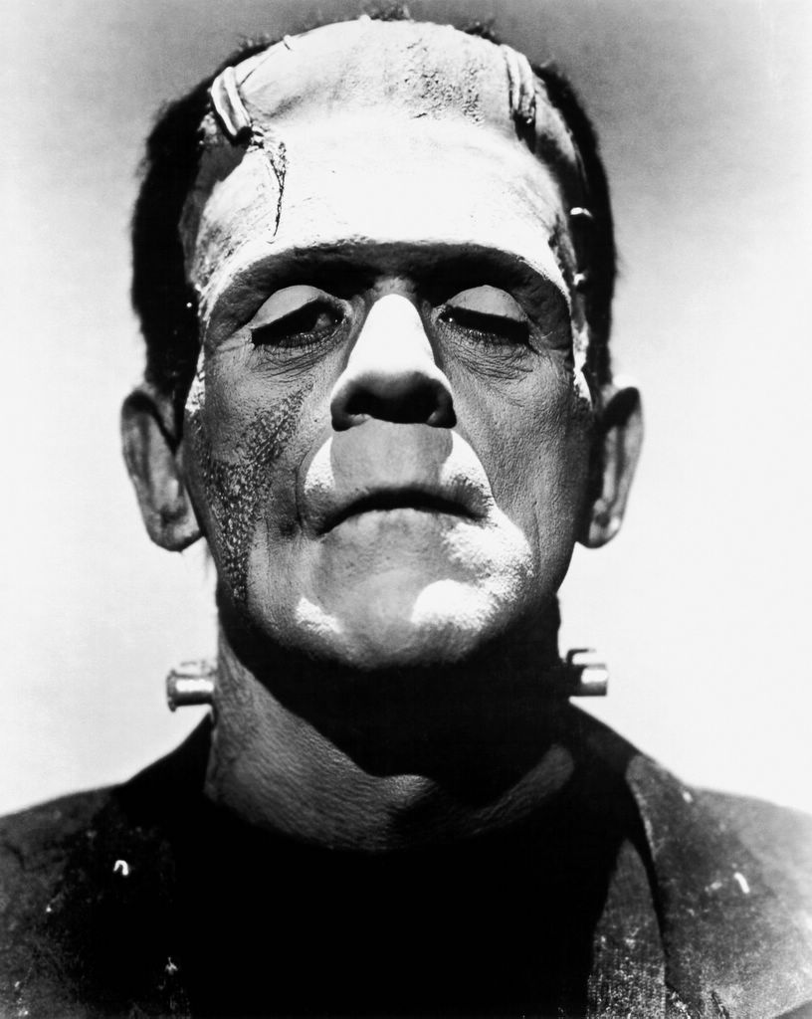
Connections
Liberal notion: „pursuit of happiness“
Includes material gain
Selfishness?
Role of the Media
Rallied the sans-culottes
Nearly 50% were underemployed or
impoverished during the times of the French Revolution
Rising unemployment in Spain
Will backfire
(Neo-)liberalism backfires
“Bad laws are those that have as their object the welfare, the preservation, and the security of only a few members, at the expense of the rest of society” –d’Holbach
ATTAC: distribution of wealth
Enlightenment: importance of the self: capitalism, egotism…
New human form → Industrial Revolution
(Frankenstein, automatons, the digitalself)
Change in philosophy (Soul as a mirror of brain functions)

Slide 17
Theme Question
Industrialization & Rev. of 1848
Ben

Slide 18
Lesson Learned
Industrialization & Rev. of 1848
Ben

Slide 19
Connections
Industrialization & Rev. of 1848
Ben

