Slide 1
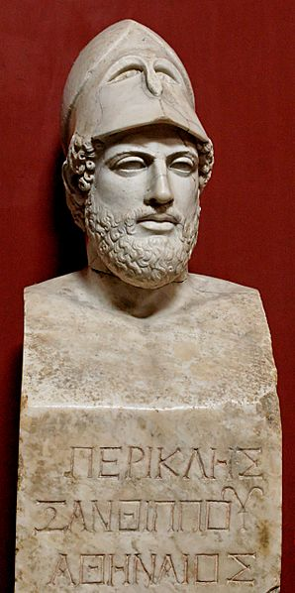
Periclean Athens
“Pericles, son of Xanthippus, Athenian”.

Slide 2
Lecture Outline
Background
Inheritance at Home & Abroad
Domestic Policy: Consolidating Reforms of Solon, Cleisthenes, & Pisistratus
Foreign Policy: From Alliance to Empire
Assessment of Pericles

Slide 3
Pericles’ Background
b. 495 – d. 429
Maternally descendent from Alcmaeonid family
Great, great grandson of Cleisthenes
Son Xanthippus, (ostracized 485–484)
Studied with Protagoras, Zeno and Anaxagoras
463, Pericles was lead prosecutor of Cimon, the leader of the conservative faction. Cimon ostracized in 461.
He and his mentor, Ephialtes, reduced power of Areopagus and increased power of Ekklessia. Ephialtes murdered in 461.
Sole Archon, 461-429. Elected every year!
Thucydides called him “the first citizen of Athens”

Slide 4
Pericles’ Inheritance: Domestic
Blended System: Democ + Aristoc
Legacies of Solon, Cleisthenes, & Pisistratus
Factionalism → Now aristocratic vs. democratic/populist
Rising middle class b/c of Solon’s reforms

Slide 5
Pericles’ Inheritance: Center of Unstable World
An insecure world. Unstable balance of power
Persia—we know that the “barbarians” were finished. Greeks did not.
Sparta—though crippled by an earthquake in 464, which was capitalized on by a massive Helot rebellion, they still strove for glory and hegemony
Sparta invites Athens to quell Helot rebellion. Athens tries and fails. Sparta, discomforted by Athenians on Peloponnese, sends Athens home. End of Spartan-Athenian Alliance. End of Greek League of 481.
Corinth rising
Tyrannies abound
Protective wall
Food dependent economy

Slide 6
Pericles’ Inheritance: Center of Unstable World
An Empire. Athenian Hegemony by invitation.
Delian League est. 478.
Thasian Rebellion—in 465 Thasos rebels over control of gold and silver mines. Athens fights them for 2 years. Athens won—took control of mines, made Thasians pay for the war, and took Thasian navy. Made Thasos a subject state.
Melos…Melian Dialogue
Empires are hard to control.
Athenians were erratic about collecting taxes and military contributions.
Athens did not create a Delian navy. They built on the Athenian navy. As such, by time of Pelop War, only Chios and Lesbos had a navy. Thus, Delian members were militarily dependent on Athens (NATO)

Slide 7
Periclean Reforms
Solon, Cleisthenes, & Pisistratus
Cautious and moderate
“Greek civilization was at its best when democracy had grown sufficiently to give it variety and vigor, and aristocracy survived sufficiently to give it order and taste.” (Durant)
Regulated international grain trade
Controlled bread prices
More regular enforcement of taxation

Slide 8
Periclean Reforms
458–457 Lowered the property requirement for the archonship. Now Zeugitai and Thetes can become Archons.
Pericles needed Thete support for growing navy
Populism as means to procuring and securing Thetes?
Promoted education for women
His 2nd wife, Aspasia, led the charge. She was an enlightened matron of salons. Pericles and Socrates attended her lectures.
Aspasia wrote the Funeral Oration (says Socrates)
Decree permitted the poor to watch plays for free
451 law limited Athenian citizenship to those with 2 Athenian parents
Historians have vehement disagreements over ultimate effects of Periclean Populism

Slide 9
Periclean Reforms
State socialism
8 miles of Long Walls
Ship building
Great Corn Exchange at Pireaus
Subsidized plays at Theatre of Dionysus
State-sponsored festivals 60 days/year
20,000 Athenians were on the state payroll (Robinson)
Used Delian Treasury funds. Moved Treasury in 454.

Slide 10
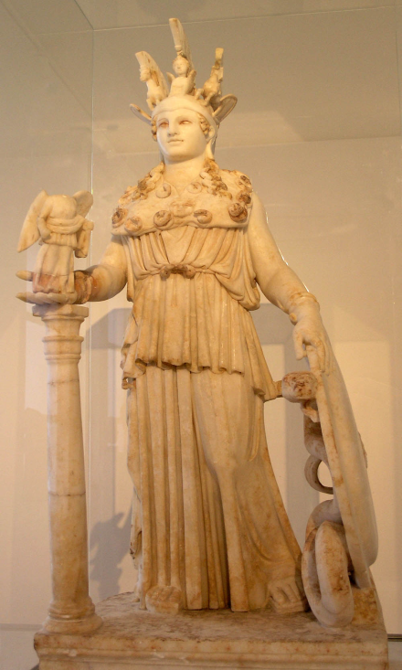
Parthenon: Symbol of Arête and Empire
Temple to Phidias’ Athena Parthenos→
Constructed between 447-432
Iktinos and Kallikrates architects
Dimensions: 228 x 101 ft. on top step
Doric order with Ionic elements
8 columns at end (usually 6)
17 columns on sides

Slide 11
Parthenon: Symbol of Arête and Empire
Metope Sculpture: Hellenic Superiority over Barbarian (Persian) Emotionality
Acropolis as Destination Point of Panathenaic Procession (Tribute-Bearers)
Depiction of Panathenaic Procession on Inner Frieze (Gods and Athenians: Hybris?)
Chryselephantine Athena (Ivory and Gold)
Imperial Statement: Blending of Ionic and Doric

Slide 12
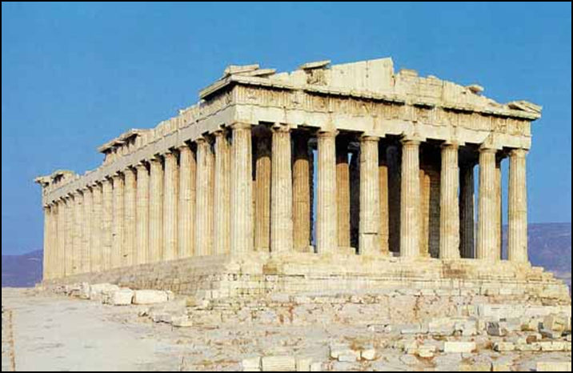
Parthenon and Acropolis (from west)

Slide 13
Parthenon from the Pnyx (1910)

Slide 14
But there was one measure above all which at once gave the greatest pleasure to the Athenians, adorned their city and created amazement among the rest of mankind, and which is today the sole testimony that the tales of the ancient power and glory of Greece are no mere fables. By this I mean his [Pericles’] construction of temples and buildings; and yet it was this, more than any other action of his, which his enemies slandered and misrepresented. They cried out in the Assembly that Athens had lost its good name and disgraced itself by transferring from Delos into its own keeping the funds that had been contributed by the rest of Greece… “The Greeks must be outraged,” they cried. “They must consider this an act of bare-faced tyranny, when they see that with their own contributions, extorted from them by force for the war against the Persians, we are gilding and beautifying our city, as if it were some vain woman decking herself out with costly stones and statues and temples worth millions.” -Plutarch, Life of Pericles, 12
Parthenon: Symbol of Arête and Empire

Slide 15
Parthenon: Symbol of Arête and Empire
Athens, alone of the states we know, comes to her testing time in a greatness that surpasses what was imagined of her. In her case, and in her case alone, no invading enemy is ashamed at being defeated, and no subject can complain of being governed by people unfit for their responsibilities. Mighty indeed are the marks and monuments of our empire which we have left.
- Pericles’ Funeral Oration

Slide 16
Heliaia Reform
No judge. Only jury.
Corruption problems
Complicated system of assigning jurors to minimize bribery
Introduced jury pay (3 obols/day)
Jury deliberation often functioned as an old age pension
No public prosecutor or lawyers. Plaintiff and defendant face to face. Speechwriters employed.
No jury deliberation. Only a vote.
1 day maximum trial
If plaintiff lost, he paid % of his professed damages to State

Slide 17
Heliaia Reform
Strengths
Simple
Equal. No advantage to wealthy
Speedy
Open to all. No barrier between citizens and law
Demanded responsible and informed citizenry
Democratic
System passes the truest test: other states adopt it (?)
Weaknesses
No precedent = quirky decisions
Law not always upheld
Speeches unhampered by law/rules of evidence
Testimony of women and children only in murder trials. No testimony from slaves.
Slaves = bodily punishment. Freemen = financial punishment

Slide 18
From Delian League to Athenian Empire: Summary
Immediate Aftermath of Persian War
Spartan Incompetence and Irresolution
Themistocles and Athens’ Fortification
Athenian Command of Delian League
470’s and early 460’s
Cimonian Policy: Continuation of Persian War
Revolts of League members and subjection
Greek states as tribute-paying subjects of Athens
Ascendancy of Pericles
Ephialtic reforms of 462/61 BCE
Change in Foreign Policy: Sparta as Enemy
Moved Delian Treasury to Athens in 454
Athenian Empire
Athens rules over 179 states
Five administrative districts
Approximately 2 million people lived in the Empire

Slide 19
Periclean Foreign Policy
Pericles wanted to stabilize Athens' dominance over its alliance and to enforce its hegemony
Pericles inherited an Empire in form of Delian League. He sought to maintain it.
Dissolving the Empire was politically impossible
449, After failing to foment an Egyptian revolt against Persia, he managed a peace with Persia, codified in the Peace of Callais.
Autonomy to the Ionian states in Asia Minor, prohibited the est. of Persian rule throughout Aegean, and prohibited Persian ships from the Aegean. Athens also agreed not to interfere with Persia's possessions in Asia Minor, Cyprus, Libya or Egypt
449, Pericles proposed the Congress Decree, which led to a meeting ("Congress") of all Greek states to debate rebuilding the temples destroyed by Persians.
449, Second Sacred War: Pericles led Athenians against Delphi and reinstated Phocis in its rights to the oracle
He was Strategos during the Pelop War (431-404)

Slide 20
Moses Finley’s Typology of Imperialism
Finley’s Typology of State Power exercised over other states:
1. Restriction of freedom of action in interstate relations
2. Political/judicial/administrative interference in internal affairs
3. Compulsory military/naval service
4. Payment of some form of tribute
5. Confiscation of land of other states
6. Various forms of economic exploitation/subordination

Slide 21
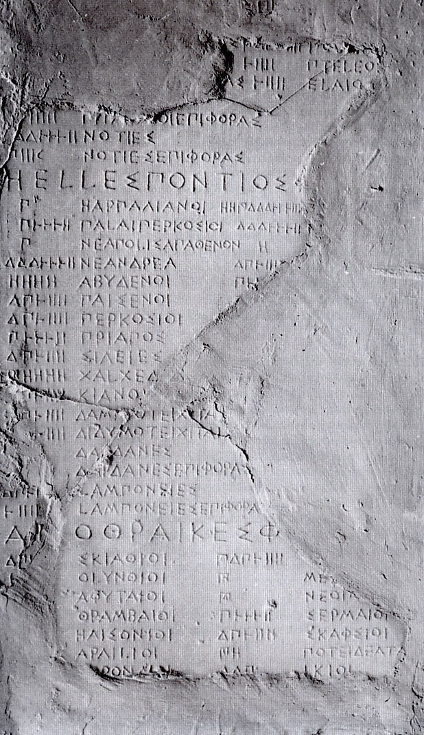
Athenian Tribute Lists

Slide 22
Imperial Economy: Infrastructure
Fleet
100 active triremes, 200 reserves
Dock workers, shipwrights, ~20,000 rowers, rope and cable industry, pitch manufacture, sail production, crew trainers
Building Program
Architects, sculptors and stone cutters, day laborers of all sorts
Athenian and Inter-State Administration of Justice
Lodging and consumer spending for non-Athenians in Athens
Pay for jury duty; interstate cases tried in Athens
Bureaucracy of the empire: 700 officials (Arist. Ath. Pol. 24.3)
Imperial Citizenship and Democracy

Slide 23
Athenian Imperialism: From the Record
"Remember, too, that if your country has the greatest name in all the world, it is because she never bent before disaster; because she has expended more life and effort in war than any other city, and has won for herself a power greater than any hitherto known, the memory of which will descend to the latest posterity.“ (Pericles' Third Oration according to Thucydides)
“We have done nothing contrary to human practice, in accepting an empire when it was offered to us and then refusing to give it up. Three very powerful motives prevent us from doing so--honor, fear, and self-interest. And we were not the first to act in this way. It has always been a rule that the weak should be subject to the strong; besides we consider that we are worthy of our power.” (Thucydides, 1.76)
“Athenian imperialism employed all the forms of material exploitation that were available and possible in that society.” (Moses Finlay)

Slide 24
Assessment of Pericles
Populist
Socrates criticized the foolishness of the masses. Mobocracy. No experts. Belief in Philosopher Kings.
Many contended that democracy was unstable
Invited factionalism and class war
Did not protect property
But
Ekklessia COULD have abolished debt with 1 vote
Pol equality ≠ econ equality
140 years of uninterrupted democracy
Was it even a democracy?

Slide 25
Assessment of Pericles: The Excluded
Women
Married b/w 12-18. Men married ~30.
From father to husband
Could not choose husband freely
Dowry
Divorce was difficult. Woman needed a male guardian to return to
A glorious role? See Funeral Oration.
Historical arguments here
England 1918, US 1920.
Slaves
Most were spoils of war
Not akin to American south. No huge plantations.
Not based on race
Slaved worked mostly in handicrafts. 1-5 slave craftsmen in a shop. Worked alongside masters
Major exception = mine workers
Athens
20-120,000. Take the mean?
¼-1/3 of Athenians had slaves
No useful #s of slave pop outside of Athens
Most slave owners freed slaves upon death
No known fear of slave revolts
Not like Sparta or US
Slavery enabled Golden Age (?)

Slide 26
Assessment of Pericles: The Excluded
Durant puts total Golden Age pop at 315,000:
115,000 slaves
20,000 metics (Durant)
Robinson puts total Golden Age pop at 270,000:
85,000 slaves
35,000 metics
The Goddess of Liberty is no friend to the Goddess of Equality

Slide 27
Assessment of Pericles
Demagogue. According to Thucydides, “Athens, though still in name a democracy, was in fact ruled by her first citizen.”
Charismatic leadership
Incorruptible
State Socialism
True Legacy is Golden Age: literary, philosophical, and artistic…
Can we credit Pericles for the Golden Age? Or do we credit Athenians and/or other cultural forces?

Slide 28
Assessment of Pericles
Hawk
Pericles’ legacy wrapped up in Pelop War.
Pelop War "grand strategy“: rejection of appeasement and the avoidance of overextension
Democracy and Empire Question (see Rhodes)
Above all, experiment!
Many historians agree that Pericles was always a better politician and orator than strategist.

Slide 29
Assessment of Pericles
Consider the audience of a 17th century symphony performance. Masses played instruments. The audience of Brahms/Beethoven understood.
Kagan offers idea that if an Athenian attended only ½ of Ekklesia meetings, he’d attend 20/year. Citizens become experts. NOT an ignorant multitude.
William F. Buckley once declared that he’d rather be tried by the first 40 names in the Boston phonebook than by the Harvard faculty
I assume that foolish speakers were deterred from speaking

Slide 30
Assessment of Pericles: From the Record
According to Plutarch, after assuming the leadership of Athens, "he was no longer the same man as before, nor alike submissive to the people and ready to yield and give in to the desires of the multitude as a steersman to the breezes".
“He kept himself untainted by corruption, although he was not altogether indifferent to money-making.” (Plutarch, Pericles, XVI)
“Many others say that the people were first led on by him into allotments of public lands, festival-grants, and distributions of fees for public services, thereby falling into bad habits, and becoming luxurious and wanton under the influence of his public measures, instead of frugal and self-sufficing.” (Plutarch, Pericles, XVI)

Slide 31
Assessment of Pericles: From the Record
“As I know, Pericles made the Athenians slothful, garrulous and avaricious, by starting the system of public fees.” (Plato, Gorgias, 515e)
“In name a democracy but, in fact, governed by its first citizen“ (Thucydides)
“The most complete man that Greece ever produced.” (Durant)
“History can afford to forgive Athens’ sins.” (Durant)
“Has any civilization ever reached its height without simultaneously sowing the seeds of its own destruction? Is there not an almost incestuous relationship between dominion and decay?” (Charles Alexander Robinson)

