Slide 1
300 Germanies to 1:
The Road to the Second Reich
Mr. Daniel Lazar

Slide 2
Lecture Outline
Neither holy, nor Roman, nor an Empire: “300 Germanies”
Impact of the Congress of Vienna on Germany and Prussia
"Siamese Twins": Zollverien and Railroads
Struggles for Nationalism, Liberalism and Democracy in Vormaerz:
  Wartburg Festival (1817)
  Carlsbad Decrees (1819)
  Hambach Festival (1832)
  Gottingen Seven (1837)
The Spirit of ‘48
  Frankfurt Parliament
  Constitution of St. Paul's Church
  Erfurt Union & Punctuation/Humiliation of Olmutz

Slide 3
Lecture Outline
Germany: Born of War?
  Von Roon, von Moltke, and the Prussian military machine
  Schleswig-Holstein Wars (1848-52, 1864)
  Austro-Prussian War (1866)
  Franco-Prussian War (1870-71)
Proclamation of German Empire (18 January 1871)
More Than Iron & Blood: Karl Baedeker, Brothers Grimm, von Fallersleben, and von Humboldt

Slide 4
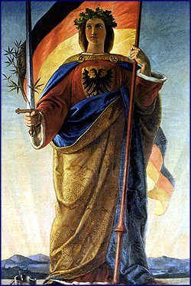
What is a Nation?
Johann Gottfried von Herder: The Volk (“nation” or “race”) decisively determines of human identity. The state is artifice.
Johann Goethe: No need for a nation-state; Germany was a “cultural community,” like Ancient Greece.
Georg Wilhelm Friedrich Hegel: An individual only achieves their full potential through service to the state.

Slide 5
“300 Germanies” in the HRE (962-1806)
“The Holy Roman Empire is neither Holy, nor Roman, nor an Empire.”
-Voltaire

Slide 6
Holy?
Emperors worked begrudgingly with the Pope
  Each Emperor had to be crowned by the Pope
  They constantly fought for power

Slide 7
Roman?
Only called Roman because of the claim that the emperors are successors of the Caesar’s.
Emperors not Roman; most were “German”
Emperors were anointed as Roman Emperor by Pope to show a united Christendom

Slide 8
Empire?
Definition Empire: a major political unit having a territory of great extent or a number of territories or peoples under a single sovereign authority
A collection of 300+ states
  Empire was often called a Flickenteppich ("patchwork carpet").
  The territories that made up the HRE were self-governing, but their sovereigns owed allegiance to the Emperor, who was elected by 7 Elector-Princes.

Slide 9
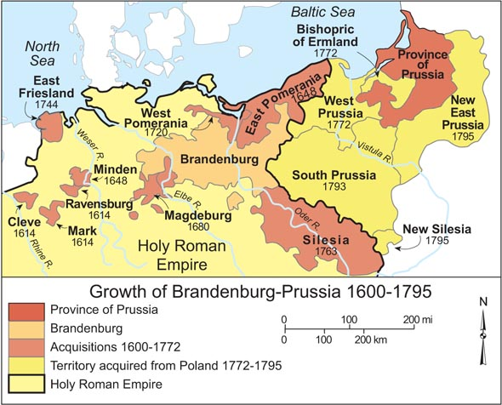

Slide 10
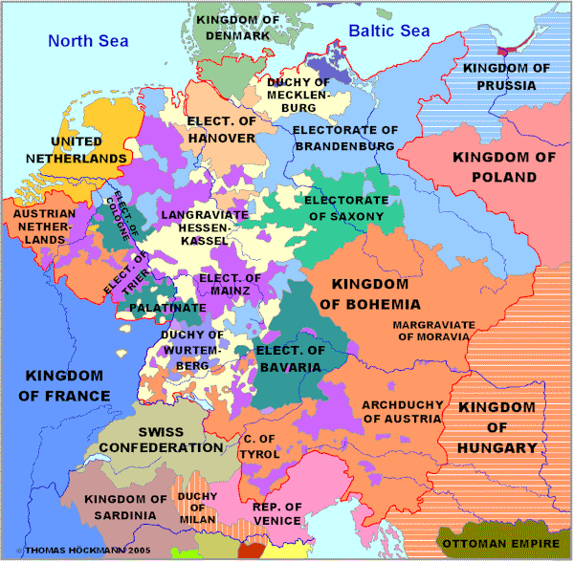
The HRE in 1789

Slide 11
French Revolution & Napoleonic Wars
HRE formally dissolved on 6 August 1806 by the Treaty of Pressburg, after the defeat of Austria by Napoleon
French Revolution & Napoleonic Wars shook foundations of Europe
  Balance of Power
  People power
  Liberalism
  Democracy (in some circles)
  Nationalism
Peace and order was more or less restored in 1815. But Europe would never be the same.

Slide 12
French Revolution & Napoleonic Wars
“The Revolutionary and Napoleonic wars witnessed the first upsurge of Nationalism in European history, partly under the inspiration of the French armies and message of liberation, partly in reaction against those armies and the realities of occupation and oppression.”
-Robert Gildea, Barricades and Borders: Europe 1800-1914 (Oxford, 1996)

Slide 13
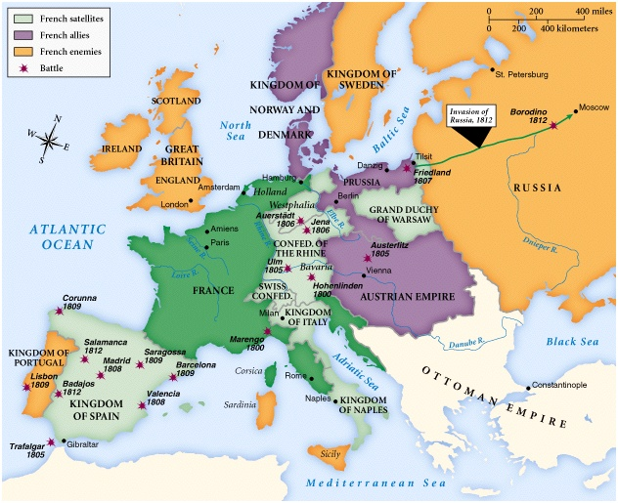
Europe in 1812

Slide 14
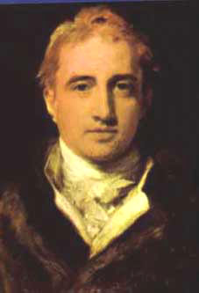
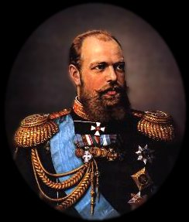
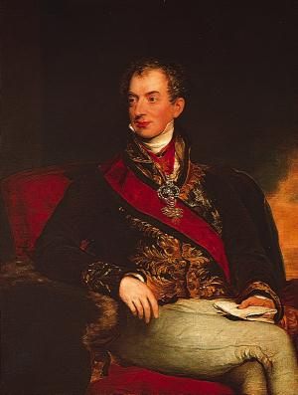
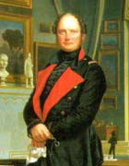
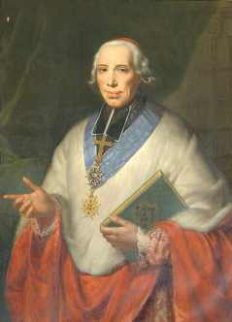
Key Players
at Vienna
Tsar Alexander I (Rus.)
Foreign Minister,
Viscount Castlereagh (Br.)
The “Host”
Prince Klemens von Metternich (Aus.)
King Frederick William III (Prus.)
Foreign Minister, Charles Maurice de Tallyrand (Fr.)

Slide 15
Changes Made at Vienna
France was deprived of all territory conquered by Napoleon
Russia was given most of Duchy of Warsaw
House of Orange given Dutch Republic and Austrian Netherlands
Norway and Sweden joined
Neutrality of Switzerland guaranteed
Britain given Cape Colony, South Africa and other colonies in Africa and Asia.
Sardinia given Piedmont, Nice, Savoy, and Genoa.
Bourbon Ferdinand I restored in the Two Sicilies
Duchy of Parma was given to Marie Louise.

Slide 16
Congress of Vienna (1815)
Freedom of navigation guaranteed for many rivers (trade)
Austria given back territory it had lost, plus more in Germany and Italy
Hanover enlarged and made a kingdom
Prussia given half of Saxony, parts of Poland, and other German territories.
Germanic Confederation of 39 states, from the 300

Slide 17

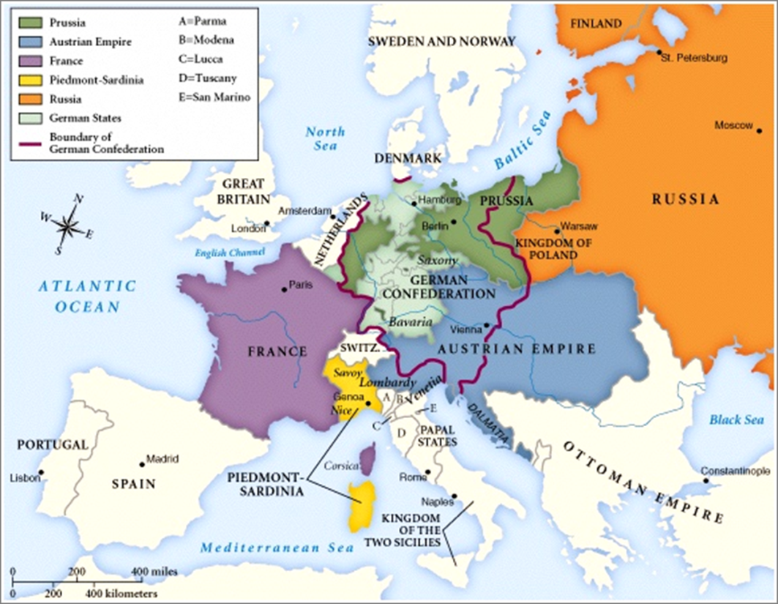
Before / After the Congress of Vienna

Slide 18
Analysis of Congress of Vienna
Conservative if not Reactionary
  Common goal: prevent another revolution
  Liberties and rights of American and French Revolutions de-emphasized
  Big 4 as Policemen against Rev
  The two great 19th Century European Movements - liberalism and nationalism - halted, temporarily.
  Not crushed : Italy under Garibaldi and Cavour, Prussia under Bismarck
Austria won undue influence
Prevented widespread European war for nearly 100 years (1815–1914)
“Gentlemen's Agreement" - verbal, no constitution

Slide 19
Analysis of Congress of Vienna on Prussia and Germany
German Confederation
Prussian Dominance
  Prussia was obvious candidate to challenge France
  Prussia as defender of small western German states
  Prussia didn’t want German unification…or wanted it strictly on their terms
People saw need in reformation of institutions -> constitutions were written
Burschenschaften – wanted unity and national power
Prussian Customs Law of 1818 – united territories into custom unions
1830’s – formation of Zollverein (Customs Union) excluding Austria

Slide 20
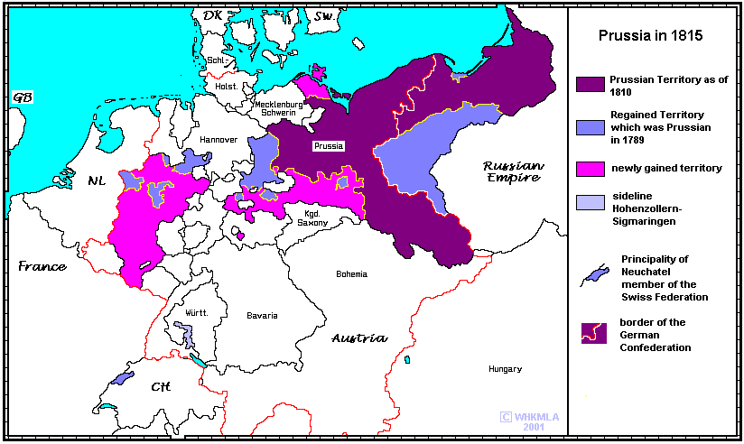
Congress of Vienna’s Impact on Prussia

Slide 21
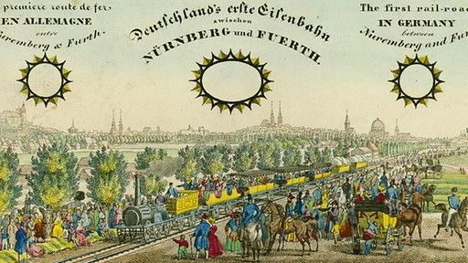
''Siamese Twins'': Zollverein & Railroads

Slide 22
''Siamese Twins'': Zollverein & Railroads
The Zollverein and the railroads connected 39 Germanies, increasing economic and cultural ties, which were crucial steps to unification.
Zollverein fostered commercial cooperation, improved communication, and catalyzed the rise of industries, and centralized banking

Slide 23
The Zollverein (1818)
1790, 1,800 Tariff Borders in German land
Free trade
Tariff Reform Act 1818 → formed the North German Zollverein
1834, German Zollverein established
  North German ZV+South German ZV+Central German Trade Union
  Included 25 states with a population of 26 million people
Uniform tariff was instituted against all non-members (including Austria, Mecklenburg, and Hanseatic towns)
Customs duties increased from 12 million to 21 million guilders

Slide 24
The Zollverein (1818)
Dominated by Prussia
Excluded Austria because of its highly protected industry; this intensified the Austro-Prussian rivalry for dominance in Europe
1851-54 negotiated treaties with Holland, Britain and Belgium

Slide 25
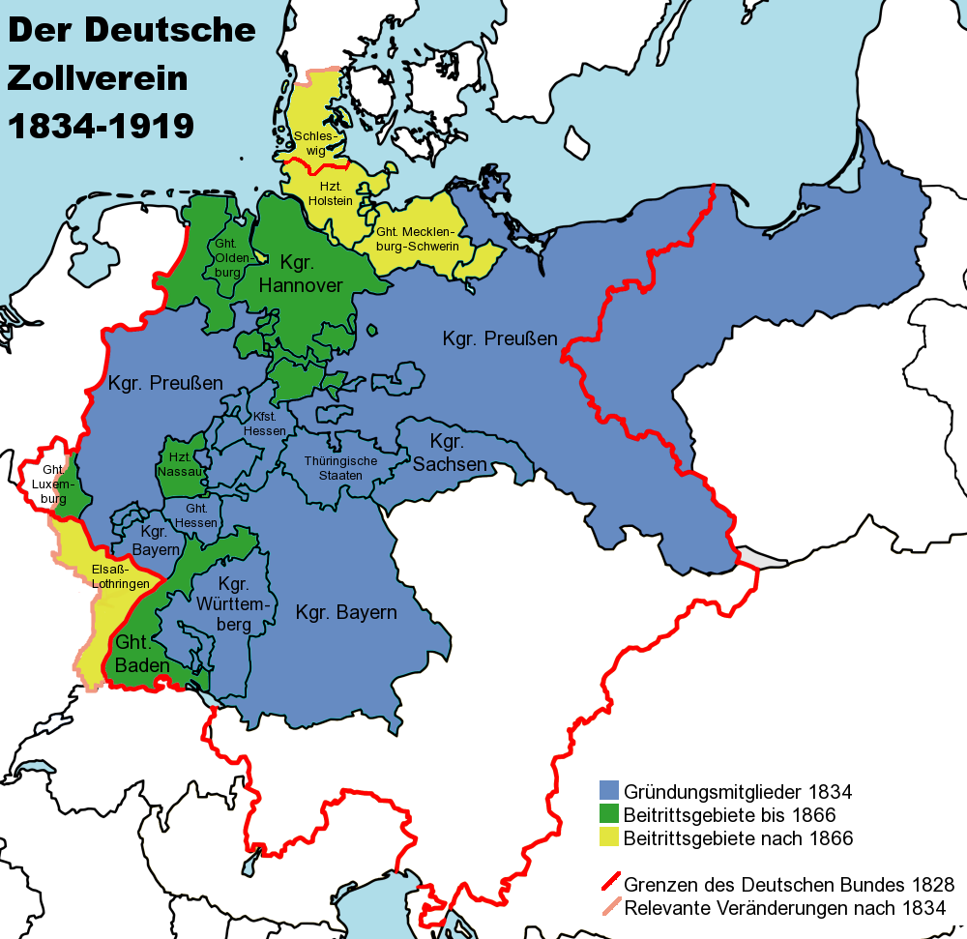
The Zollverein (1818)

Slide 26
The Zollverein (1818)
''The Zollverein had brought the sentiment of German nationality out of the regions of hope and fancy into those of positive and material interests. The general feeling is that it is the first step towards what is called the Germanization of the people. It has broken down some of the strongest holds of alienation and hostility. By a community if interests on commerical and trading questions it has prepared the way for a political nationality.''
- Dr. Bowring of the British Foreign Service, 1840

Slide 27
The Railroads
1835 the first Bayerische Ludwigsbahn, called ''Adler'', drove from Nürnberg to Fürth (6 kilometers)
1847, Union of the German Railways established
By 1850, Germany had more than 5,000 km of traintracks
By 1870 railroads connected industrial areas, coal mines, and harbors
Some passenger lines, notably Dresden to Leipzig.

Slide 28
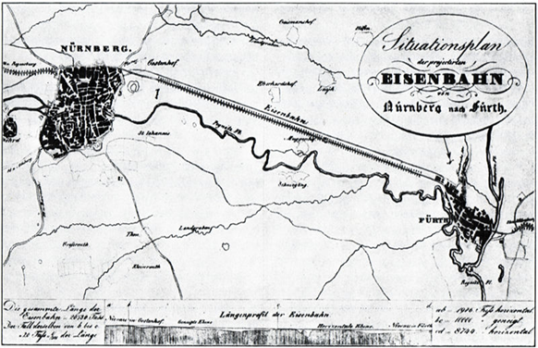
The Railroads

Slide 29
The Railroads
German Unification (1871)
Start of Zollverein(1834)

Slide 30
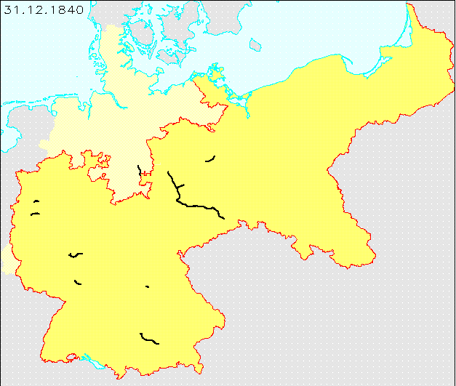
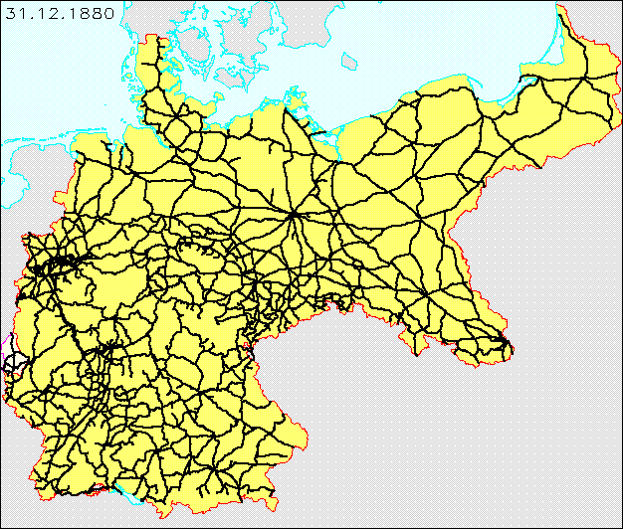
German Railway Maps from 1840 & 1880

Slide 31
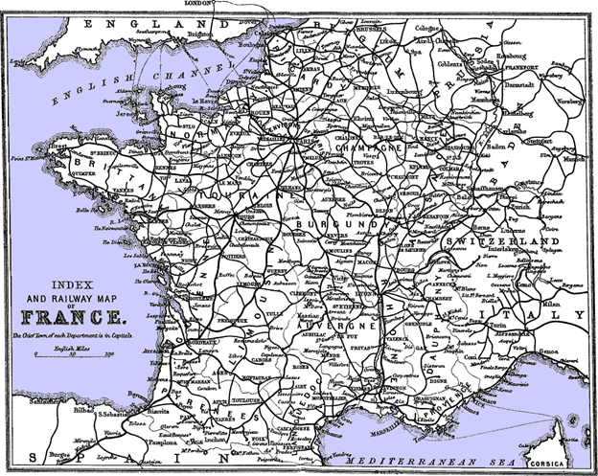
The French railway system with Paris in the center

Slide 32
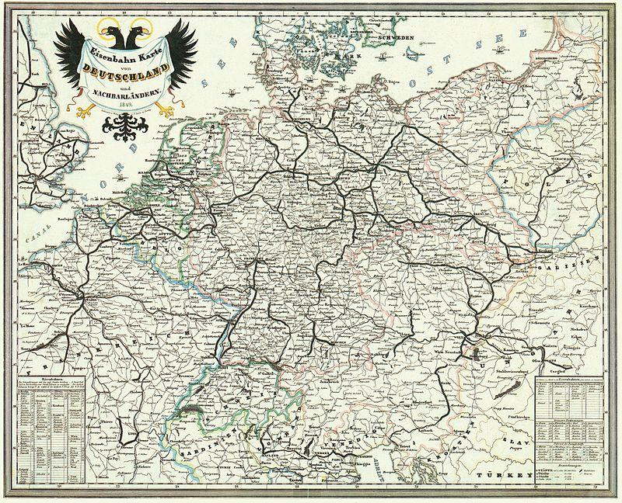
German Railway System in 1849

Slide 33
''Siamese Twins'': Zollverein & Railroads
Both the Zollverein and the Railroads gave Germany a feeling of solidarity and the idea of a single fatherland
Economic forces broke down some of the political barriers that divided Germany.

Slide 34
''Siamese Twins“ to Vormärz
Because of industrialization, overall economic growth, and an increasing sense of common identity, Germans began pursuing liberal ideas (both socially and economically).
But the political system remained stuck in the old order and did not cater to the demands of the German populace. This caused resentment, especially among students and professors...

Slide 35
Struggles for Nationalism, Liberalism and Democracy in Vormaerz (1815-1837):
  Wartburg Festival (1817)
  Carlsbad Decrees (1819)
  Hambach Festival (1832)
  Goettingen Seven (1837)
  The return of the Old Order through the Congress of Vienna and the repressive measures of Metternich presented an anachronistic political system which undermined the national and liberal political demands of German students and intellectuals who searched for unity within Burschenschaften. These mutually antagonistic ideals and demands manifested in uprisings which burst forcefully during the Revolution of 1848 in Germany…

Slide 36
The Congress of Vienna (1815)
Metternich wanted to preserve the Old Order authority over Germany and eliminate revolutionary thought
Created the German Confederation, a loose confederation of 39 states which would keep Germany weak and divided
  No united, democratic Germany
  Representatives of each state were not elected
  States cared more about their state than the confederation
Shattered hopes of those who wanted a unified German nation state and liberal reforms

Slide 37
German Nationalism and Identity during Vormärz (1815-1848)
Vormärz “Pre-March”, the years before the March 1848 Revolution, characterized by repression of liberalism, nationalism, and democracy
Misconception that majority of Germans wanted a united state → Most welcomed the stability and security of the Old Order, which had been in place before the Napoleonic Wars
There had been too many changes during 1789 and 1815 for the German population, who looked back to the “good old days” during times of unrest

Slide 38
German Nationalism and Identity during Vormärz (1815-1848)
Yet a minority (predominantly a middle class movement) demanded German nationalism
During the chaos of the Napoleonic Wars, they had felt a German national identity (had a common enemy)
They defined their German “nation” or “identity” as all those who spoke German, shared the same folk tales, had similar values, etc.
Wanted the liberal idea of a legitimate state based on the “people” and not on an absolute ruler anointed by God

Slide 39
German Nationalism and Identity during Vormärz (1815-1848)
“A minority of German students believed in the need for replacing the existing Germanic Staatenbund by a German Bundesstaat. At the same time, it was realized that such a fundamental change of the constitutional structure, involving the creation of a unified Reich, would necessitate more than just political reforms. It would require a complete reorientation of the mentality of the German peoples and of their future leaders, the academic youth.”
-F. Gunther Eyck, University of Texas

Slide 40
Student Unions (Burschenschaften) and Young Germany
Needed a “reorientation of mentality” of German life and a “moral regeneration” of student life (see Eyck’s quote), so:
  1815, first Burschenschaft was founded in Jena
  Opposed absolute monarchs and German regionalism
  Demanded right to freedom and equality and a democratic constitution
Why these students?
  Many Burschenschafter fought in the Napoleonic Wars as volunteers
    Common enemy defeated
    French Revolution and Enlightenment ideals remained
    “Teutonia” student union formed by those who fought Napoleon in the Lützow Corps

Slide 41
Heinrich von Gagern (1799-1880)
Letter to his father about German students (1818)
“For the average student in the past, the university years were a time to enjoy life... their only obligation to the university was to …avoid failing the examination…There are still many like this. Indeed, they remain the majority overall. But at several universities, another group—in my eyes, a better one—has gained the upper hand and sets the mood.
Indeed, I prefer really not to call it a "mood," for it is something really much stronger than that.... Those who share in this spirit have Love of the Fatherland as their guiding principle. Their purpose is to make a better future for the Fatherland, each as best he can; to spread national consciousness (or, to use a much ridiculed and maligned Germanic expression, more "folkish-ness"); and to work for better constitutions.
We want more sense of community among the several states of Germany, greater unity in their policies and in their principles, no separate policies for each state but the closest possible relations with each other; above all, we want Germany to be considered one land and the German people, one people. We …live in a German comradeship, one people in spirit... Above all, we want the princes to understand and follow the principle that they exist for the country, and not the country for them.”

Slide 42
Ernst Moritz Arndt and German Nationalism
The German Fatherland
Where is the German's fatherland?
Is his the pieced and parceled land
Where pirate-princes rule?
A gem
Torn from the empire's diadem?
Ah, no, no, no!
Such is no German's fatherland.
Where is the German's fatherland?
Then name, oh, name the mighty land!
Wherever is heard the German tongue,
And German hymns to God are sung!
This is the land, thy Hermann's land;
This, German, is thy fatherland.
This is the German's fatherland,
Where faith is in the plighted hand,
Where truth lives in each eye of blue,
And every heart is staunch and true.
This is the land, the honest land,
The honest German's fatherland.
This is the land, the one true land,
O God, to aid be thou at hand!
And fire each heart, and nerve each arm,
To shield our German homes from harm,
To shield the land, the one true land,
One Deutschland and one fatherland!
Ernst Moritz Arndt was a central figure to the Burschenschaften and German nationalism.
His song functioned as a German national anthem unrecognized by Metternich and the vast majority of Germans.

Slide 43
The Wartburg Festival (1819)
October 1817, liberal students from various student unions met at Wartburg Castle
Celebrated the 300th anniversary of Martin Luther’s opposition to the Pope (symbolic)
Celebrated 4th anniversary of the defeat of Napoleon at the Battle of Nations in Leipzig
500 students and professors protested the reactionary politics of the “mini-state” system
Demanded a German nation-state with its own constitution
Red, black and gold flags (like the tricolored flag of the French Revolution)

Slide 44
The Wartburg Festival (1819)
Burned books including the “Napoleonic Code”, “The History of the German Reich”
Romanticized the idea of being German, which led to xenophobia
Heinrich Heine wrote in 1840: “At Wartburg there ruled a kind of narrow Teutonomania, which whined much about love and belief, but whose love was nothing other than the hatred of the foreign and whole belief consisted solely of irrationality, and which, in its ignorance, knew nothing better to do than burn books.”

Slide 45
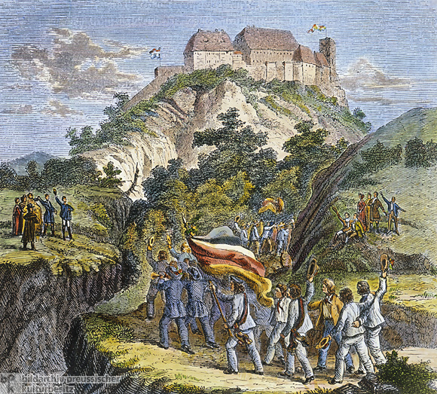
The Wartburg Festival (1819)

Slide 46
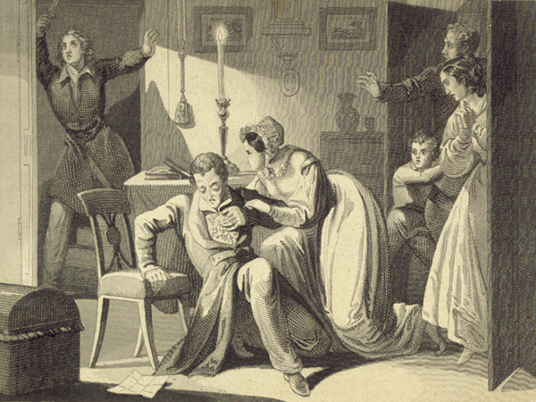
Murder of August von Kotzebue by Karl Ludwig Sand
In the “Literarisches Wochenblatt”, August von Kotzebue satirized the liberal ideas of the Student Unions
Student Karl Ludwig Sand from Jena murdered him on 23 March 1819 in Mannheim
Not the rule, most students argued more diplomatically
The last straw: compelled Metternich to pass the Carlsbad Decrees

Slide 47
The Carlsbad Decrees (1819)
Metternich feared nationalism, liberalism, and democracy
Ministers from German states (The Diet) ratified the decisions of the Carlsbad Decrees (modern day Czech Republic)
Condemned supporters of national and democratic movements
Repressive laws that hoped to contain the liberal and national desires emerging from the young Germans
University Law, Confederal Press Law, Investigatory Law…

Slide 48
The Carlsbad Decrees (1819)
The Confederal Press Law to suppress the press, which challenged absolutism, in the name of peace and order
“The Diet shall have the right, moreover, to suppress on its own authority, without being petitioned, such writings included in Article I, in whatever German state they may appear, as, in the opinion of a commission appointed by it, are inimical to the honor of the union, the safety of individual states, or the maintenance of peace and quiet in Germany. There shall be no appeal from such decisions, and the governments involved are bound to see that they are put into execution. . . . “
The Investigatory Law created an authority in Main which would investigate any movements which seemed revolutionary
“The object of the commission shall be a joint investigation, as thorough and extensive as possible, of the facts relating to the origin and manifold ramifications of the revolutionary plots and demagogical associations directed against the existing constitution and the internal peace both of the union and of the individual states; of the existence of which plots more or less clear evidence is to be had already, or may be produced in the course of the investigation. . . . “
The University Law enabled the government to alter university teaching and administration
“The function of this agent shall be to see to the strictest enforcement of existing laws and disciplinary regulations; to observe carefully the spirit which is shown by the instructors in the university in their public lectures and regular courses, and, without directly interfering in scientific matters or in the methods of teaching, to give a salutary direction to the instruction, having in view the future attitude of the students. Lastly, he shall devote unceasing attention to everything that may promote morality, good order, and outward propriety among the students….”

Slide 49
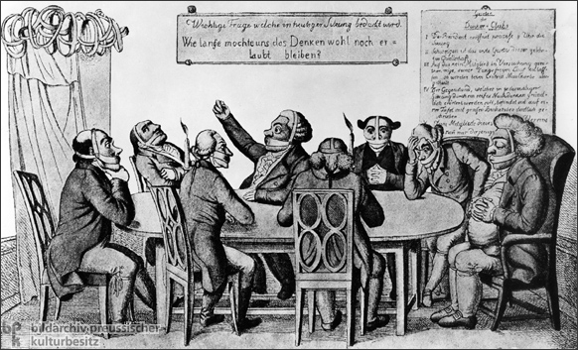
The Carlsbad Decrees (1819)
The sign on the wall behind the table reads: "Important question to be considered in today's meeting: 'How long will we be allowed to think?'"
The sign in the upper-right corner lists the rules of the Thinkers' Club: "I. The president opens the meeting at precisely 8 a.m./ II. The first rule of a learned society is silence./ III. So that no member, having made full use of his tongue, will end up in prison, muzzles will be distributed upon entry./ IV. The object of discussion, which through mature reflection should be thoroughly discussed at each meeting, will be clearly written in capital letters on a board.

Slide 50
The Carlsbad Decrees (1819)
“Most of the German governments of the day, much under the influence of the Metternich system, assumed in their panic that the mass of the academic youth constituted a potentially powerful revolutionary force… some have made the same assumption, but a closer study of the facts indicates that this is unwarranted”
-F. Gunther Eyck, University of Texas

Slide 51
Hambach Festival (1832)
20-30,000 men and women gathered at Hambach castle near Neustadt an der Haartd (Rhineland)
Disguised as a non-political county fair
Protested Carlsbad Decrees
Speeches about the sovereignty of the people, national unity, political and civil rights.

Slide 52
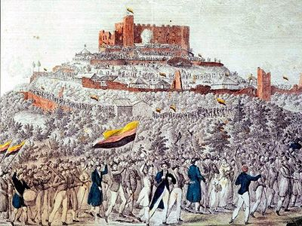
Hambach Festival (1832)
Procession of the Hambach Festival by Erhard Joseph Brenzinger

Slide 53
Hambach Festival (1832)
“Rich in all the resources of nature, Germany should be the home of joy and contentment for all its children; yet, its blood sucked by 34 kings, it is the domicile of hunger, misery, and poverty for the majority of its residents.”
- Johann August Wirth at Hambach Festival

Slide 54
Hambach Festival (1832)
“Yes, there will come the day when a united German fatherland will rise, so that all its sons will be saluted as citizens and all citizens will be embraced with equal love and equal protection. Where sublime Germania stands on the brazen pedestal of freedom and justice, in one hand holding the torch of enlightenment, which brings civilization into the farthest corners of the Earth with its light, on the other hand…[the] laws which retaliate with violence and kicks of scoffing contempt.”
- Philipp Jakob Siebenpfeiffer at Hambach Festival

Slide 55
Hambach Festival (1832)
Results:
  Not much really
  First Republican movement
  A symbolic victory
    Black, red, and gold flag
    Hambach Castle
  The German Federal Convention tightened the Carlsbad Decrees and abolished freedom of speech in its order of the 28th June 1832.

Slide 56
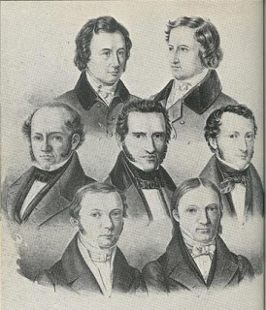
Göttingen Seven (1837)
Wilhelm Grimm, Jakob Grimm – folklorists
Wilhelm Eduard Albrecht - lawyer
Friedrich Dahlmann – historian and Leader of the G7
Georg Gottfried Gervinus – historian
Wilhelm Eduard Weber – physicist
Heinrich Georg August Ewald – theologian

Slide 57
Frankfurt Parliament (1848-49)
From Hambach on, “Germany” careened from crisis to crisis
  Schleswig and Holstein problems
  Poor harvests
  Cholera Epidemic
  Pains of industrialization and urbanization
  Growth of Veriene
  Bloody Revolts In Europe
    France: students deposed the Citizen King Louis-Philippe
    Austrian Empire: Hungary, Bohemia, Romania
    Italy: Sicily, Rome, and Northern Italy
In the meantime, The Bundestag was made up of representatives of the individual princes and was the only institution representing the German Confederation.

Slide 58
Timeline of Revolutions of 1848
24 February: Revolution in France – King Louis Philippe overthrown; Republic established.
13 March: Demonstrations in Vienna lead to the fall of Metternich
24 October: Austrian Emperor Ferdinand (1835-48) abdicates in favor of his nephew Franz Josef (1848-1916).
13 March: Prussian troops fire on demonstrators in the palace square in Berlin, leading to 2 days of rioting
16 March: King Friedrich Wilhelm IV (1840-61) agrees in principle to a new constitution, parliament and an end to censorship.
18 March: More fighting in Berlin – at least 300 rioters killed by the Army.
21 March: Friedrich Wilhelm grants a series of reforms including the appointment of a liberal ministry.
August-November: Wilhelm IV reasserts his control. Martial Law is introduced in November and the liberal constitution and parliament overturned.

Slide 59
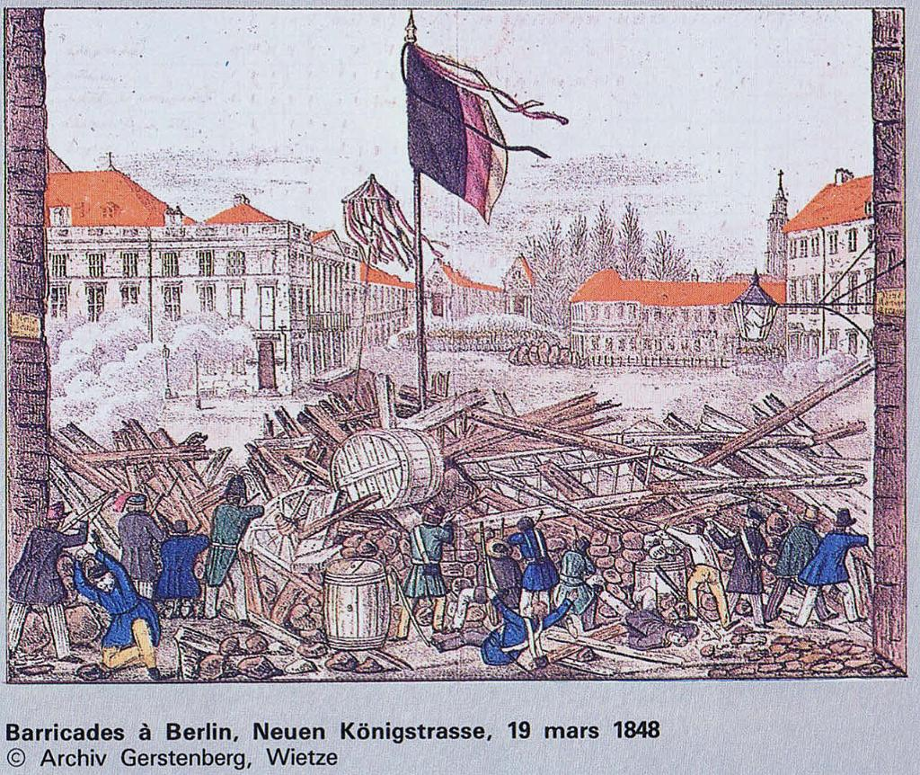
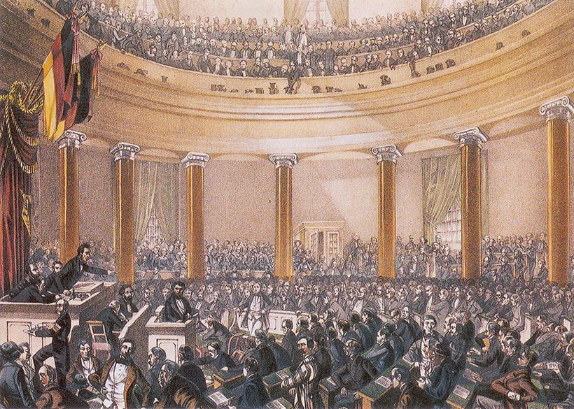

Slide 60
Demands of Frankfurt Parliament (1848-49)
Demands
  basic civil rights, regardless of property requirements
  appointment of liberal governments in the individual states
  creation of a German nation-state, with a pan-German constitution and a popular assembly.

Slide 61
Frankfurt Parliament (1848-49)
To meet these demands, a Vorparlament met in Paulskirche (St Paul's Church) in Frankfurt from 31 March to 3 April
585 members were elected
  Each electoral district had their own voting rules and qualifications
  About 85% of men could have voted
  95% of deputies had the abitur
  80% had been to university
  50% studied law
  4 were of the Gottingen 7
  The "Professors' Parliament“
  Famous Liberal Heinrich von Gagern was elected president of the parliament.
The Parliament faced many challenges…

Slide 62
Challenges of the Frankfurt Parliament: Law and Order
Wrote the Imperial Constitution
Basic rights: Freedom of Movement, Free Press, Free Trade, Equal Treatment for all Germans, the abolition of class-based privileges and medieval burdens, Freedom of Religion, Freedom of Conscience, the abolishment of capital punishment, Freedom of Research and Education, Freedom of Assembly…
Prussian king was elected as hereditary head (he declined)
Passed 267 against 263 votes on 28 March 1849

Slide 63
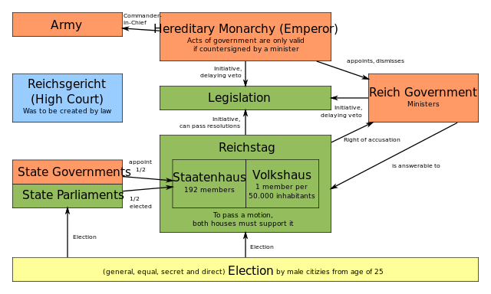

Slide 64
Challenges of the Frankfurt Parliament: Factionalism
Three main camps emerged:
democratic left (demokratische Linke)
liberal centre—the so-called "Halben" ("Halves")—consisting of the left and right centre
conservative right, composed of Protestants and conservatives

Slide 65
Challenges of the Frankfurt Parliament:
Political Legitimacy
A Loose Confederation
Since Prussian king Friedrich Wilhelm IV refused to accept a crown touched by "the hussy smell of revolution“, European powers, including France and Russia, declined to recognize the Parliament.

Slide 66
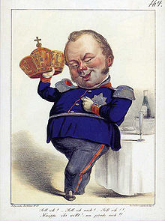
"There is no power on earth that can succeed in making me transform the natural relationship between prince and people ... into a constitutional relationship, and I never will permit a written sheet of paper to come between our God in heaven and this land ... to rule us with its paragraphs and supplant the old, sacred loyalty."
-Frederick William IV
Caricature of Frederick William IV's rejection of the imperial crown

Slide 67
Challenges of the Frankfurt Parliament: Schleswig-Holstein Question
The Schelswig-Holstein Question: Danish or German?

Slide 68
Challenges of the Frankfurt Parliament:
Relations with Austria
Relations with Austria
  Deputy Robert Blum arrested and executed by Austria for joining anti-monarchial revolution in Vienna. Claimed diplomatic immunity to no avail
Kleindeutsche Lösung ("Smaller German Solution") - Germany under the leadership of Prussia and excluding imperial Austria
Großdeutsche Lösung ("Greater German Solution") supporting Austria's incorporation
  October 1848, the National Assembly voted for a Greater Germany, but incorporating only "Austria's German lands"(excluding Poland and Hungary)
  Austrian emperor Ferdinand I refused break up his Empire
5 April 1849, all Austrian deputies left Frankfurt.

Slide 69
Johann Gustav Droysen: Speech to the Frankfurt Assembly, 1848
We cannot conceal the fact that the whole German question is a simple alternative between Prussia and Austria. In these states German life has its positive and negative poles--in the former, all the interests which are national and reformative, in the latter, all that are dynastic and destructive. The German question is not a constitutional question, but a question of power; and the Prussian monarchy is now wholly German, while that of Austria cannot be. . . .We need a powerful ruling house. Austria's power meant lack of power for us, whereas Prussia desired German unity in order to supply the deficiencies of her own power. Already Prussia is Germany in embryo. She will "merge" with Germany...

Slide 70
Austrian Prime Minister, Prince Schwarzenberg
The formation of a unified state seems to the cabinet to be impracticable for Austria, and undesirable for Germany... We will say it once more--Austria and Germany will not have their development furthered in any way by these proposals but rather weakened and discredited, and both will be hurt deep down in their political being, perhaps incurably”

Slide 71
Legacy of the Frankfurt Parliament:
Increase of Prussia's political importance
Frustration with Austria
Democracy, Liberalism, and Nationalism lost…for a while.
  Nationalism re-emerged, but without Democracy or Liberalism
The Erfurt Union…

Slide 72
Erfurt Union (1850)
A new Constitution was proposed
  Prussia at the center of a new Union with Hanover and Saxony
  Parliament in Erfurt
Elections to Erfurt Parliament held in January 1850
  Little popular support
  Turnout below 50%
  Democrats boycotted the election
  Saxony and Hanover quit the Union
  In the end, no government agreed to the Union

Slide 73
Treaty of Olmütz (1850)
November 1850, the Treaty of Olmütz was concluded between Austria and Prussia
Prussia capitulated to Austria, abandoned Erfurt Union.
The nail in the coffin of the spirit of 1848

Slide 74
Prussian Militarism
Militarism is the belief or desire of a government or people that a country should maintain a strong military capability and be prepared to use it aggressively to defend or promote national interests.
Von Roon, von Moltke, and Clausewitz were military strategy geniuses who reformed the Prussian military, allowing the Prussian state to confidently deploy the military three times in a decade.
Was Germany born of “Iron and Blood”?

Slide 75
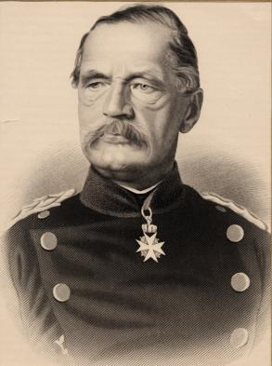
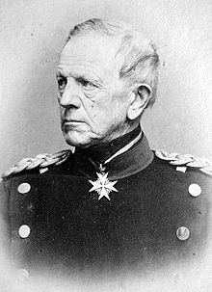
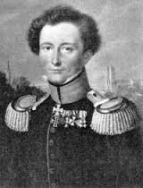
von Roon, von Moltke, and Clausewitz

Slide 76
Schleswig-Holstein Question
“Only three people...have ever really understood the Schleswig-Holstein business—the Prince Consort, who is dead—a German professor, who has gone mad—and I, who have forgotten all about it.”
-Lord Palmerston, British Foreign Secretary 1846-51

Slide 77
Schleswig-Holstein Question
Schleswig-Holstein question was first a conflict between the German Confederation and Denmark, disagreeing about the two duchies
Later devolved into a war between Austria and Prussia, who were not able to find a solution for splitting up the two duchies

Slide 78
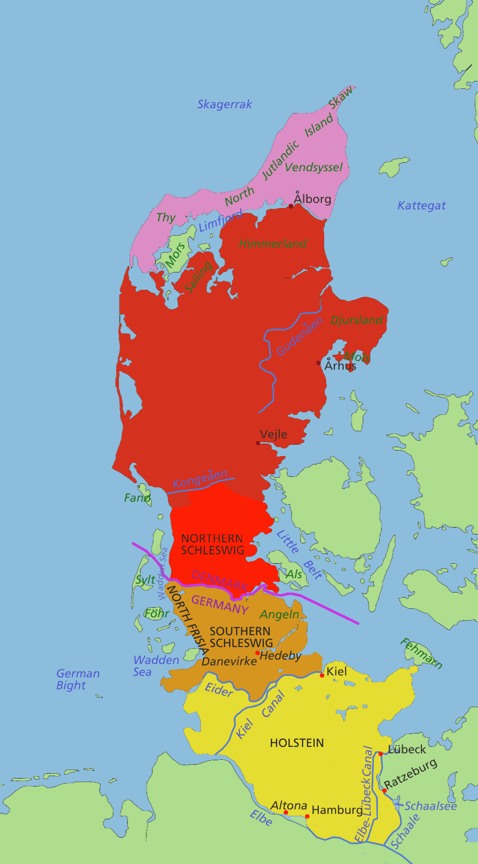
Denmark
Northern Schleswig
Southern Schleswig
Eider River
Holstein

Slide 79
Schleswig-Holstein Question
13th-14th Century: Duchy of Schleswig dependent on Denmark
1386-1460: Schleswig united with Holstein
1460-1815: Schleswig and Holstein generally ruled as different duchies by kings of Denmark
1815: Holstein became part of the German Confederation
1848: Secessionist movement of the large German majority in Holstein and southern Schleswig

Slide 80
Schleswig-Holstein Question
Was the duchy of Schleswig a territory of Denmark, with which it had been associated in the Danish monarchy for centuries?
OR
Were Schleswig and Holstein supposed to become an independent part of the German Confederation?

Slide 81
Schleswig-Holstein Question
Danish Nationalists wanted to integrate Schleswig into Denmark by detaching it from Holstein
German nationalists wanted to detach Schleswig from Denmark
1848 – Germans in Schleswig-Holstein supported independence from Denmark and a close relationship with the German Confederation
Prussia assisted this uprising of the Germans with a military intervention; Danish troops left Schleswig-Holstein
First Schleswig War between Denmark and Prussia, 1848-52

Slide 82
The London Protocol, 1852
Upheld the integrity of the Danish federation as a "European necessity and standing principle"
Schleswig and Holstein remained independent, under Danish authority
Did not resolve the issue, the German Diet refused to recognize the treaty…

Slide 83
Between London Protocol and War
1850-58: Minister-President Otto von Manteuffel pursued a policy of trying to bolster support for the monarchy through limited social (but not political) reform.
1858: Friedrich Wilhelm IV suffers strokes, Wilhelm I reigns
  The ‘New Era’ – Wilhelm appoints a mixed ministry of liberals and conservatives and the Liberals gain 55% of the seats in the Prussian Diet.
1860: Army Reform Bill
1862: Otto von Bismarck appointed Minister-President

Slide 84
Second Schleswig War, 1864
1863 – New Danish Constitution revised; integrated the Duchy of Schleswig into the Danish kingdom in violation of the London Protocol; then Danish King Frederick VII died without an heir (Christian IX took over)
Resolution was passed by the German Confederation at the initiative of PM Bismarck, calling for the occupation of Holstein by Confederate forces.
  Danish government abandoned Holstein and pulled the Danish Army back
  Prussia attacked
  Prussia + Austria vs. Denmark
  8 month war
  3300 dead

Slide 85
Second Schleswig War, 1864
Treaty of Vienna, 30 October 1864
  Denmark ceded Schleswig, Holstein to Prussia and Austria.
  200,000 Danes came under German rule
  Prussian forces were impressive
Fun Fact: Christian IX went behind the backs of the Danish government to contact the Prussians, offering ALL of Denmark to the German confederation, IF Denmark could stay united with Schleswig and Holstein. This was not known until 2010 when a Danish historian was granted access to the archives.

Slide 86
Austro-Prussian War, 1866
After 20 months of peace…7 weeks of war.
Dispute between Prussia and Austria over the administration of Schleswig-Holstein
German Diet voted for mobilization against Prussia, Bismarck left the German Confederation

Slide 87
Austro-Prussian War, 1866
In his memoirs, Bismarck claims he orchestrated the Austro-Prussian War, Northern German Confederation, and Franco-Prussian War. His “master plan”.
Historians, most notably AJP Taylor, dispute that Bismarck really had a master plan. He was a “master improviser”.
Was this Prussian nationalism? Or Prussian expansionism?
Did Bismarck want war? Or did he simply want Austria to back down?

Slide 88
Austro-Prussian War, 1866
There is, in political geography, no Germany proper to speak of. There are Kingdoms and Grand Duchies, and Duchies and Principalities, inhabited by Germans, and each separately ruled by an independent sovereign with all the machinery of State. Yet there is a natural undercurrent tending to a national feeling and toward a union of the Germans into one great nation, ruled by one common head as a national unit.
- New York Times, July 1, 1866

Slide 89
Austro-Prussian War, 1866
Seven Week War, 14 June – 23 August 1866
German Confederation under Austria vs. Prussia + Italy
Großdeutsche Lösung dead
Abolition of the German Confederation, replaced by North German Confederation, which excluded Austria and S. German states

Slide 90
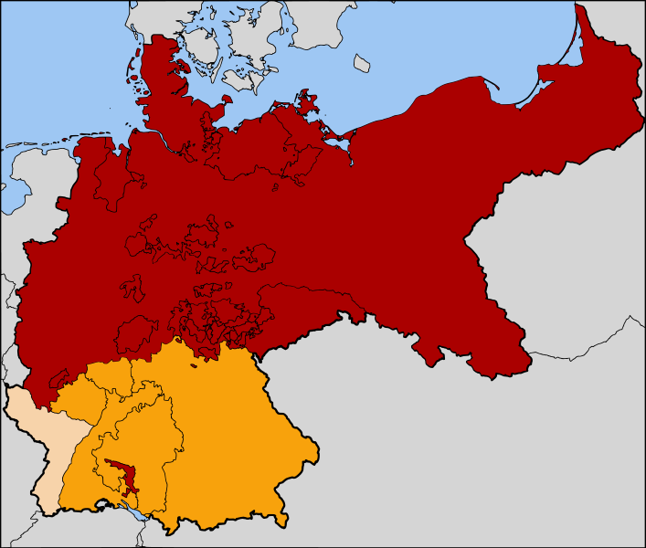
Red - The North German Confederation, 1867
Orange – Joined in 1870
Tan - Alsace-Lorraine in 1871

Slide 91
Franco-Prussian War, 1870-71: Causes
NGC provoked fears in Europe, especially in France
Some saw a France-Prussian War as inevitable
Napoleon III wanted to recapture French authority in Europe

Slide 92
Franco-Prussian War, 1870-71: Causes
Bismarck wanted war
  Bismarck wanted to bring southern German states—Baden, Württemberg, Bavaria and Hesse-Darmstadt—into an alliance with NGC
  "I did not doubt that a Franco-German war must take place before the construction of a United Germany could be realized,“ said Bismarck…after the fact
  So he edited the Ems Telegram…

Slide 93
Franco-Prussian War, 1870-71: Ems Telegram
July 1870, King Wilhelm I of Prussia was on his morning stroll in the Kurpark in Ems, where he met Count Vincent Benedetti, the French ambassador to Prussia.
  They had a pleasant chat
  Wilhelm sent a telegram detailing this to Bismarck
Bismarck altered and cut certain words of telegram
  Made it seem like Benedetti was rejected and insulted by Wilhelm
  “His Majesty the King thereupon refused to receive the Ambassador.”
Published in both Prussia and France
Enflamed public opinion on both sides
France declared war!

Slide 94
Franco-Prussian War, 1870-71: War Summary
France declared war on July 19, 1870
German states‘ militaries unite under Wilhelm
  1,200,000 NGC vs. 910,000 French Troops
Swift, decisive NGC victories
  September 1870 in Sedan (Napoleon III captured, Provisional government formed)
  October 1870 in Metz
  September 1870 - January 1871, Seige of Paris
January 28, 1871 – Surrender
28,000 NGC losses vs. 139,000 French losses

Slide 95
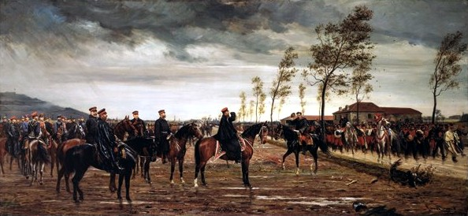
French Surrender at Metz

Slide 96
Franco-Prussian War, 1870-71: Effects
Prussian military feared
May 10, 1871: Treaty of Frankfurt
  Alsace and part of Lorraine ceded to Germany
  War reparations of 5 billion gold francs
German nationalism
New “Balance of Power“ in Europe

Slide 97
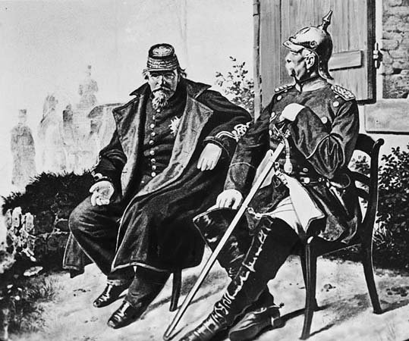
Napoleon III and Bismarck talk after Napoleon's capture at the Battle of Sedan

Slide 98
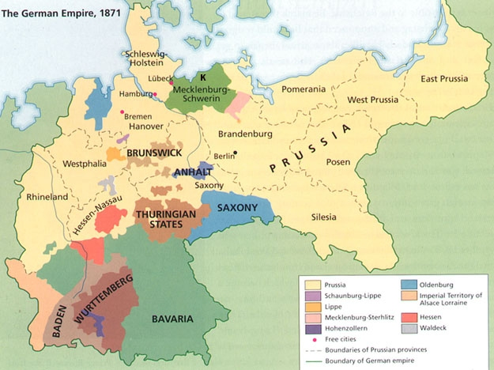

Slide 99
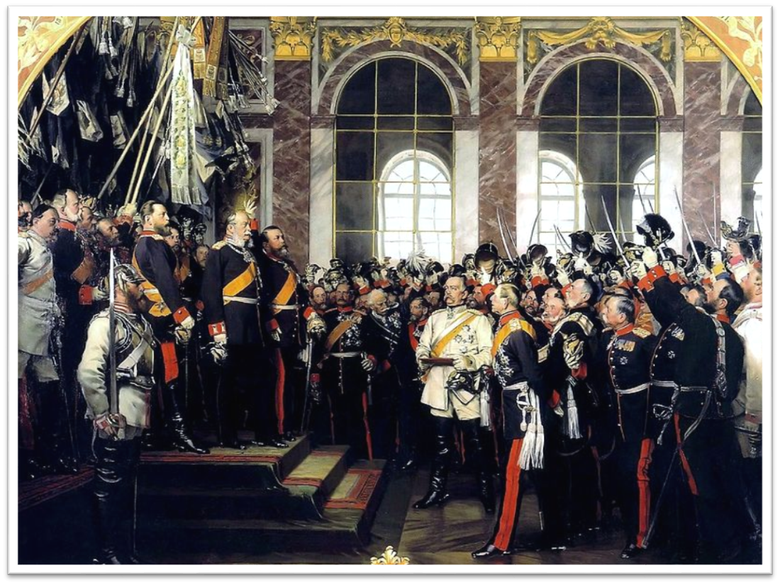
Proclamation of the German Republic, 18 January 1871 at Hall of Mirrors at Versailles

Slide 100
The Imperial Proclamation, January 18, 1871
“We assume the imperial title, conscious of the duty of protecting, with German loyalty, the rights of the Empire and of its members, of keeping the peace, and of protecting the independence of Germany, which depends in its turn upon the united strength of the people.”

Slide 101
More Than Iron and Blood
Karl Baedeker → travel
Grimm Brothers → folklore, myth, and legend
August von Fallersleben → poet of German identity
Alexander von Humboldt → German Genius

Slide 102

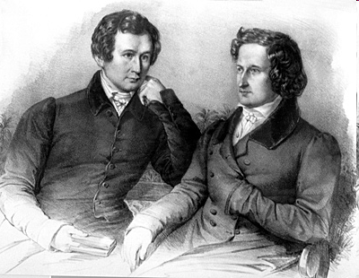
Das Lied der Deutschen
Deutschland, Deutschland über alles,
Über alles in der Welt,
Wenn es stets zu Schutz und Trutze
Brüderlich zusammenhält,
Von der Maas bis an die Memel,
Von der Etsch bis an den Belt –
Deutschland, Deutschland über alles,
Über alles in der Welt!
-von Fallersleben

