Slide 1
Lyndon Johnson’s Great Society: Triumph & Tragedy
Mr. Daniel Lazar

Slide 2
Lyndon Baines Johnson
Pushed for many of JFK’s proposals
Kept most of JFK's personnel
Capitalized on Kennedy's popularity (61% approval at time of death) and his martyrdom
SOTU Address 1964, announced his Great Society program, declaring a War on Poverty

Slide 3
Lecture Outline
Election of 1964
War on Poverty
Education
Urban Renewal
Health Care
Civil Rights
LBJ unveiling The Great Society in the first evening televised SOTU. 4 Jan 1965

Slide 4
Election of 1964
Democrats in Atlantic City nominated LBJ
Hubert Humphrey (MN) as VP
Republicans in San Francisco
The far right won an ideological tussle
Sen. Barry Goldwater (AZ) w/ NY Rep. William Miller as VP
Anti-New Deal (SSA, TVA), anti-Nuclear Test Ban Treaty, anti-CRA, anti-union, and-FICA
Pro-states’ rights, etc.
In your heart you know he’s right!

Slide 5
Election of 1964
Johnson painted himself as a cautious, Goldwater as a war-monger:
In your guts you know he's nuts!
The Daisy Ad
Both candidates vowed to stay out of Vietnam
“We are not about to send American boys 9 or 10 thousand miles away from home to do what Asian boys ought to be doing for themselves.” -LBJ in 1964

Slide 6
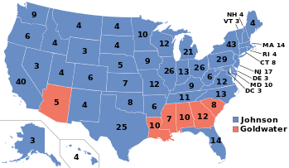
Election of 1964
486 to 52
43 mil (61%) to 27 mil (38.5%)
Dems strengthened their Congressional majority
Senate - 68-32
House - 295-140
With this sweeping electoral mandate. With THIS man in office…

Slide 7
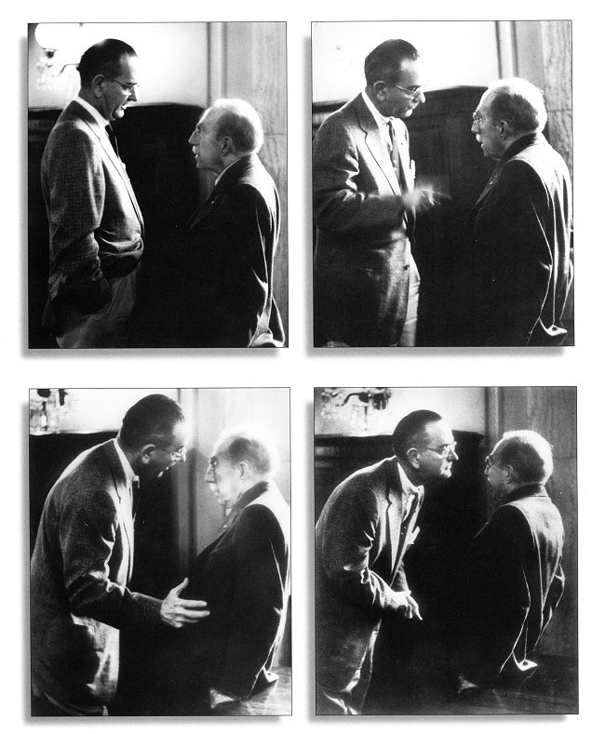
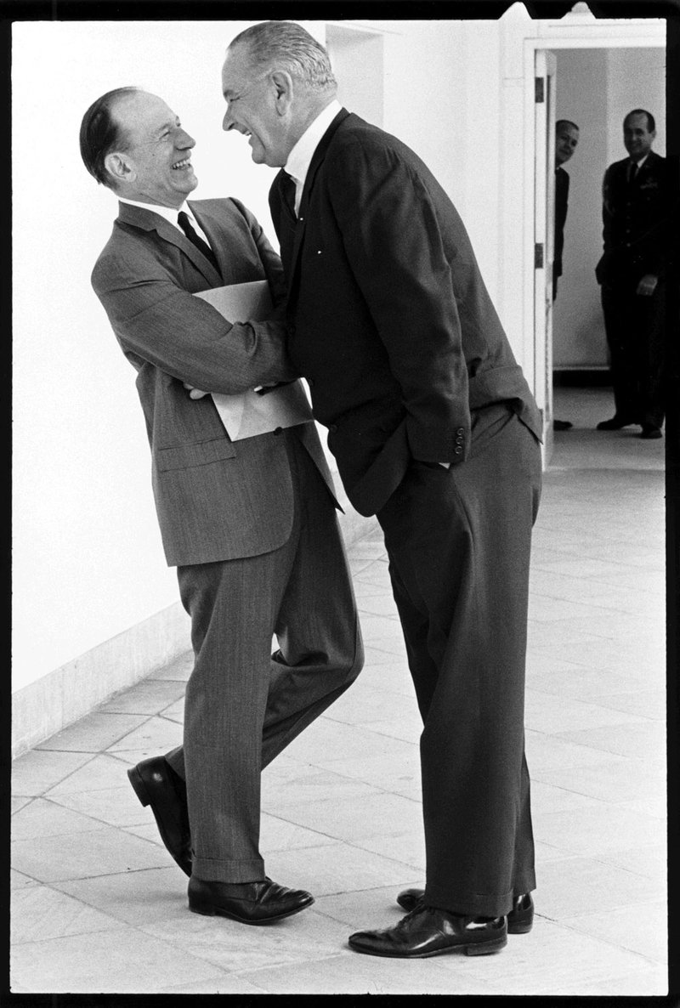
Notes:
Left: Senator Theodore Green (RI). Johnson as Sen Majority Leader. Issue: 1957 CRA. Right Johnson seeking to get is old friend and SC appointee Abe Fortas to take Johnson’s nomination for SC Chief Justice, 1968 (Southern Dems blocked Fortas’ rise).

Slide 8
The Johnson Treatment
The Treatment could last ten minutes or four hours. It came, enveloping its target, at the Johnson Ranch swimming pool, in one of Johnson's offices, in the Senate cloakroom, on the floor of the Senate itself — wherever Johnson might find a fellow Senator within his reach. Its tone could be supplication, accusation, cajolery, exuberance, scorn, tears, complaint and the hint of threat. It was all of these together. It ran the gamut of human emotions. Its velocity was breathtaking, and it was all in one direction. Interjections from the target were rare. Johnson anticipated them before they could be spoken. He moved in close, his face a scant millimeter from his target, his eyes widening and narrowing, his eyebrows rising and falling. From his pockets poured clippings, memos, statistics. Mimicry, humor, and the genius of analogy made The Treatment an almost hypnotic experience and rendered the target stunned and helpless.
-Rowland Evans & Robert Novack. Lyndon B. Johnson: The Exercise of Power. 1966.

Slide 9
The Johnson Treatment
Lyndon Johnson orders pants.
On the qualities of a Presidential Assistant: “I don’t want loyalty. I want loyalty. I want him to kiss my ass in a Macy’s window at high noon and tell me it smells like roses. I want his pecker in my pocket.” (quoted in Halberstam)
“If the circumstances make it such that you can’t f@#% a man in the ass, then just peckerslap him. Better to let him know who's in charge than to let him think he's got the keys to the car.” (White House Tapes: Eavesdropping on the President, ed. John Prados)
“If one morning I walked on top of the water across the Potomac River, the headline that afternoon would read: ‘President Can't Swim.’” (on the “credibility gap”)
“Being president is like being a jackass in a hailstorm. There's nothing to do but to stand there and take it.”

Slide 10
LBJ’s War on Poverty
Michael Harrington’s The Other America
45 million in poverty
Eradicate poverty in the richest nation in the history of the world
Aid, education, job training
“Making a speech on economics is a lot like pissing down your leg. It seems hot to you, but it never does to anyone else.” LBJ quoted in Name-Dropping by John Kenneth Galbraith
Economic Aid to Redevelop Appalachia
On the porch of Tom Fletcher's cabin, Martin County, KY, 1964.

Slide 11
LBJ’s War on Poverty
Minimum wage increased to $1.40/hour ($1.60 in 1968)
Expanded to include retail, restaurant, and hotel workers.
Kennedy-Johnson Tax Cuts lowered the rates from 20-91% to 14-70% over 2 years. Focused on middle class tax cuts.
"... the paradoxical truth that tax rates are too high and revenues too low; and the soundest way to raise revenue in the long term is to lower rates now.“ (JFK in 1963)

Slide 12
LBJ’s War on Poverty
Economic Opportunity Act, Aug 1964. Instituted:
Office of Economic Opportunity: coordinated efforts against illiteracy, unemployment, and inadequate public services. It included:
AmeriCorps VISTA, 1964, “Domestic Peace Corps”
Job Corps, 1964-1994 - (age 16-24, like CCC)
Neighborhood Youth Corps
Upward Bound
Small-business loans and incentives
1963-69, poverty declined from 23% to 12%.

Slide 13
LBJ: Investing in the Future
Johnson taught mostly Mexican children at the Welhausen School, south of San Antonio
Elementary and Secondary School Act, 1965 provided aid to needy school districts
School breakfast and lunch
1964 = 41% HS graduation rate. 88% today.
Higher Education Act, 1965, the first federal scholarships
70% of undergrads today receive fed aid
National Foundation of the Arts and Humanities, 1965 provided assistance to painters, actors, dancers, musicians, et.al.
Public Broadcasting Act, 1967 non-commercial educational TV and radio broadcasting.

Slide 14
Urban Renewal
Department of Housing and Urban Development, 1965
New cabinet post
First Black Cabinet member, Robert C. Weaver
Housing Act, 1965, established rent supplements to low-income families to aid transitions into private housing
Department of Transportation, 1966
1 of 28 Robert Taylor Towers

Slide 15
Urban Renewal
“The American city should be a collection of communities where every member has a right to belong. It should be a place where every man feels safe on his streets and in the house of his friends. It should be a place where each individual’s dignity and self-respect is strengthened by the respect and affection of his neighbors. It should be a place where each of us can find the satisfaction and warmth which comes from being a member of the community of man. This is what man sought at the dawn of civilization. It is what we seek today.”
-Special message to the Congress on the nation's cities (March 2, 1965)

Slide 16
Health Care
Medicare medical care for the elderly through the SSA
Medicaid for the poor
Food Stamp Act

Slide 17
Civil Rights
Civil Rights Act of 1964 barred discrimination in public places
Authorized the AG to file suits to desegregate schools or other public facilities
Outlawed discrimination in employment on the basis of race, color, religion, sex, or national origin
"No memorial oration or eulogy could more eloquently honor President Kennedy's memory than the earliest possible passage of the Civil Rights Bill for which he fought so long."
Upon signing CRA 64, Johnson might have said, "We have lost the South for a generation."

Slide 18
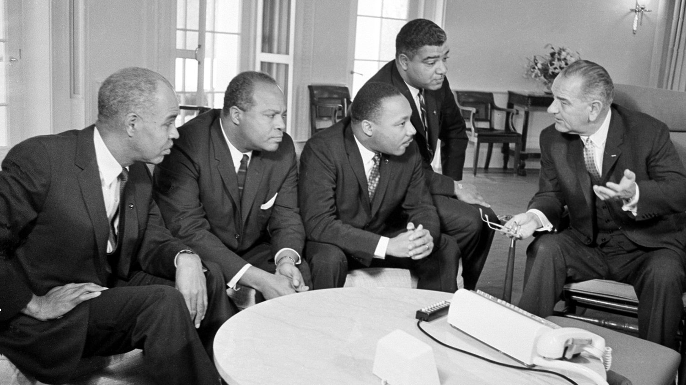
Notes:
Johnson Jan. 18, 1964. The Black leaders, from left, are, Roy Wilkins, James Farmer, Dr. Martin Luther King Jr., and Whitney Young.

Slide 19
Civil Rights
24th Amendment, Jan 1964, banned a poll tax.
Voting Rights Act, Aug 1965 - suspended literacy and other voter tests. Required federal supervision of registration. 7 of 11 Rebel States subject to preclearance. 2013 SC ruling gutted this.
LBJ denounced the Klan as a "hooded society of bigots," and warned them to "return to a decent society before it's too late."
The first president to prosecute the Klan since Grant.
Appointed first Black member to the SC, Thurgood Marshall
Immigration Act of 1965, eliminated quotas

Slide 20
Civil Rights
You do not wipe away the scars of centuries by saying: “now, you are free to go where you want, do as you desire, and choose the leaders you please.” You do not take a man who for years has been hobbled by chains, liberate him, bring him to the starting line of a race, saying, "you are free to compete with all the others," and still justly believe you have been completely fair...
This is the next and more profound stage of the battle for civil rights. We seek not just freedom but opportunity—not just legal equity but human ability—not just equality as a right and a theory, but equality as a fact and as a result.
-LBJ in the Commencement Address at Howard University, 1965

Slide 21
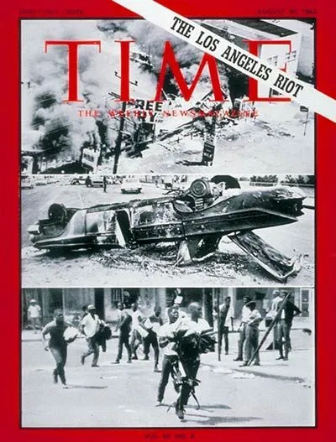
Or Does it Explode?
Harlem 1964
Watts 1965
Chicago 1966, “Division Street Burns”
Newark 1967, “Newark burned”
Detroit 1967, Gov George Romney sent in the troops

Slide 22
Or Does it Explode?
LBJ est Kerner Commission to study the riots. They reported, “Our nation is moving toward two societies, one black, one white—separate and unequal…What white Americans have never fully understood but what the Negro can never forget — is that white society is deeply implicated in the ghetto. White institutions created it, white institutions maintain it, and white society condones it.“
“What did you expect? I don't know why we're so surprised. When you put your foot on a man's neck and hold him down for three hundred years, and then you let him up, what's he going to do? He's going to knock your block off.” –LBJ
MLK assassinated summer 1968. Riots across America

Slide 23
Other Johnson Era Accomplishments
Gun Control Act of 1968 - one of the farthest-reaching federal gun control laws in American history. In context of JFK, RFK, and MLK.
Apollo Missions
Clean Air and Water Acts
Wilderness Preservation Act (9 million acres)
Truth in Lending Act
Truth in Packaging Act

Slide 24
The Warren Court, 1953-1969
Mapp v. Ohio – evidence seized illegally cannot be used in court
Gideon v. Wainright – free legal counsel to indigent defendants
Escobedo v. Illinois – accused have right to have counsel
Miranda v. Arizona – suspect must have rights read
Engle v. Vitale – outlawed compulsory school prayer

Slide 25
Snapshot of LBJ Foreign Policy
Dominican Republic - supported the overthrow of left-wing, democratically elected president Juan Bosch.
Outer Space Treaty 1967 - Set up principles for the peaceful exploration of space
Six-Day War 1967
Vietnam! “I believe we can continue the Great Society while we fight in Vietnam.”

Slide 26
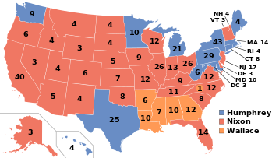
Nixon’s 1968 Landslide
RNC: Nixon, IKE’s VP
DNC Split
Sen McCarthy (MN)
Sen McGovern (SD)
Gov Wallace (AL)
Sen RFK (MA)
LBJ VP Humphrey
Realigning election – ended New Deal Coalition that dominated presidential politics for 36 years
Nixon 43% - 301
Humphrey 42.7% - 191
Wallace – 13.5% - 46

Slide 27
One Assessment of The Great Society
The Square Deal, The New Deal, The Fair Deal, The New Frontier, and The Great Society all came to a tragic halt when America’s preoccupation with war diverted the nation’s physical, economic and emotional resources away from domestic problems.
…LBJ died on January 22, 1973 at age 64, one day before a ceasefire was signed in Vietnam.

Slide 28
Assessment of Great Society: Successes
Opportunities and human dignity
Health: Medicare and Medicaid, Nursing Homes, Senior Centers, Infant Mortality Rate (esp. for Blacks)
Civil Rights: CRA 1964, Voting Rights Act, Education
Poverty relief to the elderly and disabled
Public Housing. Housing as a right.
Inner City Infrastructure (e.g. San Francisco and Washington rail lines)

Slide 29
Assessment of Great Society: Successes
Education: Head Start, College Opportunities & Literacy
Consumer Protection: Environmental Protection & Truth in Packaging
High Hopes and High Expectations
Proactive, compassionate government
Governmental Leadership & Action

Slide 30
Assessment of Great Society: Failures
Cities declined in spite of billions spent.
People who could afford to leave cities usually did
Public Housing was an utter failure
Authoritarian approach: treating the inner-city like an occupied territory
Race: not far enough. 33% Black children in poverty
Federal Bureaucratization of Schools. A state/local issue?

Slide 31
Assessment of Great Society: Failures
Welfare: poverty remains, but tax dollars are still being spent.
Give a man a fish…
Welfare vs. Workfare. TANF.
Exploding Health Care Costs
Jeffersonian self-governance? Emersonian Self-Reliance?
Vietnam Impact…

