Slide 1
Domestic Policies in the Age of Camelot: New Frontiers?
Mr. Daniel Lazar

Slide 2
Outline
1960 Election
Civil Rights
Women’s Rights
Economic Rights
Apollo Mission
Peace Corps
Assassination

Slide 3
Bi-Elections of 1958
Hope for Dems: 1958 recession, Republicans lowered farm price supports, labor opposition to state right-to-work laws, “missile gap”, Sputnik…
Dems gained
15 Senate seats (62-34)
48 House seats (282-153)
6 governorships

Slide 4
1960 Election: Conventions
In L.A.
Stevenson – Lost twice already
LBJ – appealed to rural region and the South
JFK – appealed to youth and activist wings. Chosen on first ballot.
“I now know the difference between a caucus and a cactus: in a cactus, all the pricks are on the outside.” -LBJ
In Chicago, Republicans chose Nixon w/ Lodge as VP

Slide 5
Accepts the Nomination, Challenges Americans
“The times are too grave, the challenge too urgent, and the stakes too high — to permit the customary passions of political debate. We are not here to curse the darkness, but to light the candle that can guide us through that darkness to a safe and sane future…Today our concern must be with that future. For the world is changing. The old era is ending. The old ways will not do…It is a time, in short, for a new generation of leadership.”

Slide 6
Accepts the Nomination, Proposes New Frontier
“Woodrow Wilson’s New Freedom promised our nation a new political and economic framework. Franklin Roosevelt's New Deal promised security and succor to those in need. But the New Frontier of which I speak is not a set of promises — it is a set of challenges. It sums up not what I intend to offer the American people, but what I intend to ask of them. It appeals to their pride, not to their pocketbook — it holds out the promise of more sacrifice instead of more security.”

Slide 7
1960 Election: The Catholic Conundrum
Sept 1960 speech at ministers’ meeting in Houston diffused the Catholic conundrum.
"I am not the Catholic candidate for president. I am the Democratic Party's candidate for president who also happens to be a Catholic. I do not speak for my Church on public matters – and the Church does not speak for me."

Slide 8
1960 Election: Age(ism) and (in)Experience
JFK was 43; Nixon was 48
“Who's seasoned through and through; but not so dog-gone seasoned that he won't try something new.” –Kennedy Campaign Ad Song
Four TV debates diffused the inexperience issue

Slide 9
1960 Election: Age(ism) and (in)Experience

Slide 10
1960 Election: Split Results
Population: 180 mil
Kennedy 34,226,731 / Nixon 34,189,157
118,574 vote differential; 49.7% to 49.6%
Kennedy won 303 electoral votes (22 states) to Nixon’s 219 (26 states)
Segregationist Sen. Harry Byrd D-VA: won 15 EC votes

Slide 11
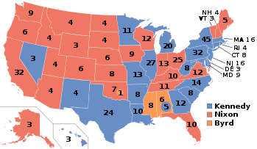
1960 Election: Split Results

Slide 12
The New Frontier in the Age of Camelot
Inaugural Speech demanded that Americans, ”Ask not what your country can do for you; ask what you can do for your country.”
"All this will not be finished in the first one hundred days. Nor will it be finished in the first one thousand days, not in the life of this Administration, nor even perhaps in our lifetime on this planet. But let us begin.“
New Frontier became: federal aid to education, urban and rural revitalization, housing, minimum wage, Medicare

Slide 13
The New Frontier in the Age of Camelot
“The Best & The Brightest”, aka “The Whiz Kids”
The Liberal Tradition: Square Deal, New Freedom, New Deal, Fair Deal
A New Deal without A Crisis? A New Deal for the Rest? A New Deal without popular support?

Slide 14
JFK & Civil Rights: Or Does it Explode?
"The denial of constitutional rights to some of our fellow Americans on account of race - at the ballot box and elsewhere - disturbs the national conscience, and subjects us to the charge of world opinion that our democracy is not equal to the high promise of our heritage."
-JFK’s First SOTU, January 1961

Slide 15
JFK & Civil Rights: Or Does it Explode?
"The fires of frustration and discord are burning in every city, North and South, where legal remedies are not at hand. Redress is sought in the streets, in demonstrations, parades, and protests which create tensions and threaten violence and threaten lives. We face, therefore, a moral crisis as a country and as a people…It is not enough to pin the blame on others, to say this is a problem of one section of the country or another…Those who do nothing are inviting shame as well as violence. Those who act boldly are recognizing right as well as reality."
Civil Rights Address on TV and Radio, June 1963

Slide 16
JFK & Civil Rights: Or Does it Explode?
23rd Amendment, Mar 1961, gave DC 3 electoral votes
24th Amendment, Jan 1962, banned poll taxes (ratified in 1964)
Despite rhetoric, Kennedy feared the CRM would repel Southern whites and alienate Southern Dems in Congress
RFK said we must, "keep the president out of this civil rights mess.” Urged the Freedom Riders to "get off the buses and leave the matter to peaceful settlement in the courts.“
Notes:
23rd had bipartisan support. But, according to the 1970 census, 71% of the federal district was Black (about 50% today), a dramatic jump. Accordingly, the district has sent its 3 electoral votes to the Democratic candidate in every single presidential election since 1964

Slide 17
JFK & Civil Rights: Or Does it Explode?
In 1963 JFK became more proactive. In June, he intervened when AL Gov George Wallace blocked the doorway to the University of Alabama. But not enough…
March on Washington for Jobs and Freedom on Aug 28, 1963
Set the stage for what became CRA 1964
J. Edgar Hoover convinced (?) JFK that King was a Commie and a public menace. Wire tapping and perpetual harassment. RFK cleared this.

Slide 18
New Frontiers for Women?
Dec 1961, est. Presidential Commission on the Status of Women, Chaired by Eleanor Roosevelt.
Illuminated systematic cultural and economic oppression of women.
Advised on the Equal Pay Act, amending Fair Labor Standards Act.
JFK endorsed the ERA

Slide 19
Economic Frontiers
“If a free society cannot help the many who are poor, it cannot save the few who are rich.” -JFK
Minimum wage raised from $1.00 to $1.25
Revenue Act of 1964 – reduced top marginal tax rate from 91% to 70%, corporate tax rate from 52 to 48%
Housing Act of 1961
Fed funds for public transit and public housing
Subsidized middle class housing
Preserved open space
Elderly housing
$2 billion in education aid

Slide 20
Apollo Mission: Whitey on the Moon
In response to Yuri Gagarin’s April 1961 space mission
May 1961, Kennedy proposed a crewed Moon landing in a Special Message to the Congress on Urgent National Needs;
“…this nation should commit itself to achieving the goal, before this decade is out, of landing a man on the Moon and returning him safely to the Earth.”
$20 billion to NASA, untold STEM funding, hopes and dreams…

Slide 21
Peace Corps: “Bear any Burden”
Senator Kennedy’s hobby horse in 1950’s
Young volunteers went to LDCs as educators, health workers, and technicians
40% were women
Implement economic development programs
Re-casted America’s image
JFK at U Michigan in 1957

Slide 22
New Frontier, Old Problems Linger
Coalition of Republicans and S. Dems stymied and/or diluted JFK agenda
Medicare defeated (again). AMA crushed it.
Medicaid never hit the floor
Civil Rights
Mass transit
Unfinished business…

Slide 24
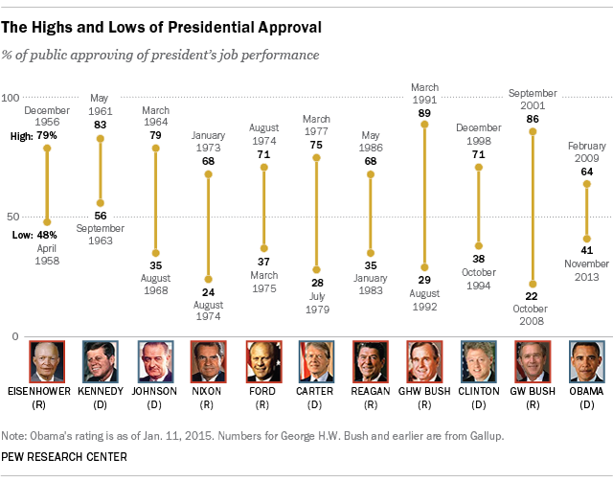
Public Approval: For What It’s Worth

Slide 25
The Autopsy Reports
The premise is that Kennedy was a very good president, and might have been a great one if he’d lived. Few serious historians take this view … In reality, the kindest interpretation of Kennedy’s presidency is that he was a mediocrity whose death left his final grade as “incomplete.” The harsher view would deem him a near disaster — ineffective in domestic policy, evasive on civil rights and a serial blunderer in foreign policy, who barely avoided a nuclear war that his own brinksmanship had pushed us toward … We confuse charisma with competence, rhetoric with results, celebrity with genuine achievement.
-Ross Douthat, The Enduring Cult of Kennedy, New York Times, November 26, 2011.
But if there was one thing that 'President Kennedy stood for that touched the most profound feeling of young people around the world, it was the belief that idealism, high aspirations, and deep convictions are not incompatible with the most practical and efficient of programs — that there is no basic inconsistency between ideals and realistic possibilities, no separation between the deepest desires of heart and of mind and the rational application of human effort to human problems.
-Robert F. Kennedy, 1966

Slide 26
Snapshot of JFKS Foreign Policy
Mar 1961 - Peace Corps
Mar 1961 - Alliance for Progress
April 1961 - Bay of Pigs Fiasco
Aug 1961 - Berlin Crisis
Oct 1962 - Cuban Missile Crisis
Dec 1962 – Est. “Special Relationship” between the US and Israel
Aug 1963 - Limited Nuclear Test Ban Treaty
Vietnam

Slide 27
The Assassination & The Ascendance of LBJ
22 Nov 1963
Warren Commission concluded that Lee Harvey Oswald acted alone
24 Nov, killed by Jack Ruby

