Slide 1
Enlightenment Presentations
Grade 9
2015

Slide 2
Jean-Jaques Rousseau
Olivia Schweizer, Adam Abu Shnaig, Eleonora Coco

Slide 3
Jean-Jaques Rousseau was the most controversial and influential philosopher of the Enlightenment, as evidenced by his radical belief in the purity of human nature, The Social Contract, and Rousseau´s theory of human development.

Slide 4
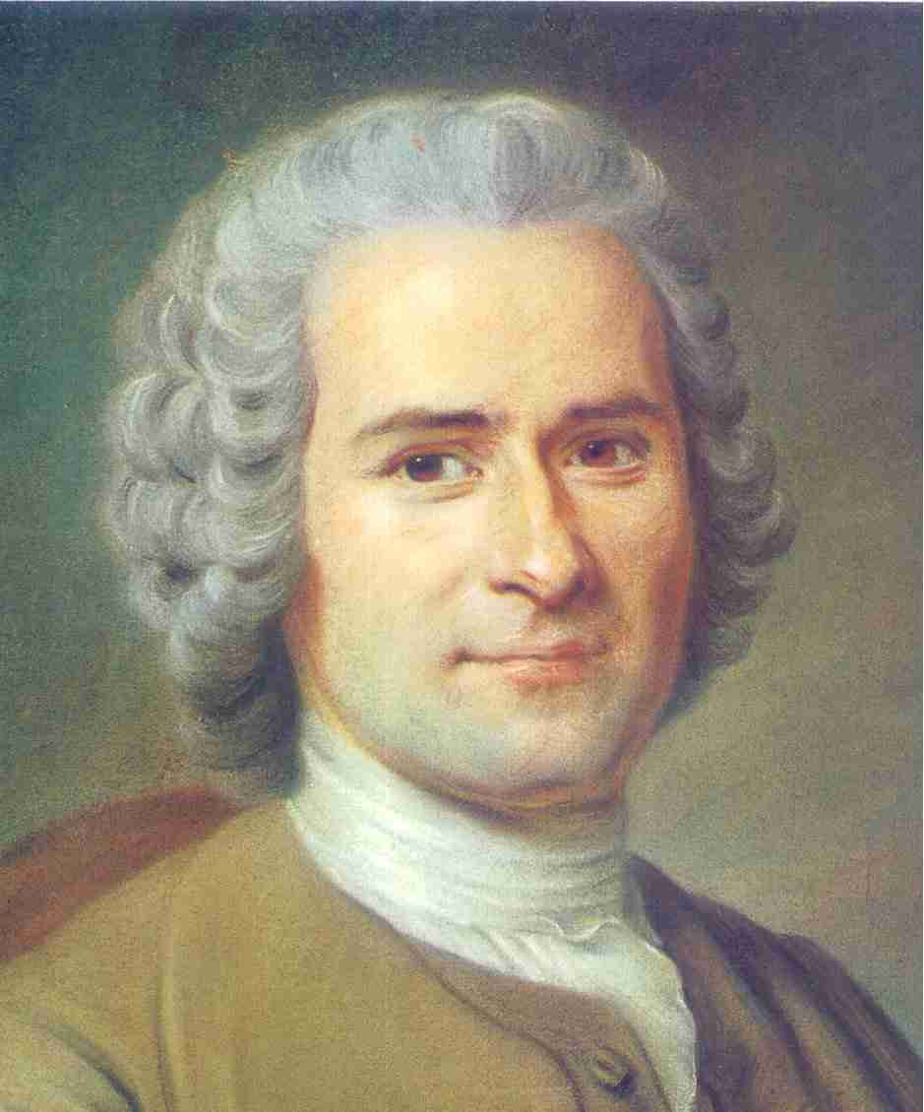

Slide 5
What is Rousseau’s view of human nature?
Naturally good
Society corrupted man
“Pure State”
Endowed with two sentiments

Slide 7
What is Rousseau’s theory of human development?
New stage
Relationships
Loss of freedom
Society changes man into an impure and selfish being

Slide 8
Direct Quotes from the Social Contract
“Man is born free and he is everywhere in chains” (Book 1 Chapter 1)
“What man loses by the social contract is his natural liberty and the absolute right to anything that tempts him and that he can take; what he gains by the social contract is civil liberty and the legal right of property in what he possesses” (Book 1, Chapter 8)

Slide 9
Quotes secondary sources
“There is no more haunting paragraph in the whole of the Social Contract than that in which Rousseau speaks of forcing a man to be free” (Maurice Cranston, Introduction to The Social Contract, Penguin Classics 1981)

Slide 10
Rousseau Enlightenment Questions
How does he embody Enlightenment thought?
social liberty
political unity
2. What is the legacy and impact of the philosopher?
recognized negative aspects of society
3. How are the ideas of the philosopher you´ve been assigned to study inspired by/related to/in opposition to the other philosophers to the list?
E.g Rousseau and Hobbes. Rousseau inspired Kant
Notes:
thanks so much adam

Slide 11
Bibliography
http://www.historyguide.org/Europe/rousseau.html
https://en.wikipedia.org/wiki/Jean-Jacques_Rousseau#Final_years
http://www.iep.utm.edu/soc-cont/
https://legacy.fordham.edu/halsall/mod/rousseau-soccon.asp
https://danassays.files.wordpress.com/2009/06/jean-jacques-rousseau.jpg
https://de.wikipedia.org/wiki/Jean-Jacques_Rousseau#/media/File:Jean-Jacques_Rousseau_Signature.svg
https://upload.wikimedia.org/wikipedia/commons/thumb/b/bb/Rousseau_pirated_edition.jpg/150px-Rousseau_pirated_edition.jpg
http://www.britannica.com/biography/Jean-Jacques-Rousseau
http://muse.jhu.edu/journals/bio/summary/v015/15.4.racevskis.html
http://plato.stanford.edu/entries/rousseau/
http://www.academia.edu/3531858/The_State_of_Nature_Thomas_Hobbes_and_Jean_Jacques_Rousseau

Slide 12
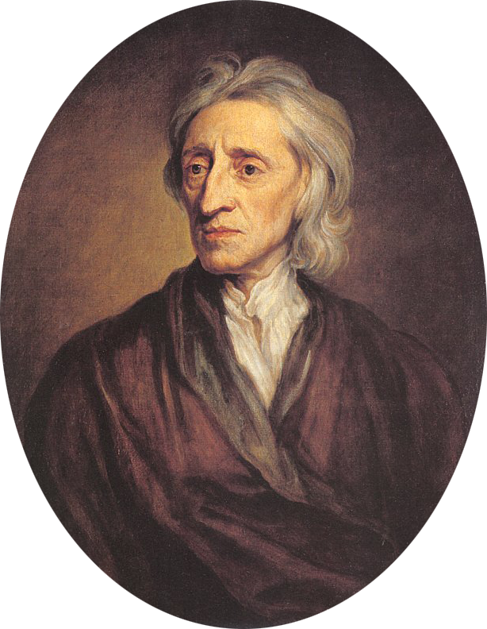
John Locke
By: Jamie DeRose, Joshua Sutton, and Aliya Loeb

Slide 13
Thesis Statement:
The english philosopher, John Locke was one of the most influential thinkers of the enlightened era. His theories drove people to question the church and human nature.

Slide 14
Basic Facts of John Locke:
Born: 29. August 1632 Wrington, Somerset, England
Died: 28.October 1704 (age 72) High Laver, Essex, England
One of the most known Philosophers and enlightenment thinkers
He is also known as the “Father of Classical Liberalism”

Slide 15
John Locke’s Blank Slate Theory
The Blank Slate Theory or tabula rasa
Children are born a “Blank slate”
The child is not evil or good
The child’s personality will be influenced by people and experiences
The influence will have an effect for his/her life
Introduced in Essay Concerning Human Understanding.

Slide 16
Locke’s Views on Religion and Religious Tolerance
In the “Letter Concerning Toleration”, he evolves on many ideas created to establish just religious and political rules
One of his central claims was that the government should not use force to bring people or a certain people to a different belief

Slide 17
Why is property so important to Locke in political thinking?
Theory:
John Locke claimed that men are not naturally free and that the government should “guard”the rights of the citizens.If the government fails the citizens have the right to rebel and over through the monarch.

Slide 18
Why is Property So Important to Locke in Political thinking?
Locks way of treating property way among his most important contributions in the political thought.
but his thought of political property was also heavily criticised
Many philosophers debate over what locke was trying to accomplish with his theory

Slide 19
How Does Locke Embody The Enlightenment Thought?
Locke goes against religion by saying we are born as a “blank slate”
Locke believed in personal rights
Locke believed we were all born equal, going against monarchy

Slide 20
John Locke’s Influence
His social contract affected the founding fathers of the U.S
His contract was written about by Alexander Hamilton, Thomas jefferson and others
Life, Liberty,and property

Slide 21
Short Quotes
Primary Source:"The main intention of nature, which willeth the increase of mankind, and the continuation of the species in the highest perfection". (First Treatise, Chapter 6/By John Locke)

Slide 22
Short Quotes
Secondary Source Quotes:”Human nature, has manifested in tribalism and nationalism, provides the momentum of the machinery of human nature.(Essay on Human evolution/By Sir Arthur Keith)

Slide 23
Bibliography
http://plato.stanford.edu/entries/locke-political/#Pro
http://www.iep.utm.edu/locke/
http://umich.edu/~ece/student_projects/childrens_lit/Educationalist_Theory.htm
https://en.wikipedia.org/wiki/Tabula_rasa
http://oll.libertyfund.org/pages/locke-on-religious-toleration-by-mark-goldie
https://en.wikipedia.org/wiki/John_Locke#Theories_of_religious_tolerance
https://en.wikipedia.org/wiki/John_Locke#Influence
http://www.nlnrac.org/earlymodern/locke
http://legacy.fordham.edu/halsall/mod/1692locke-education.asp

Slide 24
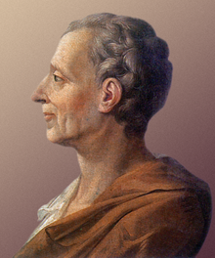
Montesquieu
Philosophy and Ideas
By: Jack Kent, Annika Tophoven, and Daniel Osterkruger

Slide 25
Thesis Statement
Montesquieu's views on the separation of powers as well as his views on slavery were radical and righteous challenges to the political and economic power structures of the eighteenth century.

Slide 26
Short Bio
-Full Name: Charles-Louis de Secondat, baron de La Brède et de Montesquieu
-Born: 18 January, 1689 southern France
-Died: 1755 Paris, France
-Born into a wealthy family
-Despite his family's wealth, montesquieu was put in the care of a poor family during his childhood
-Studied science and history in college
-Became a lawyer after college

Slide 27
Information
-divided the french government into three parts, the legislative, judicial, and executive sections, although he was incorrect about this.
-Montesquieu is most known for his systematic classification of governments.
-Montesquieu, like other philosophers, wanted freedom and tolerance.

Slide 28
Continued Info
-Montesquieu, although preceding a later generation of philosophes who became concerned with man`s natural place in the universe, moves past this and accepts as common sense that man is an intelligent being created be an intelligent God.
-Montesquieu published “The Spirit Laws” in 1748, which contained his theories and statements on slavery, and seperation of powers, both of which we will cover in this presentation.
-Montesquieu believed that in the state of nature, individuals were so fearful that they avoided war and violence.

Slide 29
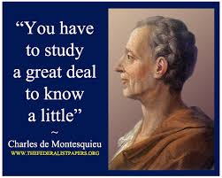

Slide 30
Inspiration
-Montesquieu admired John Locke
-He was influenced by Newton's laws and physics
-He inspired the U.S Constitution
-Montesquieu was inspired by Aristotle, Thomas Hobbes, Adam Smith, Cicero.

Slide 31
Montesquieu
Philosophy and Ideas
By: Jack Kent, Annika Tophoven, and Daniel Osterkruger

Slide 32
Thesis Statement
Montesquieu's views on the separation of powers as well as his views on slavery were radical and righteous challenges to the political and economic power structures of the eighteenth century.

Slide 33
Short Bio
-Full Name: Charles-Louis de Secondat, baron de La Brède et de Montesquieu
-Born: 18 January, 1689 southern France
-Died: 1755 Paris, France
-Born into a wealthy family
-Despite his family's wealth, montesquieu was put in the care of a poor family during his childhood
-Studied science and history in college
-Became a lawyer after college

Slide 34
Information
-divided the french government into three parts, the legislative, judicial, and executive sections, although he was incorrect about this.
-Montesquieu is most known for his systematic classification of governments.
-Montesquieu, like other philosophers, wanted freedom and tolerance.

Slide 35
Continued Info
-Montesquieu, although preceding a later generation of philosophes who became concerned with man`s natural place in the universe, moves past this and accepts as common sense that man is an intelligent being created be an intelligent God.
-Montesquieu published “The Spirit Laws” in 1748, which contained his theories and statements on slavery, and seperation of powers, both of which we will cover in this presentation.
-Montesquieu believed that in the state of nature, individuals were so fearful that they avoided war and violence.

Slide 37
Inspiration
-Montesquieu admired John Locke
-He was influenced by Newton's laws and physics
-He inspired the U.S Constitution
-Montesquieu was inspired by Aristotle, Thomas Hobbes, Adam Smith, Cicero.

Slide 38
The Separation Of Powers
-The separation of powers is a model that was first developed in congress. Under this model the state is divided into three branches, each with separate and independent powers
-divided the french government into the legislative, judicial, and executive branches, although he was incorrect about this
-Legislative branch handled bills and taxes,
-Judicial branch handled laws, reviewing them and creating new laws
-Executive branch is commander in chief of the army and executed instructions of congress

Slide 39
Continued Separation of Powers
-Montesquieu is most known for his systematic classification of governments
- The separation of powers is the political doctrine of the constitutional law that are under the three branches of government. They are kept separate to prevent abusive power
- Montesquieu did not invent the doctrine of the separation of power, but he contributed new ideas to it.

Slide 41
View on Slavery
-Montesquieu's argument in “The Spirit of the Law” was that slavery is against the natural way of things.
-Montesquieu also argued that slavery was not lawful because slaves who are born slaves are not benefitting from the law; the law works against them every day of their lives.
-“It is not good by its nature; it is useful neither to the master nor the slave”.

Slide 42
How Does He Embody Enlightenment Thought?
-Montesquieu published “The Spirit Laws” in 1748. Unlike some of the other philosophers (Hobbes and Locke). Montesquieu believed that in the state of nature, individuals were so fearful that they avoided war and violence.
- Montesquieu wrote that the main purpose of the government is to maintain law, order and the property of the individual.
- Montesquieu expressed his Enlightenment thought through his greatest work published: “The Spirit Laws”.
-He also expressed his thoughts through the “Separation of Powers”.

Slide 43
What is the legacy and impact of the philosopher?
-His ideas were used to form the U.S Constitution, and his “separation of powers” idea still shapes modern government.
-Montesquieu completed his goal by dividing the governmental power into branches.
-Montesquieu remained a hero during the early part of the French Revolution.
-Until Jean-Jacques Rousseau came after he died the people took him as their inspiration.

Slide 44
The Separation Of Powers
-The separation of powers is a model that was first developed in congress. Under this model the state is divided into three branches, each with separate and independent powers
-divided the french government into the legislative, judicial, and executive branches, although he was incorrect about this
-Legislative branch handled bills and taxes,
-Judicial branch handled laws, reviewing them and creating new laws
-Executive branch is commander in chief of the army and executed instructions of congress

Slide 45
Continued Separation of Powers
-Montesquieu is most known for his systematic classification of governments
- The separation of powers is the political doctrine of the constitutional law that are under the three branches of government. They are kept separate to prevent abusive power
- Montesquieu did not invent the doctrine of the separation of power, but he contributed new ideas to it.

Slide 47
View on Slavery
-Montesquieu's argument in “The Spirit of the Law” was that slavery is against the natural way of things.
-Montesquieu also argued that slavery was not lawful because slaves who are born slaves are not benefitting from the law; the law works against them every day of their lives.
-“It is not good by its nature; it is useful neither to the master nor the slave”.

Slide 48
How Does He Embody Enlightenment Thought?
-Montesquieu published “The Spirit Laws” in 1748. Unlike some of the other philosophers (Hobbes and Locke). Montesquieu believed that in the state of nature, individuals were so fearful that they avoided war and violence.
- Montesquieu wrote that the main purpose of the government is to maintain law, order and the property of the individual.
- Montesquieu expressed his Enlightenment thought through his greatest work published: “The Spirit Laws”.
-He also expressed his thoughts through the “Separation of Powers”.

Slide 49
What is the legacy and impact of the philosopher?
-His ideas were used to form the U.S Constitution, and his “separation of powers” idea still shapes modern government.
-Montesquieu completed his goal by dividing the governmental power into branches.
-Montesquieu remained a hero during the early part of the French Revolution.
-Until Jean-Jacques Rousseau came after he died the people took him as their inspiration.

Slide 50
Voltaire
Naliyah Helmy & Daniel Delfs

Slide 51
Thesis: Why was Voltaire enlightened?
Voltaire was a true rebel of his age, fighting for the sparse gift of freedom, his most notable opponents being the church and aristocracy. Voltaire fought for the rights of believing what you believed, and saying anything anytime, which even today is controversial.

Slide 52
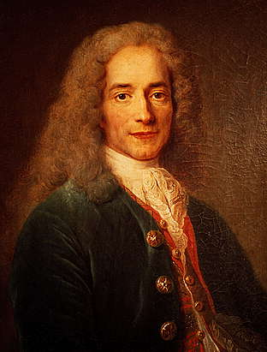
Who is Voltaire?
Real name: François-Marie Arouet
Born: 21 November 1694 & Died: 30 May 1778
Main Philosophies:
Free Speech
Free Religion (no persecution for religion)
Absolute rule
Separation of church and state

Slide 53
What (events and people) Inspired Voltaire?
Frederick the Great: inspired/affected each other in ideas of absolutism
Isaac Newton: inspired, and great follower of the Newtonian sciences; he brought/showed France Newton’s Laws of Phzsics
Getting banned from France; going to England: learned about English philosophy/philosophers

Slide 54
Free Speech
Voltaire was the first individual who successfully criticized government, and religion (and encouraged others to do so).
Voltaire lived in an age where saying the wrong things could get you killed, or in jail.
Even if he did not agree with what one said, Voltaire would still fight for one's right to speak freely.

Slide 55
Free Speech Quote
“I disagree with what you say, but I will defend to the death your right to say it”
This means, Voltaire really did not care what it was you were saying, you could say anything you wished, and he believed you had the right to say it.

Slide 56
Free Religion
Voltaire was a deist*, and so believed most religions to be false and silly, but…
believed religious persecution to be wrong
believed one should be able to choose one’s own religion
*does not believe in a religion, but in a God

Slide 57
Quotes On Religion
If God did not exist, it would be necessary to invent Him.
This implies that Voltaire believes that God is perceived by everyone differently, and humans need some higher power to go to live.
"[Christianity] is assuredly the most ridiculous, the most absurd and the most bloody religion which has ever infected this world.”
Voltaire had no fear of saying what he truly believed
He thought that religion (especially Christianity) is very stupid and it is a sort of disease.

Slide 58
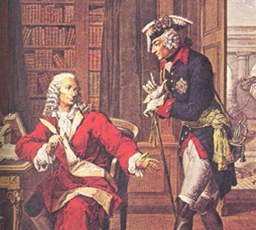
Government: Absolute Rule
Voltaire was a major supporter of Frederick the Great arguably the greatest German absolutist ruler
The best government is a benevolent tyranny tempered by an occasional assassination. --Voltaire
Voltaire believed in letting people
do and say what they wished as long
as they obeyed

Slide 59
Separation of Church and state
Voltaire thought the Church should really just stay out of the way of the state (the absolute ruler)
he did not believe in controlling the church for the uses of the government, but instead that the church should have no power over the people, although they may believe in the church if they wish to.

Slide 60
Quote on Separation of Church and state
“Those who can make you believe absurdities can make you commit atrocities.”
This quote is referring to “powerhouses” over all, but in specific the church and what it has made people do (the crusades) and what it can make you do (e.g. stand up to the government) which Voltaire was wholeheartedly against.

Slide 61
Fun Facts
Voltaire made his artist’s name “Voltaire”, by using code on his name and then it turned out as “Voltaire”
Voltaire was actually thrown out of Paris twice, the first time out of all of France!
Voltaire’s aforementioned quote “I disagree with what you say, but I will defend to the death your right to say it”, is actually not by Voltaire, but his biographer Evelyn Hall, who said it “in his place”

Slide 62
Bibliography
https://de.wikipedia.org/wiki/Voltaire
http://www.voltaire.ox.ac.uk/www_vf/about_voltaire/enlightenment.ssi
http://www.philosophybasics.com/philosophers_voltaire.html
http://www.csudh.edu/phenom_studies/western/lect_8.html
http://plato.stanford.edu/entries/voltaire/
http://www.uark.edu/depts/comminfo/freespeech/voltaire.html
https://ebooks.adelaide.edu.au/v/voltaire/portrait.jpg

Slide 63
Adam Smith and His Ideals
By Brendan and Oskar

Slide 64
Presentation table of contents
Thesis Statement
Basic biographical info of Adam Smith
Arguments in The Wealth of Nations
The division of labor
What the invisible hand is
The introduction of GDP
His arguments for free market
How/why he´s an Enlightened philosopher
What his impact has done
How are his ideals similar to other philosopher´s ideals
Bibliography
Conclusion

Slide 65
Thesis Statement
Adam Smith was an economic renegade.
By presenting his arguments, he changed how economics were run for centuries to come.

Slide 66
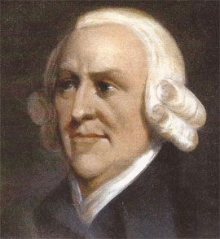
Basic biographical information about Adam Smith
Born on the 16th of June 1723, in Kirkcaldy (Scotland)
Died on the 17th of July 1790, in Edinburgh (Scotland).
https://ihb.io/wp-content/uploads/2014/02/Adam-Smith-IHB-News%E2%84%A2.jpg

Slide 67
Arguments in The Wealth of Nations
An Inquiry into the Nature and Causes of the Wealth of Nations, more commonly known as The Wealth of Nations, is made up of five books.
The point of these books is to give people a new and different perspective on economics, and a new system on how to run them.
In the first two books, he develops the idea of the division of labor.
In Book III, Smith writes about Great Britain’s social evolution of society in general, from hunting and gathering to international trade.
In his fourth book, Smith argues that the measure of a country’s wealth is the amount of goods and services that it produces.
In his last book, Adam Smith writes about what the proper work and tasks of a government are (defending the people of a nation, putting crime to justice, creating public services for the people).

Slide 68
The division of labor
The concept of the division of labor is pretty much the division of a job into many smaller jobs.
Workers are then assigned to these smaller jobs, which are easy to become specialized in.
Many people being employed to do specific small jobs means that people don’t have to switch to different tasks during the day, which saves time and money.
https://saylordotorg.github.io/text_masteringstrategicmanagement/section_13/0c692940ae42c922629f3d0c76907d90.jpg

Slide 69
The division of labor (continued)
Therefore, many people becoming specialized in their own line of work leads to higher efficiency, which leads to growth.
“When every individual person labors a-part, and only for himself, his force is too small to execute any considerable work”. (David Hume, 1739, A Treatise of Human Nature)
http://blogsdir.cms.rrcdn.com/91/files/2014/01/construction-worker-8-arms.jpg
http://lh6.ggpht.com/-YaBCe2dM36M/ULIR0IRDU-I/AAAAAAAAQgs/vYaglGuSxa8/india-

Slide 70
What is the invisible hand? How does it work?
The invisible hand is the natural market force that directs the free market to a positive outcome by trying to equalize the amounts of supply and demand.
The invisible hand is directed by multiple businesses competing out of self-interest.
These businesses will either lower their prices or increase the quality of their product to attract customers. When enough people want something, then the market will supply it to them.
Smith argues that these people working out of self-interest help benefit the public/nation, even if unintentionally.
“Every man lives by exchanging”. “Individual ambition serves the common good”.(both quotes by Adam Smith)
https://i.ytimg.com/vi/ulyVXau4wE/maxresdefault.jpg

Slide 71
The introduction of GDP
Gross Domestic Product (GDP) is one of the units used to measure the condition of an economy.
GDP does this by adding up all of the money that is earned by the production of goods and services.
Adam Smith proposed this system, in contrast to how the mercantile system measured the wealth of a nation.
The mercantile system of Adam Smith’s time thought that the measure of a country’s wealth was how much precious metals and other goods were in a country at a given moment.

Slide 72
Smith’s arguments for the free market
Smith wanted an economy/market where people could work hard out of self-interest, in whatever line of work that they chose.
Smith thought that the free market scenario catered to human nature, as people would work harder out of self-interest.
Furthermore, Smith thought that government intervention with the economy, through regulations, taxes, tariffs and monopolies did not favor the individual’s best interest.
This was because this intervention restricted an individual’s ability to work out of self interest, and guided them towards more specific jobs and lines of employment.

Slide 73
Arguments for the free market (continued)
Smith also said that people should be able to have more independence with what they bought, and his free market scenario (with multiple businesses competing) allowed this.
“Consumption is the sole end and purpose of all production; and the interest of the producer ought to be attended to, only so far as it may be necessary for promoting that of the consumer”.
(Adam Smith, The Wealth Of Nations, Book IV Chapter VIII, v. ii, p. 660, para. 49.)
https://upload.wikimedia.org/wikipedia/en/e/e2/French_Meadow_Bakery_logo.JPG
http://gdj.gdj.netdna-cdn.com/wp-content/uploads/2014/11/psd-logo-1.jpg

Slide 74
How/why he is an Enlightened thinker
Adam Smith is an Enlightened thinker because he proposed new theories, concepts and systems that were very different compared to how things were being run during his time.
He criticized many of the systems that were in place ad instead proposed new, fairer and more efficient systems.
His literary works embody Enlightened thought.

Slide 75
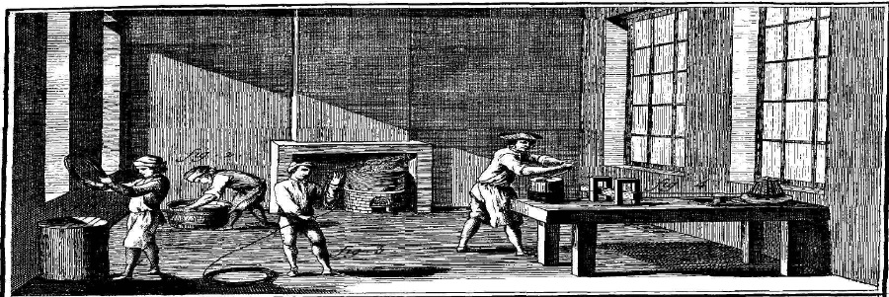
Adam Smith’s impact on the world
Adam Smith introduced a new system of economics and proposed how they should be run.
Adam Smith introduced the free market scenario, which is in use today and has been in use for centuries.
Adam Smith is also credited with introducing the division of labor, which is an efficient system that is also in use today.
His literary works created a new perspective on economics, and helped to influence many people into following them.
http://lf-oll.s3.amazonaws.com/titles/2437/EPINGLIER1-detail900.jpg

Slide 76
Philosopher’s with similar ideals to Smtih’s
Many people and physiocrats agreed with the general idea of “Laissez faire” that Adam Smith promoted (Vincent de Gournay, Rene Louis de Voyer de Paulmy d’Argenson, a bunch of other French physiocrats)
People also liked and supported his idea of the division of labor (Charles Babbage, factory owners)

Slide 77
Bibliography
http://www.acton.org/pub/religion-liberty/volume-9-number-4/adam-smith-and-virtues-enlightenment

Slide 78
Conclusion
Adam Smith was a revolutionary economics reformer of his time.
His ideas, based around human nature, were appealing and had a large impact on how economics were run.

Slide 79
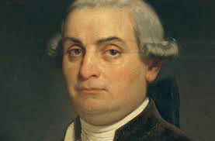
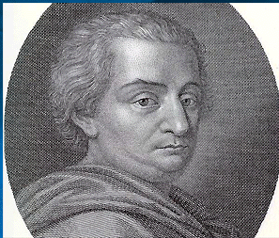
Cesare Beccaria
By Kenji Zaharchuk, Giovanni Sebastiano Caire, Bill Bodem

Slide 80
Table of contents
Thesis
Introduction to Beccaria
Central arguments
Punishment and torture
Death penalty
Beccaria’s theory
How does he embody enlightenment
What is his legacy
Who did he inspire/get inspired
What did he change today

Slide 81
Thesis Statement
Beccaria‘s ideas changed the criminal justice system by applying reason to it and challenging the government, thus taking away power from the government.
Here we will explore more deeply into the thoughts and achievements of Cesare Beccaria against the criminal justice system.

Slide 82
Introduction to Beccaria
Born in Milan, Italy on March 15th, 1738
Died Nov 28 1794
Received early education at the Jesuit college in Parma
Studied Baron de Montesquieu
Focused on criminal justice system
In his mid 20s Cesare joined an intellectual circle called the “Academy of Fists“
Became acquainted with other philosophers such as Hobbes, Diderot, Helvetius, Montesquieu, Hume, and Voltaire

Slide 83
Central arguments
Believed that punishment was part of society
The amount and type of punishment of criminal should be determined by the affect of the crime on the whole community.
Hated the idea of the death penalty

Slide 84
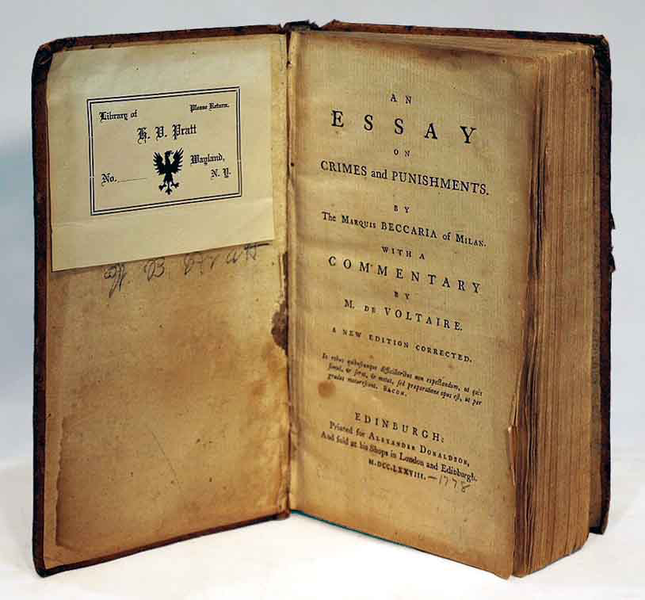
punishment and torture
Torture is a useless punishment
Published book On Crimes and punishment
Erned the title of “one of the most enlightened thinkers of his age”

Slide 85
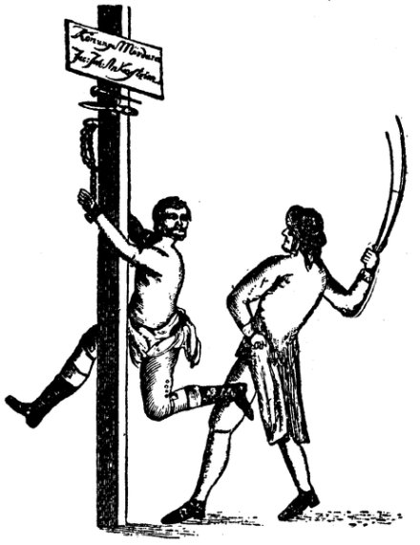
Death Penalty
State should not have the right to take lives
Not a usefull form of punishment
Chapter in On Crimes and punishments talks about death penalty
Defys social contract

Slide 86
Beccarias Theory
Three main legs…
1st all individuals posess free will
2nd all individuals rationally look out for their own personal satisfaction
3rd all individuals rationally look out for their own self interest, making them controllable

Slide 87
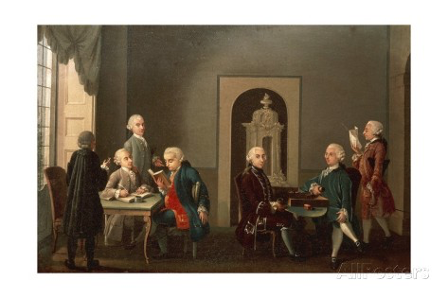
How does he embody enlightenment?
He thinks for all the people not only one point of view
He publishes books about crimes and jusctic
He joins the “academy of fists” to try and stop tortur
He writes an article on the coin

Slide 88
What is his legacy?
Deppressed from the french revolution
Abbandoned his family and friends
His influence with the world managed to partially shape the bill of rights and the constitution
He worked as an economist in the government

Slide 89
Who did he inspire/get inspired by?
Inspired founding fathers of America
Inspired the common people
Got inspired by Hobbes, JJ Rouseau, Voltaire, Montesquieu

Slide 90
How his ideas effect us today
Reformed most of the European justice systems
Reformed some in America

Slide 91
Sources
https://en.wikipedia.org/wiki/Cesare_Beccaria
https://en.wikipedia.org/wiki/On_Crimes_and_Punishments
http://www.biography.com/people/cesare-beccaria-39630
https://legacy.fordham.edu/halsall/mod/18beccaria.asp
http://study.com/academy/lesson/cesare-beccaria-theories-impact-jurisprudence.html

Slide 92
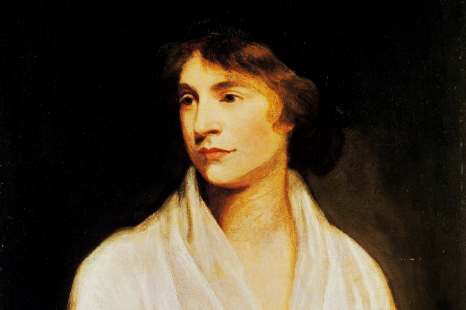
Mary Wollstonecraft
27 April 1759 – 10 September 1797
Jasper Vonderau, Linnea Noll, Helena Zeppos

Slide 93
Thesis Statement
Among the most revolutionary philosophers, Mary Wollstonecraft challenged many of the ideas about aristocracy and the rights of women.

Slide 94
“Virtue can only flourish among equals.”
- Mary Wollstonecraft

Slide 95
The Vindication of the Rights of Men
In the Vindication of the Rights of Men Wollstonecraft argues against aristocracy. A few things she wants to change are:
That a common man should be able to use public offices without making money contributions of any type
All members of society should be able to vote
Criminal punishment in England

Slide 96
"I do not wish them (women) to have power over men, but over themselves." -Mary Wollstonecraft

Slide 97
The Vindication of the Rights of Women
In the Vindication of the Rights of Women Wollstonecraft has quite a few main arguments. The most important arguments are:
Women are not just wives, mistresses and mothers
Women deserve to have their virtues and thoughts respected.
Women do not recognise their power, which becomes an “artificial weakness”.

Slide 98
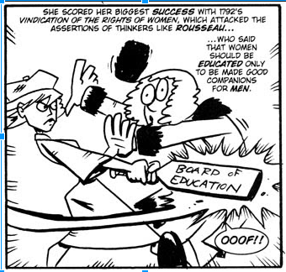
Political Cartoon

Slide 99
“Unfortunately, Mary Wollstonecraft’s arguments, dated though they may be, have more than historical importance, for her particular battle has not altogether been won.”- Carolyn W. Korsmeyer

Slide 100
Concluding Slide
From our studies we can see that Mary Wollstonecraft was a very important philosopher. Some of her ideas of women's rights have helped shape our world today. She took old ideas, found faults in them and challenged them to be changed for the better. Mary Wollstonecraft was one of the most radical philosophers, and should be remembered because of it.

Slide 101
Bibliography
https://en.wikipedia.org/wiki/Mary_Wollstonecraft
http://departments.kings.edu/womens_history/marywoll.html
http://plato.stanford.edu/entries/wollstonecraft/
https://en.wikipedia.org/wiki/A_Vindication_of_the_Rights_of_Woman
http://www.umich.edu/~ece/student_projects/wollstonecraft/vindicationm.html
http://www.csun.edu/~djl73050/ws300/legacy.html
https://en.wikipedia.org/wiki/A_Vindication_of_the_Rights_of_Men
http://bodyandbeing.lmc.gatech.edu/bab_wiki/index.php/A_Vindication_of_the_Rights_of_Men
http://history.hanover.edu/courses/excerpts/111wollstone.html
http://images.google.de/imgres?imgurl=http://1.bp.blogspot.com/_7S6koRX0l1w/RuHeo8KmfzI/AAAAAAAABbI/H7cNM5kVPTw/s400/MaryW.jpg&imgrefurl=http://gadsircomics.blogspot.com/2007_09_01_archive.html&h=323&w=340&tbnid=_rh6C-SNjPbtyM:&docid=kCGu_qjZiEofTM&ei=E4JYVs6VMKG6ygOM_L7gAQ&tbm=isch&iact=rc&uact=3&page=1&start=0&ndsp=18&ved=0ahUKEwiO68m2gLHJAhUhnXIKHQy-DxwQrQMILTAF
http://ir.uiowa.edu/cgi/viewcontent.cgi?article=1247&context=ijls

Slide 102
Thanks For Watching our Presentation!

