Slide 1
The Enlightenment: Constructing a New Paradigm of Man and Society
Mr. Daniel Lazar

Slide 2
Lecture Outline
Operational Definition
The Road to Enlightenment
The State of Nature
Enlightened Governance
Enlightened Economics
Enlightened Education
Enlightenment vs. Religion
Challenges to Enlightenment

Slide 3
Operational Definition: What is Enlightenment?
“Enlightenment is man’s emergence from his self-incurred immaturity...The motto of Enlightenment is Sapere Aude [dare to know]: have courage to make use of your own understanding.”
-Immanuel Kant from “Answering The Question: What Is Enlightenment” (1784)

Slide 4
Operational Definition: What is Enlightenment?
Principal goals of Enlightenment thinkers were liberty, progress, reason, tolerance, and ending the abuses of church and state
German - Aufklärung
French - Siècle des Lumières (Century of Enlightenment)
The Era
Begins?
1637 - Descartes' Discourse on Method
1687 - Isaac Newton's Principia Mathematica
Ends?
1789 – French Revolution
1804 – Napoleonic Wars

Slide 5
The Road to Enlightenment
Medieval worldview: Nature was perceived to be a hierarchy of beings ascending from inanimate material, to lower life forms, to man, finally reaching spiritual beings (e.g. saints and angels) residing with God in heaven.
Similarly, the social structure was an ascending hierarchy from the peasants to the nobles and the priests who had spiritual responsibilities

Slide 6
The Road to Enlightenment
Newton and his predecessors shook the medieval view of nature.
Newton had shown:
1. Nature was guided by natural laws.
2. These laws are discoverable through human reason.
The philosophes added another corollary. Man is a part of nature; therefore man must follow natural laws as well.

Slide 7
The Road to Enlightenment
“Nature and nature's laws lay hid by night; God said let Newton be and all was light.”
- Alexander Pope (1688-1744)

Slide 8
Man in the State of Nature
The philosophes conceptualized an imaginary "State of Nature," prior to the historical development of family, language, custom, government, or religion.
The philosophes tried to imagine a secular "Garden of Eden," a time when humans were, in a sense, "naked."
In this sense, the Enlightenment was universalistic in believing that all humans are members of the same "natural family," thus basically sharing the same aptitudes, desires, and needs. Men are equal.
The philosophes tried to "take man's clothes off."
Varying cultural practices— religion, diet, values, traditions— were seen as secondary.
The philosophes wanted to probe underneath these superficial qualities to determine who we are

Slide 9
Man in the State of Nature
Human nature is "ruggedly individualistic." We were once completely free, answering only to our own needs, not socially bound to family, society, or government. Every person was his own monarch.
Individual freedom also entailed political anarchy. What happens if two basically equal autonomous human beings reach for the same apple? How was such conflict to be resolved?
As Thomas Hobbes stated, “Life was nasty, brutish, and short.”
Thus Rousseau posed a "social contract."

Slide 10
Man in the State of Nature
"Man being, by nature all free, equal, and independent, no one can be put out of his state of nature and subjected to the political will of another without his own consent, which is done by agreeing with other men, to join and unite into a community (social contract) for their enjoyment of their personal properties.”
-John Locke

Slide 11
Man in the State of Nature
The fewer rules the better. "The best society is the society that governs the least."
A valid social contract will preserve, in a sense, the original state of nature as much as possible.. Hence the social contract was to protect "life, liberty, and property "— the Enlightenment secular trinity.
Do these institutions as they presently exist promote life, liberty, and the pursuit of happiness? If they do not serve well these ideals, they should be significantly modified, reformed, or even abolished.
Even the best religion should “govern least”: "To worship God and to leave every other man free to worship Him in his own way— this is my religion." (Voltaire)

Slide 12
Man in the State of Nature
“Man is not born wicked; he becomes so in the same way that he becomes sick.”
-Voltaire

Slide 13
Enlightened Governance
Enlightenment thinkers did not believe divine right. So where should governmental authority come from?
power is derived from the people
the establishment of government is a contract between the governed and those who govern.

Slide 14
Enlightened Governance
No consensus on Enlightened governance
Voltaire and Hobbes called for enlightened despotism.
Locke, Jefferson, and Montesquieu argued for the separation of powers and constitutional checks and balances
Rousseau, the most radical among them, argued that democracy was the most suitable form of government, for it would allow all citizens to equally participate in promoting the "general will"

Slide 15
Enlightened Governance
“We each of us place, in common, his person and all his power under the supreme direction of the General Will; and we receive into the body-politic each member as an indivisible part of the whole...In this form of association the person and property of each individual, while united with all, shall obey only himself, and remain free...”
-John Jacques Rousseau, The Social Contract

Slide 16
Enlightened Governance
“Man being, by nature all free, equal and independent, no one can be put out of this state and subjected to the political will of another without his own consent, which is done by agreeing with other men, to join and unite into a community for their enjoyment of their personal properties...”
-John Locke, Two Treatises on Government

Slide 17
Enlightened Governance
“When in the course of human events, it becomes necessary for one people to dissolve the political bonds which have connected them with another, and to assume among the powers of the earth, the separate and equal station to which the laws of nature and nature's God entitled them...We hold these truths to be self-evident, that all men are created equal, that they are endowed by their Creator with certain inalienable Rights, that among these are Life, Liberty and the pursuit of Happiness. That to secure these rights, governments are instituted among men, deriving their just powers from the consent of the governed. That whenever any form of government becomes destructive of these ends, it is the right of the people to alter or to abolish it, and to institute new government, laying its foundation on such principles and organizing its powers in such form, as to them shall seem most likely to effect their safety and happiness.”
-Thomas Jefferson, Declaration of Independence

Slide 18
Enlightened Political Economy
In Wealth of Nations, Adam Smith argues that the best way to release the productive energies of a people/nation is through a governmental policy of laissez-faire.
Marketplace forces of supply and demand are the natural, hence correct mechanisms that determine wages, prices, and the kind of goods that a society produces.
Royal monopolies, tariff restrictions, quotas, craft-guilds, fixed prices, etc. are all inefficient and harmful practices which restrict economic freedom and, thus, the growth of a nation's wealth.
By allowing each person to freely pursue his own economic interests will ultimately benefit the society as a whole.

Slide 19
Enlightened Political Economy
“It is not from the social compassion of the butcher, the brewer or the baker that we expect our dinner, but from their regard to their own self-interest...”
-Adam Smith

Slide 20
Enlightened Political Economy
“Every individual is continually exerting himself to find the most advan­tageous employment of whatever wealth he can command. But in the pursuit of his own individual gain, without the interference of governmen­tal intervention, his individual actions will ultimately, through the invis­ible law of supply and demand, most advantageously benefit the society as a whole...”
-Adam Smith

Slide 21
Enlightened Education
Prior to the Enlightenment, education was in the hands of the church. Students were not seen as children, but as small, sinful, ignorant adults
The rod, rote memorization, and hard benches.
Curricula derived from Scriptures and a few classical texts.
Teacher stood before the class with absolute authority
Locke and Rousseau argued that bad environments, not bad children, are the true source of ignorance and human underdevelopment.
Rousseau argued that traditional education had failed because it treated children as mini adults; curriculum should be built around a child's intellectual, physical, and emotional development.

Slide 22
Enlightenment vs. Religion
The power of science—Newton had revealed the universe to be guided by natural laws. As Galileo commented, "Where is God? Well, he's not up there, spinning the universe like some vast toy."
Increasing awareness of a wider world in the Age of Exploration
Maturing historical scholarship probed into the Christian past with increasingly antagonistic sophistication (e.g. Gibbon's Decline and Fall of the Roman Empire)
Widespread disgust with the fanaticism of the religious conflicts of the late 16th and early 17th centuries.
18th century was a time of prosperity and relative peace. Wars were limited in scope and short in duration. It seems to be an anthropological-psychological fact that times of crisis turn people's eyes to the heavens. Hence the inverse also seems to be true.

Slide 23
Enlightenment vs. Religion
Enlightenment philosophes were suspicious of religion.
The Reformation had produced 150 years of religious and political conflict, the philosophes argued for
religious
separation of church and state
atheism
deism - God was a Great Clock-Maker
the new heaven: "perfectibility of man"
Jesus was viewed primarily as an ethical teacher, a moral philosopher closer to Socrates than the Hebrew prophets

Slide 24
Enlightenment vs. Religion
"A miracle is a violation of the laws of nature and therefore cannot happen."
-David Hume
"Theology amuses me, for there we find man's insanity in all its abundance."
-Voltaire

Slide 25
Enlightenment vs. Religion
"I do not find in Christianity one redeeming feature... " -Thomas Jefferson
"What has been Christianity's fruits? Superstition, bigotry, and persecution."
-James Madison
"Religion is excellent stuff for keeping the common people quiet..."
-Napoleon

Slide 26
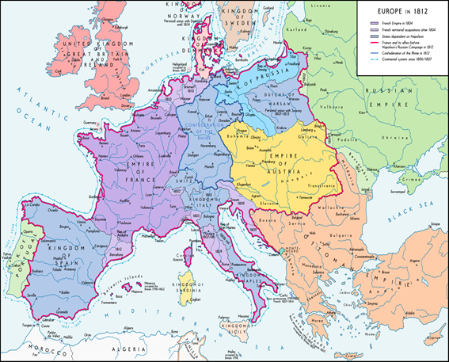
The Revolutionary Challenge to Enlightenment

Slide 27
The Romantic Challenge to Enlightenment
Enlightenment | Romanticism
Science | Anti-Science
Knowledge | Feeling + Experience
Reason | Imagination
Technology | Literature and Painting
Machinery | Nature
Power | Love
Control | Harmony
Man | God

Slide 28
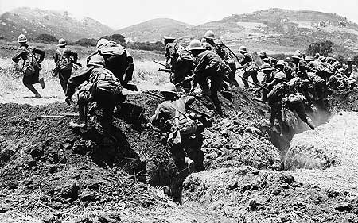
Crisis: World War I

Slide 29
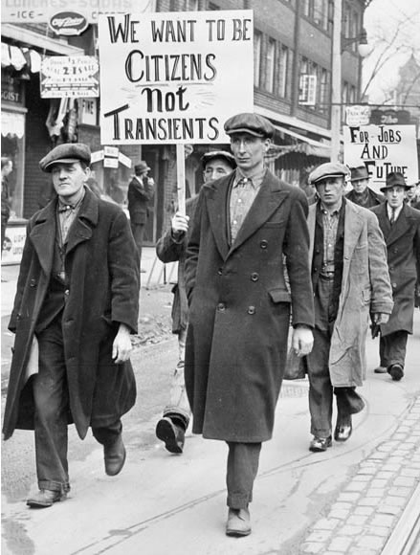
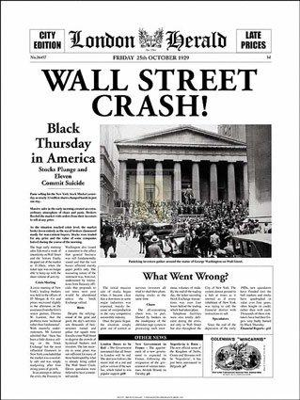
Crisis: Wall St. Crash & Great Depression

Slide 30
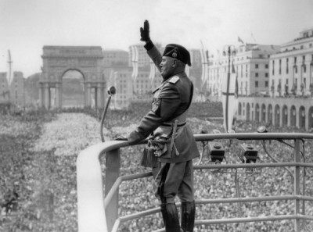
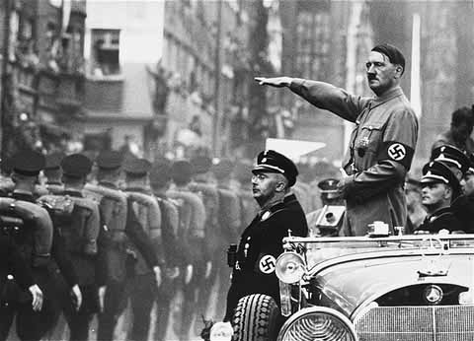
Crisis: Rise of Fascism in Europe

Slide 31
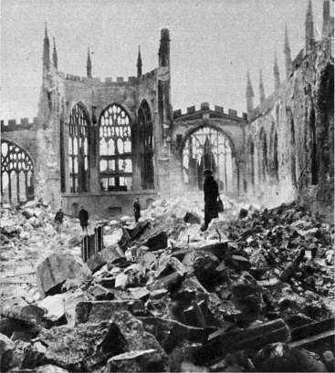
Crisis: World War II

Slide 32
The Postmodern Challenge to Enlightenment
Industrialism, Imperialism, Depression, Fascism, WWI, WWII.
“...we [have] set ourselves nothing less than the discovery of why mankind, instead of entering into a truly human condition, is sinking into a new kind of barbarism.”
“...the Enlightenment has always aimed at liberating men from fear and establishing their sovereignty. Yet the fully enlightened earth radiates disaster triumphant.”
-Adorno & Horkheimer, Dialectic of Enlightenment (1944)

