Slide 1
Quiz Crash Course
Presidential vs. Parliamentary Systems
Bureaucracy and the Iron Triangle
Why Parties and Elections in Authoritarian Regimes?

Slide 2
Presidential | Parliamentary
More checks and balances | Leg and Exec ‘fused‘
Gridlock/stalemate | Usually faster moving. But when many parties in legislative, stalemate can ensue
President as head of executive branch only | PM as head of party and ‘Primus inter pares‘
Exec is elected | Exec is appointed. (S)he is an MP
Cabinet NOT legislators | PM cabinet made of MPs
Less party discipline –the tendency of a legislator to vote with his/her party. In presidential systems, legislators more likely to identify with their individual constituency interests, or other regional, ethnic or ideological interests | Party discipline. Party whips
No Confidence votes | Votes of confidence
U.S., Mexico, Nigeria | UK, Iran(?)
→Hybrid Systems: Russia, China, Iran (?)

Slide 3
Bureaucracy
Merriam Webster’s Definition of Bureaucracy:
a body of unelected government officials, an administrative policy-making group
government characterized by specialization of functions, adherence to fixed rules, and a hierarchy of authority
a system of administration marked by officialism and red tape

Slide 4
Max Weber (1864-1920) & The Functions of Bureaucracy
Bureaucratic coordination of activities is a mark of the modern era.
Through bureaucracy, heads of state can mobilize and centralize political power, which in feudal times, had been dispersed in a variety of centers.
Bureaucracies are organized according to rational principles. Offices are ranked in a hierarchical order and their operations are characterized by impersonal rules.
Bureaucratic types of organization are superior to other forms of administration, much as machine production is superior to handicraft methods.

Slide 5
Max Weber (1864-1920) & The Functions of Bureaucracy
Ideal Traits of Bureaucracy:
Hierarchy of authority
Goal Directed
Impartial, Impersonal
Apolitical Non-Ideological
Written rules of conduct
Standardized procedures
Promotion based on achievement
Specialized division of labor
Efficiency

Slide 6
Max Weber (1864-1920) & The Functions of Bureaucracy
"From a purely technical point of view, a bureaucracy is capable of attaining the highest degree of efficiency, and is in this sense formally the most rational known means of exercising authority over human beings. It is superior to any other form in precision, in stability, in the stringency of its discipline, and in its reliability."
"The needs of mass administration make it today completely indispensable. The choice is only between bureaucracy and dilettantism in the field of administration" (Weber)

Slide 7
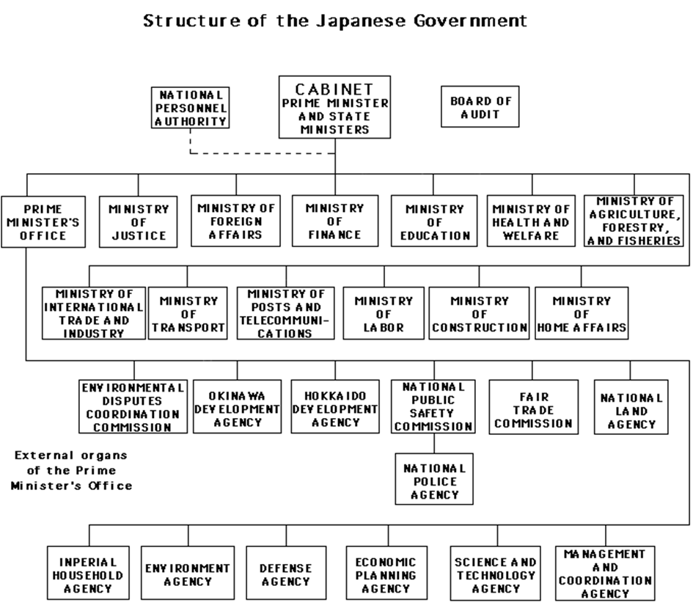

Slide 8
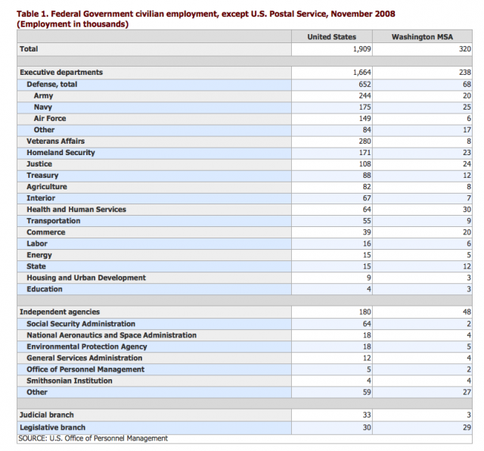

Slide 9
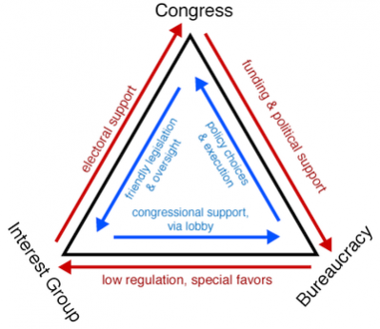
The Iron Triangle

Slide 10
Dysfunctions of Bureucracy
Unaccountable
Inflexible
Impersonal
Slow
Undemocratic (?)

Slide 11
Dysfunctions of Bureucracy
“Bureaucracy is the death of all sound work” (Einstein)
“A bureaucracy is sure to think that its duty is to augment official power, official business, or official members, rather than to leave free the energies of mankind; it overdoes the quantity of government, as well as impairs its quality. The truth is, that a skilled bureaucracy is, though it boasts of an appearance of science, quite inconsistent with the true principles of the art of business’’ (Bagehot)
“Every revolution evaporates and leaves behind only the slime of a new bureaucracy.” (Kafka)
“More harm was done in the 20th century by faceless bureaucrats than tyrant dictators.” (Thomas Sowell)

Slide 12
Why Parties and Elections in Authoritarian Regimes?
A substantial majority of authoritarian governments hold elections, devote substantial resources to its support party, and spend heavily on pre-election political campaigns
Questions
If party formation is not motivated by the need to compete effectively in order to win elections why are they created and maintained?
What benefits do these institutions to provide for the authoritarian leaders who choose them?
Whose interests, exactly, do they serve?

Slide 13
The Routes to Authoritarianism
3 ways that authoritarian regimes come to power
They defeat incumbents in a revolutionary insurgency or civil war.
Via internal transformation of a constitutional government. Elected ruling parties or leaders can engineer rule changes that outlaw opposition parties, tilt the electoral playing field, and close or purge non-executive branches of government.
The most common means of seizing power is the military coup

Slide 14
Why Parties and Elections in Authoritarian Regimes?
Focus: uses of parties and elections during periods when dictators are not challenged by mobilized mass opposition or irresistible outside pressures.’

Slide 15
Functions of Parties in Authoritarian Regimes
Parties and elections are central elements in a personal survival strategy
Official party names, platforms, and ideologies claim a broader and more impersonal purpose than support for particular leaders
Parties can end up prolonging the life of authoritarian regimes not just particular leaders
Parties can counterbalance the power of the military or other internal government factions
Easier for party workers to mobilize mass demonstrations to support the dictator
Authoritarian parties often distribute benefits to citizens and spread the regime’s ideology or policy views, as means of building popular support for the government.

Slide 16
Functions of Parties in Authoritarian Regimes
Elite recruitment and patron-client relations:
Provide officials and volunteer activists with benefits that give them a stake in the regime.
Patron-Client Network - Parties have preferential access to jobs in the state bureaucracy and schooling for their children.
Party workers often draw salaries.
Parties provide insider opportunities to form businesses subsidized by the government, manage or even take ownership of expropriated businesses or land.

Slide 17
Functions of Parties in Authoritarian Regimes
Organization & Education
extending the government’s reach into outlying districts
distribute resources that ensure loyalty of citizens
create routine ways of choosing lower level officials
provide an essential channel of information from ordinary people to the government
educate and socialize citizens to support the ideology and economic strategy of the regime

Slide 18
Elections in Authoritarian Regimes
Like parties, elections also deter challenges to the dictator from elite rivals. Overwhelming victories at the polls demonstrate to potential civilian rivals that they have little hope of defeating the incumbent
Elections alert the incumbent to strength of opposition
Elections are easy to rig

Slide 19
Data
Nearly all single-party regimes hold regular national elections
Some military regimes hold regular elections, and 1/4 of them held at least some elections
Authoritarian regimes that hold regular elections last longer than those that do not
Military regimes that hold regular elections last more than 3x longer than those that hold no elections

Slide 20
Questions (PRI-Related)
Why spend so much campaigning and buying votes when everyone knows how the election will come out, and fraud can be used if there are any surprises?
Why did PRI leaders think they needed supermajorities?
Why expend so much effort on achieving real supermajorities when fraud would be so much cheaper and there is no real impediment to using it?
Why does some version of minimum winning coalition logic apparently not hold in authoritarian regimes, which notoriously rely on divisible goods to build support?

