Slide 1
The Reagan Administration
1981-1989
Mr. Daniel Lazar

Slide 2
Reagan Administration Lecture Outline
Domestic Arena
International Arena
Elections
“Reaganomics”
Culture Wars
Other
Central America: Nicaragua, Grenada, El Salvador
Middle East: Lebanon, Iran-Iraq, Israel
South Africa
USSR

Slide 3
Election of 1980: Overview
Carter survived primary challenge from Senator Edward Kennedy.
Republicans nominated Ronald Reagan of CA
  Was a New Deal Democrat
  B-grade movie star in 1940s
  President of SAG during HUAC Crisis
  TV Spokesman for General Electric in 1950’s. Got rich.
  Became a Republican in 1962
  CA governor 1967-75
John Anderson, R-IL, third party ticket. Rockefeller Republican.

Slide 4
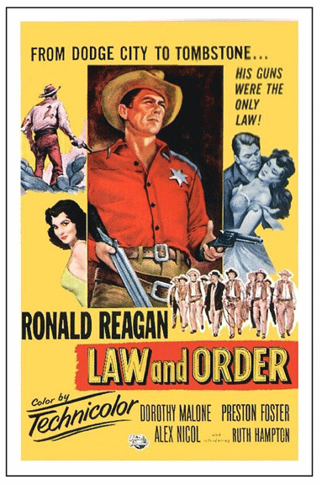
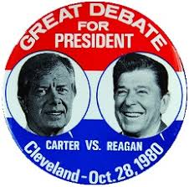

Slide 5
Election of 1980: Carter’s Uphill Climb
Platform
  Alternative Energies
  Supported ERA
  Combat “double digit” inflation
  Charged that Reagan was a war-monger (The LBJ move on Goldwater)
Liabilities:
  “Malaise Speech”
  Lacked Reagan’s charisma and humor
  His record
  Iran crisis
  Soviets in Afghanistan

Slide 6
Election of 1980: Reagan Platform
Shift from federal to state power
Reduce government spending and taxes; end “failed social engineering” of the New Deal consensus
“Traditional American values”: family, religion, patriotism.
  Vigorous support from the “New Right”
Channeled anger of mainstream white America at: minorities, affirmative action, immigrants, feminists, taxes, big government
Increase military spending. End détente. Renew/end Cold War.

Slide 7
Election of 1980: Results
Reagan d. Carter 489 to 49. Reagan won 44 states
Reagan 51%; Carter 41%; Anderson 7%.
  6th best Third Party Result (TR, LaFollete, Wallace, Perot twice)
House: D – 243; R - 193 (R+34)
Senate: R – 53; D - 46 (R+12)
Carter first President to be unseated by voters since Hoover.
Reagan, 69, oldest President in USH (Trump 70)

Slide 8
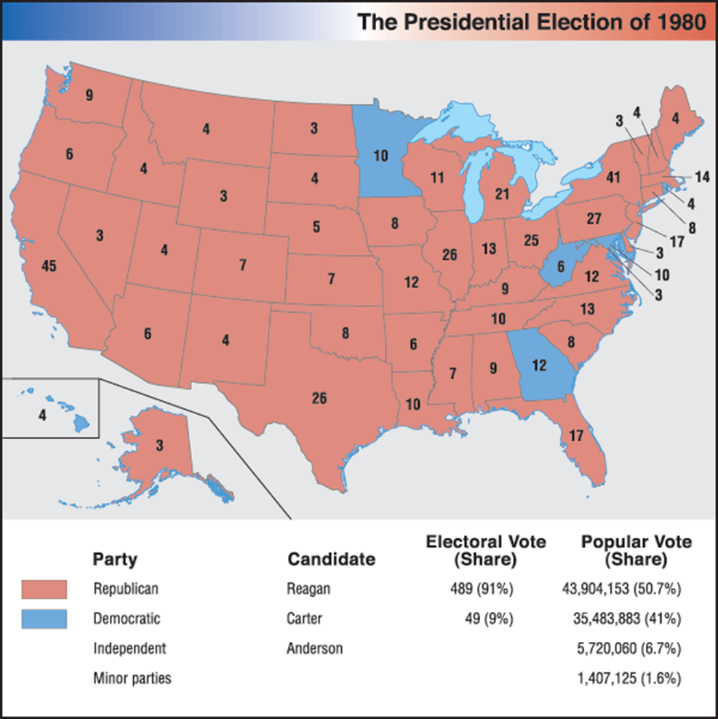

Slide 9
Election of 1980: Realigning
New Deal Coalition
Urban North
Democratic South
African-Americans
Union members
Immigrants and newer ethnic groups
Farmers
Reagan Coalition
White Southerners
Midwest small towns
Evangelicals
Wealthiest Americans
Yuppies
Blue Collar in North and Midwest (union and non-union)
Foreign policy Hawks

Slide 10
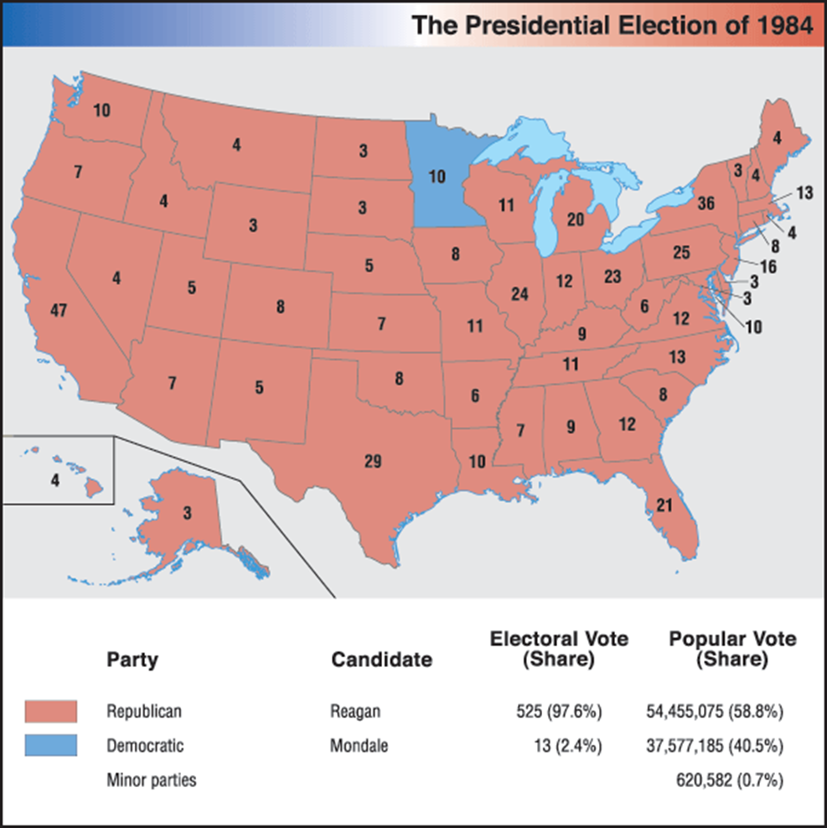
Versus Mondale (D-MN)
  Geraldine Ferraro VP
D Keep House (R + 16)
R Keep Senate (D +2)

Slide 11
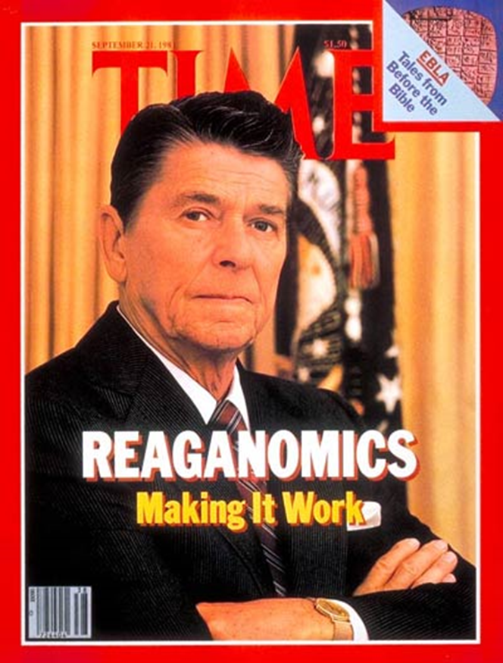
Reaganomics: Context
By way of introduction/reminder: 20th Century Cycle: From TR to Reagan…and Beyond
Conservative backlash to the New Deal Consensus (Keynesian economics)
  Myths vs. realities of welfare state
Stagflation in 1970’s
Globalization

Slide 12
Reaganomics: Goals of Reaganomics / Supply Side Economics / “Trickle Down” Economics
Four Goals:
1. Cut government spending
    Middle Class Programs Protected (SS, Medicare)
    Lower Class Programs Slashed (Medicaid, AFDC, food stamps, mass transit, job training…)
2. Cut federal income tax and capital gains tax
3. Cut government regulation
4. Tighten money supply in order to reduce inflation

Slide 13
Reaganomics: Deregulation
Ideological vs. Non-ideological thinking about regulation
PACs, Lobbying, and growth of powerful multinationals
Case Study: Savings and Loan Industry (S & Ls)
  Thrifts are banking institutions that invest in real estate, sometimes risky estate.
  Thrifts deregulated in 1980 and again in 1982. Gave thrifts more capabilities without more gov regulation (no FDIC oversight). S&L assets grew by over 50% in early 80’s.
  A wave of mergers, acquisitions and leveraged buyouts left companies saddled with heavy debt. Filed bankruptcy to escape debt.
  1 in 3 S&Ls failed by 1989; Taxpayers forced to bailout over $500 mil worth of thrift failures.

Slide 14
Reaganomics: Deregulation
Case study: Environmental Deregulation
  James Watt - Secretary of the Interior, 1981-83
  Cut EPA budget 18%
  Toxic Dumping, Oil Drilling, Pollution, Ozone…
  Sold public land to private investors, opened continental shelf to oil drilling
  "I do not know how many future generations we can count on before the Lord returns, whatever it is we have to manage with a skill to leave the resources needed for future generations.“
  Time Magazine Top 10 worst Cabinet appointments in US History
    He later was found guilty of 25 counts of perjury, obstruction, and influence peddling while at HUD

Slide 15
Reaganomics: Unions
1981 – 13,000 PATCO workers went on strike
  Federal employees can’t strike
  They wanted higher pay and a 32 hour week
  11,000 PATCO members fired (2000 went back to work)
  Put the military in charge of ATC
  Banned PATCO from federal employment for life (Clinton reversed)
  Union was bankrupted and decertified
De-unionization: shift to white and pink collar work
Symbolic Impact: PATCO supported Reagan in 1980 election. He took a strong stand. Set a tone early in his presidency.

Slide 16
Reaganomics: Tax Cuts
Economic Recovery Tax Act of 1981
  Lowered top marginal tax bracket from 70% to 50%; lowest bracket from 14% to 11%.
  Cut estate taxes and corporate taxes $150 billion, 1981-1986
  Reduced the maximum capital gains rate to only 20% – lowest since Hoover
Tax Reform Act of 1986
  Lowered highest marginal rate to 28%
  Simplified tax system by eliminating many deductions and reducing the number of tax brackets.

Slide 17
Reaganomics: Summary
Department of Defense budget rose from
  $267.1 billion in 1980 (4.9% of GDP and 22.7% of public expenditure) to
  $393.1 billion in 1988 (5.8% of GDP and 27.3% of public expenditure)
U.S. borrowed domestically and abroad to cover deficits, raising the national debt from $997 billion to $2.85 trillion.
  U.S. went from being the world's largest creditor nation to the world's largest debtor. Government pays interest on debt.
  Reagan called this his “greatest disappointment”
Unemployment rate rose from 7% in 1980 to 11% in 1982, then declined to 5% in 1988.
Inflation rate declined from 10% in 1980 to 4% in 1988
508 point Dow crash (23% decline) in 1987

Slide 18
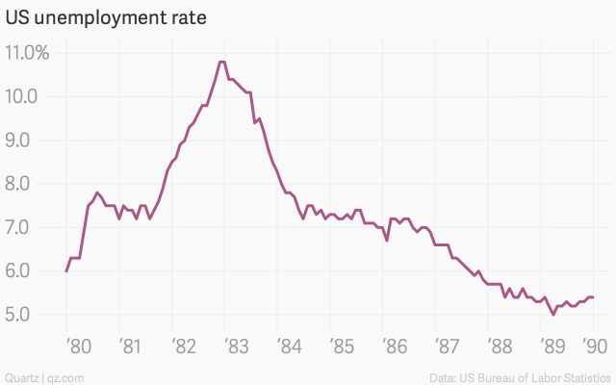
Reaganomics: Unemployment

Slide 19
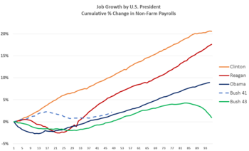
Reaganomics: Job Growth
Job growth by U.S. President, measured as cumulative percentage change from month after inauguration to end of term. Reagan was second only to Clinton post-1980.

Slide 20
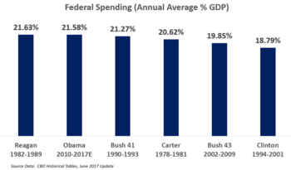
Reaganomics: Spending
Reagan spent the most of any recent President, measured as annual average % GDP.

Slide 21
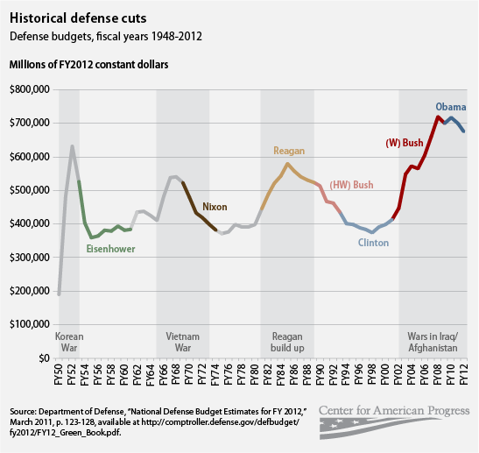
Reaganomics: Defense Spending
SDI or “Star Wars”
Deterrence
“Starved USSR”?
1 million to “Stop the Madness” in Central Park

Slide 22
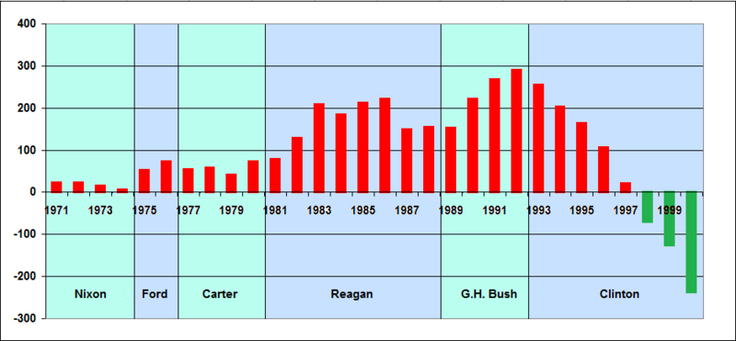
Reaganomics: Budget Deficit in $Bil

Slide 23
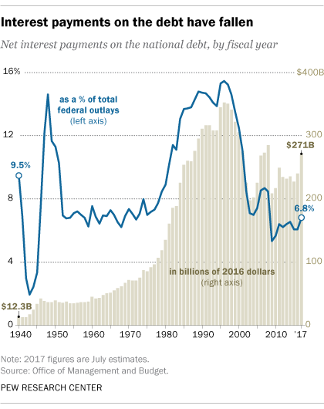
Reaganomics: Interest on Debt

Slide 24
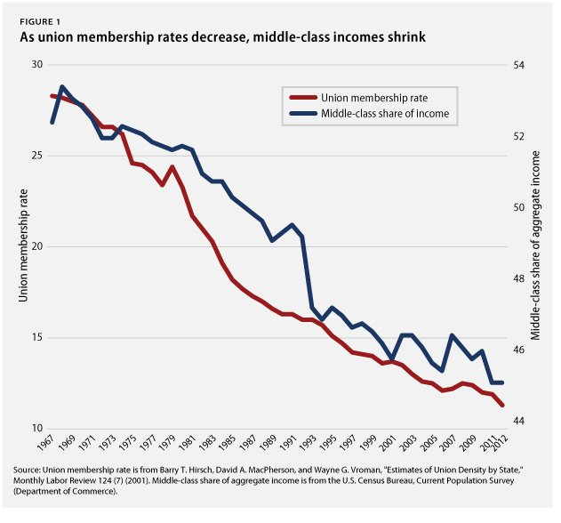
Reaganomics: Unions

Slide 25
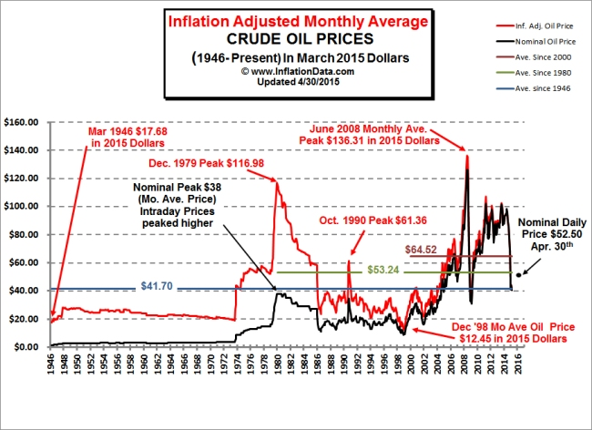
Reaganomics: Oil Prices

Slide 26
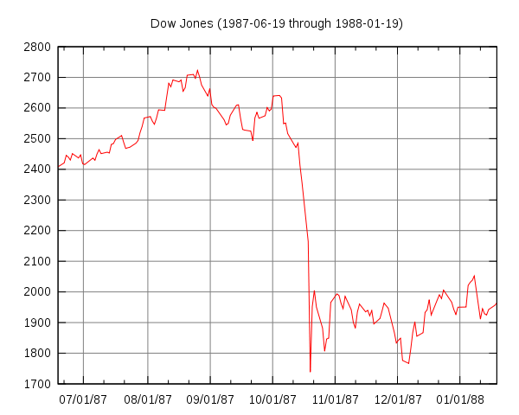
Reaganomics: The Dow Jones

Slide 27
The New Right
Moral Majority, The Christian Coalition
Jerry Falwell, Pat Robertson, Bob Jones, Oral Roberts, Jim Bakker
Evangelical Think Tanks: Family Research Council, Witherspoon Institute
Evangelical Colleges: Liberty U, Bob Jones U, Oral Roberts U
Pro: school prayer, harsh sentencing, conversion, “family”
Anti: pornography, homosexuality, ERA, divorce, abortion, affirmative action, secularism, socialism
Powerful Political Action Committees. 4 million members. 2 million donors.
Televangelism
Third Great Awakening?

Slide 28
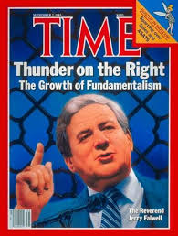
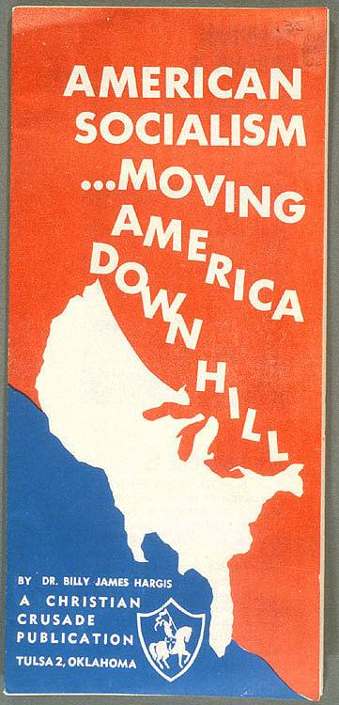
The New Right

Slide 29
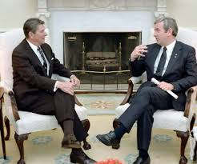
A New Right Case Study: Jerry Falwell
1933-2007
Pastor, televangelist, activist
1966 – Founded Liberty Christian Academy as a segregation academy in VA
1971 – Founded Liberty U
IRS does not offer tax-exempt status for segregated institutions
1973 – Roe v. Wade
1994 – Distributed a video claiming Bill Clinton was part of a murder conspiracy

Slide 30
A New Right Case Study: Jerry Falwell
On Brown Ruling: “If Chief Justice Warren and his associates had known God's word and had desired to do the Lord's will, I am quite confident that the 1954 decision would never had been made. The facilities should be separate. When God has drawn a line of distinction, we should not attempt to cross that line.”
"I listen to feminists and all these radical gals... These women just need a man in the house. That's all they need. Most of the feminists need a man to tell them what time of day it is and to lead them home. And they blew it and they're mad at all men. Feminists hate men. They're sexist. They hate men; that's their problem.“ (1974)

Slide 31
A New Right Case Study: Jerry Falwell
In an effort to stop Florida from passing a law that would bar discrimination against gay Americans, “Gay folks would just as soon kill you as look at you.“
“AIDS is not just God's punishment for homosexuals, it is God's punishment for the society that tolerates homosexuals.“
Falwell blamed 9/11 on “the pagans, and the abortionists, and the feminists, and the gays and the lesbians….who have tried to secularize America. I point the finger in their face and say 'you helped this [9/11] happen.'"

Slide 32
Other Important Domestic Notes
1981 - John W. Hinckley Jr. shot Reagan, his press secretary, and Jim Brady, a Secret Service agent
1981 - AIDS crisis
1981 – First IBM PC released
1986 - Christa McAuliffe became the first civilian sent to space. Challenger Exploded.
1986 – Chernobyl meltdown
1986 - Immigration Reform and Control Act, aka the Reagan Amnesty

Slide 33
Other Important Domestic Notes
White Backlash:
  Affirmative Action (1978 Bakke case)
  “Welfare Queens”
Reagan/Bush appoint 4 SC justices
War on Drugs continues - crack cocaine epidemic
Population shift from NE and MW Frostbelt to SW Sunbelt
  Deindustrialization
  Lower taxes
  Retirees
  Further fostered resurgence of conservatism.

Slide 34
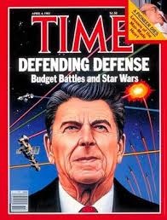
Foreign Policies of the Reagan Administration
Contents:
Central America: Nicaragua, Grenada, El Salvador
Middle East: Lebanon, Iran-Iraq, Israel
South Africa
USSR
Reagan Doctrine: US will provide overt and covert aid to resistance movements in an effort to “roll back“ communism

Slide 35
Reagan Foreign Policies: Context
In a post-Vietnam Cold War context: When is it justified to intervene in the affairs of another country?
Promote Capitalism / Stop Communism?
Keep Peace?
Promote Human Rights?
Promote Democracy?
Promote Stability?
Stabilize global oil supply?
Fulfill promises of predecessors?

Slide 36
Reagan Foreign Policies: Context
In a post-Vietnam Cold War context: What means can a nation adopt to intervene?
Soft Power
Economic: sanctions, aid, boycotts
Political: engagement and disengagement / recognition vs. non-recognition
Overt vs. Covert
Military
  Unilateral vs. Multilateral

Slide 37
Reagan Foreign Policies: Context
General Notes on Foreign Policy in the post-Vietnam Era:
Vietnam Syndrome
War Powers Act
US national interests are the primary concern
Creating stability is essential to global powers
Humanitarianism matters
Good versus Evil mentality
Heated nuclear world
Increasingly inter-dependent world

Slide 38
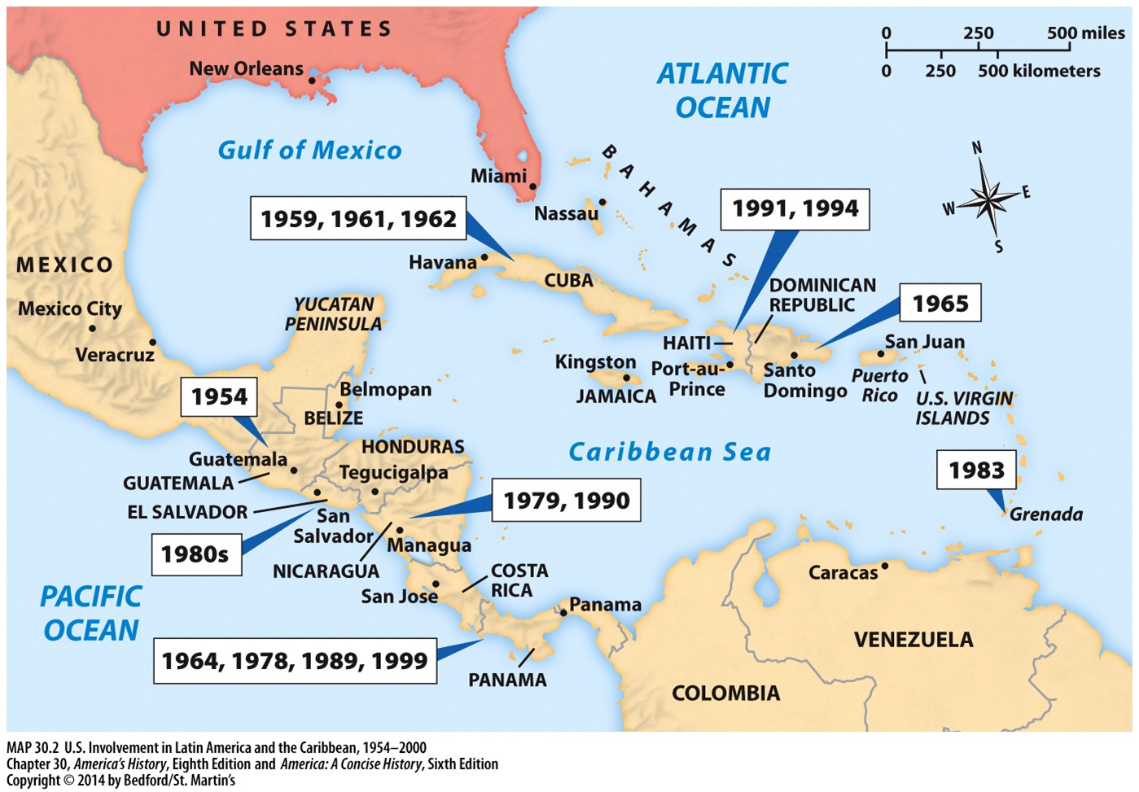
Reagan Foreign Policies: Central America
Nicaragua
Grenada
El Salvador

Slide 39
Reagan Foreign Policies: Nicaragua
The long view:
  1912-33 – U.S. Marines occupied to control Nicaraguan Canal.
  1927-79 - U.S. engineered and puppeteered the Somoza Dynasty
  1972 – Huge earthquake. 90% of Managua destroyed. 500,000 homeless. Martial law declared. Somoza had to ask elites for help. They had demands. Civil War broke out.
1979 - Sandinistas Topple Somozas
  “Moral Diplomacy” - Carter cut aid to the Somozas. They were brutal.
  USSR and China Aid Sandinistas

Slide 40
Reagan Foreign Policies: Nicaragua
Reagan feared Soviet and Cuban influence on Sandinistas as well as Sandinista influence in Central America (domino theory)
1983 - Reagan funded the Contras via CIA
  Violating 1982 Boland Amendment to War Powers Act, in which Congress specifically bars funding of any measure, “which would have the effect of supporting, directly or indirectly, military or paramilitary operations in Nicaragua.”
  Reagan signed it
1984 – Sandinistas won “free and fair” elections with 67% (say HRW). Daniel Ortega President.
U.S. continued to pressure via Contras based in Honduras. Sandinistas ruled via “State of Emergency”

Slide 41
Reagan Foreign Policies: Nicaragua
Nicaragua v. United States (1986) - ICJ ruled that the U.S. had violated international law by supporting the Contras and by mining Nicaragua's harbors. The US never paid.
1990 – Violeta Chamorro won Presidency in fair election. First female head of state in LA.
2007 - Ortega won Presidency

Slide 42
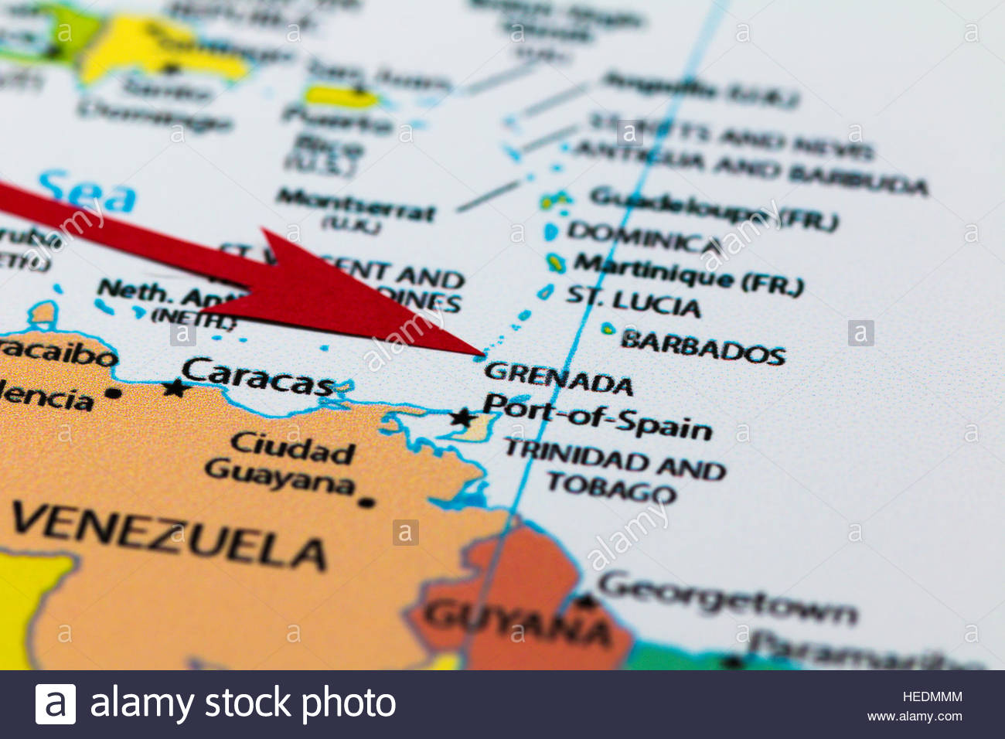
Reagan Foreign Policies: Grenada
Population 90,000
600 U.S. medical students; Fear of hostage crisis.
British Commonwealth member, indep from UK in 1974

Slide 43
Reagan Foreign Policies: Grenada
1979 military coup led by Maurice Bishop killed PM Sir Eric Gairy and brought a Marxist regime to power.
  Sought to be non-aligned and make Grenada a tourist spot. Also:
    Sought aid from Cuba and USSR
    Banned non-Marxist parties
1983 – Deputy PM Bernard Coard & army executed Bishop
  Military rule under General Hudson Austin declared.

Slide 44
Reagan Foreign Policies: Grenada
Austin had overt ties to Cuba
Oct 1983 - Reagan sent 6,000 troops in Operation Urgent Fury
  Mission Accomplished: Depose Austin, place Sir Paul Scoon in power
Pentagon Refused Media Coverage
UK, Canada “deeply deplored” this action.
Reagan’s dear ally Thatcher told Reagan, “I cannot conceal that I am deeply disturbed by your latest communication. You asked for my advice. I have set it out and hope that even at this late stage you will take it into account before events are irrevocable.”
UN condemned this "flagrant violation of international law" by a vote of 108-9. Reagan was unphased by this (“it didn't upset my breakfast at all.“)

Slide 45
Reagan Foreign Policies: Grenada
Four-day affair
19 Americans killed; 45 Grenadians and 24 Cubans killed
Grenada has been democratic since
Grenada’s airport named for Maurice Bishop
The date of the US-led invasion is now a national holiday in Grenada, called Thanksgiving

Slide 46
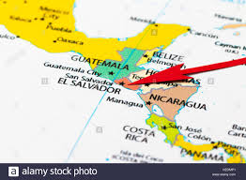
Reagan Foreign Policies: El Salvador
95% of economy was coffee.
  2% owned all the coffee.
  .01% owned 77% of land.
1973 oil crisis→spike in food prices
Civil War in El Salvador 1979-1992
Left Wing Farabundo Nat Lib Front (FMLN) + Cuba + Nicaragua
vs.
US + Chile + Argentina + El Sal Gov

Slide 47
Reagan Foreign Policies: El Salvador
1984 - Election won by Jose Napoleon Duarte, who received $25 mil. in election aid from U.S.
  Leftists refused to take part in elections or recognize Duarte
U.S. gave Duarte military aid and strategic advice. U.S. was running Salvadoran military by 1984.
By 1987, public opinion soured after news of gov “death squads” killing tens of thousands, leaving them on streets as “fair warning”.
  UN concluded that 85% of killings of civilians by Salvadoran military

Slide 48
Reagan Foreign Policies: El Salvador
1989, VP Dan Quayle had to visit Salvador to urge less violence.
  Maybe smarter violence? “They have an ocean and they ought to use it [to dump bodies],” said a senior US adviser.
  Sec of State Baker argued the violence was "absolutely appropriate."
70,000 killed, 85% by gov forces.
1 million displaced (20% of population)

Slide 49
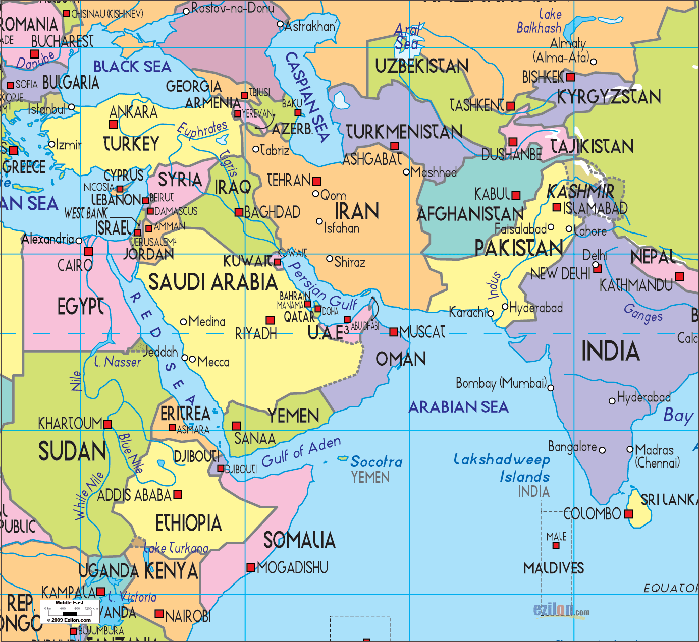
Reagan Foreign Policies: Middle East
Lebanon
Iran-Iraq
Israel

Slide 50
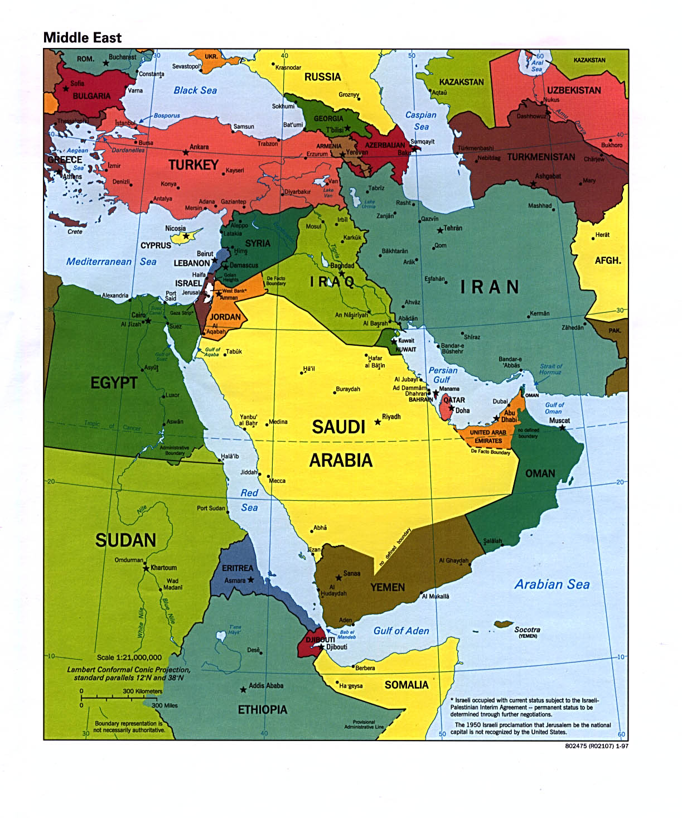
Reagan Foreign Policies: Lebanon
Est in 1920, Lebanon is a very diverse society. 60% Muslim, 40% Christian. 18 religious sects.
1/3 size of Brandenburg
US invaded in 1958
Beirut was “Paris of the Middle East”
Establishment of Israel in 1948 and the Wars of 1967 and 1973 led Palestinian refugees to Lebanon, destabilizing a sensitive cultural balance.
1979 Iranian Rev and Iraq-Iran war further destabilized the region

Slide 51
Reagan Foreign Policies: Lebanon
1979-1982 - Civil War in Lebanon
  Hezbollah and IRGC (Iran), PLO, Syria
  US, France, Israel
1982 - Israel Invaded PLO bases in Lebanon; US supplied arms to Israel. UN ordered (and U.S. asked) Israel to withdraw.
Sec of State Haig (81-82) called for “international action” to end the Civil War. He thought Israel had no limits.
An Israeli-caused bloodbath forced Reagan to deploy troops

Slide 52
Reagan Foreign Policies: Lebanon
1983 – 100 US hostages
1983 - 241 killed in detonation of Marine barracks
Reagan Administration’s Missteps
  Insufficient Force (hostages)
  Firing 16” Guns into the Countryside
  “Something of a homeland” for Palestinians
  Encouraging then discouraging Israeli Invasion
Reagan’s opponents called him a “Teflon president”

Slide 53
Reagan Foreign Policies: Iran-Iraq War
Newly crowned authoritarians: Khomeini & Hussein
Initiated and escalated by Iraq
Hussein wanted: territory, power, oil, water, land
2 oil giants at war. US needed to hedge bets.
30+ countries offered aid, mostly to Iraq

Slide 54
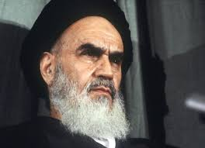
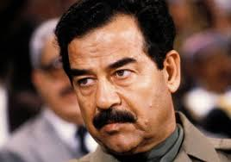
Reagan Foreign Policies: Iran-Iraq War

Slide 55
Reagan Foreign Policies: Iran-Iraq War
US supported both sides. Leaned strongly towards Iraq throughout. USSR and Israel supported Iraq. Kissinger stated, "It's a pity they both can't lose."
Heartless and brutal war
  Shiite vs. Sunni
  Iraqi military superiority (U.S. aid)
  Waves of fruitless human assault waves by outgunned Iranians
  Chemical weapons on civilians

Slide 56
Reagan Foreign Policies: Iran-Iraq War
Americans and Brits either blocked or watered down UN resolutions that condemned Iraq for using chemical weapons against Iranians and their own Kurdish citizens.
US & USSR removed their support (after 7 years)
UN Bartered a Peace
1990 Iraq Invaded Kuwait…

Slide 57
Reagan Foreign Policies: Iran-Contra Affair (Contragate)
1977 - Carter called Iran an “island of stability”
1979 - Revolution
1980 - Iran was subject to a U.S.-led arms embargo (Operation Staunch)
US sold anti-tank and anti-missile units to Iran at 2-3 times the cost. Funneled some of the proceeds to the Contras in Nicaragua, violating Boland Amendment.
US and Israel hoped to make allies with the moderate wing of the Iranian regime

Slide 58
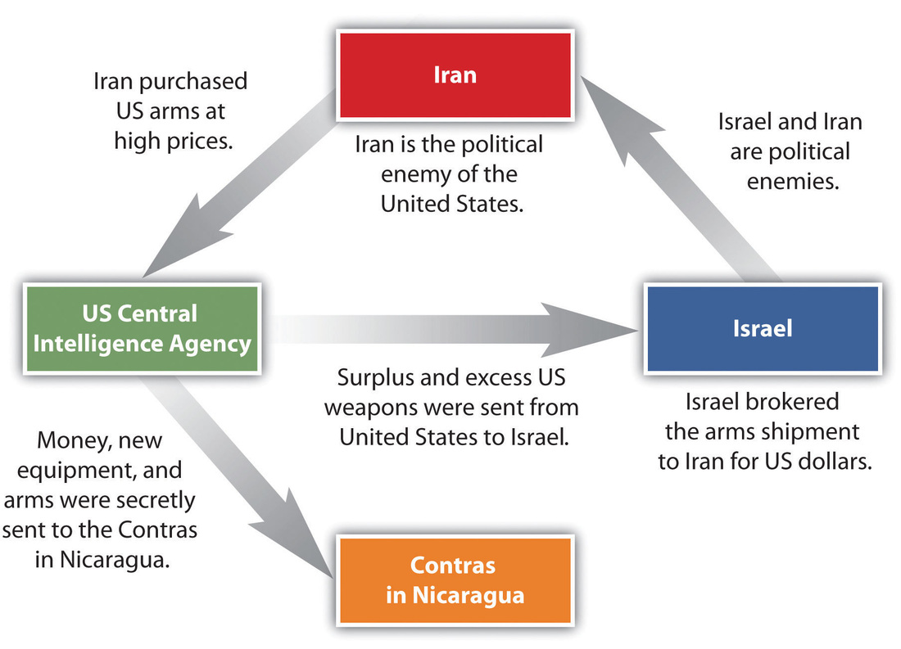
US opposed Sandinistas in Nicaragua
Secret weapon sales to Iran
$ from weapon sales sent to Contras
Contras fought against Sandinistas
Destabilized both regions

Slide 59
Reagan Foreign Policies: Iran-Contra (Contragate)
Reagan assumed Khomeini could free 7 hostages held in Lebanon. “Arms for Hostages” or “We don’t negotiate with terrorists”?
Three months after denying the “arms of hostages” charge, Reagan went on TV and said, "what began as a strategic opening to Iran deteriorated, in its implementation, into trading arms for hostages".
  Reagan might not have known of the funding Contras.
Reagan’s approval ratings dropped more than any U.S. president in history, from 67% to 46%. Back to 69% on his last day in office.

Slide 60
Reagan Foreign Policies: Iran-Contra (Contragate)
11 convictions. Some vacated, the rest pardoned by Bush 41
Caspar Weinberger Secretary of Defense: two counts of perjury and one count of obstruction
Robert C. McFarlane, National Security Advisor 83-85: withholding evidence, two years of probation.
John Poindexter, National Security Advisor, 85-86: convicted of five counts of conspiracy, obstruction of justice, perjury, defrauding the government, and the alteration and destruction of evidence.
Elliott Abrams, Assistant Secretary of State: withholding evidence., two years probation.
Oliver North, member of the National Security Council: of accepting an illegal gratuity, obstruction of a congressional inquiry, and destruction of documents

Slide 61
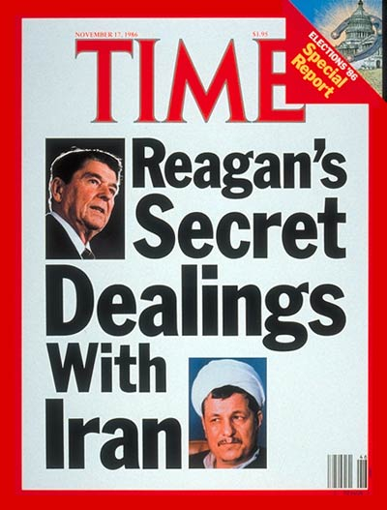
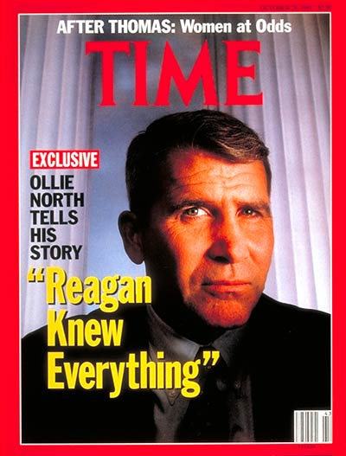
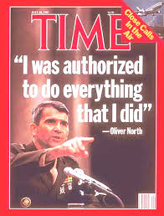

Slide 62
Reagan Foreign Policies: Israeli-Palestinian Crisis
In context of disruptions in the region, in 1987 Palestinians showed frustration with their living conditions and lack of progress towards an independent state and/or integration in the state of Israel.
  Palestinian Liberation Organization shifted away from political moderation.
  Palestinian demonstrations, strikes, boycotts, rock throwing, and gasoline bombs.
Thousands of protesters marched in Jabiliya, a Palestinian refugee camp in the Gaza Strip, to protest the Israeli killing of four Palestinians
  Within days it spread through the Occupied Territories

Slide 63
Reagan Foreign Policies: Israeli-Palestinian Crisis
400+ Israelis killed
1500+ Palestinians killed, some a result of Palestinian in-fighting
US criticized for not stopping Israel
First Intifada officially ended with 1993 Oslo Accords

Slide 64
Reagan Foreign Policies: South Africa
Old Allies: WWII, Korea, Vietnam, “Five Eyes”
Uni students since the 1970’s, esp. at Cal, protested to get university trustees to divest SA holdings.
Pivoting on Carter’s sanctions, Reagan supported Apartheid government under the guise of the policy of “constructive engagement” – engaging the moderates in the SA gov, promoting gradual change. NOT imposing rapid change, which might alienate them.
  Reagan saw the ANC as potentially pro-Communist.
  He called the ANC terrorists.
1986 - Comprehensive Anti-Apartheid Act to support SA corporations that employed Blacks and impose sanction on Apartheid SA gov
  Reagan vetoed, saying it was “economic warfare”. Overridden.

Slide 65
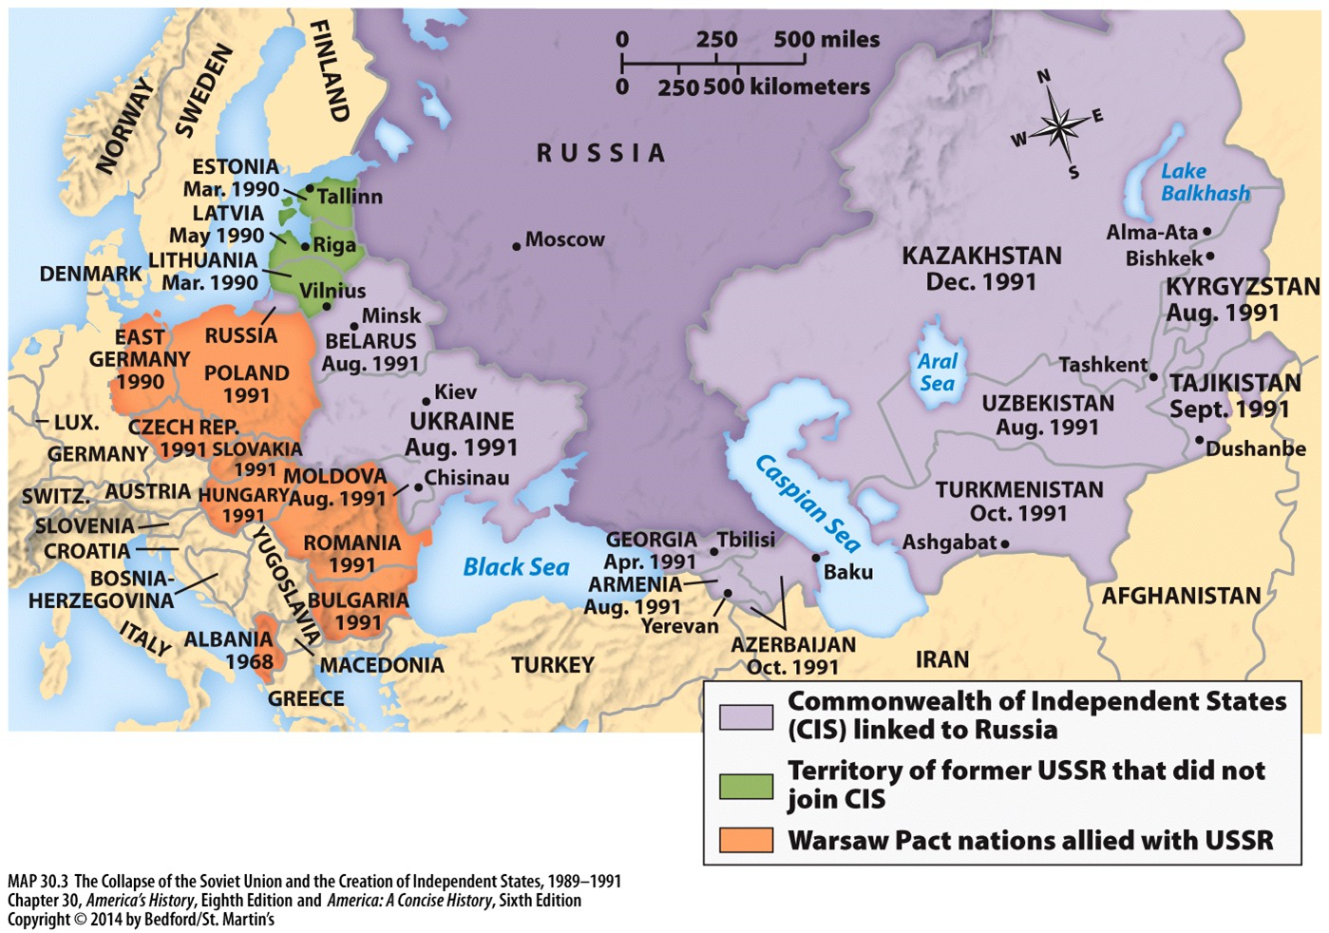
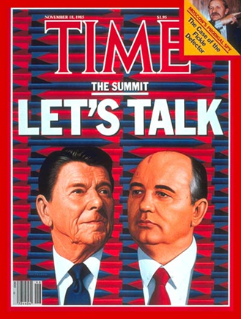
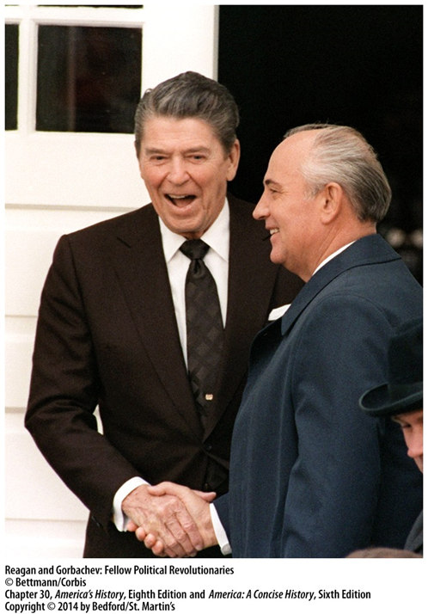
Reagan Foreign Policies: The Cold War

Slide 66
Reagan Foreign Policies: Cold War Arms Race
“Peace Through Strength”
“Evil Empire” Speech: Reagan called the USSR the “focus of evil in the modern world” which justified his military build-up
Mutual Assured Destruction (MAD) assured “balance of “terror” for 4 decades
SALT I and II failed
Nuclear Utilization Theory (NUTs) advocated the winning of a nuclear war.
Intermediate Range Nuclear Force (INF) Treaty, 1987
  All intermediate-range nuclear missiles from Europe banned.
  Reagan & Gorbachev: “Nuclear war cannot be won and must never be fought”
Strategic Defense Initiative (SDI) or “Star Wars”
  Challenger explosion damaged NASA’s credibility and reinforced doubts about Star Wars
  Chernobyl forced some to rethink nuclear altogether

Slide 67
Reagan Foreign Policies: The Cold War
Operation Cyclone: Funded bin Laden’s Mujahedeen vs. USSR invasion of Afghanistan
Gorbachev: perestroika (“restructuring”); glasnost (“openness”)
1989 - Poland, Germany, Czech, Romania…
25 Dec 1991 - Fall of the Soviet Union - end of Cold War.
Communism in China, Cuba, North Korea
U.S. is the last remaining Superpower
  1991 - Defense Planning and Guidance Initiative

Slide 69
Jimmy Carter – “Crisis of Confidence Speech” (1979)
Ronald Reagan – “Acceptance Speech at the Republican National Convention” (1980)
The threat is nearly invisible in ordinary ways. It is a crisis of confidence. It is a crisis that strikes at the very heart and soul and spirit of our national will. We can see this crisis in the growing doubt about the meaning of our own lives and in the loss of a unity of purpose. The erosion of our confidence in the future is threatening to destroy the social and the political fabric of America… We are at a turning point in our history. There are two paths to choose. One is a path I’ve warned about tonight, the path that leads to fragmentation and self-interest. Down that road lies a mistaken idea of freedom, the right to grasp for ourselves some advantage over others. That path would be one of constant conflict between narrow interests ending in chaos and immobility, It is a certain route to failure. All the traditions of our past, all the lesson of our heritage, all the promises of our future point to another path, the path of common purpose and the restoration of American values. That path leads to true freedom for our Nation and ourselves. We can take the first steps down that path as we begin to solve our energy problem. Energy will be the immediate test of our ability to unite this Nation and it can also be the standard around which we rally.
Never before in our history have Americans been called upon to face three grave threats to our very existence, any one of which could destroy us. We face a disintegrating economy, a weakened defense, and an energy policy based on the sharing of scarcity… Tonight, let us dedicate ourselves to renewing the American Compact. I ask you not simply to “Trust me,” but to trust your values – our values – and to hold me responsible for living up to them. I ask you to trust the American spirit which knows no ethnic, religious, social, political, regional, or economic boundaries, the spirit that burned with zeal in the hearts of millions of immigrants from every corner of the earth who came here in search of freedom. Some say that spirit no longer exists. But I have seen it – I have felt it – all across the land, in the big cities, in the small towns, in rural America. The American spirit is still there, ready to blaze into life if you and I are willing to do what has to be done, the practical, down-to-earth things that will stimulate our economy; increase productivity, and put American back to work.

