Slide 1
George H.W. Bush Administration, 1989-1993
Mr. Daniel Lazar

Slide 2
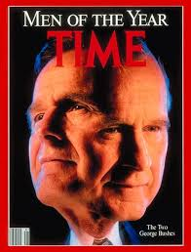
George H.W. Bush Administration
Lecture Outline
Background
1988 Election
Domestic Policies
Foreign Policies
  Panama
  NAFTA
  USSR
  Iraq
“George Bush seemed like two presidents last year: One displayed a commanding vision of the new world order; the other showed little vision for his own country.” (1991)

Slide 3
Bush’s Background
His father, Prescott Bush Sr., Wall Street exec then Senator from CT
Went to Phillips Academy of Andover
Distinguished Naval combat service in WWII
Yale BA in Economics, 1948. Skull and Bones.
1948-1964 - Offshore oil business in TX
1967-1971 – R-TX-7
1971-1973 – Ambassador to UN
1976-1977 – Director of CIA
1981-1989 - VP

Slide 4
1988 Election
Bush Platform: school prayer, mandatory Pledge of Allegiance, capital punishment, gun rights, abortion, “no new taxes”, "kinder and gentler nation"
Dukakis Platform: anti- mandatory Pledge of Allegiance, sentencing reform, anti-capital punishment, unclear on taxes, “No First Use”
Dirty Campaign
  Dukakis as an elite “Massachusetts Liberal” (Gov of MA) with “boutique” Harvard ideas
  Repub strategist Lee Atwater claimed Kitty Dukakis was a Vietnam War flag-burner and was treated for mental illness.
  Bush TV campaigns were ruthless, especially the Willie Horton ad
  Dukakis campaign: “Quayle is dangerously inexperienced to be first-in-line to the presidency."
  Dukakis fired his campaign assistant Donna Brazile who spread rumors that Bush had an affair with his assistant, Jennifer Fitzgerald.

Slide 5
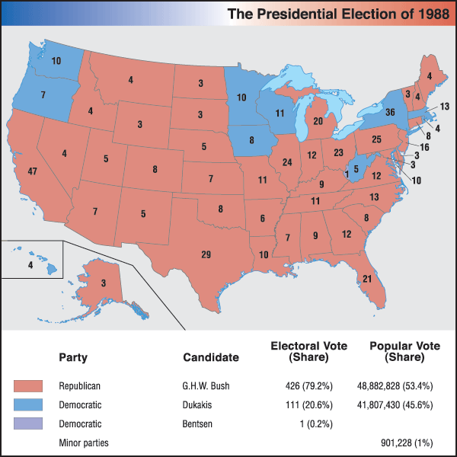

Slide 6
Bush Domestic Policies
Dems controlled both Houses all four years.
Budget deficit: cut spending or raise taxes? Dems convinced him to raise taxes. “No new taxes” promise…His regret.
By 1992, interest and inflation rates were under control but unemployment was 8%, highest since 1984

Slide 7
Bush Domestic Policies
American Disabilities Act – protects disabled people under CRA ‘64. Demands “reasonable accommodations” for employees and accessibility in public spaces
Vetoed Civil Rights Act of 1991 – arguably unclear language in the bill may or may not have encouraged companies to establish racial quotas. Bush’s legal team thought it did encourage quotas; proponents argued otherwise.
  Bill also offered unlimited compensatory damages to victors in discrimination lawsuits.
  It’s hard to veto a CRA.
  Not overridden by one vote.

Slide 8
Bush Domestic Policies
Immigration Act of 1990 – family reunification priority, Diversity Immigrant visa, Raised cap on immigration from 270,000 to 675,000 annually, eliminated exclusion of gays.
Thousand Points of Light - promoted volunteerism
Funded International Space Station
Pardoned 6 more Iran-Contra criminals
Bush was open about his preference for foreign policy….

Slide 9
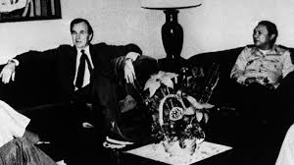
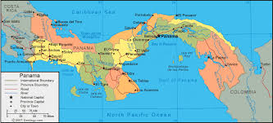
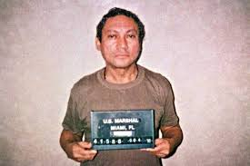
Foreign Policy: Panama

Slide 10
Foreign Policy: Panama
Panamanian Dictator Manuel Noriega was a US ally. Worked with CIA against El Salvador. Worked with DEA. CIA protected him from DEA.
Noriega was exposed in the wake of Iran-Contra. Reagan demanded Noriega step down. Reagan issued sanctions and froze assets. Did not invade in part because his VP was tied to Noriega in the 1970s.
1988 – Noriega lost elections. Refused to step down. Survived a military coup.
Oct 1989 – Four US military personnel seized by Noriega's forces
Operation Just Cause – 5 weeks, Dec 1990-Jan 1991

Slide 11
Foreign Policy: Panama
Four Causes of Invasion:
  Safeguarding U.S. citizens in Panama
  Protecting Panama Canal
  Defending democracy and human rights
  Combating drug trafficking and drug money laundering
23 Americans and 1000 Panamanians died
Noriega captured and tried in the US. Convicted on 8 counts of drug trafficking, racketeering, and money laundering. Sentenced to 40 years. Released in 2007 then extradited to France to face similar charges.

Slide 12
Foreign Policy: NAFTA
Signed by Clinton in 1993
Ended most tariffs between US, Canada, and Mexico
Copyright protection
Reduced investment restrictions
Substantial Democratic opposition: American job loss, no workers’ rights protections

Slide 13
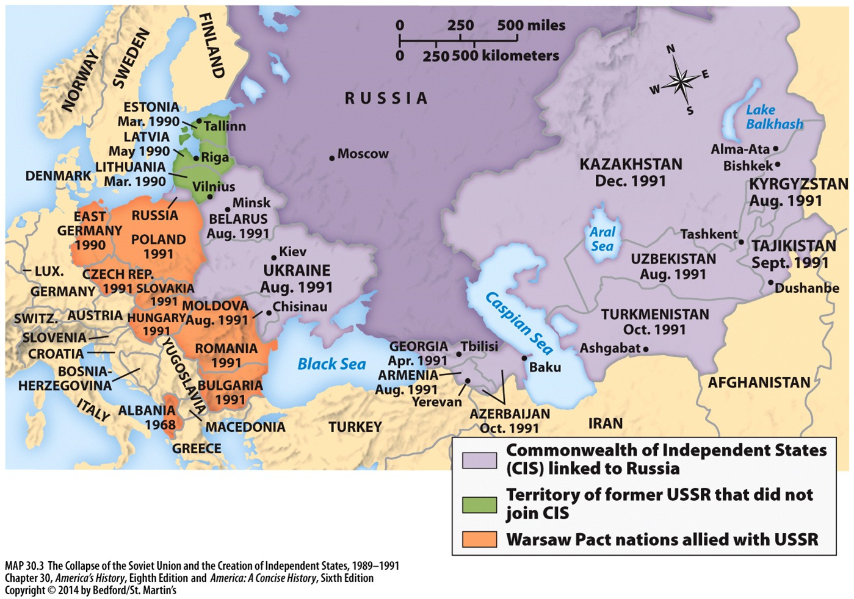
Foreign Policy: USSR

Slide 14
Foreign Policy: USSR
In light of the fall of the Wall, who/when/where to meet was complicated.
  Bush met Gorbachev in Malta in December 1989
1991 - Strategic Arms Reduction Treaty (START I)
25 Dec 1991 – USSR Dissolved
1992 – Defense Planning and Guidance Initiative (The “Wolfowitz Doctrine” that was later edited by Cheney and Powell to become the Bush 43 Doctrine)

Slide 15
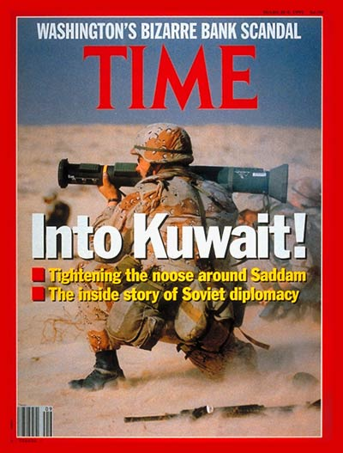
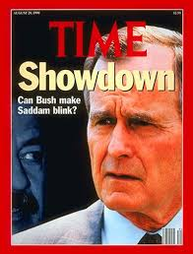
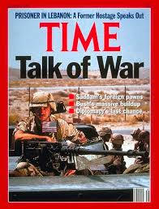
Foreign Policy: Iraq

Slide 16
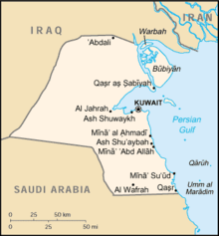
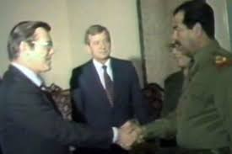
Foreign Policy: Iraq

Slide 17
Foreign Policy: Iraq
1916 Sykes-Picot Map drew a virtually landlocked Iraq
1980-1988 – Iran-Iraq War further destabilized the region. Reagan Admin had to make contingency plans for a wider war. Oil supply needed to be stable.
  1984 - US and UK secretly pledged to defend against an aggressive Iraq.
  Iraq lost friends and face in the Iran-Iraq War
2 August 1990 – Iraq invaded Kuwait. Iraq also:
  Threatened Saudi stability
  Used chemical and biological weapons on Kurds
  Was developing a nuclear program
  Had a real jerk of leader

Slide 18
Foreign Policy: Iraq
Hussein offered to cease hostilities in exchange for half of Kuwait. Bush refused.
Hussein offered to cease hostilities if Israel pulled out of occupied territories. Refused.
UN condemned Iraq in UNSC Res 660, imposed sanctions in 661, and endorsed force in 678.
US earned support of France, Britain, UK, Saudi Arabia and 40 other countries.
  Saudis footed 50% of the $60 bil war bill; Germany and Japan combined funded another 25%
  US troops represented 73% of the coalition's 956,600 troops

Slide 19
Foreign Policy: Iraq
17 Jan – 28 Feb 1991 – Operation Desert Storm - US-led air forces attacked. 4 days of ground forces 5 weeks later.
Bush allowed the Iraqi regime to stay. Otherwise, he said, “we would have been forced to occupy Baghdad and, in effect, rule Iraq.“
292 Coalition dead, including 150 Americans; 40,000 Iraqis
Desert Storm gave a new dimension, some argue new hope, to the Arab-Israeli peace process.
Non-stop CNN coverage
Cured Vietnam War Syndrome?

Slide 20
Foreign Policy: Also Noteworthy
June 1989 – Chinese crushed democracy movement in Tiananmen Square. Bush responded cautiously with light sanctions, despite some in Congress who demanded harsher sanctions.
Feb 1990, "Two-Plus-Four Approach" - East and West Germany dealt with the internal details of unification while the four victors of WWII worked with the two Germanys on external issues. Germany entered NATO, Soviet troops exited the former East.
Sep 1990 – Bush declared the need for a New World Order based in multilateralism and democracy. This was never clearly defined.
Bush firmly supported Israel. His administration shared intelligence and weapons with Israel vis-à-vis PLO. Also, gave Israel $10 billion to settle Soviet Jews.
Dec 1992 – UN Res 794 – Bush committed U.S. troops to Somalia to help ease a humanitarian crisis after the breakdown of civil society and the onset of mass famine and starvation. Clinton mismanaged this…

Slide 21
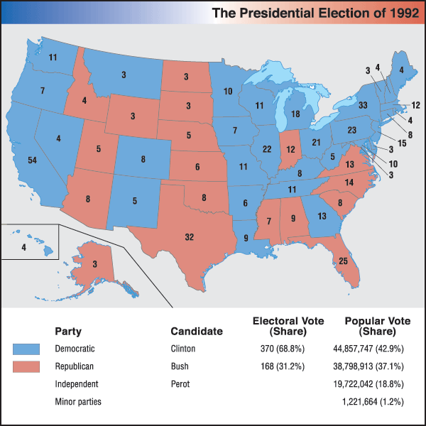

Slide 22
SAQ: “The Cold War and Beyond: Stability, Hegemony, Chaos?”
John Lewis Gaddis - ”We Now Know: Rethinking Cold War History” (1997)
Odd Arne Westad – “The New International History of the Cold War: Three (Possible) Paradigms” (2000)
At the same time, though, it is difficult to see how a strategy of containment could have developed – with the Marshall Plan as its centerpiece – had there been nothing to contain. One need only recall the early 1920s, when similar conditions of European demoralization, Anglo-French exhaustion, and American economic predominance had existed; yet no American empire arose as after World War II. The critical difference, of course, was national security: Pearl Harbor created an atmosphere of vulnerability Americans had not known since the earliest days of the republic, and the Soviet Union by 1947 had become the most plausible source of threat. The American empire arose primarily, therefore, not from internal causes, as had the Soviet empire, but from a perceived external danger powerful enough to overcome American isolationism.
Had it not been for the existence of these new [decolonization] states, it is likely that the Cold War conflict, in its 1940s and 1950s form, would have petered out sometime in the 1960s, with the stabilization of European borders and the Soviet post-Stalin “normalization.” What prolonged the conflict was its extension into areas in which the Cold War ideological duality had no relevance for the majority of the people, but where U.S. and Soviet leaders convinced themselves that the postcolonial states were theirs to win or lose. Local Third World elites were therefore able to attain Great Power allies in their wars against their peoples, and the organizations opposing them could often forge their own foreign links, in some cases based on the most incongruous of ideological alliances, such as U.S. support for radical Islamist parties in Afghanistan.

