Slide 1
The Debate over the League of Nations
Mr. Daniel Lazar

Slide 2
Should the U.S. Join the League?
At stake was the issue of American participation in the NWO
The debate was not initially partisan
Not a simple debate between complete isolation or inter­nationalism
The two main questions of the great debate of 1919-1920:
  Would such a worldwide system work?
  Would the American people prepared support such a system even if it did work?

Slide 3
Advantage Wilson
Wilson consulted Taft and other Republican supporters of the League and, in response to their suggestions, obtained changes in the Covenant:
    right of member nations to withdraw after giving due notice
    exempted domestic questions from the League's jurisdiction
    permitted member nations to refuse to accept a colonial mandate
    accorded formal recognition to the Monroe Doctrine

Slide 4
Advantage Wilson
Refreshed by the return voyage, Wilson returned to Washington on July 8, 1919 in a confident mood. Americans were excited about The League:
“The stage is set, the destiny disclosed. It has come about by no plan of our conceiving, but by the hand of God who led us this way. We cannot turn back. We can only go forward, with bright eyes and freshened spirit, to follow the vision. It was of this that we dreamed at our birth. America shall in truth show the way. The light streams upon the path ahead, and nowhere else.”

Slide 5
Opposition from Below
Powerful voices condemned the Treaty on various grounds:
  German-Americans - feared the Motherland got shafted by the Treaty
  Italian-Americans - angered by Wilson's opposition to Italy's demands
  Irish-Americans - inflamed by the civil war then raging in Ireland, were angered because Wilson had refused to win Irish independence at Paris and because the Treaty allegedly benefited the reviled English.
  Hearst newspapers - marshalled and incited all hyphenate protests.
  Anti-Imperialists - condemned the Treaty because it failed to end the colonial order
  Pure isolationists - believed that American membership in the League would mean entanglement in all of Europe's rivalries and wars.
However, the above represent a minority among the leaders of political opinion (at least before 1920, if not afterward).

Slide 6
Opposition at the Top
Distinguished leaders, esp. in Senate:
  Senator Frank B. Kellogg of Minnesota
  President Nicholas Murray Butler of Columbia University,
  Former Secretary of State Elihu Root
  Charles Evans Hughes, SC Justice 1910-16, Republican presidential candidate in 1916…Sec State 1921-25
  Senator Henry Cabot Lodge, Chairman of the Senate FRC, loathed Wilson.
Most were Republicans, because few Democrats dared to incur the President's wrath by opposing him.
They were not isolationists but limited internationalists

Slide 7
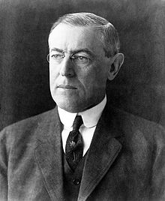
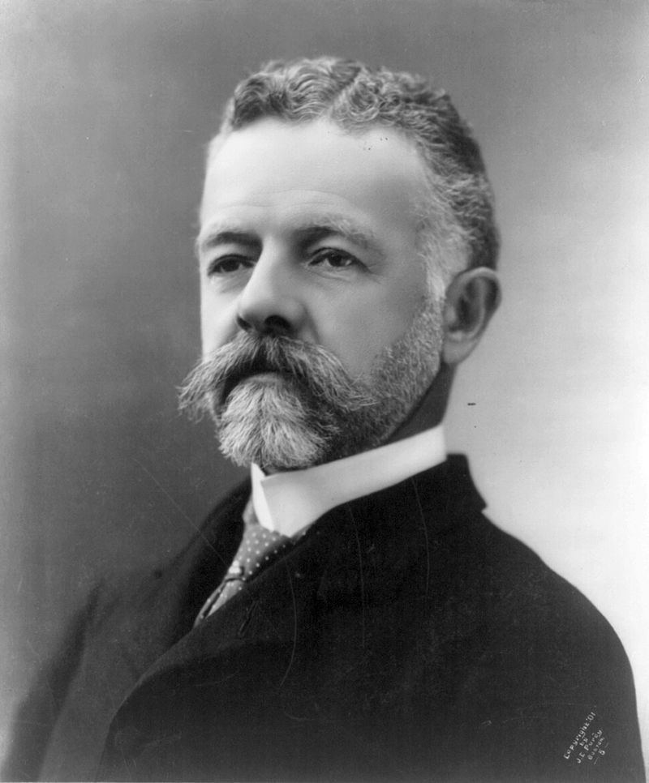
The Debate
Woodrow Wilson
Henry Cabot Lodge

Slide 8
Opposition‘s Arguments
A system of collective security will not work. No nation will go to war to vindicate Article 10* unless its vital interests compel it to do so. Such sweeping guarantees as the Covenant affords offer and illusory hope of security
American people are not ready to support the Covenant's sweeping commitments. Fight in the Balkans? Shantung Province? Fight for British supremacy in Ireland or India?
Unqualified membership in the League could raise grave dangers to American interests and the American constitutional system.
  Increased the power of the President
  Necessitated the maintenance of a large standing army
The end of American sovereignty in foreign affairs

Slide 9
* ARTICLE 10
The Members of the League undertake to respect and preserve as against external aggression the territorial integrity and existing political independence of all Members of the League. In case of any such aggression or in case of any threat or danger of such aggression the Council shall advise upon the means by which this obligation shall be fulfilled.

Slide 10
Reservations
Amendments and reservations designed to satisfy the moderate inter­nationalists. Foreign Relations Committee (Lodge) presented reservations to the Senate on September 10, 1919.
Reservation 2 to Article 10: “The United States assumes no obligation to preserve the territorial integrity or political independence of any other country or to interfere in controversies between nations-whether members of the league or not-under the pro­visions of Article 10, or to employ the military or naval forces of the United States under any article of the treaty for any purpose, unless in any particular case the Congress, which, under the Constitution, has the sole power to declare war or authorize the employment of the military or naval forces of the United States shall by act or joint resolution so provide.”

Slide 11
Reservations and Partisanship
“Wilson wanted to divide and conquer the Republicans. What Wilson did not know…was that virtually all of the so-called mild reservationists had already coalesced into the central hard-core Republican pro-League group in the Senate. They were the men who voted with Democrats to convert Lodge's amendments into reservations. They were the ones who forced Lodge, for the sake of party unity, to support the treaty with res­ervations. Wilson would get nothing more from Republicans.“

Slide 12
Wilson’s Fateful Decision
  “To go to the people and purify the wells of public opinion that had been poisoned by the isolationists and opponents of un­reserved ratification.’’ –Wilson

Slide 13
Wilson’s Fateful Decision
“We should make no general promise, but leave the nations associated with us to guess in each instance what we we’re going to consider ourselves bound to do and what we were not going to consider ourselves bound to do.
It is as if you said, ‘We will not join the League definitely, but we will join it occasionally. We will not promise anything, but from time to time we may cooperate. We will not assume any obligations.’ This reservation proposes that we should not ac­knowledge any moral obligation in the matter; that we should stand off and say, ‘We will see, from time to time; consult us when you get into trouble, and then we will have a debate, after two or three months we will tell you what we are going to do….’
It means the rejection of the Treaty, my fellow countrymen, nothing less. lt means that the United States would take from under the structures its very foundations and support.”

Slide 14
Wilson’s Fateful Decision
“Instead of wishing to ask to stand aside, get the benefits of the League, but share none of its burdens or responsibilities, I for my part want to go in and accept what is offered to us, the leadership of the world.” -Wilson

Slide 15
The Irony
US would have a veto over the Council's decision for war, because that body could not advise member nations to go to war except by unanimous vote.

Slide 16
The Tragedy
2 October 1919, Wilson suffered a severe stroke, leaving the left side of his face and body paralyzed
For several days his life hung in the balance; his recovery was partial at best

Slide 17
Decision Amidst Weakness
Wilson had to choose between accepting the Lodge reservations or running the risk of the outright defeat of the Treaty.
He could not accept Lodge reservation to Article 10
November 19, a Republican majority defeated the resolution 38 ayes to 53 nays.
In the absence of any reliable indices, it is impossible to measure the division of public opinion as a whole; but there is little doubt that a majority of people favored ratification with some kind of res­ervations

Slide 18
Election of 1920
Wilson decided to make the election a referendum on the League. As an expert in the American constitutional and political systems at Princeton, he should have known better.
Henceforth most Republican senators voted as Republicans, most Democrats as Democrats
  Warren G. Harding, the Republican nominee and a strong reservationist, sidestepped the League issue

Slide 19
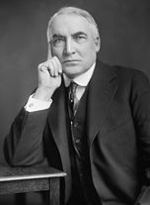
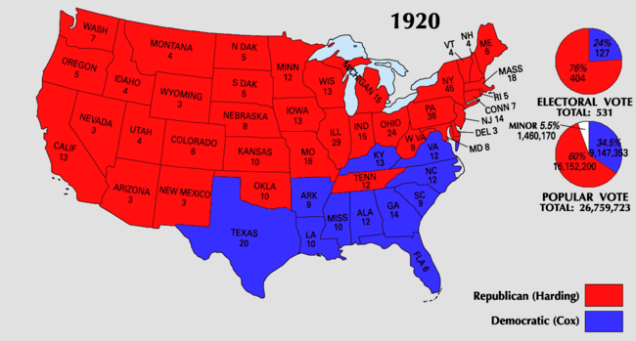
The Verdict
Senate took its second and final vote on the Treaty on March 19, 1920
Treaty with reservations failed by seven votes.
Ohio Republican Warren Harding won in a landslide election (60.3%, 404:127)

Slide 20
We‘ll give Wilson the last words
"I would rather fail in a cause that will ultimately triumph than triumph in a cause that will ultimately fail.”
“The most immoral thing that a nation (or individual) can do is to refuse to exercise power responsibly when it possesses it.”

Slide 21
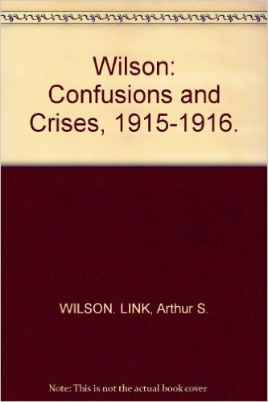
Adapted from Wilson a biography in 5 Volumes. Link, Arthur. Princeton University Press.
"I've read a lot of history in my life, and I think that aside from St. Paul, Jesus and the great religious prophets, Woodrow Wilson was the most admirable character I've ever encountered in history.“ -Link

