Slide 1

Stalin: The Hero who Preserved the Revolution or the Villain who Destroyed it?
Mr. Daniel Lazar

Slide 2
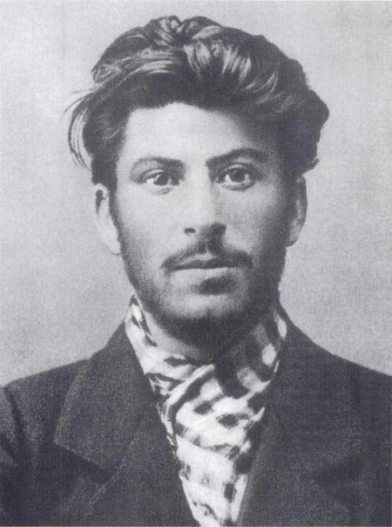
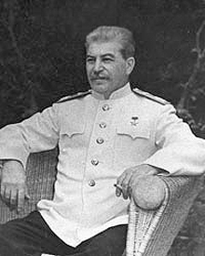
Stalin: Hot Emo Hipster Turned Sociopathic Statesman
c. 1902
Yalta, 1945

Slide 3
Lecture Outline
Brief note on origins
Stalin’s Inheritance & His Plans
Mixed Industrial Results
Mixed Agricultural Results
Raw Terror
  Propaganda
  Religion
  Purges
Foreign Policies
Stalin's Legacy

Slide 4
Origins of the Man of Steel
18 December 1878 – 5 March 1953
Stalin spent much of his post-adolescent life in and out of prisons for revolutionary activity against the Czars.

Slide 5
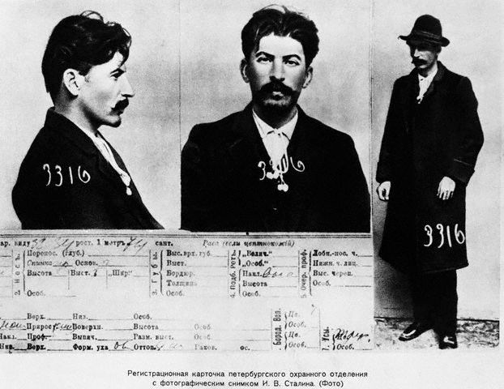
Origins of the Man of Steel
1911 information card from the files of the Tsarist secret police

Slide 6
Stalin’s Inheritance & His Plans
1922 Constitution was democratic and socialist
  Supreme Soviet - elected legislature
  Universal suffrage for 18+
  Political power to the Soviets – workers’ councils
  Reclamation of the old Soviet Empire
Paper vs. Practice: Power lay with The Party, not the people
  Army and secret police (NKVD) ruthlessly promoted order
  Russia dominated the USSR

Slide 7
Stalin’s Inheritance & His Plans
1921 – In response to mass famine in USSR, Lenin gambled with the New Economic Policy:
  “State capitalism” or "mixed economy”
    "We are taking one step backward to later take two steps forward.“ (Lenin)
  Focused on ag sector
  Tax incentives to stimulate economic growth
  Highly controversial

Slide 8
Stalin’s Inheritance & His Plans
1922 – Lenin suffers strokes; died in 1924
Stalin and Trotsky vied for power upon Lenin’s strokes.
  Trotsky, through his rhetorical capacity, had the hearts of the people
  Stalin, though political savvy, won control of The Party against Lenin’s wishes.
  1940, Stalin ordered assassination of Trotsky

Slide 9
Origins of the Man of Steel
“Comrade Stalin, having become Secretary-General, has unlimited authority concentrated in his hands, and I am not sure whether he will always be capable of using that authority with sufficient caution…
Stalin is too coarse and this defect, although quite tolerable in our midst and in dealing among us Communists, becomes intolerable in a Secretary-General. That is why I suggest that the comrades think about a way of removing Stalin from that post…”
-Lenin’s Last Will and Testament

Slide 10
Stalin’s Inheritance & His Plans
Russia was suffering from Three Calamities: WWI, Civil War, and War Communism
1928 - Stalin abolished NEP in favor of the First Five Year Plan (1928-32)
  “A Great Turn” and a “Revolution from Above” to reclaim Russia from backwardness.
  Command economy: abolished the “capitalism” part of State Capitalism.
  Focused on Industrialization and Collectivization.
  “Socialism in one country” (the international workers movement will come…)

Slide 11
  Mixed Industrial Results
USSR needed to industrialize to compete economically and militarily with the Western world
1924-1936:
    Heavy Industry ^300%
    Light industry ^200%
    Electrical power ^ 400%
    Coal ^80%
    Steel ^50%.
Focus on heavy industry: coal, steel, trains, oil, and farm equipment at the expense of consumer goods
Quality vs. Quantity
These improvements came at a high price

Slide 12
  Mixed Industrial Results
Shift from rural to urban was difficult on peasants, both socially and economically.
  City infrastructure was not prepared
  1940 - 80% of the industrial workers were peasants in 1930
  1940 - 1/3 of the population lived in cities
Tiny carrots & vicious sticks
Skilled vs. Unskilled laborers: the debate

Slide 13
Mixed Industrial Results
Low productivity: in 1927, the Russian worker produced ½ as much as a British worker and ¼ as much as an American worker
Stakhanovism – inspired by Alexi Stakhanov (who was rumored to mine 102 tons of coal in 6 hours) as well as recovery in the USA, set the stage for "Socialist Competition"
  "The Stakhanovite movement means organizing labor in a new fashion, rationalizing technologic processes, correct division of labor, improving work place, providing rapid growth for labor productivity, and securing significant increase of workers' salaries" (from the 1935 CCP Central Committee Plenum)
  June 1940 - 7 day work week enforced

Slide 14
  Mixed Agricultural Results
Collective Farming - personal property permitted, private property belonged to the state.
By 1933, the total collectivized peasant households was 65%; by 1936, it surpassed 90%!
Modernized farming: increase efficiency of farming so less people needed to farm and more people could move to the cities to feed the industrial machine.
Raised gross output by 200%

Slide 15
Mixed Agricultural Results
Stalin tried to destroy the kulak (wealthy peasant) class. He confiscated their land, distributed it to the collective system, and sent the kulaks to gulags.
  On dekulakization: “Treat the kulak as the most cunning and still most undefeated enemy.” (Molotov, Chairman of the Council of People's Commissars)
Peasants were the heart Russia and the heart of the Russian world was broken by dekulakization and collectivization.

Slide 16
Mixed Agricultural Results
“The argument went that if the USSR was to industrialize rapidly, it had to exploit the peasants; yet if the peasants were taxed too heavily or if the terms of trade were turned against them, they would simply withdraw from the market and withhold their grain…that is exactly what happened.” (Suny)
Peasants resisted collectivization by burning crops and destroying livestock.
The Great Famine of 1932-33 – Due to failed ag policy, peasant revolts, crop failures the USSR starved. Hungry people start revolutions. Stalin was afraid…

Slide 17
Totalitarianism: Raw Terror
secret police
censorship
show trials
labor camps
executions

Slide 18
Totalitarianism: Propaganda
Used modern technology to create the most effective propaganda system in the history of mankind. The Party used radio, television, billboards, newspapers…
Socialist Realism: painters, sculptors, filmmakers, etc.
Nationalism and internationalism
Production quotas

Slide 19
Totalitarianism: Propaganda
Though clearly propagandistic, Soviet education promised to pull the USSR from its backwardness and move her into competition with the West.
  “Give us the child for eight years and it will be a Bolshevik forever.” (Lenin)
  Russification and Communization
  1929-1931 - 14 to 29 million children in school
  CPSU rewrote history

Slide 20
  Totalitarianism: War on Religion
“Religion is the opiate of the masses” (Marx)
In Soviet law, the "freedom to hold religious services" was constitutionally guaranteed
Atheism emphasized in curricula
Sacred religious texts replaced by the sacred texts of Marxism-Leninism

Slide 21
Totalitarianism: War on Religion
By the early 1920’s USSR confiscated all church property
1922 - 1926, 28 Russian Orthodox bishops and 1,200+ priests were killed. Many more persecuted.
Yemelyan Yaroslavsky headed the "Committee on the Execution of the Decree Separating Church and State" (aka the "Anti-Religious Commission")
  A 1929 meeting of the CPSU CC, chaired by Yaroslavsky estimated that 80% of Russians were “believers”.

Slide 22
Totalitarianism: War on Religion
1917 - ~54,000 active parishes
1941 - ~500 active parishes
WWII forced Stalin to reach out to Orthodox Church
  ~22,000 churches in 1956
  1959 Khrushchev's war on religion → 1975 ~ 7,000 churches
1982 poll conducted by Soviet authorities recorded 20% of the Soviet population as "active religious believers."
USSR even more brutal towards Catholics and Muslims…

Slide 23
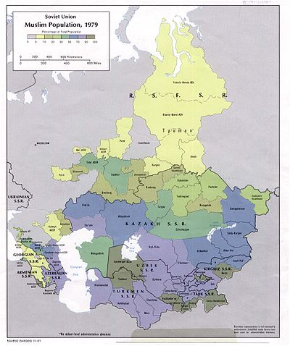
Totalitarianism: War on Religion
1980’s – 50 million Muslims, 500 Mosques
Mosques supervised by the Spiritual Directorate for Central Asia and Kazakhstan

Slide 24
The Purge (1934-1939)
Stalin had obsessive fears of opposition plots from within and outside of the Party. He was convinced that many were out to ruin him and the revolution.
  To a great extent he was correct.
  Some argue he was diagnosably paranoid.
His obsessiveness ruined his personal life as well; his second wife, Nadzheda Alliluyeva, shot herself (officially appendicitis) at age 31 after being scorned by Stalin in front of dinner guests.

Slide 25
The Purge (1934-1939)
When someone (a disillusioned Party member or a gun hired by Stalin?) assassinated Leningrad Party leader Sergei Kirov in 1934, Stalin’s fears were exacerbated. Some argue that this was the turning point towards mass terror.
Stalin set “show trials” for suspected opposition leaders: writers, lawyers, army officials, intellectuals, artists, dissenting Party members
  U.S. led Dewey Commission concluded, "We therefore find the Moscow Trials to be frame-ups.”

Slide 26
The Purge (1934-1939)
1933 - 400,000 Party members expelled
1935 - 177,000 expelled + 15,000 arrested
Great Terror of 1937-38
  Purge of Red Army leadership harmed USSR in WWII
During WWII, Party leaders “confessed” at show trials that they had conspired with Axis Powers.

Slide 27
The Purge (1934-1939)
According to declassified Soviet archives during 1937-1938 the NKVD detained 1,548,366 people, of whom 681,692 were shot - an average of 1,000 executions per day
Stalin’s role? Party run amok? Some debate here.
  Stalin signed 357 lists authorizing executions of 40,000
  “You cannot make a revolution with silk gloves.” (Stalin)
17th Party Congress of 1934 showed they knew Stalin was becoming a ruthless totalitarian, but failed to act.
  Rather, they lauded him as “the outstanding genius of the era”. Why?

Slide 28
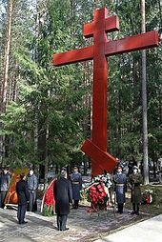
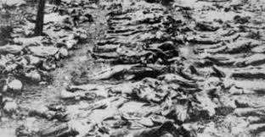
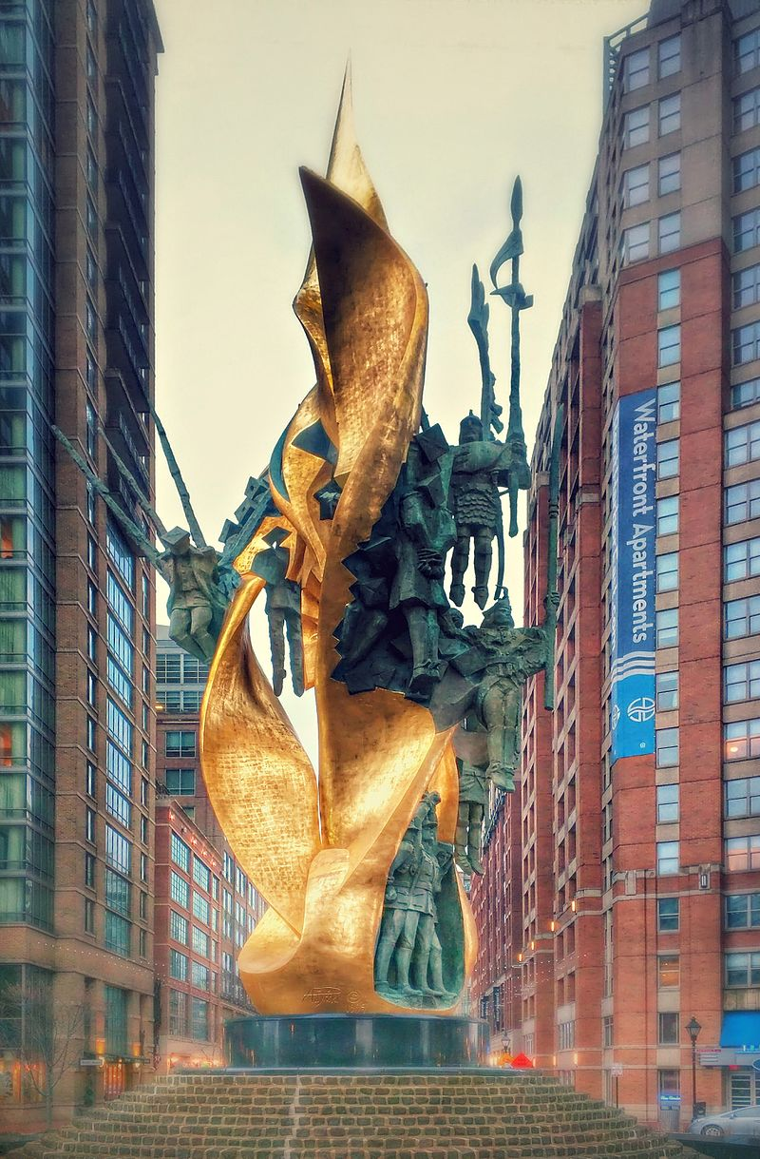
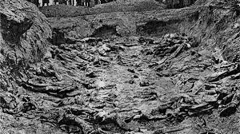
The Great Purge (1934-1939)
Mass graves in Katyn Memorialized from Katyn to Baltimore

Slide 29
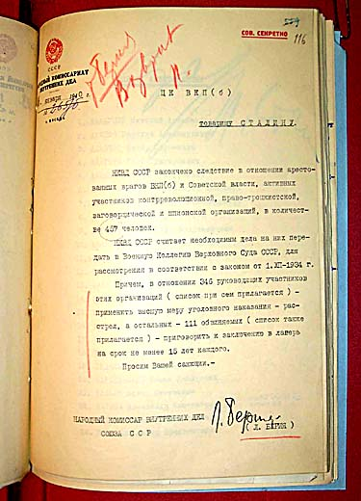
The Purge (1934-1939)
Beria's 1940 letter to Stalin, asking permission to execute 346 "enemies of the CPSU and of the Soviet authorities" who conducted "counter-revolutionary, right-Trotskyite plotting and spying activities."

Slide 30
Soviet Foreign Policies
“Workers of the world unite!” vs. “Socialism in one country.”
“Everyone imposes his own system as far as his army can reach.” - Stalin
Goals: to expand Soviet influence around the world while promoting stability and prosperity at home. These goals were often conflicting.
Communist International 1919-1943 (aka Cominterm)
USSR 1922 - 1991
Warsaw Pact 1955 - 1991

Slide 31
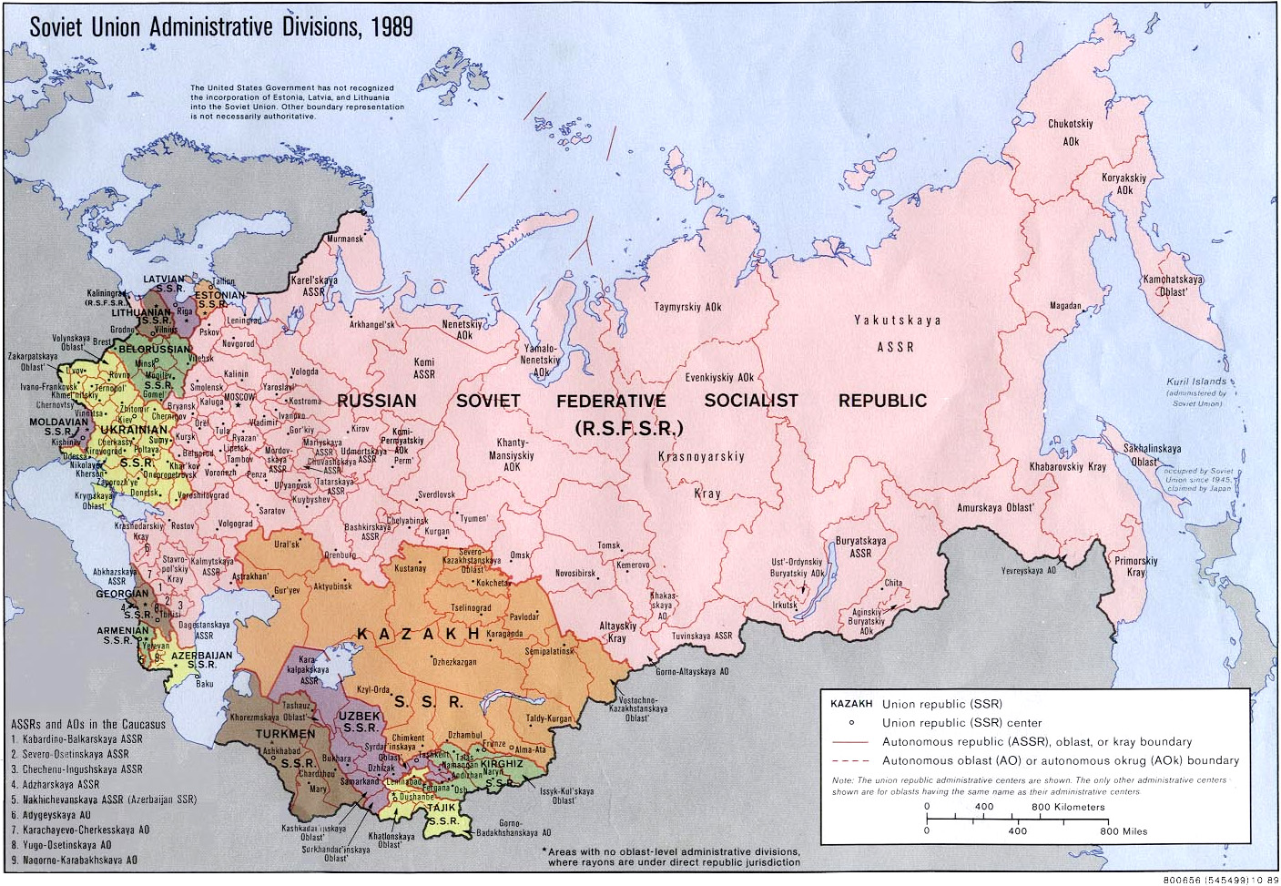
The Soviet Union

Slide 32
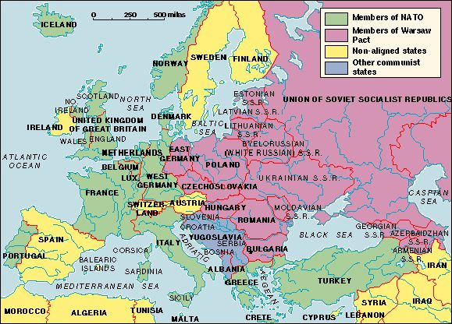
NATO vs. Warsaw Pact

Slide 33
Russia in WWII: An Overview
WWII was a war of ideologies: nazism, fascism, capitalism, communism.
In fear of Nazi militarism, Soviets joined the League of Nations (1934) and allied with France (1935). Fragile alliances.
As Western Europe appeased Hitler in Munich after he seized Czechoslovakia, Stalin decided the USSR stood alone. To “save the revolution” he signed the Nazi-Soviet Pact in 1939.

Slide 34
Russia in WWII: An Overview
Hitler launched Operation Barbarossa in June 1941
When Stalin was informed of the invasion he had a nervous breakdown. He had not been adequately preparing the Soviet military. His worst fears had come true. He was paralyzed with depression. He refused to order his troops to return fire on the German invaders! He did not address the nation until a week later.
General Distance, General Mud, and General Winter, accompanied by a merciless scorched earth policy, defeated the Germans.

Slide 35
Russia in WWII: An Overview
872-day Siege of Leningrad
  3 million dead
  Rape and Cannibalism
20 million Soviets died during WWII. The land was devastated. War cost: $192 billion ($2.8 trillion today)
“Great Patriotic War” rekindled Russian spirit
Stalin was The Hero.
If WWI brought Russia the “light” of Communism and the 1930’s brought the USSR out of backwardness, WWII brought the USSR into the realm of global superpower.

Slide 36
Stalin’s Legacy
Stalin died of a stroke on 5 March 1953. He designated no successor.
Russia was no longer backwards.
Education: science, technology, literacy, medicine…
Work become a right
WWII Hero
Nationalism and internationalism
Cult of Personality
The Party
Leviathan State

Slide 37
Stalin’s Legacy
International Communism:
  Eastern Europe: Satellite States
  Asia: China, Vietnam, Korea
  Latin America: Cuba, Chile, Guatemala
Recent poll conducted by the Russian Center for Public Opinion, 71 percent of the respondents said that they considered Stalin to be a great historical figure
Another poll states 42 percent of the respondents said that they believed that he was more good than bad.
Intentions vs. Actions
Did Stalin “ruin” Communism?

Slide 38
Stalin's Terror: The Numbers
Numbers are not facts. Numbers are ideologically biased. 68% of all statistics are false.
Illustrative estimates from the Big Numbers School:
  Adler, N., Victims of Soviet Terror, 1993 cites these:
    Chistyakovoy, V. (Neva, no.10): 20 million killed during the 1930s.
    Dyadkin, I.G. 56 to 62 million "unnatural deaths" for the USSR overall, with 34 to 49 million under Stalin.
    Gold, John.: 50-60 million.
  Davies, Norman (Europe A History, 1998): c. 50 million killed 1924-53, excluding WW2 war losses.
  William Cockerham, Health and Social Change in Russia and Eastern Europe: 50M+
  Wallechinsky: 13M (1930-32) + 7M (1934-38)
  MEDIAN: 51 million for the entire Stalin Era; 20M during the 1930’s

Slide 39
Stalin's Terror: The Numbers
From the Lower Numbers School:
Nove, Alec ("Victims of Stalinism: How Many?" in J. Arch Getty (ed.) Stalinist Terror: New Perspectives, 1993): 9,500,000 "surplus deaths" during the 1930s.
Cited in Nove:
  Maksudov, S.: 9.8 million abnormal deaths between 1926 and 1937.
  Tsaplin, V.V.: 6,600,000 deaths (hunger, camps and prisons) between the 1926 and 1937 censuses.
Gordon, A. (What Happened in That Time?, 1989, cited in Adler, N., Victims of Soviet Terror, 1993): 8-9 million during the 1930s.
MEDIAN: 8.5 Million during the 1930s.

Slide 40
Stalin's Terror: The Numbers
A consensus seems to be forming around a death toll of 20 million.
  Time Magazine (13 April 1998): 15-20 million.
  Britannica, "Stalinism": 20M died in camps, of famine, executions, etc.

