Slide 1
Immigration, Urbanization, Social Reform, and Political Machines
In the Gilded Age
Mr. Daniel Lazar

Slide 2
Context
1820-1860: Antebellum / Manifest Destiny Era
1861-1865: American Civil War
1865-1877: Reconstruction Era
1870-1900: The Gilded Age
  Growth of industry, mass immigration, urbanization, political corruption
1900-1920: The Progressive Era

Slide 3
Lecture Outline
Immigration
  Push and Pull Factors
  Responses to Immigration
    Nativism & APA
    Organized Labor
    Anti-Immigrant Legislation
The Reformist Reaction
  Americanization
  Social Gospel Movement
  Settlement House Movement
  Socialism?
Urbanization & The Shame of Cities
Political Machines

Slide 4
Key Themes of this Lecture
The enduring immigration dilemma
Redefining the American Dream
Social Movements and Religious Activism
Transition from Producers to Consumers
Mixed Blessings of the Metropolis: The Pain of Progress & The Shame of Cities
Race, Ethnicity, and Gender in Industrial Capitalism
Paradoxes of the Political Machine
…Action and Reaction, Cause and Effect

Slide 5
Etymology
"The golden gleam of the gilded surface hides the cheapness of the metal underneath.”
-The Gilded Age: A Tale of Today is an 1873 novel by Mark Twain and Charles Dudley Warner that satirizes greed and political corruption in post-Civil War America

Slide 6
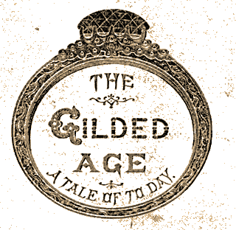
Etymology
Dems & Reps both ruthlessly corrupt
Political offices given through spoils system
Local governments run by party bosses

Slide 7
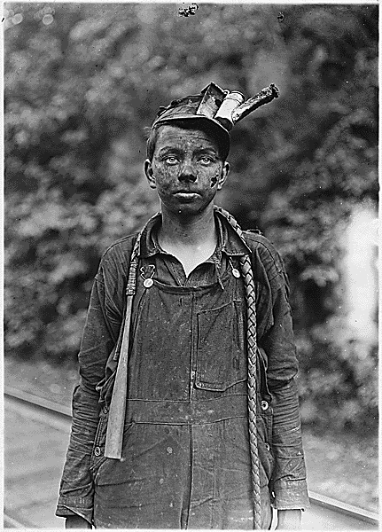
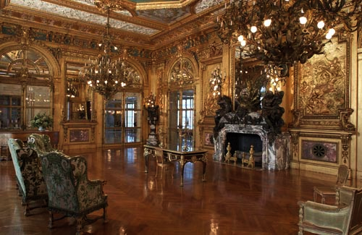
Etymology
Opalescent, gleaming, ornate, capitalist excess…
Built on the backs of the exploited and oppressed working class
Built in 1892 by for William K. Vanderbilt

Slide 8
The Gilded Age Trifecta
URBANIZATION
INDUSTRIALIZATION
IMMIGRATION

Slide 9
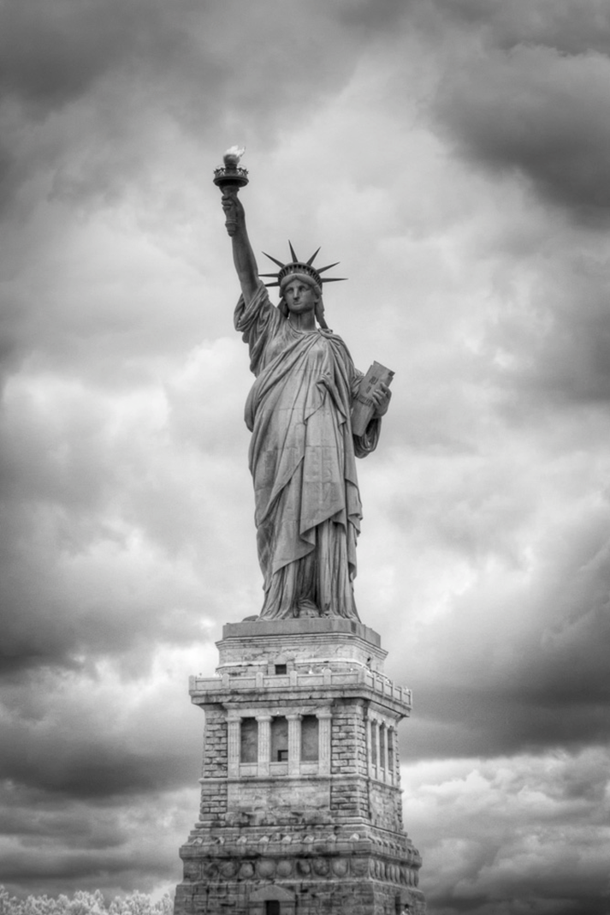
Immigration

Slide 10
The Numbers
Between 1870-1920, US pop doubled!
3.5 million in NYC, 2nd most populated after London
Flood from S and E Europe
1851-1883, ≈ 300,000 Chinese arrived
By 1920 ≈ 200,000 Japanese on West Coast
1880-1920 ≈ 260,000 immigrants from West Indies

Slide 11
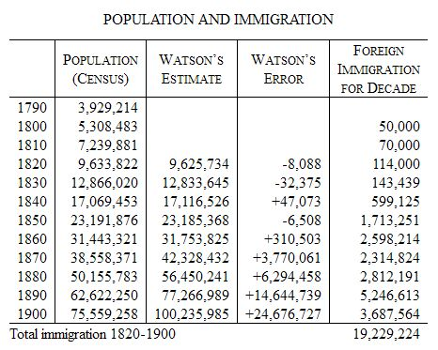
In 1815, mathematician Elkanah Watson predicted census numbers for the forthcoming century.

Slide 12
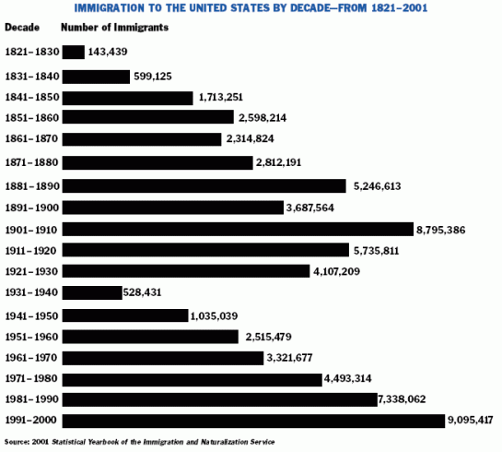

Slide 13
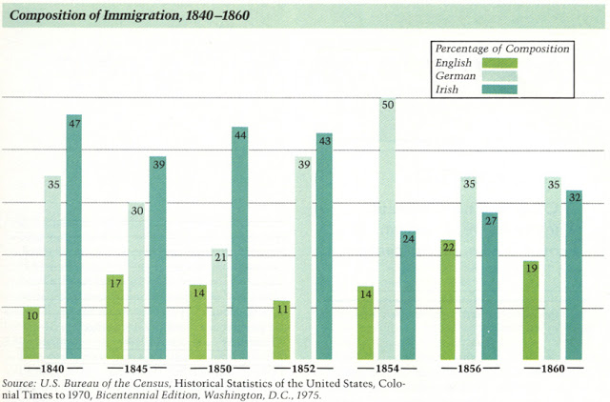
Immigration until Civil War primarily from NW Europe:

Slide 14
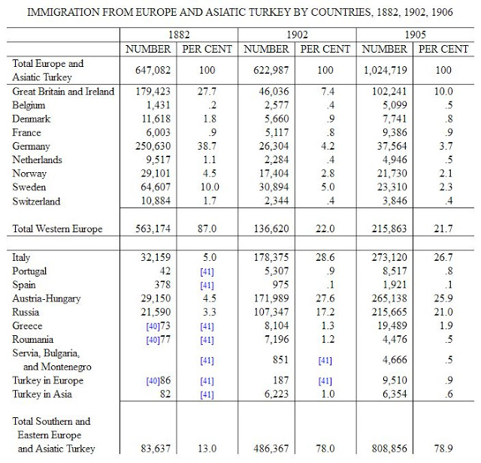

Slide 15
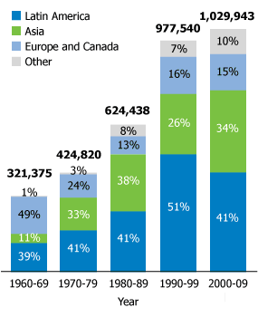
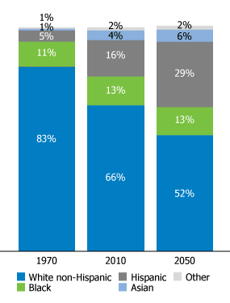
…just an update
Legal U.S. Immigrants by Decade and Region of Origin, 1960-2009
U.S. Population by Race and Ethnic Group, 1970, 2010, 2050
Both graphs from census.gov

Slide 16
Push Factors
Europeans:
Chinese
1840-50: Irish Potato Famine
1848 Revolutions create turmoil
Escape religious persecution
  Jewish driven out of Russia by programs
  Catholics escape Bismarck’s Germany
1800-1900: Population of Europe doubles to 400 million
1839-42: Opium War with Britain
1850-64: Taiping Rebellion
Agricultural crisis, rice shortage
Mexicans:
Relatively open borders until 1920
Mexican Revolution 1910 → Political turmoil

Slide 17
Pull Factors: De Jure Encouragement
Immigrants satisfy US economic needs
1864 Immigration Act (to encourage immigration)
  validated labor contracts made by immigrants before arrival
  exempted immigrants from compulsory military service
1868: Burlingame Treaty between U.S. and China allowed unrestricted immigration to work on the transcontinental railroad
  Sec. of State Seward hoped to open Chinese markets to U.S. goods.
  By 1870, Chinese were 10% of CA pop
1870s: Companies recruit in Mexico in part to replace Chinese, mostly seasonal work
1901 National Reclamation Act irrigated new farmland in Western States (west of Iowa)
Japanese recruited by Hawaiian Planters. Once Hawaii was annexed in 1898, Japanese immigrated to the West Coast.

Slide 18
Pull Factors: Business Supports Immigration
Throughout the 1800s (as today), immigration had been most staunchly supported by Big Business and the professional class, and most fiercely resisted by the wage-earner.
“It is an easy and patriotic matter for the lawyer, minister, professor, employer, or investor, placed above the arena of competition, to proclaim the equal right of all races to American opportunities; to avow his own willingness to give way should even a better Chinaman, Hindu, or Turk come in to take his place; and to rebuke the racial hatred of those who resist this displacement. His patriotism and world-wide brotherhood cost him and his family nothing, and indeed they add to his profits and leisure.”
  JOHN R. COMMONS PROFESSOR OF POLITICAL ECONOMY, UNIVERSITY
  OF WISCONSIN, 1907

Slide 19
Pull Factors: Opportunity
Large tracts of open land, abundant natural resources, excellent soil
  Homestead Act of 1862
Eager “Can do” attitude
A government that encouraged “rugged individualism” and “free enterprise”

Slide 20
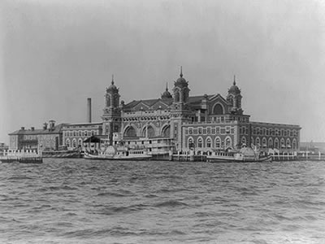
Ellis Island
1892 – 1924: 5000 enter daily, about 1 in 50 rejected

Slide 21
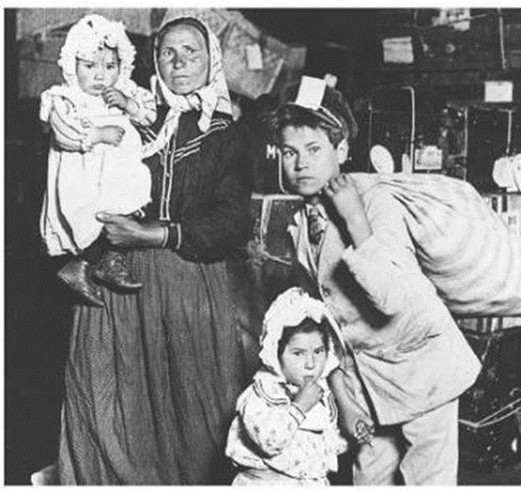
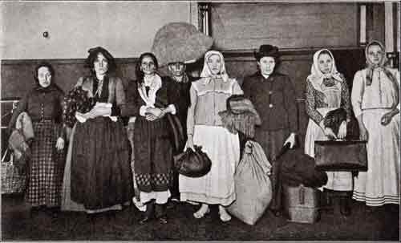
Ellis Island

Slide 22
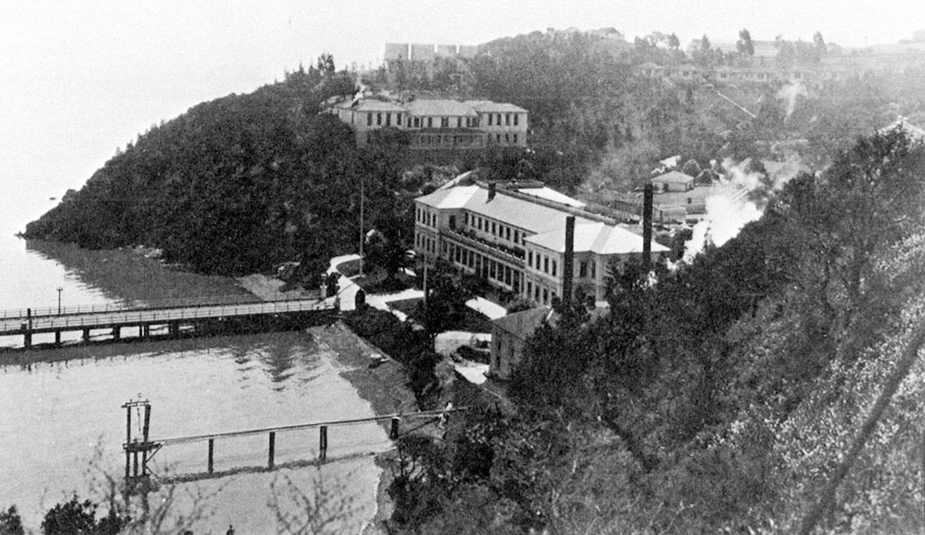
Angel Island

Slide 23
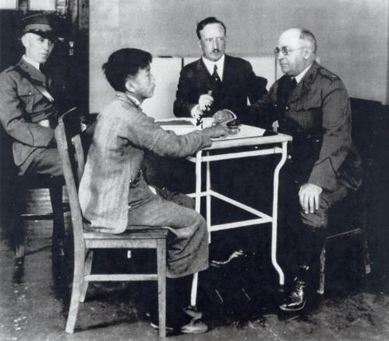
Angel Island
Immigrants at Angel Island faced harsh questioning and long detention in filthy buildings before finding out if they could immigrate.

Slide 24
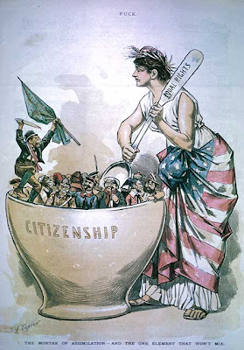
Challenges to the Melting Pot Theory
To what extent would immigrants relinquish their cultural identities and assimilate to “American” culture?
25-30% of those who came between 1870-1900 returned to country of origin.
Cooperation for survival meant many groups remained in communities of origin

Slide 25
Reactions to Mass Immigration: Nativism
Nativists viewed Eastern and Southern Europeans as culturally and religiously exotic/inferior and often treated them inhumanely.
Concerned about foreign doctrines e.g. Catholicism, Socialism, Anarchism.
Perceived threat to Anglo-Saxon America.
Alarmed at high birthrates of the poor and the Catholic
Blamed immigrants for degrading cities
Angry at immigrant willingness to work for "starvation" wages.
Alarmed at prospect of “mongrelized” America with a mixture of "inferior" South European blood.

Slide 26
Reactions to Mass Immigration: APA
American Protective Association, est. 1887
  Urged voting against Roman Catholic candidates
  1 million members
  Strongest in the Midwest
  Came under heavy attack from Democrats until its collapse in the mid-1890s.

Slide 27
Reactions to Mass Immigration: Labor
Organized Labor infuriated at use of immigrants as strike breakers.
  Argued if American industry was entitled to protection from foreign goods, American labor was entitled to protection from foreign laborers.

Slide 28
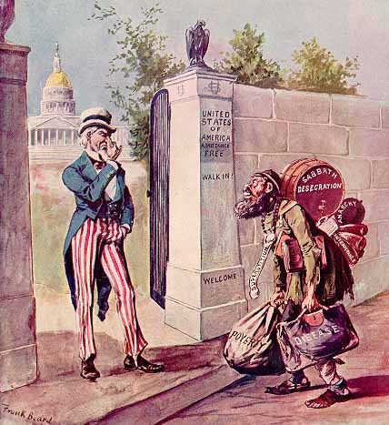

Slide 29
Thomas Nast, 1867

Slide 30
Reactions to Mass Immigration: Social Gospel
Rev. Josiah Strong: Our Country: Its Possible Future and Its Present Crisis (1885)
  Congregational minister, a founder of SGM
  Loathed immigrant impact on cities
    Condemned cities as wicked places
    Condemned low wages, gambling, robbery, and corruption
  Seven "perils" facing the nation: Catholicism, Mormonism, Socialism, Intemperance, Wealth, Urbanization, and Immigration.
  More on SGM later in lecture…

Slide 31
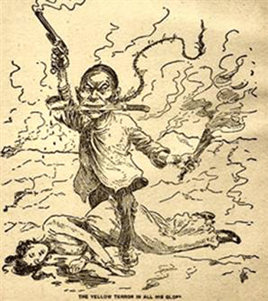
Reactions to Mass Immigration: Anti-Chinese Sentiment
Anti-Chinese sentiment intensified after Panic of 1873
1882 Chinese Exclusion Act ended Chinese immigration for 10 years (with exceptions for some students, teachers, government officials, and merchants)
  1892 extended for 10 years
  1902 extended indefinitely
  Repealed in 1943 (WWII)

Slide 32
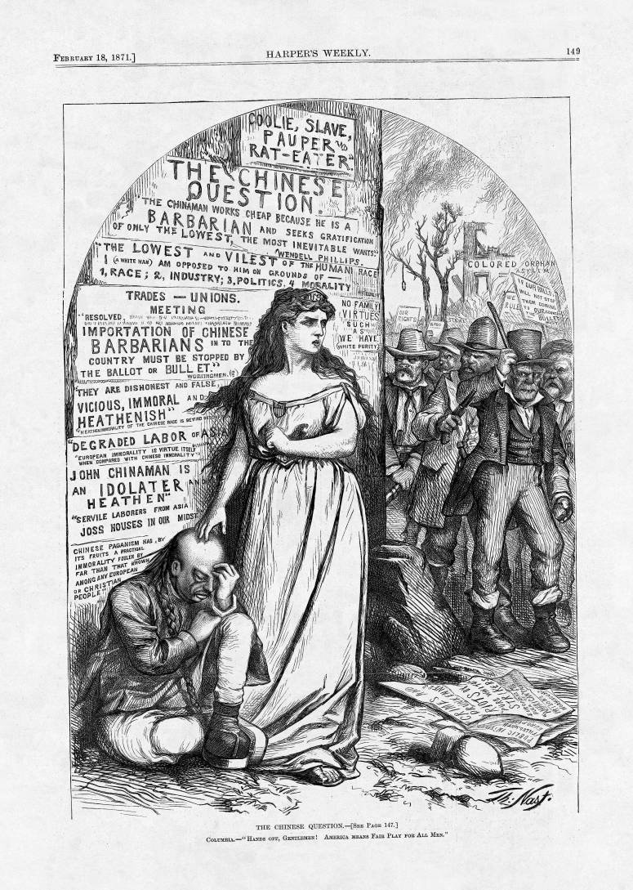
Thomas Nast

Slide 33
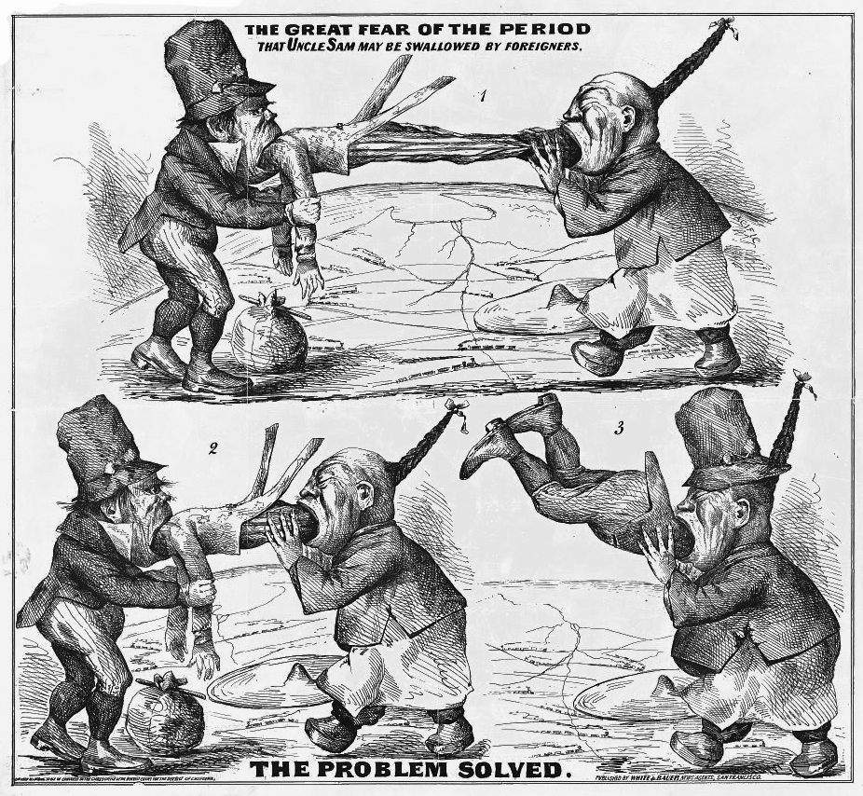

Slide 34
Reactions to Mass Immigration: Anti-Japanese Sentiment
Anti-Chinese fears were extended to Japanese and other Asians
1906 local boards of education (esp San Francisco) segregated Japanese children. Japan protested.
TR’s 1907 Gentleman’s Agreement
  US would not impose restriction on Japanese immigration, and Japan would not allow further emigration to the U.S
  SF segregation order was repealed, largely unenforced
  Nullified by the Immigration Act of 1924, which legally banned almost all Asians from migrating to the US.

Slide 35
Reactions to Mass Immigration: Anti-Immigrant Legislation
1897- Congress passed a bill requiring a Literacy Test for immigrants that would refuse entry to those who could not read 40 words any language
  Vetoed by President Cleveland. Taft vetoed a similar bill in 1913. Wilson’s 1917 veto was overridden.
It took a World War to cap immigration
  1921 Emergency Quota Law & 1924 Immigration Quota Act
  Reduced non-NW Euro entries to a mere drip
  No major immigration legislation until 1965

Slide 36
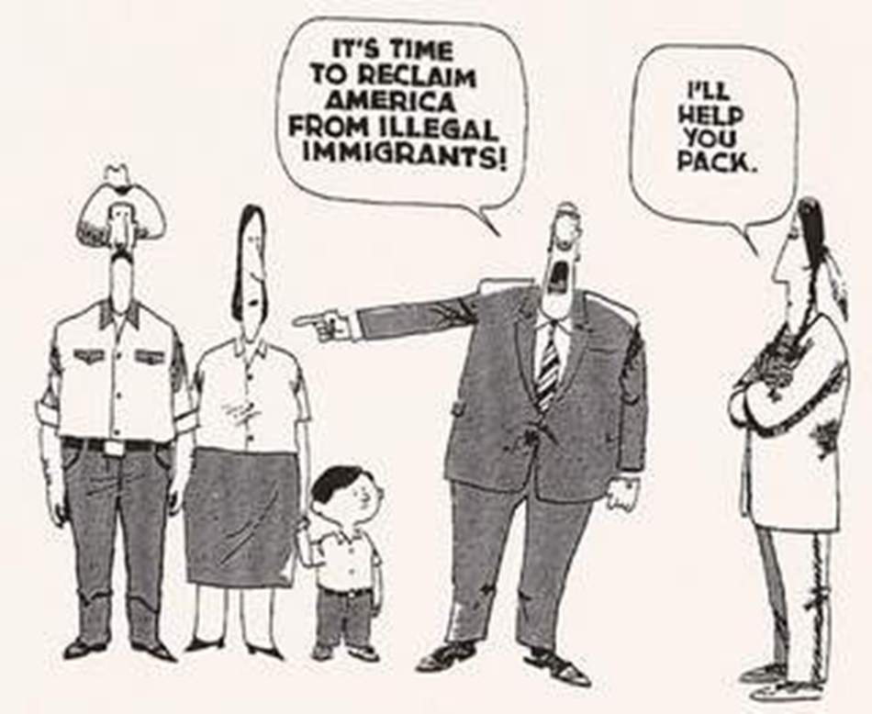

Slide 38
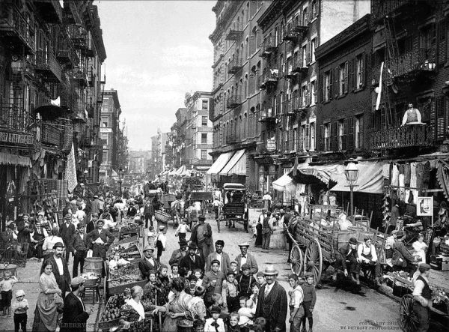
Urbanization

Slide 39
The Numbers
Urban pop: 10 → 54 million 1870-1920
By 1910, immigrant families comprised > 50% of the population of 18 major American cities
By 1890, 2x as many Irish residents in NY than Dublin
1890-1910, 200,000 Blacks moved North: NYC, Detroit, Chicago
  1910-1930, 6 million more
  See Great Migration lecture…

Slide 40
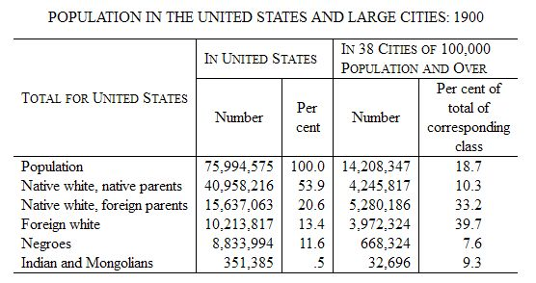

Slide 41
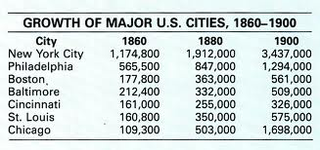

Slide 42
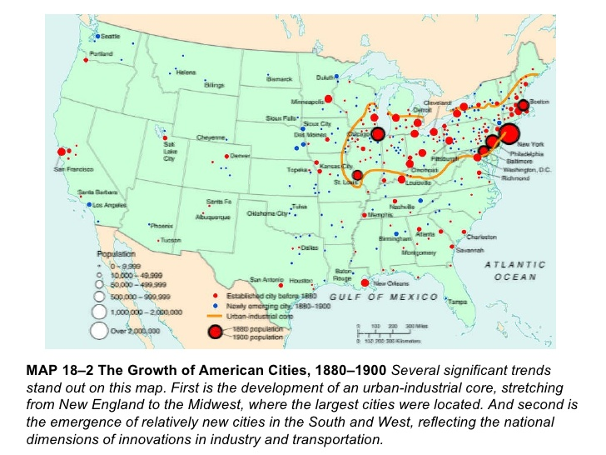

Slide 43
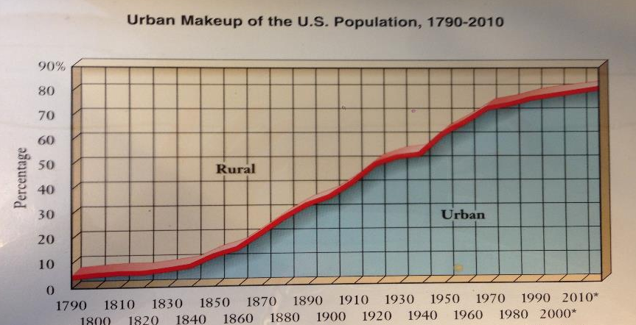

Slide 44
Urbanization: Pull Factors
Immigration + Internal Migration
  Farm foreclosures (see Populism lecture)
  Natural and economic disasters made industrial jobs attractive. Offered unskilled laborers steady jobs in mills and factories
Economic and social opportunities lured people: Rural America could not compete
  Department stores emerged
  Allure of endless entertainment
    “Bread & Circus” - Barnum & Bailey Circus, est. 1881
  Amenities: electricity, plumbing, telephones

Slide 45
The Shame of Cities: Muckrakers
TR credited with popularizing the term in a 1906 speech, but the challenge from the Fourth Estate preceded the speech by decades
Watchdog Function: Journalists, novelists, and critics during who expose abuse and corruption in business and politics
Harper’s, Atlantic Monthly, Scribner’s, The Nation
Fine line between muckrakers and yellow journalists
  Expose vs. Sensationalism

Slide 46
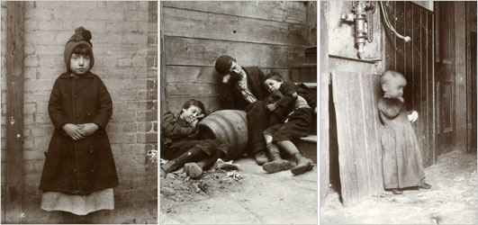
The Shame of Cities: Housing
Exposed by muckraker Jacob Riis used “flash power”, a new photography technique in How the Other Half Lives.

Slide 47
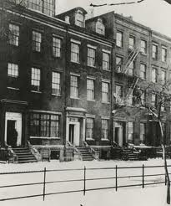
The Shame of Cities: Housing
  Row Houses
  Tenements: multiple families in one residence, dark, poorly ventilated, vermin ridden…

Slide 48
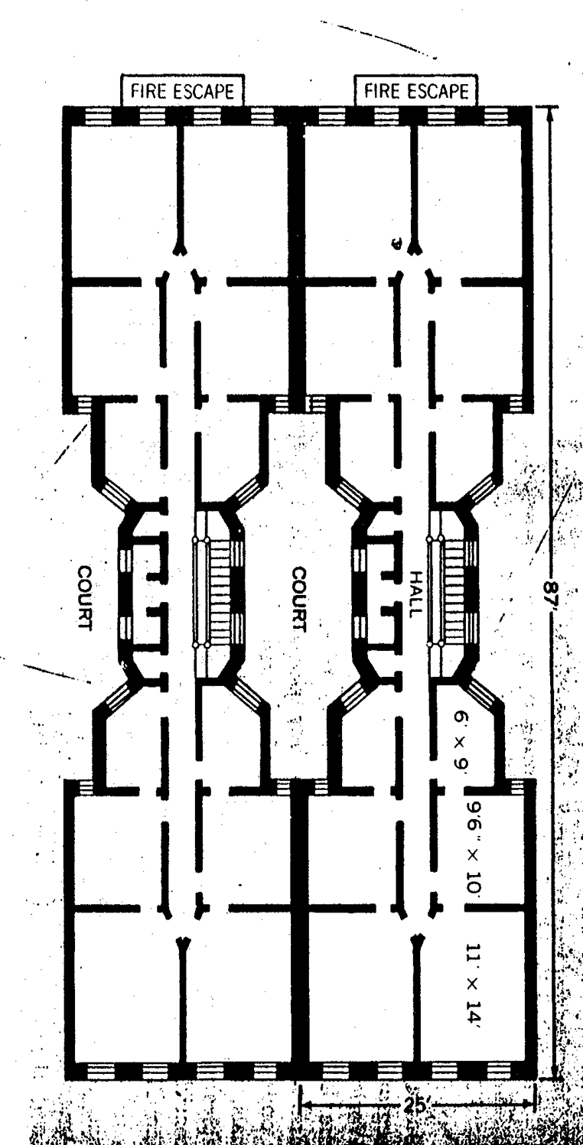

Slide 49
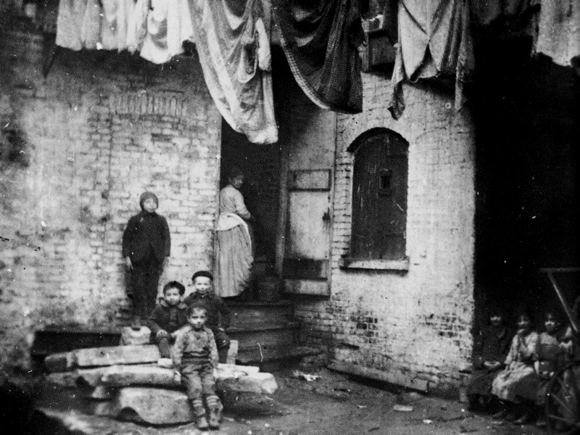

Slide 50
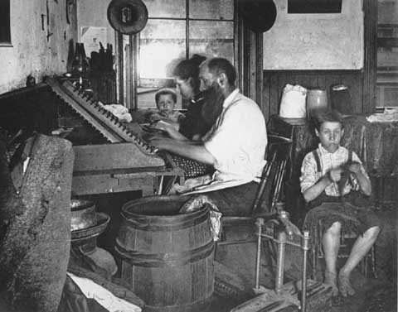

Slide 51
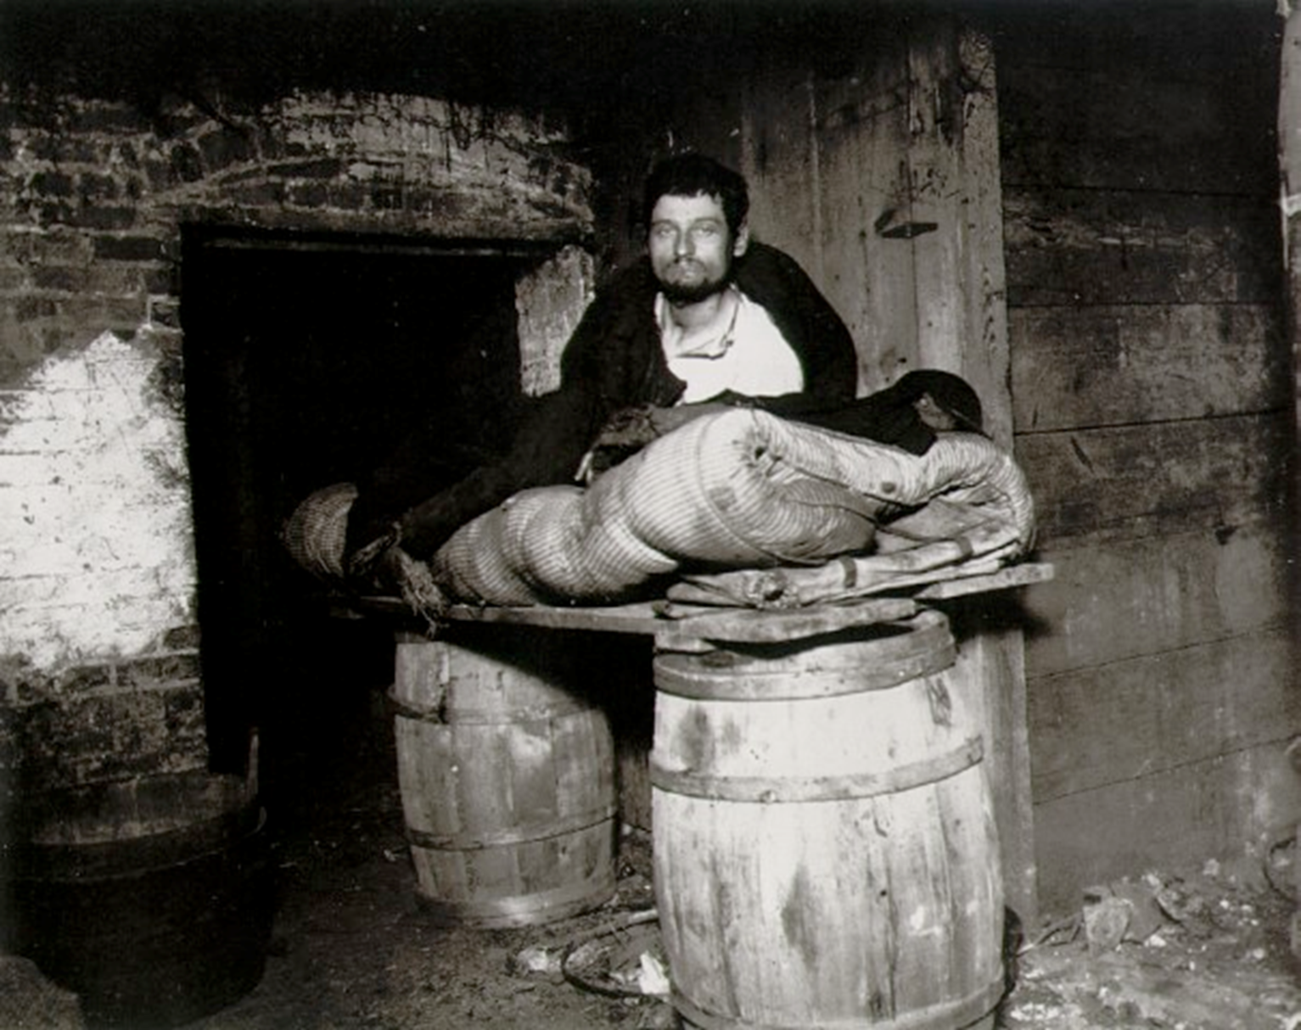

Slide 52
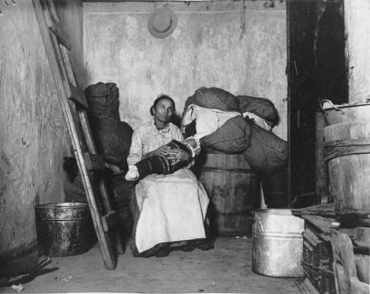

Slide 53
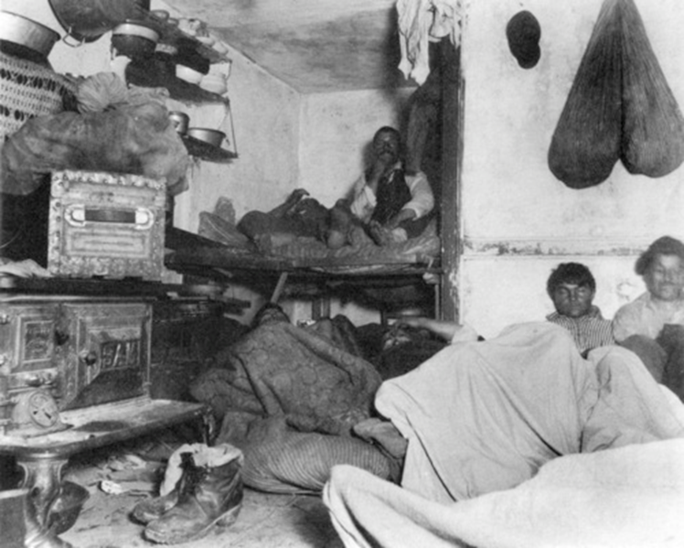

Slide 54
From How the Other Half Lives
“In self-defence, you know, all life eventually accommodates itself to its environment, and human life is no exception.”
"The slum is the measure of civilization.”

Slide 55
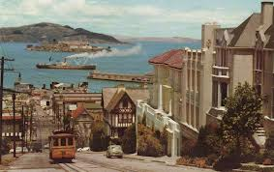
The Shame of Cities: Transportation
Innovations in mass transit developed to move people from home to factories
1873 street cars in SF
1897 electric subways in Boston
By 1900 most cities had a system connecting the inner city to new suburbs, the bourgeoisie escape

Slide 56
The Shame of Cities: Water
Problem of supplying safe drinking water
1840s and 1850s cities built public waterworks to handle demand, then post-war immigration boom…
  Typhoid fever and cholera
1870s Filtration introduced
1908 Chlorination

Slide 57
The Shame of Cities: Sanitation
Horse manure, human sewage flowed through open gutters, factories pollution
Trash collection was a racket
By 1900 many cities developed sewer lines

Slide 58
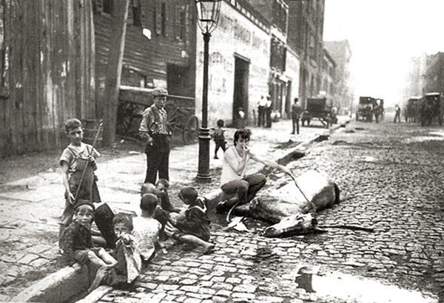

Slide 59
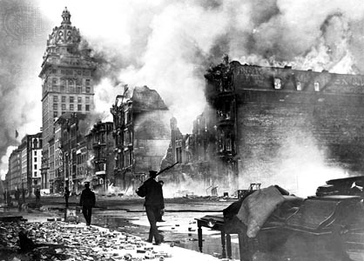
The Shame of Cities: Fire
Limited water supply
Candles and kerosene lamps
Wood frame construction
Volunteer fire service
1871 Chicago Fire - 17,500 buildings destroyed
1906 San Francisco Earthquake and Fire - 28,000 buildings destroyed
1911 Triangle Shirtwaist Factory Fire in Manhattan - deadliest industrial disaster in the history of NYC. 146 dead garment workers. 123 women and 23 men, mostly recent Jewish and Italian immigrants ages 16-23

Slide 60
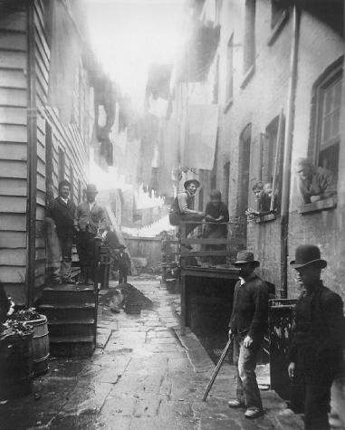
The Shame of Cities: Crime
Pickpocketing
Gangs
Violent crime
Prostitution, cocaine, gambling…
1844 NY first to organize a full-time salaried police force

Slide 61
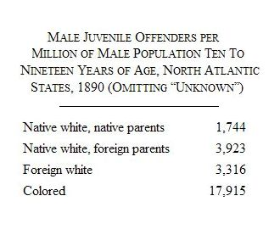
Project Gutenberg's Races and Immigrants in America, by John R. Commons

Slide 62
Impact of IIU on Class & Gender
Class distinctions became more pronounced in American history by 1900
  1. New class of super-wealthy bourgeoisie: the nouveau riche
    1890 in US
      Top 12% of families owned 86% of wealth.
      Bottom 44% of families owned 1.2% of wealth.
    Today:
      In US: Top 1%; 45% (Zakaria)
      In World: 85 people control the same amount of wealth as half the world's population. 85 people compared with 3.5 billion. (Oxfam)
  2. Middle class
    Upper end: lawyers and doctors
    Lower end: salesmen, some government workers, and teachers
    Mostly WASP

Slide 63
Impact of IIU on Class & Gender
3. Working Class (the proletarian)
  Skilled northern mechanics at top; miners and RxR workers at bottom
  Often Catholic, S/SE European immigrants, Blacks
  25-30% of workforce unemployed for some period every year
  In 1900, nearly 20% of children under 15 worked in non-agricultural work.
  About 20% of urban women worked outside the home…

Slide 64
Impact of IIU on Class & Gender
Middle and upper-class married women rarely worked. If they did, social workers and teachers
In 1900…
  6% of married women worked outside the home
  17% of the labor force was female
  5 million women worked for wages
  45% of single women worked
    20% worked textiles
    40% domestic servants

Slide 65
Impact of IIU on Class & Gender
Hierarchy of female workers
  Secretaries, store clerks, telephone operators, bookkeepers.
    Open to mainly "American" girls (WASPs)
  Factory work
    Farm girls who sometimes returned to farm
    Immigrant girls
    1900 - International Ladies' Garment Workers' Union
    1903 - Women’s Trade Union League
      Offered some protection
  Domestic servants
    Usually foreign-born (esp Irish) or Black
    Often worked 12+ hours/day, 6 days/week
    No protection, no union

Slide 66
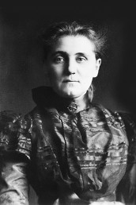
The Reformist Reaction
Jane Addams

Slide 67
Who were the reformers and what did they want?
Mostly middle class whites, informed and inspired by Muckrakers, concerned with:
    Immigration
    Urban squalor
    Unchecked influence of Big Business
    Direct democracy
    Reformed tax code
    Women’s Suffrage
    Labor unrest
    Crime and moral corruption
    Child Labor

Slide 68
Reform: Americanization Movement
Many groups resisted assimilation and were comfortable in their ethnic communities . So local ad hoc movements formed to assimilate them.
Promoted by entities such as
NGOs provided programs to teach skills for citizenship such as:
  Language
  Literacy
  American history and government
  Cooking
  Social Etiquette
  School boards
  YMCA / YWCA
  Labor unions
  Knights of Columbus
  National Chamber of Commerce
  Ford Motor Company

Slide 69
Reform: Social Gospel Movement
Social Crusaders to improve the Shame of Cities
Churches stepped in where government failed
In addition to preparing for the afterlife, Christianity should improve life on Earth
Motivations:
  Fear of violent working class Revolution
  Human decency. Christian Ethics. Service.
  Spread the Gospel

Slide 70
Reform: Social Gospel Movement
Insisted that churches tackle burning social issues: poverty, alcoholism, crime, racial tensions, slums, bad hygiene, child labor, inadequate labor unions, poor schools, and the danger of war.
Salvation Army: uplift and Save the poor. Soup kitchens, clothing donations, etc.
YMCA
Dwight Lyman Moody, Moody Bible Institute, 1889
Associated with the liberal wing of the Progressive Movement

Slide 71
Reform: Settlement House Movement
England’s Toynbee Hall, 1884.
New York’s Stanton Hall, 1886
Primarily white, educated, well-to-do Northeastern and Midwestern women
  Teaching or volunteerism were almost the only permissible occupations for young well-to-do women
  Settlement houses became centers of women’s activism and social reform. Politicization of women, roots of second Suffrage Movement.
Jane Addams’ Hull House in Chicago, 1889…

Slide 72
Reform: Settlement House Movement
Jane Addams (1860-1935) ("St. Jane")
  Believed living among the poor would give meaning to lives of young, educated, humane women
  Hull House in Chicago (with Ellen Gates Starr)
  Taught immigrants English, nutrition, health and child care. Also discussed current events.
1892, Addams published her thoughts on "the three R's" of the settlement house movement: residence, research, and reform.
  These involved “close cooperation with the neighborhood people, scientific study of the causes of poverty and dependence, communication of [these] facts to the public, and persistent pressure for [legislative and social] reform..."

Slide 73
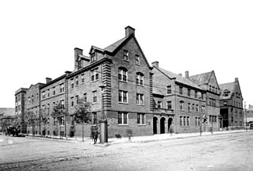
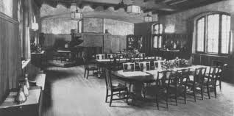
Hull House
Daycare and 1 kids meal a day
Free Kindergarten
Boy’s club
Coffee shop for adult men
Established the city's first public playground and bathhouse
Extensive social, educational, and artistic programs
Medical clinic

Slide 74
Saint Jane, Beyond Hull House
1893, Illinois banned the exploitation of minors in the workplace.
Addams' efforts, the Juvenile Court of Chicago est.
During WWI (1914-18) she organized the Women's International League for Peace and Freedom, which worked to end WWI
  1931 Nobel Peace Prize for her work with WILPF .

Slide 75
Reform? Or Revolution. Creeping Socialism…
The collective has deep roots in American history
America is abound with utopian experiments (City on a Hill)
  Brook Farm, New Harmony, Shakers, Oneida…
German, Italian, and Jewish immigrants…
Unions & Socialism / Social Democracy
  1866 - National Labor Union (William H. Sylvis)
  1876 - Workingmen's Party/Socialist Labor Party (Terence Powderly)
  1886 - American Federation of Labor (Samuel Gompers)
    4 mil. members!
    1886 - Haymarket & International Workers’ Day (May Day)
  1893 – American Railway Union (Eugene Debs)
  1905 – International Workers of the World / “Wobblies” (Big Bill Haywood, Mother Jones, Eugene Debs)

Slide 76
Reform? Or Revolution. Creeping Socialism…
1901 - Socialist Party
  Florence Kelley - fought against sweatshops and for the minimum wage, eight-hour workdays, children's rights
  Various socialist mayors, congressmen, etc.
  1920, Socialist Party presidential candidate Eugene V. Debs won nearly 1m votes…from prison
Progressive Reform Era (1900-1920) curtailed the Socialist impulse
Two Red Scares coming right up…

Slide 77
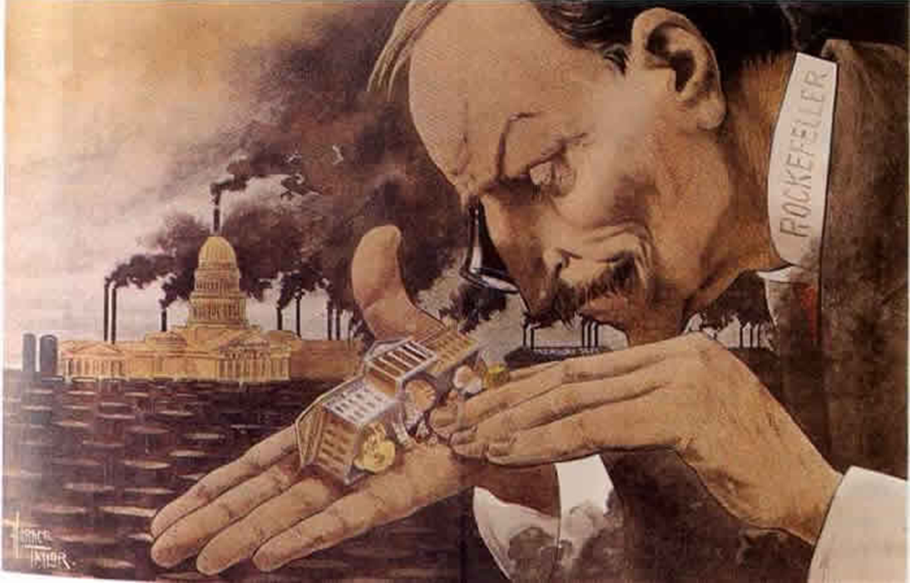
Politics of the Gilded Age
What a Funny Little Government, 1900

Slide 78
Political Machines
During Gilded Age, many cities run by political machines.
  Controlled by a city boss and his party
  Where Americanizers, Nativists, the APA, The Salvation Army, and Reformers failed…
  Machines offered services to voters and businesses in exchange for political or financial support

Slide 79
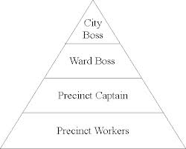
Political Machine Organization

Slide 80
Political Machines: Bosses
Ran local business and politics
Controlled access to municipal jobs and business licenses
Influenced the courts
Gained voter loyalty through providing the city with municipal benefits
  Built waterworks, roads, sewers, parks, schools, hospitals, and orphanages
Corrupt! But…

Slide 81
Political Machines: Immigrants and the Machine
Many precinct captains and bosses were 1st or 2nd generation immigrants
Spoke the immigrants’ language and help to find jobs, housing, loans, lawyers…
Favors for Votes: “democracy at its finest”

Slide 82
Political Machines: Tactics
Many Bosses got rich through
  graft - illegal use of political influence for personal gain.
  kickbacks – extorting cash in exchange for favors (jobs, insider info, friendly judges…)
  Running gambling and loan shark fronts
Until 1900s, police forces were hired and fired by city bosses

Slide 83
Political Machines: Tammany and Tweed
William Magear Tweed (1823-78), a.k.a. Boss Tweed, one of the most powerful political bosses.
Head of Tammany Hall, NY’s Democratic machine
His path
  1853-55 – HOR, D-NY-5th
  1858 – NY Board of Supervisors & Ward Boss
  1862 – Chair of Dem General Committee
  1867-73 - NY State Senate
  Got buddies elected to office. They became Tweed Ring
Swindled NYC in the 1860s and 1870s

Slide 84
Political Machines: Fraud!
Tweed Ring milked NYC via: fake leases, padded bills, false vouchers, unnecessary repairs, and overpriced goods and services bought from suppliers controlled by the ring. Examples:
  Bought 40 old chairs and three tables: $179,792 ($2 million today)
  Carpenter paid $360,751 for one month's labor ($5 million today)
  Plasterer's wages for 9 month job: $2,870,464 ($34 million today)
  30 months of advertising paid to a Tweed-controlled printing company: $7,168,212 (about $87 million today)

Slide 85
Political Machines: Fraud!
Bought undeveloped property in Harlem, used city funds to develop it (run water and roads to it), then sell the property.
  Tweed was 3rd largest property owner in NYC
Tweed’s masterpiece was a three-story courthouse in Lower Manhattan originally budgeted at $250,000. By Tweed’s death, the city had spent more than $13 million ($180 mil today) – and the building was still not finished.
In the end he plundered $50-200 million.
  $365 million - $2.4 billion today

Slide 86
Political Machines: Voting Fraud
Voting fraud was common
No voter identification
Shave your beard and vote again
Dogs and dead people
Counting

Slide 87
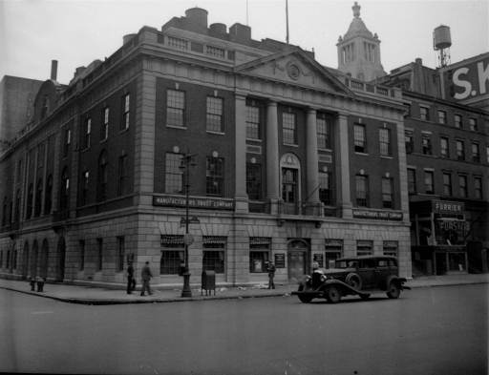
Tammany Hall

Slide 88
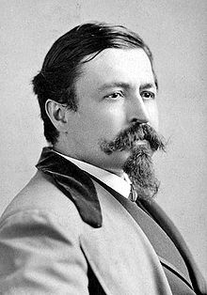
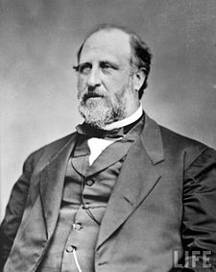
Nast vs. Tweed Ring
Thomas Nast
William Tweed

Slide 89
Thomas Nast vs. Tweed Ring
Harper’s cartoonist, attacked Tweed Ring
"Stop them damned pictures. I don't care so much what the papers say about me. My constituents don't know how to read, but they can't help seeing them damned pictures!" –Tweed

Slide 90
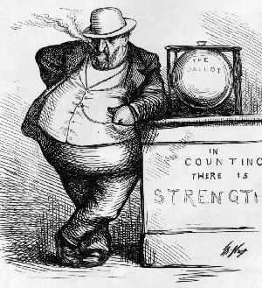

Slide 91
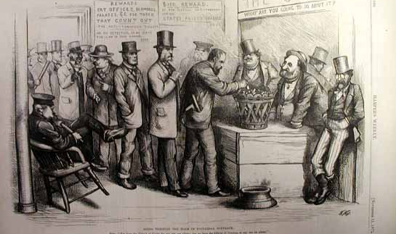
Going Through the Form of Universal Suffrage, 1871
Caption: (Boss) "You have the Liberty of Voting for any one you please;
but we have the Liberty of Counting in any one we please."

Slide 92
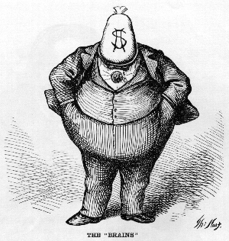
One of Nast’s most famous cartoons speaks for itself on
“The Brains” of Tammany Hall.

Slide 93

Caption (not pictured) says:
“Who Stole the People’s Money? -- Do Tell.‘TWAS HIM.”

Slide 94

New York Corruption - 'The City Treasury - Empty to the Workmen, and the Four Masters who Emptied It'

Slide 95


Slide 96


Slide 97

Published on the eve of the 1871 NYC elections.
Caption says:
“The Tammany Tiger Loose-What Are You Going to Do About It?”

Slide 98
Nast vs. Tweed Ring
Tweed sent someone to inform Nast that some admirers of his work wanted to send him to Europe to study art.
When Nast, suspicious, replied that he could not possibly afford to leave his work at Harper's, the reply was that $100,000 was set aside for him. Nast responded it would take more than that to make it worth his while. When the figure was raised to $500,000 , Nast said he'd rather see Tweed and his gang in jail first.
"Be careful Mr. Nast," his caller replied, "that you do not find yourself in a coffin first." Not long after that, suspicious looking characters were seen outside of Nast's home in Manhattan, so he moved his family to suburban Morristown, New Jersey.

Slide 99
Nast vs. Tweed Ring
Failing to bribe Nast, Tweed tried to intimidate Harper’s Brothers Publishing by threatening to have the Board of Education throw out all Harper textbooks and never buy any more.
  This would bankrupt Harper’s
  The board of directors voted to stand by Nast

Slide 100

Following the threats against himself and Harper’s, Nast published The New Board of Education.

Slide 101
Nast vs. Tweed Ring
Nast and other muckrakers eventually brought Tweed down in 1871.
  220 counts
  Hung jury
  Re-tried, convicted to 1 year. Does time.
  Civil suit > fled to Spain > recognized due to a Nast cartoon > extradited > agreed to tell all in a plea
  Died in the Ludlow Street Jail in 1878

Slide 102

Spanish police interpreted the cartoon to mean that Tweed was wanted for kidnapping and the word "REWARD" caught their eye.

Slide 103

Mystic chords of memory: 1908 hit song.
'Tammany Tiger' or 'trust-buster' (and ex-NY governor) Teddy Roosevelt

Slide 104

Terry Golway. Machine Made: Tammany Hall and the Creation of Modern American Politics. 2014.
Tammany courted immigrants because “they knew how to count”
Tammany provided relief for Irish immigrants/refugees
Though sympathetic to the plight of Black and Chinese Americans, German-born Nast loathed Catholics. His criticism of Tammany was informed by his bigotry
  In 1871, The American River Ganges portrayed Catholic bishops as crocodiles waiting to attack American school children.
  In 2011 Nast denied entrance into the NJ Hall of Fame for his bigotry

Slide 105
From the Record
As long as I count the votes what are you going to do about it?
-Marcy Tweed
The politician who steals is worse than a thief. He is a fool. With all the grand opportunities around for the man with a political pull, there's no excuse for stealin' a cent.
-Boss Pendergast of Kansas City, MO
Politics is a business just like anything else.
-George Washington Plunkett (Tammany Machine, NY State Senator)
Don't worry if they're Democrats or Republicans. Give them service and they'll become Democrats
  -Richard J. Daley
“Vote for Fred and Nobody Gets Hurt.”
-Campaign slogan of Chicago 1st Ward alderman Fred “Peanuts” Roti

Slide 106
From the Record
A political machine is a united minority working against a divided majority -Will Durant
Mothers all want their sons to grow up to be president but they don't want them to become politicians in the process -John Fitzgerald Kennedy
Politics is supposed to be the second-oldest profession. I have come to realize that it bears a very close resemblance to the first. -Ronald Reagan
Politicians are like diapers. They should both be changed frequently and for the same reason. -Mark Twain

Slide 107
Coming Soon….
Cleaning Up in the Progressive Era

