Slide 1
The Weimar Republic:
The Constitution, Political Parties, and Early Threats to the Republic
Mr. Daniel Lazar

Slide 2
Lecture Outline
Background to Weimar: Born in Crisis
Structural-Functional Analysis of Weimar Constitution
Weimar Political Parties
Discussion & Conclusions

Slide 3
The Weimar Republic
Three Phases:
  The Years of Crisis, 1918-1923
  The Years of Stability, 1924-1929
  The Collapse of the Weimar, 1930-1933

Slide 4
Weimar: Born of Crises
Was Weimar “stillborn”? If not then…
Abdication
Versailles
Inflation
Challenges from the Left
[More Substantial] Challenges from the Right
1923 Occupation of the Ruhr
Ebert’s Government & the Desperate Effort to Stabilize

Slide 5
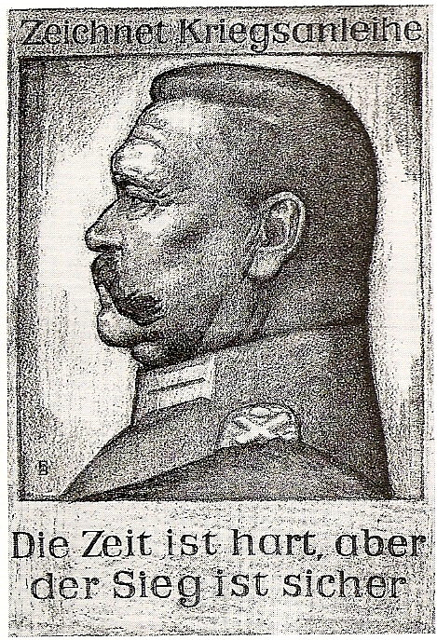
Weimar: Born of Crisis
From 1916 the German population became increasingly war-weary
↑ casualties + ↓ living standards + food & fuel shortages = growing labor unrest.
Mass strikes in Jan. 1918 throughout Germany and Austria-Hungary
Defeat profoundly shocked Germans–had all their suffering been for nothing?
“The Times Are Hard but Victory Certain.”
Poster by Bruno Paul (1917)

Slide 6
Weimar: Born of Crisis
Versailles Treaty (previous lecture)
2.5 million war deaths + 4 million wounded
Spanish Flu Pandemic (20-50 mil dead)
Food and fuel shortages
Economic woes
Anarchy on Eastern Border

Slide 7
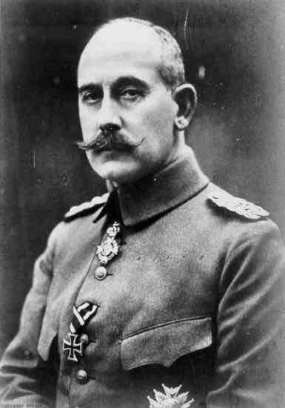
Weimar: Born of Crisis
High Command argued the Allies would deal more leniently with a parliamentary gov
3 Oct 1918: Prince Max von Baden made Chancellor
26 October: Reform of the Constitution. Announced:
  3 class franchise abolished
  Kaiser’s powers over the army and appointments curtailed
  Chancellor and the Government made accountable to Reichstag
‘Revolution from above’?
Prince Maximilian of Baden (1867-1929)

Slide 8
Crisis: November Revolution
3 Nov 1918: Sailors at the naval base in Kiel mutiny. The unrest rapidly spreads to Wilhelmshaven, Hamburg, Bremen, and Berlin. Dockworkers and Soldiers join the mutineers.
6 Nov: Workers’ and Soldiers’ Councils est.
7-8 Nov: Revolution in Munich—Wittelsbach dynasty deposed. Republic proclaimed.
9 Nov: Abdication of Kaiser & Max von Baden resigns
  Republic declared by SPD’s Philip Scheidemann
  Friedrich Ebert becomes Chancellor
10 Nov: Ebert-Groener Pact - army agrees to support the new regime in return for:
  Promise of Army’s independence
  Ebert stand against Communists
11/11 at 11am: Armistice signed

Slide 9
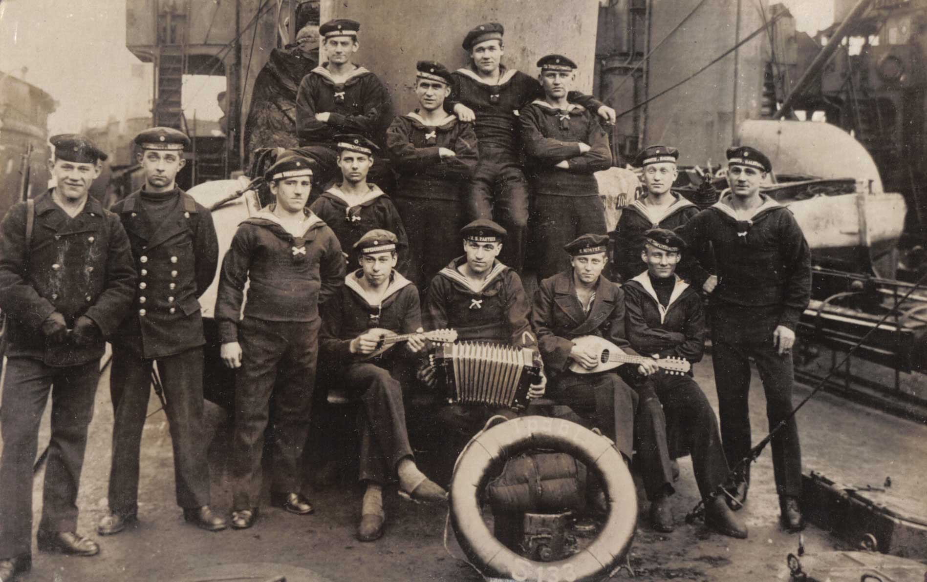
Revolutionary Sailors at Kiel, November 1918

Slide 10
Crisis: Abdication
Wilhelm could not decide whether to abdicate
Thought that even if he vacated German throne, he would retain Prussian throne
Wilhelm's abdication abruptly announced by Chancellor, Prince Max of Baden, 9 Nov 18
Hindenburg, a lifelong royalist, advised Wilhelm to abdicate
November 10, Wilhelm went into exile in Netherlands
  Didn’t want to end up discovered with his wife and 4 children by an amateur archeologist in Sverdlovsk in 1979
End to 5 centuries of Hohenzollern rule
  2 December 1919, Wilhelm complained in a letter about his forced abdication. Blamed Jews who were a "nuisance that humanity must get rid of some way or other. I believe the best would be gas!"

Slide 11
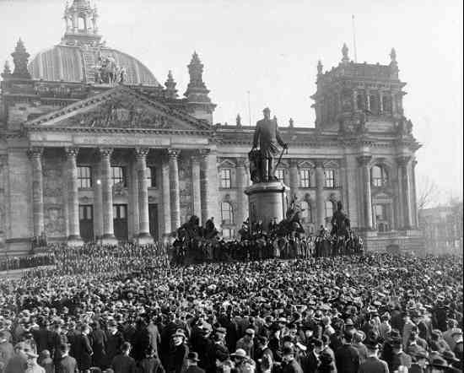
Proclamation of the Republic, 9/11/1918

Slide 12
Inflation Crisis
Roots in the pre-war and wartime economy.
Lack of capital investment, large trade deficit, and difficulties in switching from a war-time to peace-time economy were made worse by the necessity of paying reparations
Government refused to either raise taxes or cut expenditures— feared that either measure would lead to unemployment and political unrest
Default on reparations payments led to French and Belgian occupation of Ruhr (1923-24).
  Unable to collect taxes from the Ruhr and cut off from the supplies of coal that powered German industry and exports, the government’s finances collapsed.

Slide 13
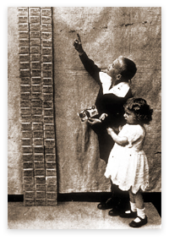
Inflation Crisis
People on fixed incomes or welfare support (students, pensioners, people on benefits etc.) were worst hit.
But landowners and businessmen able to pay off debts, mortgages etc. with worthless currency.
Long term psychological effects
  ↑ crime and prostitution
  ↑ nihilism and materialism
  ↓ faith in the Republic

Slide 14
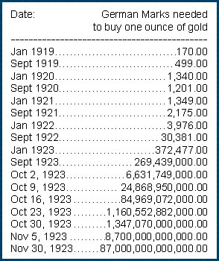
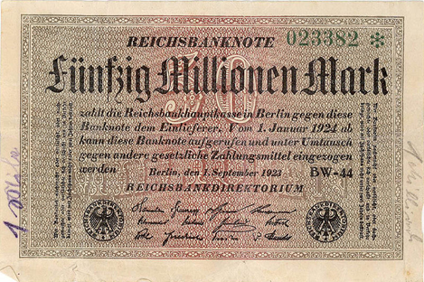

Slide 15
Crisis: Challenge from the Left
Communists feel conditions ripe for Rev
Spartacist Revolution
  Karl Liebknecht & Rosa Luxembourg, et al.
General Strike announced
Support from Lenin and CCP
Communist infiltration of some police forces
Bavaria declared a Socialist Republic

Slide 16
Years of Crisis: Threats from the Left
Two primary Left factions:
  SPD - moderate socialists, committed to working within a parliamentary democracy
  KPD (Communists) - extreme leftists who wanted Marxist revolution. Rejected Weimar system.
    Supported by 10-15% of electorate from 1919-1923
    Backed protests, strikes, and uprisings…many crushed by Freikorps
    Viewed as Bolshevik puppets
Hard to argue, at least in retrospect, that the Far Left posed a legitimate threat.

Slide 17
Crisis: Revolution in Bavaria
7 November 1918 first anniversary of Russian Rev, Kurt Eisner of USPD addressed crowd of 60,000, on the Theresienwiese (home to Oktoberfest)
Demanded an immediate peace, an 8 hour workday, relief for the unemployed, abdication of Bavarian King Ludwig III and Emperor Wilhelm II, and formation and recognition of workers' and soldiers' councils
Crowd marched to army barracks and won over most of the soldiers to the side of the revolution

Slide 18
Crisis: Revolution in Bavaria
8 November 1918, Eisner declared Bavaria a "free state"
21 February 1919, Eisner on his way to parliament to announce his resignation (USPD lost elections), assassinated by right-wing nationalist Anton Graf von Arco auf Valley

Slide 19
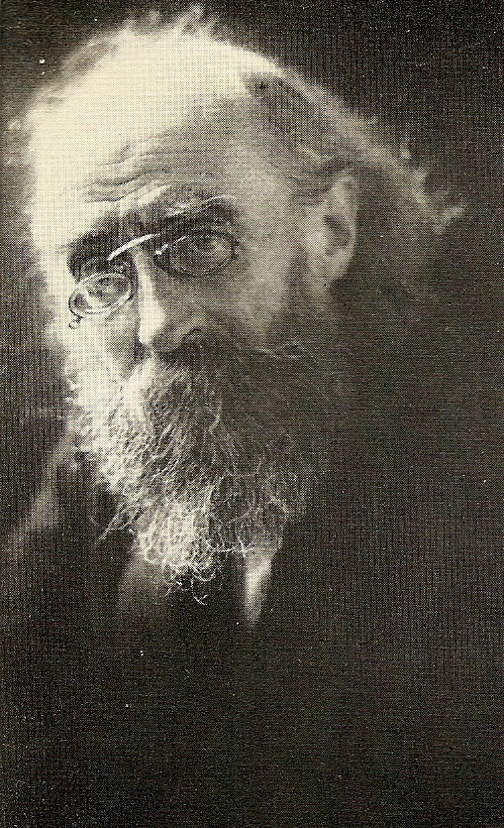
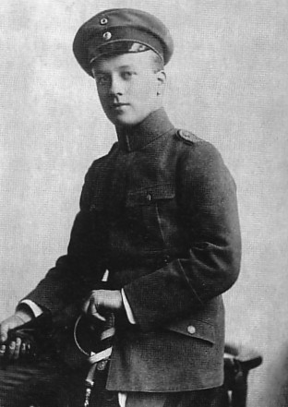
Crisis: Revolution in Bavaria
Kurt Eisner (1867-1919)
Leader of the Bavarian Revolution
Eisner’s assassin, 22 year old Anton
Arco auf Valley (1897-1945)

Slide 20
Crisis: Winter 1918-19
16-21 December 1918: Meeting of the All-German Congress of Workers’ and Soldiers’ Councils
23-24 December: Street fights in Berlin
29 December: USPD resigns from the government
1 January 1919: Kommunistische Partei Deutschland (KPD) formed
6-15 January: Spartacist Rising – KPD attempt a coup, crushed by the army and Freikorps.

Slide 21
Crisis: Winter 1918-19
6 April 1919 proclaimed Bavaria a Soviet Republic
April-May 1919, loyal elements of the German army (called "White Guards of Capitalism" by communists), with a force of 9,000, and 30,000 Freikorps entered Munich and defeated the communists
  1,000 dead Communists in street fights
  700 arrested and summarily executed by Freikorps

Slide 22
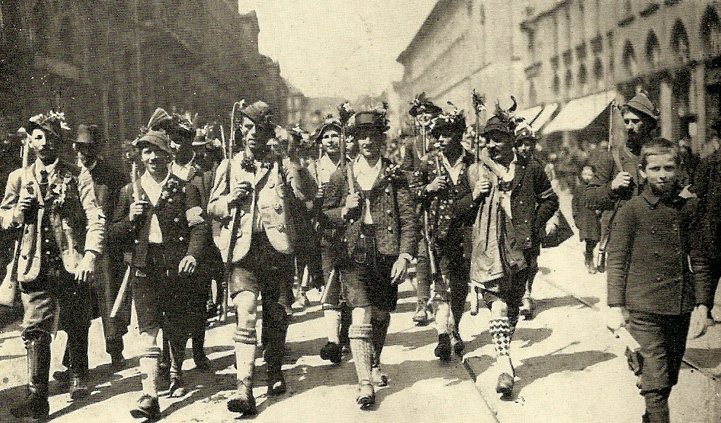
Crisis: Revolution in Bavaria
Freikorps entering Munich, May 1919

Slide 24
Crisis: Threats from the Right
The Right was not unified by a coherent ideology like the Left (until later), but did share the following ideas:
  Anti-democracy
  Anti-Marxism
  Authoritarianism
  Nationalism
  The “Stab in the Back” myth

Slide 25
Crisis: Rightwing Paramilitaries
Paramilitary organizations of demobilized soldiers 1918-1920
Army couldn’t maintain discipline or pay soldiers; Freikorps filled the vacuum
Many soldiers felt disconnected from civilian life and joined Freikorps in search of stability provided by a military structure
Fought in Baltics against Red Army, in Silesia against Polish insurgents
Fought against communist uprisings
Political assassinations (Erzberger, Rathenau, et al.)
  Hostile towards new government and towards the Left
  “Stab in the back” myth

Slide 26
Crisis: Threats from the Right
Paramilitary groups and political parties made up the extreme right, including:
  DNVP (German National People’s Party): old imperial conservatives
  Freikorps
Unlike the Left, the Extreme Right posed a legitimate threat to Weimar

Slide 27
Crisis: Threats from the Right
Kapp-Lüttwitz Putsch
13-17 March 1920 in Berlin
Built on stab-in-the-back myth
To undermine the Republic
Supported by Freikorps
Wolfgang Kapp (b. 1858 in NYC, returned in 1870 and attended Friedrich-Wilhelm-Gymnasium in Berlin) declared Chancellor by his troops
Navy supported putsch. Army split.
German gov forced to flee Berlin. Went to Dresden then Stuttgart.
Germans followed the government's call for a general strike. Unions sympathetic to SPD.

Slide 28
Crisis: Threats from the Right
Kapp-Lüttwitz Putsch
Hitler flew to Berlin to meet with Kapp. Met by striking workers at the airport. Had to disguise himself.
Strong indication that Weimar judiciary was biased
  28/354 right wingers found guilty, 0 executed
  22 Leftists found guilty, 10 executed
Kapp fled to Sweden and Lüttwitz to Hungary
  Kapp returned to Germany in April 1922 and died the same year in prison while awaiting trial.
  Lüttwitz returned to Germany as part of an amnesty in 1925.

Slide 29
Crisis: Threats from the Right The Munich ‘Beer Hall’ Putsch (1923)
Inspired by Mussolini’s 1922 March on Rome
8 November: Hitler held the right-wing rulers of Bavaria hostage in an attempt to persuade to join him in a march on Berlin to overthrow the Republic.
Initially they agreed, but once free they turned their back on Hitler and brought extra troops into Munich.
9 November at a demonstration a Nazi shot a policeman and the police returned fire, dispersing the demonstration.
Hitler, Ludendorff, and other leaders put on trial for high treason but received lenient sentences.

Slide 30
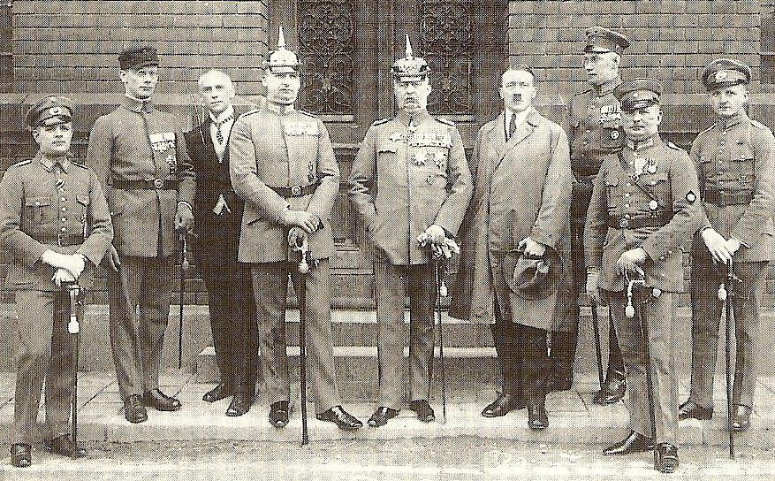
Defendants at the treason trial following the
Munich Beer Hall Putsch. Ludendorff is in
The centre. Hitler is on his left.

Slide 31
Years of Crisis: Threats from the Right
 | Left | Right
Murders Committed | 22 | 354
Sentenced to death | 10 | 0
Severely punished | 17 | 1

Slide 32
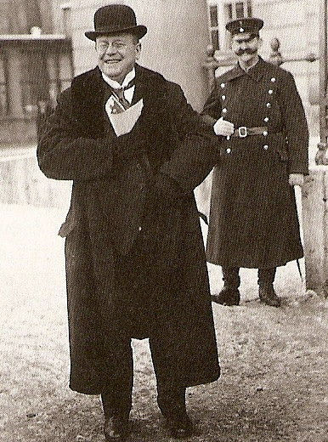
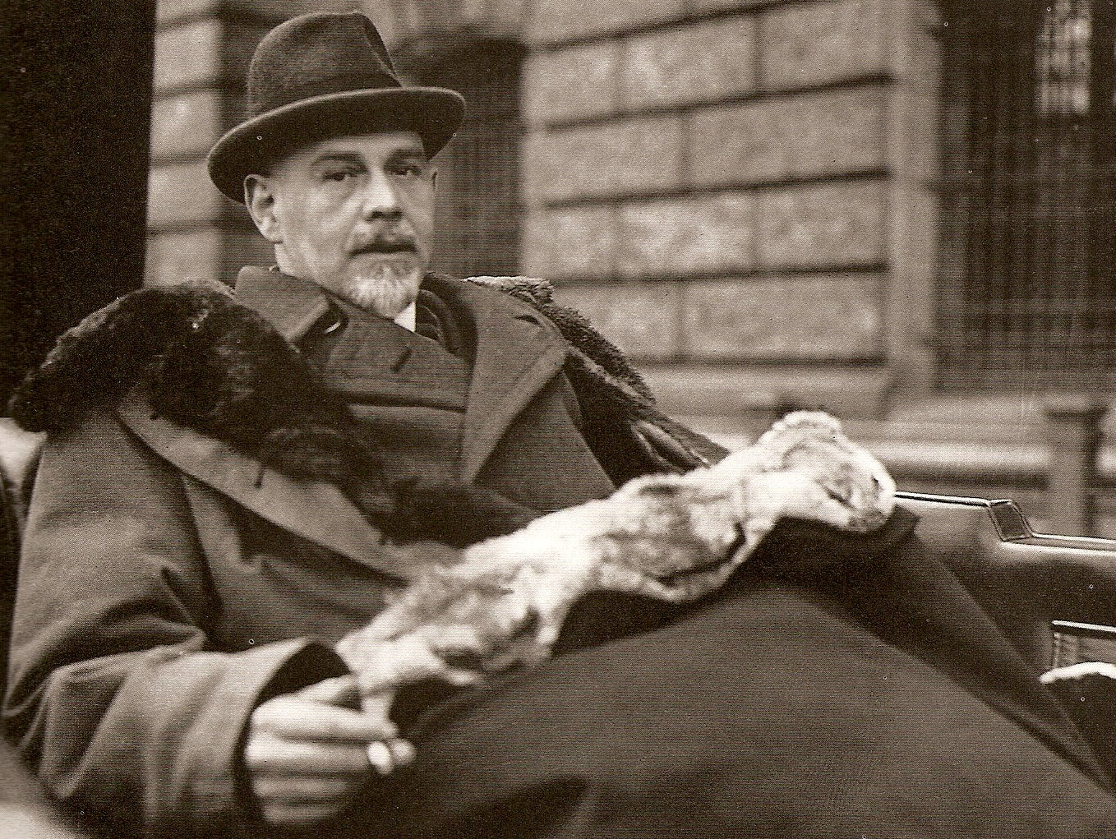
Victims of paramilitary violence: Finance Minister Matthias Erzberger (left) and Foreign Minister Walther Rathenau (right)

Slide 33
‘Actually there was only one political common denominator that held the whole “national movement” together at that time, and it was a negative one: it amounted to this: “We must make an end to Erfüllungspolitik, to the policy of accepting the Versailles Treaty and co-operating with the West.” That was the one point on which all the groups and sub-groups were agreed, though they might and did argue about everything else.
We had no wish to become a political party with mass support and all that that implies…But we did, from the beginning, desire basic change, a “national revolution” that would free us from the material and ideological supremacy of the West as the French Revolution had freed France from its monarchy.
So our means had to be different from those of the political parties…in that case the only course open was to “eliminate” every Erfüllungs politician. To eliminate in that context is, of course, to kill. What other means was there at our disposal?’
-Ernst von Salomon, German writer and Freikorps member. Took part in assassination of Walter Rathenau

Slide 34
1923 Ruhr Occupation
11 January 1923 - 25 August 1925
Germany not paying reparations. France and Belgium invade Ruhr
Killed 132 Germans, including a 7 yr. old boy
Expelled 150,000 from region
Workers told workers to carry out non-violent resistance and refuse to work. Stresemann orders Ruhr workers back to work and calls off strike
October 1923 Rhenish Republic proclaimed at Aachen. Cologne mayor Adenauer invites delegates to discuss Prussian “hegemony” in Weimar and Rheinish separatism.
Notes:
In 1922, Germany managed to pay its first installment of 2 billion gold marks. Weimar Germany was allowed to pay in kind (actual materials) as opposed to just cash. Most of this 2 billion was paid in coal, iron and wood. In 1923, Germany simply could not pay the reparations owed to France as part of the Versailles Treaty.
This the Allies did not believe - especially France where anger towards Germany still ran deep - and the German government was accused of trying to get out of her reparations responsibilities. This apparent refusal was only four years after the end of the war, and the attitude of the public towards Germany was still very hostile - and not just in France.
In 1922, French and Belgium troops invaded the Ruhr; Germany’s most valuable industrial area. The French and Belgium troops took over the iron and steel factories, coal mines and railways. Those Germans who lived in the Ruhr and were considered not to be co-operating with the Germans were imprisoned. Food was taken. That this action by the French and Belgium broke the rules of the League of Nations - which both belonged to - was ignored by both countries. France was considered one of the League's most powerful members and here she was violating its own code of conduct.
Weimar’s government responded by ordering the workers in the Ruhr to go on strike and it ordered all people in the Ruhr to passively resist the French and Belgium soldiers. This meant that they were not to openly confront the French and Belgium soldiers, simply that they were not to help them in any way whatsoever. This lead to violence and over the next 8 months of the occupation, 132 people were killed and over 150,000 Ruhr Germans expelled from their homes.

Slide 35
1923 Ruhr Occupation
Results
  1925 - Inter-Allied Mission for Control of Factories and Mines [MICUM] est. to ensure coal repayments
  Inspired the Right
  Germany won world sympathy. Dawes Plan to follow
  To meet economic crisis, Germany printed currency
  …leading to further hyperinflation

Slide 36
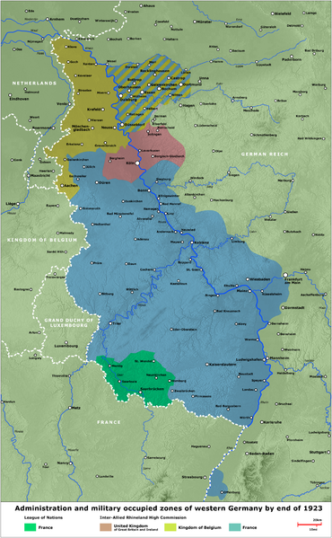

Slide 37
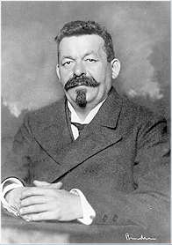
Friedrich Ebert (1871-1925)
Son of a tailor, became a saddler, active in the trade union movement.
1905: Elected to Central Committee of the SPD
1912: Elected to Reichstag as SPD deputy.
1913: Elected joint leader of the SPD along with Hugo Haase.
1918: Became ‘Imperial Chancellor’
1919: Elected first president of the Weimar Republic.
1925: Died of ruptured appendix

Slide 38
Ebert tries to stabilize Germany
 | Short Term Gain | Long Term Problem
Army left intact | Restore Law and Order | Leaves conservative institution alone
Civil Service left intact | Allows Germany to function reasonably stably | Leaves conservatives at heart of government
3 USPD socialists invited into government | Show willingness to cooperate with opposition | Tarnished by association with Communists
Worker’s councils set up | Show socialist credentials | Shows communist sympathy
Employers and trade unions brought together | Prevents strikes and increases production at a crucial time | Industrialists resentful at being dictated to by government. Smacks of communism
Constituent Assembly elections called | SPD gains support of conservative/nationalists desperate to avoid Communism | Convinces SPD that they have more support than they really do

Slide 39
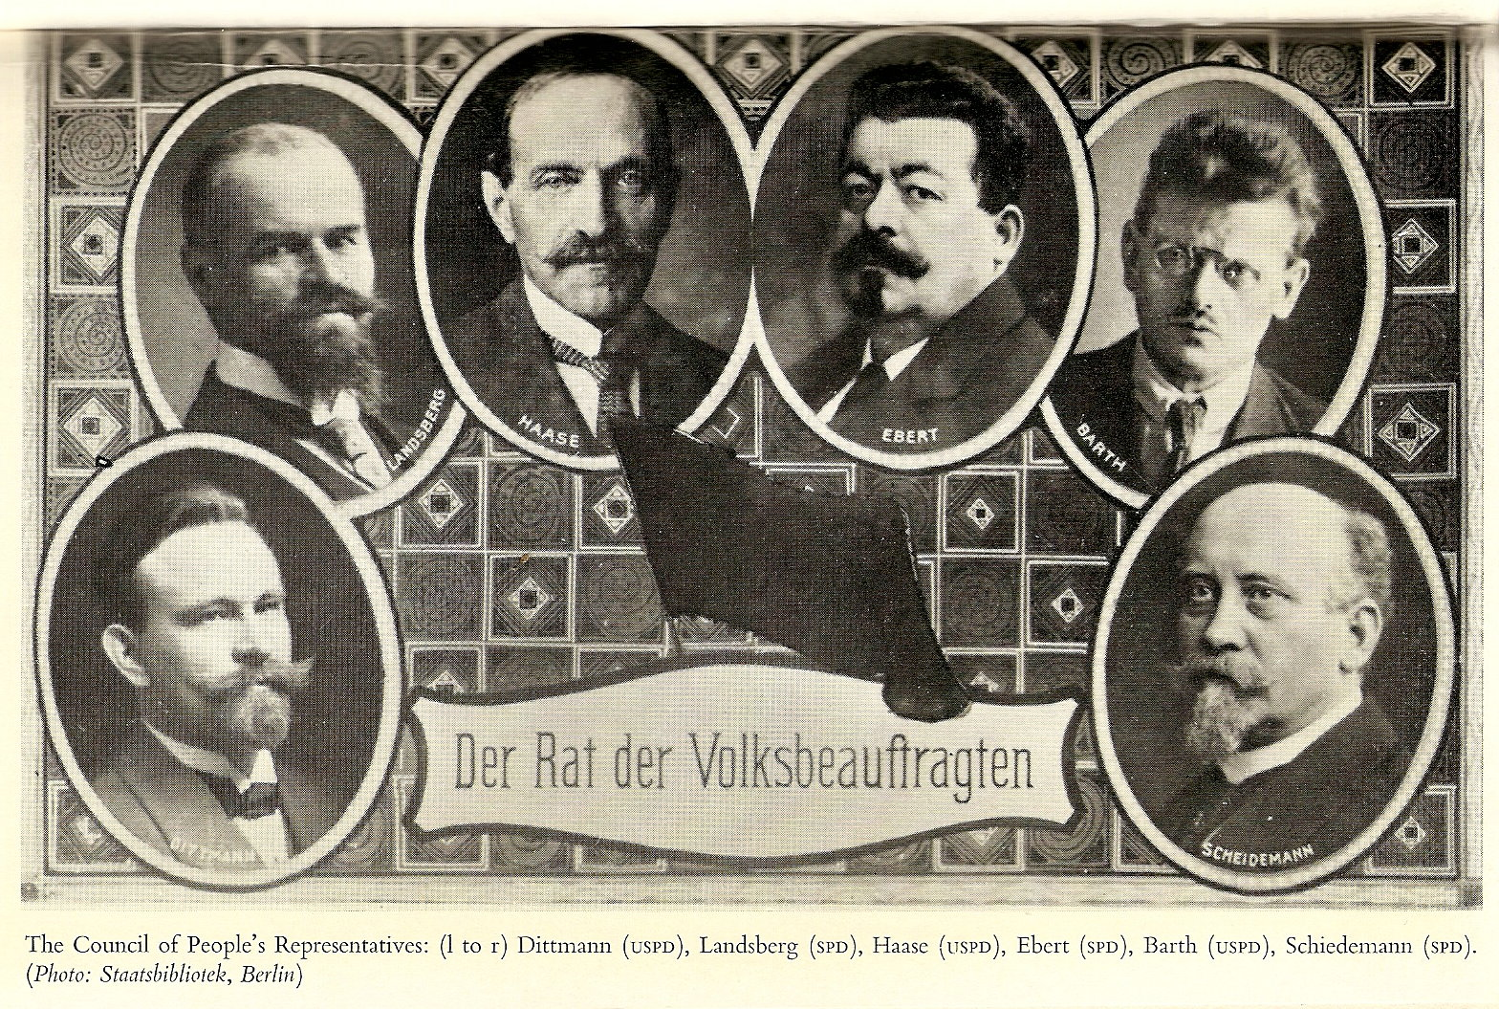

Slide 41
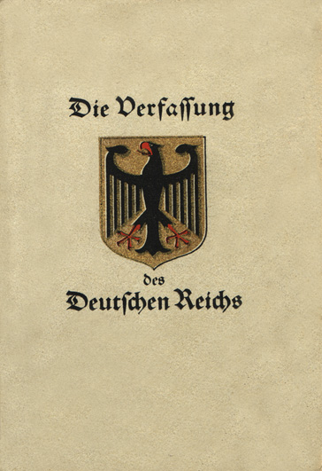
“The German people, united in its tribes and inspired with the will to renew and strengthen its Reich in liberty and justice, to serve peace inward and outward and to promote social progress, has adapted this constitution.”

Slide 42
Structure of Weimar Constitution
Part One: Composition of the Reich and its Responsibilities
Reich and the States
Reichstag
Reich President and Reich Government
Reichsrat
Reich Legislation
Reich administration
Judiciary
Part Two: Basic rights and obligations of Germans

Slide 43
Weimar Constitution
Art 1. The German Reich is a Republic. State authority derives from the people.
Art 9.The Reich has the legislative power over
1. welfare system
2. protection of law and order
Art 13. Reich law supersedes state law
Art 22. Members of parliament are elected in a general, equal, immediate and secret election; voters are men and women older than 20 years; the election is held according to the principles of proportionate representation.
Art 23. Reichstag is elected to serve for four years.

Slide 44
Weimar Constitution
Art 25. The Reich president has the right to dissolve the Reichstag
Art 41. The Reich President is elected by the entire German nation
Art 43. The term of office of the Reich President lasts seven years. Reelection is permitted. The Reich President can be deposed by plebiscite, which has to be suggested by the Reichstag. This Reichstag decision requires a majority of two thirds of the votes.
Art 45. When it comes to international law, the Reich is represented by the Reich President
Art 47. The Reich President has the supreme command over the armed forces

Slide 45
Weimar Constitution
Article 48.
If a state does not fulfill the obligations laid upon it by the Reich constitution or the Reich laws, the Reich President may use armed force to cause it to oblige.
In case public safety is seriously threatened or disturbed, the Reich President may take the measures necessary to reestablish law and order, if necessary using armed force.
In the pursuit of this aim he may suspend civil rights.

Slide 46
Weimar Constitution
Art 53. The Reich chancellor, and, at his request, the Reich ministers, are appointed and dismissed by the Reich President.
Art 54. The Reich chancellor and the Reich ministers…require the confidence of Reichstag. Any one of them has to resign, if the Reichstag votes to withdraw its confidence.
Art 60. To represent the German states in Reich legislation and administration, a Reichsrat is formed. [17 States]
Art 73. A law passed by Reichstag has to be presented in a plebiscite, if the Reich president decides so, within the period of one month.
Art 75. A plebiscite can override Reichstag decisions only if the majority of enfranchised voters participate.

Slide 47
Weimar Constitution: Basic Rights
109 - All Germans are equal in front of the law. In principle, men and women have the same rights and obligations…noble titles may not be granted any more.
111 - Freedom to move and settle anywhere
114 - The rights of the individual are inviolable.
117 - Privacy of correspondence, of mail, telegraphs and telephone are inviolable.
118 - There is no censorship.

Slide 48
Weimar Constitution: Basic Rights
119 - Motherhood is placed under state protection and welfare.
123 - All Germans have the right to assemble peacefully and unarmed
135 -All Reich inhabitants enjoy full freedom of liberty and conscience. Undisturbed practice of religion is guaranteed by the constitution.

Slide 49
Weimar Constitution: Economic Rights
151 - The economy has to be organized based on the principles of justice, with the goal of achieving life in dignity for everyone. Within these limits the economic liberty of the individual is to be secured.
153 - Property is guaranteed by the constitution
157 - Labor enjoys the special protection of the Reich
159 - The right to form unions and to improve conditions at work as well as in the economy is guaranteed to every individual and to all occupations.

Slide 50
Weimar Constitution: Economic Rights
161 - In order to maintain health and the ability to work, in order to protect motherhood and to prevent economic consequences of age and weakness, and to protect against the vicissitudes of life, the Reich establishes a comprehensive system of insurances
162 - The Reich advocates an international regulation of the rights of the workers, which strives to safeguard a minimum of social rights for humanity's working class.
163 - In case appropriate job openings cannot be provided, he will receive financial support.
165 - Workers and employees are called upon to participate, on an equal footing and in cooperation with the employers, in the regulation of wages and working conditions

Slide 51
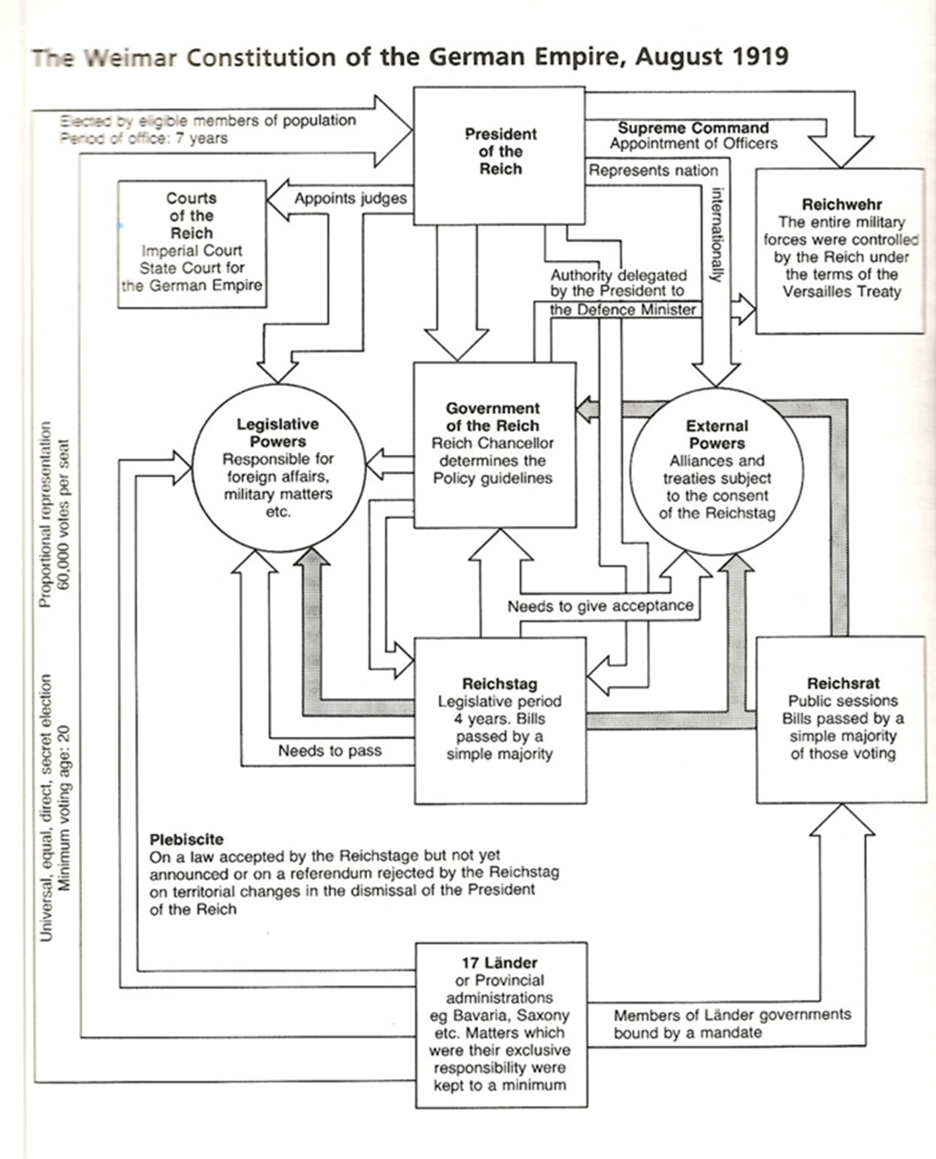

Slide 52
The President
Elected every seven (!) years
appoints
The Chancellor
Appointed from the Reichstag by the President. Had to be supported by a majority of the Reichstag
Article 48
In emergency Pres. can make laws without going first to the Reichstag
The Reichstag
Proportional representation
makes laws
elect
elect
The German people
All adults can vote; all have equal rights
The states kept their own governments, but with reduced powers. National laws could overrule state laws.

Slide 53
Strengths | Weaknesses
All Germans had equal rights, including the right to vote | The Republic had many enemies. Was it sensible to give equal rights to those who wished to destroy it?
PR made sure that political parties were allocated seats in Parliament in proportion to the number of votes they got. This was fair. | PR encouraged lots of small parties (up to 40!) . Required coalitions which can be tricky and can undermine a government’s legitimacy. No 5% rule
Strong president was necessary to control government an to protect the country in a crisis. | President had too much power. Article 48 gave the President powers to rule on his own in an ‘emergency’.
 | President can dismiss Chancellor even when the Chancellor retained the confidence of the Reichstag and similarly the appointment of a non-supported one

Slide 54
Strengths | Weaknesses
Referendum clause: Democratic. Prevent possibility that Reichstag’s legislative monopoly could contradict will of the people | -German people divided. Referenda can exploit this -National referenda were only used by anti-Republican forces (including the Nazis)
-Reichsrat provided continuity from 1871 Constitution -Reichsrat gave states a voice | Delegates to the Reichsrat were not elected, state governments appointed them.
-Reichsrat could veto a law passed in the Reichstag w/ a 2/3 majority. | -Reichsrat could not initiate any legislation.
-7 year Presidential term offers stability | -7 years is too long.
 | Voting by Party List: Electors vote for a party, not a specific candidate. Weakens the personal bond between voters and their candidates

Slide 55
Weimar Constitution: From the Record
“The Weimar Constitution was, on paper, the most liberal and democratic document of its kind the twentieth century had ever seen... full of ingenious and admirable devices which seemed to guarantee the working of an almost flawless democracy.”
The Rise and Fall of the Third Reich, by William Shirer

Slide 56
Weimar Constitution: From the Record
“All in all, Weimar's constitution was no worse than the constitutions of most other countries in the 1920's, and a good deal more democratic than many. Its more problematical provisions might not have mattered so much had the circumstances been different. But the fatal lack of legitimacy from which the Republic suffered magnified the constitution's faults many times over.”
- The Coming of the Third Reich, Richard J. Evans

Slide 57
Weimar Constitution: From the Record
The German people had had little practice of politics…By 1919, there was democracy and the Weimar Republic opened the door to real politics, the Germans stood at the door gaping , like peasants asked to a palace, hardly knowing how to behave themselves.
-Weimar Culture, Peter Gay, 1974

Slide 59
Weimar Political Parties
Sozialdemokratische Partei Deutschlands (German Social Democratic Party, SPD)
Unabhängige Sozialdemokratische Partei Deutschlands (Independent German Social Democratic Party, USPD).
Kommunistische Partei Deutschlands (Communist Party of Germany, KPD)
Deutsche Demokratische Partei (German Democratic Party, DDP)
Zentrumspartei (Centre Party)
Deutsche Volkspartei (German People’s Party, DVP)
Deutschenationale Volkspartei (German National People’s Party, DNVP)
30+ smaller parties including the Bayerische Volkspartei (Bavarian People’s Party, BVP) and the Nationalsozialistische Partei Deutschlands (NSDAP).

Slide 60
Split in the Left
April 1917: 42 SPD deputies broke away from the rest of the party and formed the Independent Social Democratic Party (USPD), while the remaining 68 SPD deputies reconstituted themselves as the Majority Socialist Party (MSPD) with Friedrich Ebert as chairman.
USPD committed to an immediate peace without annexations and was associated with Spartacist League and the Revolutionary Shop Stewards.
German Left divisions:
  MSPD upheld democracy, wanted moderate reforms, opposed to Soviet-style communism.
  USPD wanted radical social, economic and political reform, but shied away from full communism. Deeply divided.
  Spartacists and Revolutionary Shop Stewards wanted socialist republic based on the Workers’ and Soldiers’ Councils which would follow the same path as Bolshevik Russia.

Slide 61
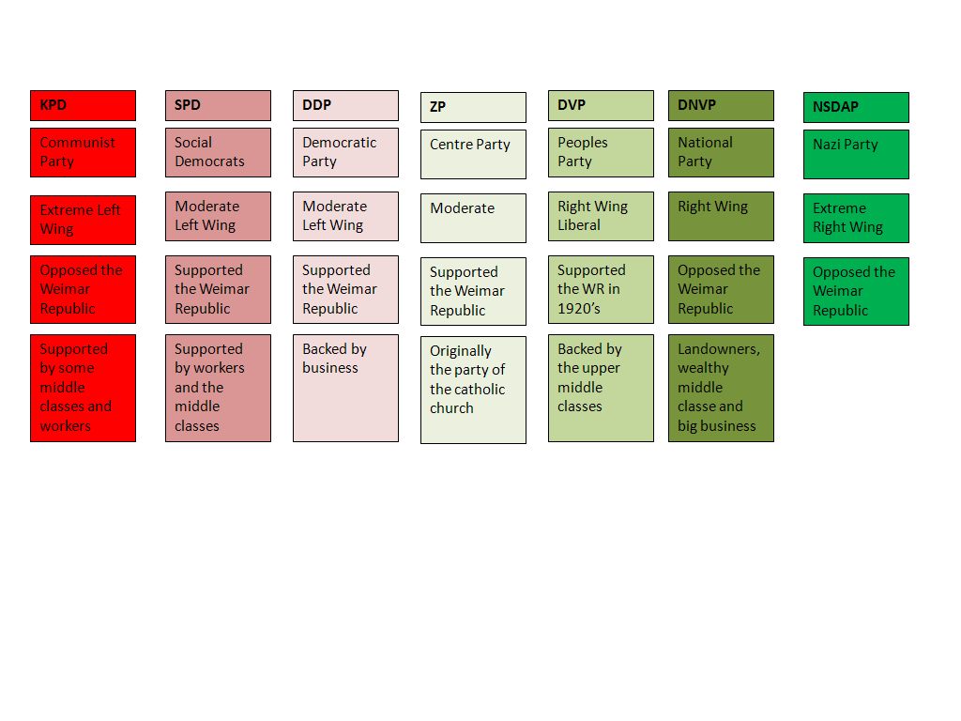

Slide 62
Evolution of Party Power
 | Jan 1919 | Jun 1920 | May 1924 | Dec 1924 | May 1928 | Sep 1930 | Jul 1932 | Nov 1932 | Mar 1933
SPD Social Democrats | 165 | 102 | 100 | 131 | 153 | 143 | 133 | 121 | 120
Communists KPD/USPD | 22 | 88 | 62 | 45 | 54 | 77 | 89 | 101 | 81
Centre Party (Catholics) | 91 | 64 | 65 | 69 | 62 | 68 | 75 | 70 | 74
DDP (Democrats) | 75 | 39 | 28 | 32 | 25 | 20 | 4 | 2 | 5
Right-wing parties (BVP/ DVP/DNVP) | 63 | 157 | 156 | 174 | 134 | 90 | 66 | 83 | 72
NSDAP (Nazis) |  |  | 32 | 14 | 12 | 107 | 230 | 196 | 288
Others | 7 | 9 | 29 | 29 | 51 | 72 | 11 | 12 | 7
Total Deputies | 423 | 459 | 472 | 493 | 491 | 577 | 608 | 584 | 647

Slide 63
15 Chancellors of the Republic
Coalitions | Elections | Chancellor | Enter Office | Leave Office | Political Party
SPD, Zentrum; DDP | Jan 1919 | Friedrich Ebert | Nov 1918 | Feb 1919 | SPD
SPD, Zentrum, DDP |  | Philip Scheidemann | February 13, 1919 | Jun 1919 | SPD
SPD, Zentrum, DDP |  | Gustav Bauer | Jun 1919 | Mar 1920 | SPD
SPD, Zentrum, DDP |  | Hermann Müller | March 27, 1920 | June 1920 | SPD
Zentrum, DDP, DVP | June 1920 | Konstantin Fehrenbach | June 25, 1920 | May 4, 1921 | Zentrum
Zentrum, DDP, SPD |  | Josef Wirth | May 10, 1921 | November 14, 1922 | Zentrum
Zentrum, DDP, DVP |  | Wilhelm Cuno | November 12, 1922 | August 12, 1923 | No Party
DVP, SPD, DDP |  | Gustav Stresemann | August 13, 1923 | Nov 1923 | DVP
Zentrum, DDP, DVP | June 1924 | Wilhelm Marx | November 30, 1923 | December 15, 1924 | Zentrum

Slide 64
Coalitions | Elections | Chancellor | Enter Office | Leave Office | Political Party
Zentrum, DVP, DNVP, BVP | Dec 1924 | Dr. Hans Luther | January 15, 1925 | May 12, 1926 | No Party
Zentrum, DDP, DVP, BVP |  | Wilhelm Marx | May 1926 | Jun 1928 | Zentrum
SPD, DDP, Zentrum, BVP, DVP | May 1928 | Hermann Müller | June 28, 1928 | March 30, 1930 | SPD
Rule by presidential decree | Sep 1930 | Dr. Heinrich Brüning | March 30, 1930 | March 30, 1932 | Zentrum
Rule by presidential decree | July 1932 | Franz von Papen | March 30, 1932 | November 17, 1932 | Zentrum/No Party
Rule by presidential decree | Nov 1932 | Kurt von Schleicher | December 2, 1932 | January 28, 1933 | No Party
Rule by presidential decree | Mar 1933 | Adolf Hitler | January 30, 1933 |  | NSDAP

Slide 65
Presidents of Weimar Republic
Friedrich Ebert | 1919 -1925 | Won with 73% 1st Round
Paul von Hindenburg | 1925- 1932. 1932 -d. Aug 2, 1934 | Won with 48% in 2nd Round
Adolf Hitler | Aug 1934 | 90% of pop voted to merge Chancellor and President
1925 Presidential Election
Candidate | Party | Supported by | Votes | %
Paul von Hindenburg | Independent | DVP, DNVP, BVP, NSDAP | 14,655,641 | 48.3
Wilhelm Marx | Center Party | SPD, DDP | 13,751,605 | 45.3
Ernst Thälmann | Communists |  | 1,931,151 | 6.4
Total |  |  | 30,351,813 | 100
Registered voters/turnout |  |  | 39,414,316 | 77.0

Slide 66
Jan 1932, at the age of 84, Hindenburg was senile. Ran for President again. ‘The only man who could defeat Hitler’
Nov 1932, Hindenburg stated his fears that "a presidential cabinet led by Hitler would necessarily develop into a party dictatorship with all its consequences for an extreme aggravation of the conflicts within the German people"
Jan 1933, Hindenburg privately told a group of his friends: "Gentlemen, I hope you will not hold me capable of appointing this Austrian corporal to be Reich Chancellor“…Hitler was sworn in 30 Jan 1933
March 1933, Hindenburg signed the Enabling Act into law, which gave decrees the force of law.

Slide 68
Conclusions
German politics were radicalized by the experience of war and defeat.
But the vast majority of Germans were primarily concerned with their material well-being, not political reform.
The circumstances of its birth hampered the Weimar Republic – revolution and counter-revolution, economic crisis and the bitter legacy of defeat all helped to undermine faith in the new democracy.
The Weimar constitution achieved much (a democratic system, welfare state etc.), but did little to solve deep divisions within German society and left key institutions (military and judiciary) unreformed.
But the Republic weathered the storm – which should indicate that it had more popular support and stronger institutions than has sometimes been suggested.

Slide 69
Discussion
Was Weimar doomed from the start?
Which of the following posed the greatest threat to Democracy taking root in Germany?
  Place them in an order of greatest threat to democracy:
    Limited Nature of the 1918 German Revolution
    Weimar Constitution
    Treaty of Versailles
    Right Wing Extremism
    Left Wing Extremism
    The Economic Crisis
    Attitudes of the German elite
    Attitudes of ordinary Germans

