Slide 1
British India and the Indian Resistance
Mr. Daniel Lazar

Slide 2
Lecture Outline
Mughal Dynasty
British East Indian Company Rule
Resistance to BEIC Rule
The Raj
Raj Methods
Benefits of the Raj
Detriments of the Raj
Resistance to the Raj

Slide 3
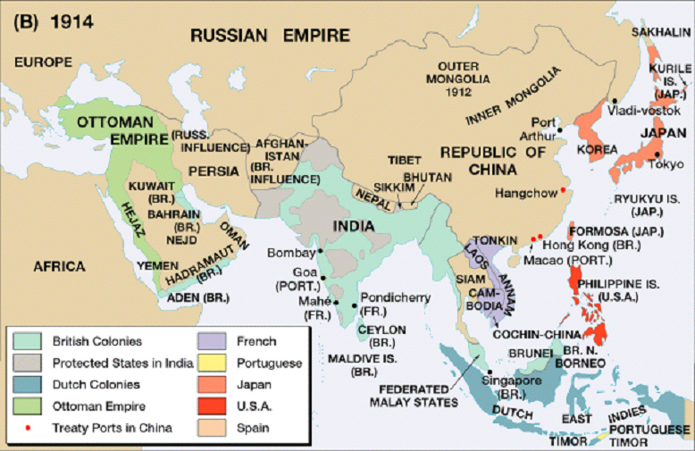

Slide 4
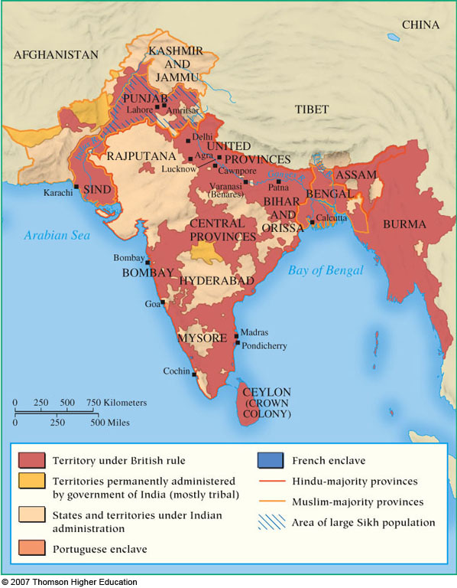

Slide 5
Mughal Disintegration
India was not a country. It was a vast and diverse territory ruled by the once epic, now fading, corrupt Mughal Dynasty (1526-1857) - a systematic, centralized, uniform Absolute Monarchy which ruled “Hindustan”
Road system, uniform currency, shipbuilding, textiles
Taj Mahal
War elephants
Astronomy
Trade trade trade

Slide 6
Mughal Disintegration
By 1700, Mughal Dynasty was collapsing under its own diversity
Yeoman Hindu warrior Marathas rebelled
Shah of Afghanistan seized power
Ethno-religious Muslim and Sikh states emerged
In-fighting ate away at Mughal capacity to represent legitimate authority
Power Vacuum formed. BEIC exploited this.

Slide 7
The British East India Company
Royally-chartered corporation, owned by shareholders, indirectly controlled by Crown
Led by 1 Governor and Court of 24 Directors
BEIC competed with Dutch, French, Spanish, and Portuguese Companies
Demise of Spanish and Portuguese powers
1754–1763 - Seven Years’ War → defeat of the French forces → limited French imperial ambitions
1781 - American defeat of Britain → India became the “Crown Jewel”

Slide 8
The British East India Company
BEIC constructed infrastructure, reduced banditry, preserved relative peace, and tried to stabilize the economy.
They wanted 300 million Indians to be stable enough to supply and consume.
Cotton, silk, indigo dye, salt, tea, and opium
BEIC aimed to establish triangular trade with China
Trade monopoly → massive wealth → political influence
Soon BEIC mismanagement made governmental and military controls necessary.
Private armies were hard to predict or control
Crown-BEIC relations: strained, uneasy, and unclear…..

Slide 9
Under the auspices of the King

Slide 10
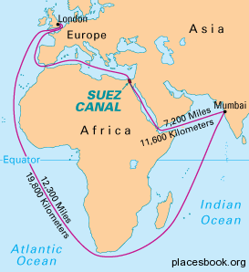
The Suez Canal
Opened in 1869

Slide 11
East India Company recruiting poster, England, 1810: In 1836 there were about 17,000 British troops in India
Notes:
East India Company recruiting poster from 1810.
SOURCE: Lawrence James, _RAJ: The Making and Unmaking of British India_ (New York, 1997), following p. 178.

Slide 12
Britain Expanded Control
Regulating Act of 1773 - Parliament imposed a series of administrative and economic reforms which established its sovereignty and ultimate control over BEIC. “The acquisition of sovereignty by the subjects of the Crown is on behalf of the Crown and not in its own right.“
Warren Hastings became the first Governor-General of Bengal and had administrative powers over all of British India
Board of Control: Chancellor of the Exchequer, Secretary of State, and four Privy Councillors, nominated by the King.
Internal Administration of British India bill laid the foundation for the centralized and bureaucratic British administration of India

Slide 13
Warren Hastings, first Governor-General of Bengal 1773-84
Hastings respected Indian customs but was loyal to the British mission.
Thus he was both the "architect of British India and the one ruler of British India to whom the creation of such an entity was anathema.“
-The Honourable Company: History of the English East India Company. John Keay, 1994

Slide 14
Britain Expanded Control
Many acts followed the 1773 Act to clarify the relationship, all of which led to more Crown control.
The most notable was the Charter Act of 1813
asserted sovereignty of Crown over BEIC territory
renewed the charter of the company for a further 20 years
deprived the company of its Indian trade monopoly
provided education budget
opened India to missionaries

Slide 15
Mission to Uplift and Civilize
Christian Superiority: its all how you look at it. Either way, missionaries sought to “save” 300 million
End slavery
Slavery in was different than slavery in the West
Dutch and Portuguese dealt in Indian slaves
Liberate women to some extent
British outlawed sati—the practice in which a widow joins her husband in death by throwing herself on his funeral fire or being buried alive next to him.

Slide 16
Mission to Uplift and Civilize: Rammohan Roy
"Father of Modern India”
Western education
Modernization, free speech, equality, intellectualism
Preached about the unity of God
Translated Vedic scriptures into English
Co-founded the Calcutta Unitarian Society
Campaigned against sati
Sought to integrate Western and Indian Cultures

Slide 17
Indian Resistance?
Why were Indians unable to unite against BEIC?
remarkable diversity
mutual suspicion: inter and intra-religious divisions
Unsure of British motives
hindsight is 20/20
The “Grand Design” hypothesis is uncertain
lacked a common political vocabulary
BEIC military staffed by Sepoys (Indian officers in British Army)
…Perhaps just enough Indians benefitted from British rule?
Or perhaps not…

Slide 18
Sepoy Revolt, 1857-58
Causes for discontent:
300,000 Sepoys in the army; about 50,000 British
Class tension: domination of higher castes in the Bengal Army angered some. Segregated mess halls.
Rise in conversions. Increasing suspicion of Anglican motivations.
British encouraged widow remarriage
New Sepoy soldiers denied pensions, older Sepoys feared this would later be applied to them.
General Service Enlistment Act of 1856 demanded foreign service (Burma, China). Overseas travel was a religious offense to high-caste Hindus
The Spark: Sepoys found out that rifle cartridges were sealed with fat from beef (Hindus) and pork (Muslims).
Sepoy discontent spread to the people…

Slide 19
Sepoy Revolt, 1857-58
1753-1856 there were 40+ armed revolts
Scores of peaceful protests, especially boycotts
Feudal nobility, rural landlords and peasants rebelled
Old Aristocratic power was eroded by BEIC
To promote equality, BEIC interfered with a traditional system of inheritance
Landlords lost parts of estates to peasants
Rent increases by British landlords
Aristocrats feared “moral dangers” resultant from “religious pollution” (female education, more math than religious education)

Slide 20
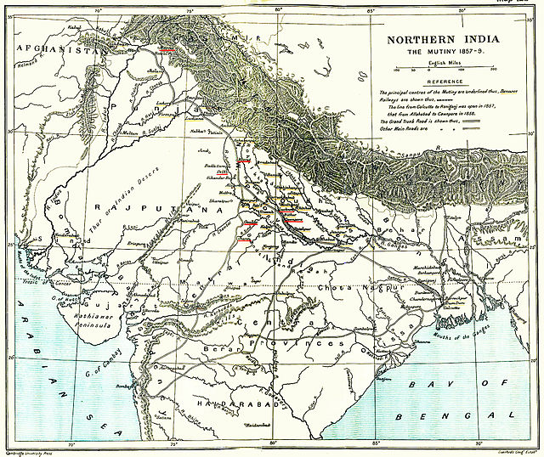

Slide 21
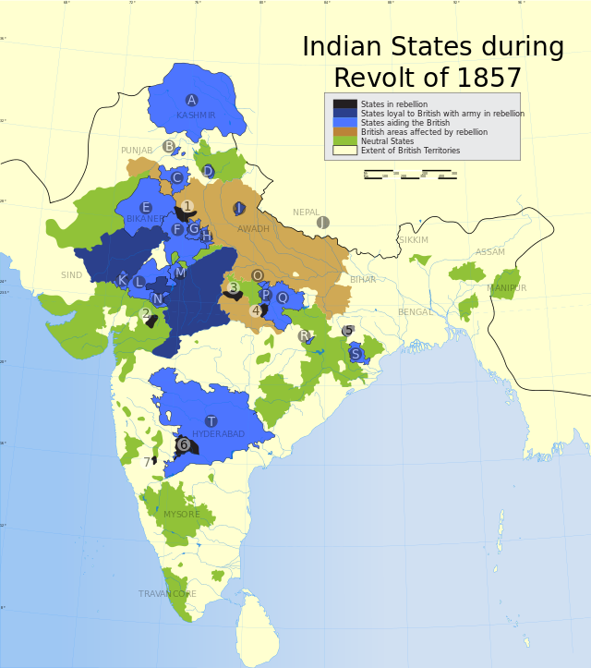

Slide 22
The Sepoy Rebellion of 1857

Slide 23
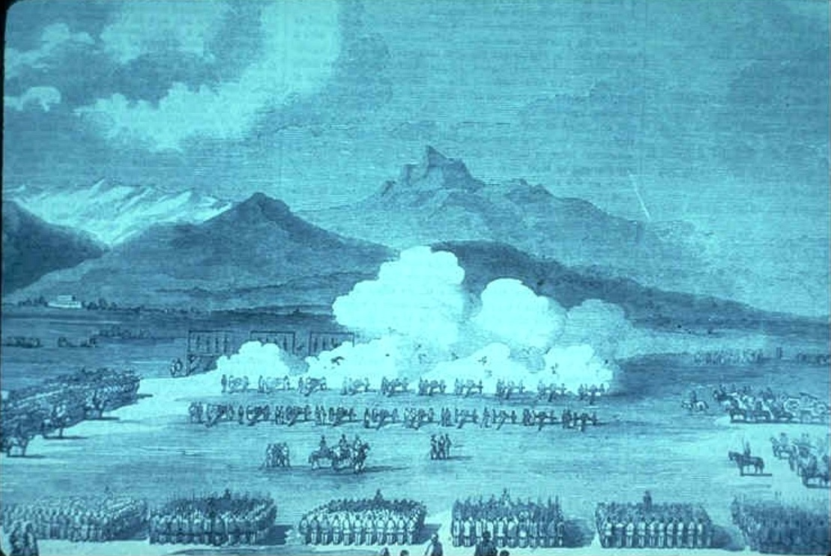
Mass execution of Sepoy rebels by the British in Peshawar, 1857
Notes:
23
Sepoy mutineers in India suffer a mass execution by the British at Peshawar in 1857. From http://academic.brooklyn.cuny.edu/history/core/pics/

Slide 24
Legacy of Sepoy Rebellion
Rebels massacred British men, women and children across northern India for almost a year.
British massacres in response.
100,000+ Indians killed
No prisoners policy in some areas.
British had some rebels "blown from cannon“
Brits conquer in part due to Hindu/Muslim tension over who would rule (should the rebellion succeed)
Distrust, fear and hatred. The British press…
End of the Mughal and Maratha Empires
Parliament ended BEIC rule; The Crown took over…

Slide 25
Legacy of Sepoy Rebellion
“For many years the British in India had successfully avoided entanglements, because entanglements led to responsibility, and responsibility interfered with profit.” (Read and Fisher)
Government of India Act 1858: BEIC dissolved and its ruling powers over India were transferred to the British Crown. The Raj
British reorganized the army, the financial system, and the administration in India.
Semantic Dilemma: Mutiny? Revolt? First War of Independence?

Slide 26
The British Raj
1858–1947

Slide 27
Queen Victoria, Proclamation of November 1, 1858
“We hold ourselves bound to the natives of our Indian territories by the same obligations of duty which bind us to all our other subjects…
“Firmly relying ourselves on the truth of Christianity, …we disclaim alike the right and desire to impose our convictions on any of our subjects. We declare it to be our royal will and pleasure that none be in anywise favoured, none molested or disquieted, by reason of their religious faith or observances, but that all alike shall enjoy the equal and impartial protection of the law...
“And it is our further will that, so far as may be, our subjects, of whatever race or creed, be freely and impartially admitted to offices in our service, the duties of which they may be qualified, by their education, ability, and integrity, duly to discharge.”

Slide 28
British dominions in 1857, on the eve of the “Great Mutiny”
Notes:
28
India in 1857, at the time of the Great Mutiny. From www.britishempire.co.uk/maproom/india.

Slide 29
“The British conquered India with Indian manpower, paid for with Indian revenues and with information they acquired through Indian sources.”
-Read and Fisher

Slide 30
Methods of British Colonial Rule
All-India Census 1868-1871. Conquered them, now count and control them
Stability first
Demilitarize local leaders and warlords
Co-opt local leaders and warlords
Criminalize threatening practices
Knowledge and Surveillance
Ensure steady revenue supply: fund Raj, employ Indians
Keep costs down
Promote British Settlement
Propaganda Wars: in Britain and in India

Slide 31
Ruthless Raj Bureaucracy
Government of India Act 1858 – “Double Governance”:
1. Imperial government in London
27 Secretaries of State from 1858-1947
2. Central government in Calcutta
Led by Viceroy
Direct control over much of India
Indirect Suzerainty over 600ish princely states
200 states < 10 sq miles (Steglitz-Zehlendorf is 40 sq miles)
Nominally sovereign entity with an indigenous Indian ruler
Dependent on Britain
…had authority over provincial governments

Slide 32
Structure | Function
Viceroy (Gov Gen) | -Head of State -Ruled in the name of the Crown
Executive Council | Departments of: home, revenue, finance, military, communication, commerce, post, supply, and law…
Legislative Council | -12 Members: 6 British (voting members) and 6 Indian (advisory members) for each department for 2 year term. -All decisions required approval of Sec of State in London
District Officers | -Could be hard and lonely or beautiful and mysterious -Sometimes men as young as 20 ruling tens of thousands of Indians
Indian Civil Service | -By 1880, 100,000 Brits in India -In beginning, Top 1000 were Oxbridge Brits; by 1947 32% were Indians. -Civil Service exams then 2 years training in Oxbridge -“Neither Indian, nor civil, nor a service“ (first PM, Nehru in 1949)

Slide 33
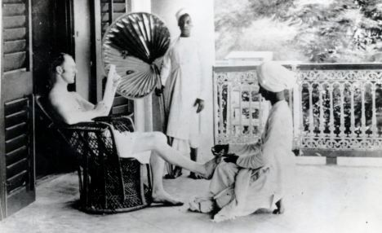
British Army officer during the early days of the Raj

Slide 34
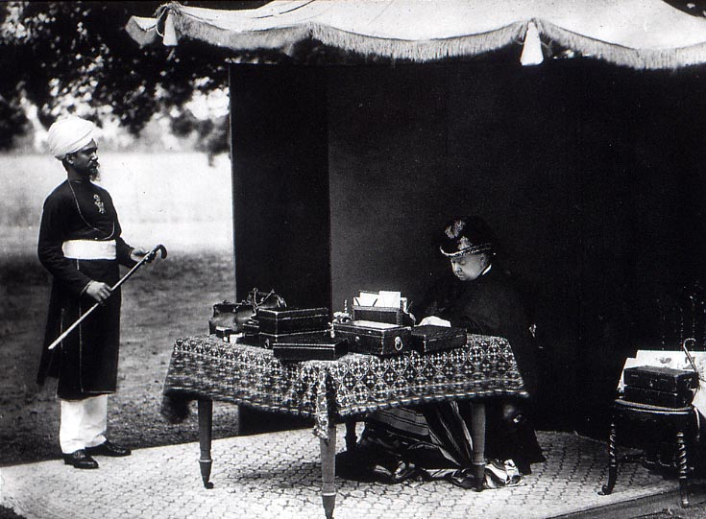
Image of Imperial Administration
Queen Victoria: Empress of India in 1876

Slide 35
Orientalists | Anglicists
Cultural Relativists | Ethnocentrists
Intellectually curious romanticization of India | Saw Indian society as degraded and stagnant and backwards. India needed reform imposed from outside
Gradual change via reason | Immediate change via force if necessary
“My first rule, and it certainly was the wisest, was to leave everything as I found it.” -Governor of Mumbai Mountstuart Elphinstone: | “A single shelf of a good European library is worth the whole native literature of India and Arabia” -Governor General’s Council member, later Secretary of War, Lord Macaulay

Slide 36
Benefits of British Rule
Modern infrastructure (with Indian labor)
Roads, canals, and bridges, telegraph lines, irrigation systems
Central India Spinning, Weaving, and Manufacturing Company in Bombay
Tata Iron and Steel Company had 120,000 employees
4th largest railway network in the world

Slide 37
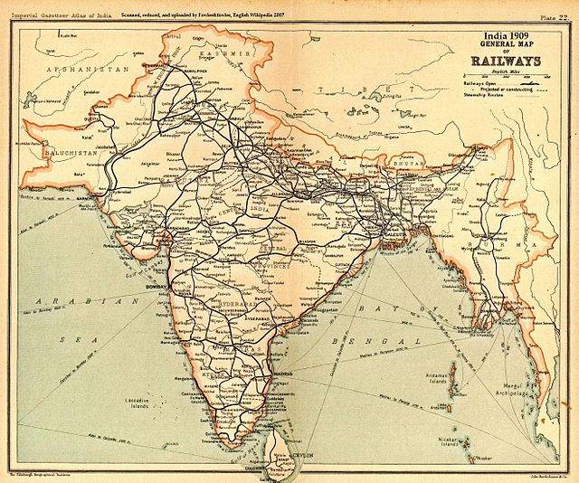

Slide 38
Benefits of British Rule
Agricultural revolution: ended small farming and pushed cash crops
Mass deforestation
Health care and modern medicine
Helped, but Ag Rev → population boom → famine → starvation

Slide 39
Benefits of British Rule
Education: Brahmins were encouraged to go to British schools
Main aims: Anglicization & training civil servants
In 1947 21 universities and 496 colleges
By 1887 of 21,000 mid-level civil service appointments:
45% Hindus
7% Muslims
19% Eurasians (European father and Indian mother)
29% Europeans
(Robin J. Moore, "Imperial India, 1858-1914)

Slide 40
Benefits of British Rule
Equality: reformed legal system that attacked caste distinctions
Women’s Rights: discouraged purdah (isolation of women in separate quarters)
Unity: the British united India under one rule (though it wasn’t pretty)
Stability: Lord Thomas Macaulay felt that post-Mughal India was like post-Rome Europe. He wanted a code of laws. “Uniformity where you can have it, diversity where you must have it; but in all cases certainty.”
India is now the world’s largest democracy. But…?

Slide 41
Detriments of British Rule
Enlightenment Ideal: Self-Determination?
Capitalist Ideal of Invisible Hand?
Censorship
The Vernacular Press Act of 1878 censored Indian language papers
confiscated any printed material it deemed objectionable
repealed in 1882 by Lord Ripon
Newspaper Act of 1908 and the Indian Press Act of 1910 to quell Nationalist Sentiment

Slide 42
Detriments of British Rule
The British flooded the market with machine-made, lower quality textiles to India, thereby destroying their once-prosperous hand-weaving tradition.
Fueled religious and cultural divisions
Ethnocentrism (Macaulayism)

Slide 43
Reaction and Resistance:
Roots of Indian Nationalism

Slide 44
Reaction and Resistance: Indian National Congress (est 1885)
Founded by Brits and Indians, most notably Scotsman, A.O. Hume and Indian Dadabhai Naoroji
Promoted Indian-British dialogue
Wanted self-rule but advocated Western modernization
Schisms emerged in INC…

Slide 45
Reaction and Resistance: Indian National Congress (est 1885)
Moderate, middle class, conservative, professional and industrial men stood a lot to lose by radicalism and violence.
INC became increasingly extremist and violent over time
By 1907, the party was split into two-halves
Garam dal ("hot faction") of Bal Gangadhar Tilak
Naram Dal (“soft faction")
“The Congress is tottering to its fall, and one of my greatest ambitions while in India is to assist it to a peaceful demise” (Lord Curzon, 1899)
INC is now the dominant political party in India

Slide 46
Reaction and Resistance: Dadabhai Naoroji (1825–1917)
Indian National Congress Founder
Poverty and Un-British Rule in India, 1901
Drain Theory
“British Vampires” sucking 200-300 million pounds from India
Second class citizens in their own land
Indians paid taxes for internal improvements; Brits capitalized on trade
First Asian to be a British MP
Many British educated intellectuals came to despise British rule

Slide 47
Reaction and Resistance: Dadabhai Naoroji (1825–1917)
Mahatma Gandhi wrote to Naoroji in 1894 that:
"The Indians look up to you as children to the father. Such is really the feeling here."

Slide 48
Reaction and Resistance: Society for the Promotion of Indian Feeling
Prospectus of a Society for the Promotion of National Feeling among the Educated Natives of Bengal by Rajnarayan Basu
Restoration of traditional values, customs, and culture: festivals, etiquette, diet, medicine, Sanskrit language, history, education, sports and games, music, poetry,
“If we at all imitate other nations, we should not do so slavishly. We should chalk out a path of our own.” (Basu)

Slide 49
Reaction and Resistance: Bal Gangadhar Tilak
"Father of Indian unrest."
English educated at Government Law College
Indian nationalist, journalist, teacher, social reformer, lawyer
Swadeshi Movement-“of our own country”
Swaraj – self-rule
"Swaraj is my birthright, and I shall have it!"

Slide 50
Reaction and Resistance: Muslim League, 1906
Goals of the Muslim League:
promote unity with the British Crown
advance the rights and interests of Muslims in India
maintain peace in India
Division as a ripe time to fight for a separate state
The League, led by Mohammed Ali Jinnah, comprised of 400 Muslim aristocrats, was not reflective of popular Muslim sentiment
***The Hindu-Muslim Schism cannot be emphasized enough.

Slide 51
Reaction and Resistance: Muslim League, 1906
Muhammad Ali Jinnah
(1876-1948)
English trained lawyer
20 years in INC
Resigned when INC agreed on Gandhi’s non-violent methods
Led Muslim League 1913-47
Founder of Pakistan in 1948

Slide 52
Reaction and Resistance
Was there a political vision behind the Rebellions?
nascent forms of political identity seen in rebel statements: “Hindus and Muslim of Hindustan”
evidence of some level of planning and coordination
use of panchayats
rallying around the figure of the Mughal Emperor
speech, press and petition
boycotts of foreign goods
rebel violence was not indiscriminate, it targeted symbols of Colonial rule
some vision and planning, sometimes from Jail
Bal Gangadhar Tilak in 1891

Slide 53
Reaction and Resistance
Answer: Competing political visions
Though united against the Raj, India was still a divided nation
Uniting against something is different than uniting for something.
Uniting with a common vision proved near impossible
Uniting with multiple visions overthrew the Raj, but left another power vacuum and an insecure fate…..

