Slide 1
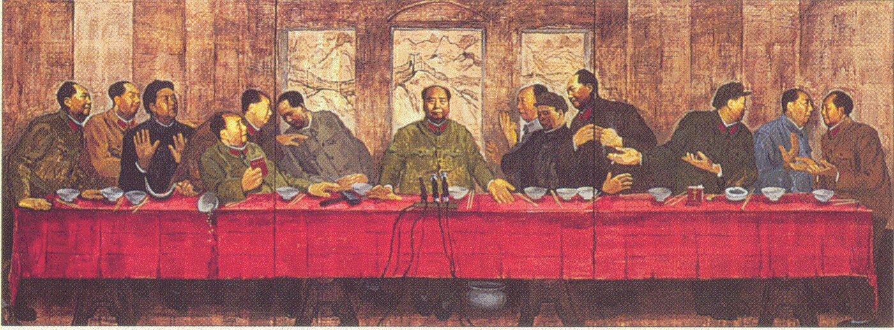
Mao’s China 1949 - 1976

Slide 2
Presentation Outline
Theoretical Maoism
Overview of the Civil War in China
The Great Leap Forward
The 100 Flowers Campaign
The Cultural Revolution
Maoist Propaganda
Conclusions
Reconciliation with the West
The Deng Xiaoping Reforms

Slide 3
Brief Sketch of the Mao Years
KMT-CCP Civil War (1946-1949)
Recovery and Socialism (1949-1956)
Rethinking the Soviet Model (1956-1957)
Great Leap Forward (1957-1961)
Recovery & Growing Elite Division (1962-65)
Proletarian Cultural Revolution (1966-1976)
Enter Deng (1978)

Slide 4
Maoism in Theory
In the late sixties the "Little Red Book" containing the thoughts of Chinese Communist Party Chairman Mao Zedong was one of the most intensively-studied books in the world.
Assembled by Party editors from old speeches and writings of Mao, it was intended as a guide for the Cultural Revolutionaries of 1966-1976

Slide 5
Maoism in Theory
1. Classes struggle, some classes triumph, others are eliminated. Such is history, such is the history of civilization for thousands of years. To interpret history from this viewpoint is historical materialism; standing in opposition to this viewpoint is historical idealism.
"Cast Away Illusions, Prepare for Struggle" (August 14, 1949), Selected Works, Vol. IV, p. 428.
2. A well-disciplined Party armed with the theory of Marxism-Leninism, using the method of self-criticism and linked with the masses of the people; an army under the leadership of such a Party; a united front of all revolutionary classes and all revolutionary groups under the leadership of such a Party - these are the three main weapons with which we have defeated the enemy.
"On the People's Democratic Dictatorship" (June 30, 1949), Selected Works, Vol. IV, p. 422.
3. No political party can possibly lead a great revolutionary movement to victory unless it possesses revolutionary theory and a knowledge of history and has a profound grasp of the practical movement.
On the Question of Agricultural Co-operation (July 51, 1955), 3rd ed., pp. 19-20.

Slide 6
Maoism in Theory
4. A revolution is not a dinner party, or writing an essay, or painting a picture, or doing embroidery; it cannot be so refined, so leisurely and gentle, so temperate, kind, courteous, restrained and magnanimous. A revolution is an insurrection, an act of violence by which one class overthrows another.
"Report on an Investigation of the Peasant Movement in Hunan" (March 1927), Selected Works, Vol. I, p. 28.
5. The socialist system will eventually replace the capitalist system; this is an objective law independent of man's will. However much the reactionaries try to hold back the wheel of history, sooner or later revolution will take place and will inevitably triumph.
"Speech at the Meeting of the Supreme Soviet of the U.S.S.R. in Celebration of the 40th Anniversary of the Great October Socialist Revolution" (November 6, 1957).
6. We are now carrying out a revolution not only in the social system, the change from private to public ownership, but also in technology, the change from handicraft to large-scale modern machine production, and the two revolutions are interconnected. In agriculture, with conditions as they are in our country co-operation must precede the use of big machinery (in capitalist countries agriculture develops in a capitalist way). Therefore we must on no account regard industry and agriculture, socialist industrialization and the socialist transformation of agriculture as two separate and isolated things, and on no account must we emphasize the one and play down the other.

Slide 7
Maoism in Theory
7. We must have faith, first, that the peasant masses are ready to advance step by step along the road of socialism under the leadership of the Party, and second, that the Party is capable of leading the peasants along this road. These two points are the essence of the matter, the main current.
On the Question of Agricultural Co-operation (July 31, 1955), 3rd ed., p. 18.*
8. By over-all planning we mean planning which takes into consideration the interests of the 600 million people of our country. In drawing up plans, handling affairs or thinking over problems, we must proceed from the fact that China has a population of 600 million people, and we must never forget this fact.
On the Correct Handling of Contradictions Among the People (February 27, 1957), 1st pocket ed. p. 47.

Slide 8
Maoism in Theory
9. "Don't you want to abolish state power?" Yes, we do, but not right now; we cannot do it yet. Why? Because imperialism still exists, because domestic reaction still exists, because classes still exist in our country. Our present task is to strengthen the people's state apparatus - mainly the people's army, the people's police and the people's courts - in order to consolidate national defence and protect the people's interests.
"On the People's Democratic Dictatorship" (June 30, 1949), Selected Works, Vol. IV, p. 418.
10. In all the practical work of our Party, all correct leadership is necessarily "from the masses, to the masses." This means: take the ideas of the masses (scattered and unsystematic ideas) and concentrate them (through study turn them into concentrated and systematic ideas), then go to the masses and propagate and explain these ideas until the masses embrace them as their own, hold fast to them and translate them into action, and test the correctness of these ideas in such action. Then once again concentrate ideas from the masses and once again go the masses so that the ideas are persevered in and carried through. And so on, over and over again in an endless spiral, with the ideas becoming more correct, more vital and richer each time. Such is the Marxist theory of knowledge.
"Some Questions Concerning Methods of Leadership" (June 1, 1943)

Slide 9
Anti-Japanese War (1937-1945)
The United Front: Myth and Reality
Russian Aid 1937
U.S. Intervention 1941
BOTH U.S. and Russia offer aid
Russia offered mil. aid
U.S. gave financial and mil. aid (ex- American Export-Import Bank lent the Chinese-owned Universal Trading Corporation $45,000,000)

Slide 10
Civil War (1945 – 1949)
KMT: Kuomintang (Nationalist Party) (also GMD)
Chiang Kai-shek (President)
Nationalist
Modernist/Westernist
Stronghold in the East
CCP: Chinese Communist Party
Mao Zedong Chairman
Marxist-Leninist
Stronghold in western, rural areas

Slide 11
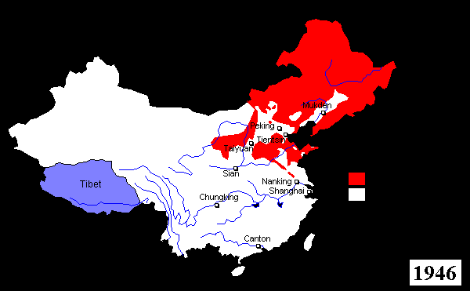
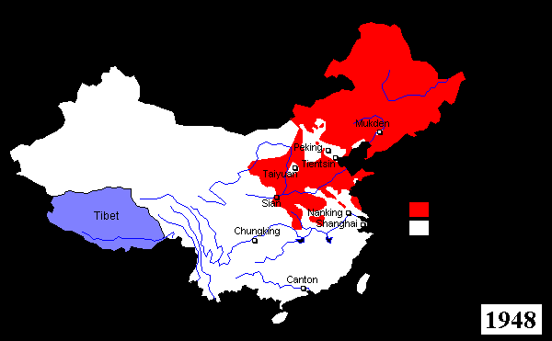
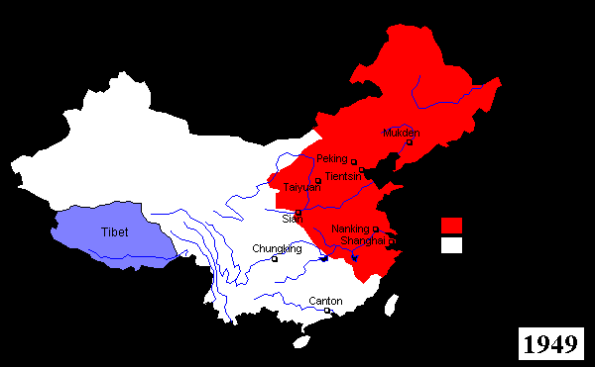
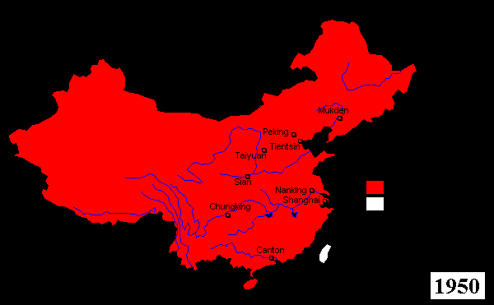
“War of Liberation”

Slide 12
Mao’s Basic Goals
A revolution from above to remove “3 big mountains”
imperialism
feudalism
bureaucratic-capitalism
A “United Front” of …
workers
peasants
petty bourgeoisie

Slide 13
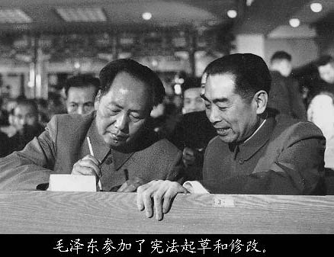
1950s Economic Reconstruction
Soviet model and assistance
Land reform (eliminate landlord class)
Heavy industry (state-owned enterprises)
First National People’s Congress (1954)
PRC Constitution
Zhou Enlai
Premier
Foreign Minister

Slide 14
The 100 Flowers Campaign of 1956-1957
CCP authorities, led by Zhou encouraged a variety of views and solutions to ongoing problems, launched under the slogan: "Letting a hundred flowers blossom and a hundred schools of thought contend is the policy for promoting progress in the arts and the sciences and a flourishing socialist culture in our land."
Have intellectuals discuss the country's problems in order to promote new forms of arts and new cultural institutions.
Mao & Zhou believed it would be apparent that socialist ideology was superior to capitalism and would thus propel the development and spread of the goals of socialism.

Slide 15
Effects of the HFC
Situation spiralled out of control. Millions of critical letters arrived in government offices:
“We protest against CCP control over intellectuals, the harshness of previous mass campaigns such as that against counterrevolutionaries, the slavish following of Soviet models, the low standards of living in China, the abolition of foreign literature, economic corruption among party cadres, and the fact that 'Party members [enjoyed] many privileges which make them a race apart’.“
“The country should separate with each Political Party controlling a zone of its own.”
"Each political party in China should rule in transitional governments, each with a 4 year term."
In July 1957, Mao ordered a halt to the campaign. By that time Mao had witnessed Khrushchev denouncing Stalin and the Hungarian Revolution of 1956, events by which he felt threatened. Mao's earlier speech, On the Correct Handling of the Contradictions Among the People, was meaningfully changed and appeared later on as an anti-rightist piece in itself.

Slide 16
Effects of the HFC
Bureaucracy vs. Intelligentsia vs. Mao. Moderates vs. Radicals. Urban vs. Rural…
Flowers turned to ‘weeds’…
The result of the Hundred Flowers Campaign was the persecution of intellectuals, officials, students, artists and dissidents labeled "rightists" during the Anti-Rightist Movement that followed.
550,000+ identified as "rightists" were humiliated, imprisoned, demoted or fired from their positions, sent to labor and re-education camps, tortured, or killed.
Deng was operative in the purge. Zhou lost credit.
Led to Cultural Revolution…

Slide 17
The Great Leap Forward 1958-63 (2nd 5YP)
Mao’s early experiences with peasant revolution convinced him of the immense potential of peasant strength. He believed that if properly organized and inspired, the Chinese masses could accomplish amazing feats. Mao called upon all Chinese to engage in zealous physical labor to transform the economy and overtake the West in industrial and agricultural production within a few years (“walking on two legs”)
Beginning in the mid-1950s Mao advocated the rapid formation of agricultural communes, arguing that the energy of the people could help China achieve a high tide of Communist development.

Slide 18
The Great Leap Forward 1958-63 (2nd 5YP)
1959 -1962 were known as the "Three Bitter Years" and the Three Years of Natural Disasters. If the weather was better…?
Many local officials were tried and publicly executed for giving out misinformation. Afraid to disappoint their leaders (b/c of HFC?), peasants falsified grain production numbers.
Several poor harvests caused massive famine and the deaths of 2-3 million of people throughout China.

Slide 19
The Great Leap Forward 1958-63 (2nd 5YP)
Vast initiatives implemented in 5 months … too brief for proper preparation. Organizational chaos ensued and Russia withdrew support … radicals forced to abandon the effort due to falling agricultural/industrial output.
Entered a period of “Readjustment, Consolidation and Repair” (1961-65)
With the abandonment of the GLF, the moderates in the CCP fostered sharp changes in policy to restore order and to repair damage done to economy.
Particular emphasis was given to agriculture to reduce threat of mass malnutrition and starvation.
focus on communes.

Slide 20
The Great Leap Forward 1958-63 (2nd 5YP)
Mao’s relationship with intellectuals was uneasy, and he was critical of the gap between the lives of the urban educated elite and the rural masses.
Liu Shaoqi made a speech in 1962 at Seven Thousand Man's Assembly criticizing that "The economic disaster was 30% fault of nature, 70% human error."
Mao’s policies in the GLF failed, but those in the government who criticized him directly, such as Peng Dehuai, were humiliated and purged.

Slide 21
The Great Leap Forward 1958-63 (2nd 5YP)
At the Lushan Conference an attack was led by Minister of National Defense Peng Dehuai who had become troubled by the potentially adverse effect Mao's policies would have on the modernization of the armed forces. Peng argued that "putting politics in command" was no substitute for economic laws and realistic economic policy—can’t "jump into communism in one step."
Peng Dehuai was alleged to have been encouraged by Khrushchev to oppose Mao.
Mao now saw himself as a "dead ancestor”, respected but never consulted

Slide 22
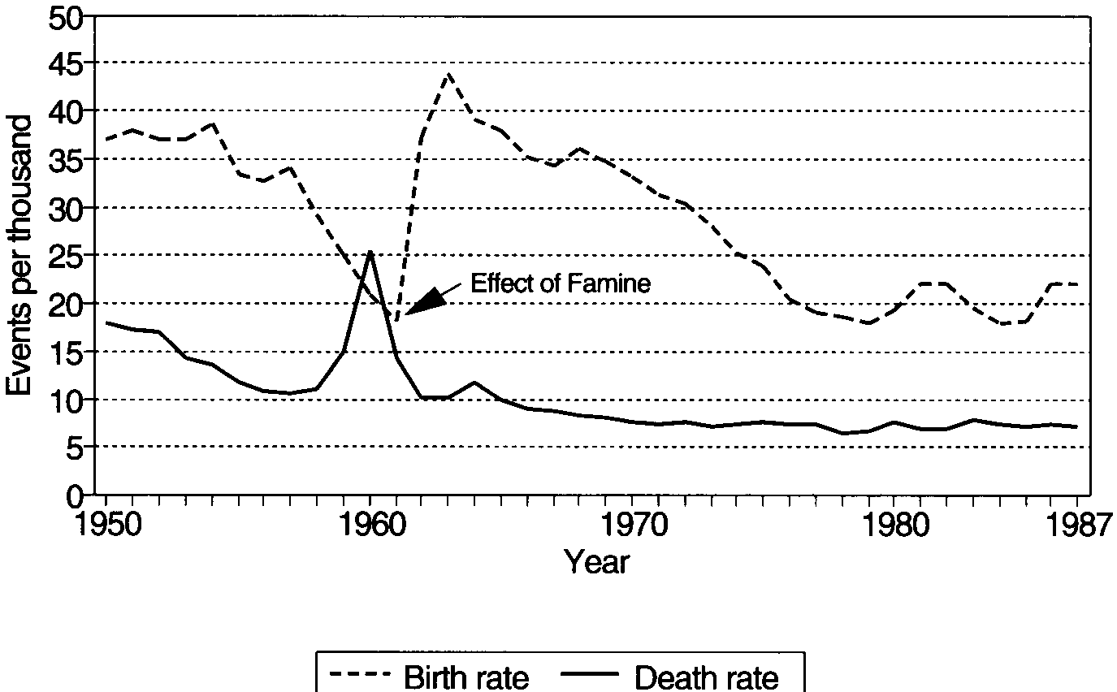
The Great Leap Forward 1958-63 (2nd 5YP)

Slide 23
The Great Leap Forward 1958-63 (2nd 5YP)
GLF is now widely seen – both within China and outside – as a major economic and humanitarian disaster.
The official toll of excess deaths recorded in China for the years of the GLF is 14 million, but scholars have estimated the number of famine victims to be between 20 and 43 million
These tensions were among the underlying causes of the Cultural Revolution…

Slide 24
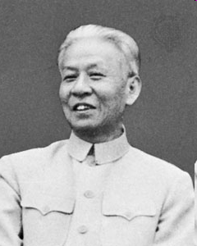
Growing Divisions (1962-1965)
Mao Zedong versus:
Liu Shaoqi
Peng Dehuai
Deng Xiaoping
Charismatic leadership vs. bureaucracy
Russia vs. China

Slide 25
Great Proletarian Cultural Revolution (1966-1976)
To renew the revolutionary spirit…
Mao’s Red Guards would raid houses looking for “four olds”
old custom, old culture, old habit, or old ideas
Mao declared the Chinese people ‘blank’
Before the drama had played itself out, it consumed, physically or spiritually, virtually all of the original promoters as well as many of its intended victims.

Slide 26
Great Proletarian Cultural Revolution (1966-1976)
‘There is no period in China’s history so complex and contradictory or so lacking in historical precedents, no other period where all historical analogies fail. Rarely has any society revealed itself so openly with all its contradictions and scars, and rarely have events unfolded in ways so strange, torturous and bizarre.’ (293)
The main responsibility for the movement rests with Mao himself. (292)
The legacy of the CR is mass disillusionment with Communism.

Slide 27
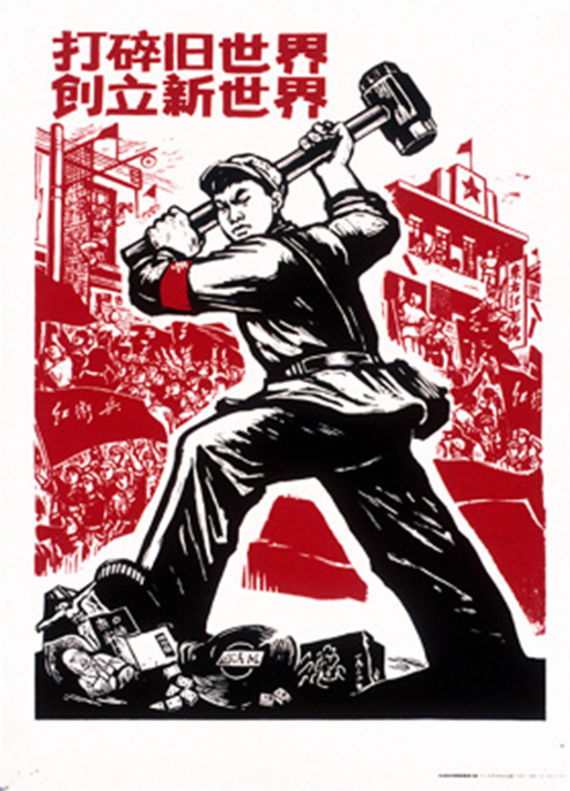
Red guards raiding houses. They destroyed museums, homes and works of art in order to destroy the Four Olds.

Slide 28
Cultural Revolution (1966-1976)
Mao tried to co-opt the intellectuals (who, like Mao, rejected traditionalism).
At the same time, Mao tried to co-opt the peasants and to arm them with revolutionary consciousness
In sum, Mao wanted to solve 3 main problems:
Growing inequality
The fading socialist vision
The entrenchment of bureaucratic elites
What began as a war against bureaucatic privelege and oppression, but soon fell under the sway of the Chinese Army—the most oppressive and bureaucratic organ of the CCP.

Slide 29
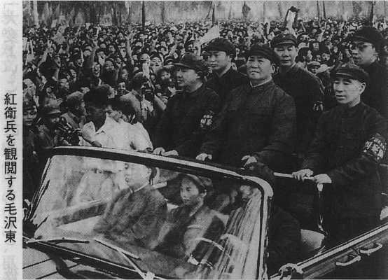
Red Guards (1966-69)
Renamed streets and buildings
Lined the streets with pictures of Mao
Attacked and humiliated thise in Western or traditional clothing
As early as 1967, Red Guards seen by many in the Party as a liability.

Slide 30
Cultural Revolution (1966-1976)
I. Public struggle session:
Places where the accused were struggled against:
the workplace or school of the accused (ordinary people)
Huge, opened stadiums (famous people, e.g., Liu Shaoqi)
Participants:
Accusers: whoever believed Mao and/or wanted to succeed him
Spectators: entertainment for the masses
Process of struggle:
Verbal attack by colleagues, students, friends, relatives
Subordinates were pitted against superiors, students against teachers, friends against friends, colleagues against colleagues, spouse against spouse

Slide 31
Cultural Revolution (1966-1976)
II. Against the Four Olds
Red guards: school students, mostly teenagers
Sacking, looting, beating and killing
Destroyed public and personal properties, and anything regarded as representing the Four Olds
Whoever classified as: landlords, reactionaries, counterrevolutionaries, rightists, bad elements, traitors, spies, capitalist-roaders, all of them “ox ghosts and snake spirits”

Slide 32
Cultural Revolution (1966-1976)
III. Self-Destruction
Self-criticism, including false confession
Suicide
depression and despair
fear
protest against an unjust government
IV. Psychological Terror
Some 12 million young people were rounded up and sent to the countryside to “study” (xuexi)

Slide 33
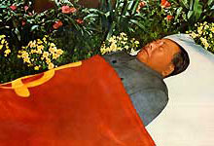
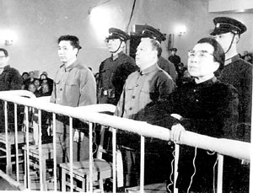
Mao and Zhou Died in 1976
Turning point in China’s postwar era
“Gang of Four” were arrested
End of the Cultural Revolution
Enter Deng Xiaoping. Criticized Mao’s “cult of personality” (sound familiar?)

Slide 34
“Long Live Chairman Mao”

Slide 35
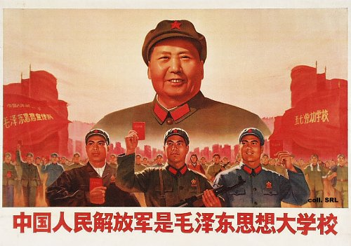
“The People's Liberation Army represents the great school of Mao Zedong Thought”

Slide 36
“Criticize the old world and build a new one with Mao Zedong Thought as our guide”

Slide 37
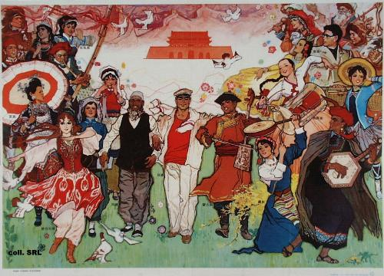
“Our country is a united, multicultural nation”

Slide 38
“We are proud to participate in the industrialization of the nation”

Slide 39
“Awakened people! You will certainly attain the ultimate victory”

Slide 40
“Thoroughly engage in revolutionary criticism”

Slide 41
“Strike the battle drum of the Great Leap Forward even Louder”

Slide 42
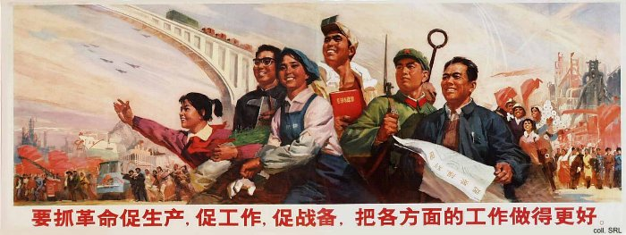
“We must grasp revolution. Increase production!

Slide 43
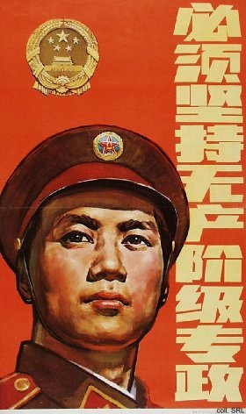
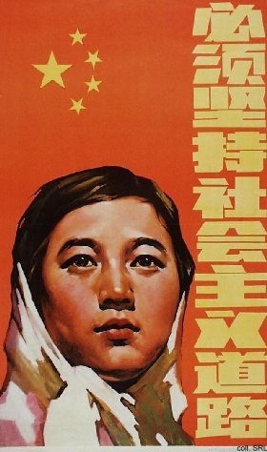
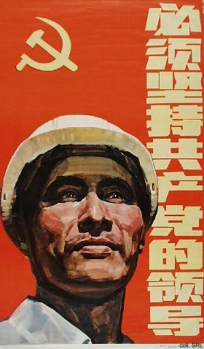
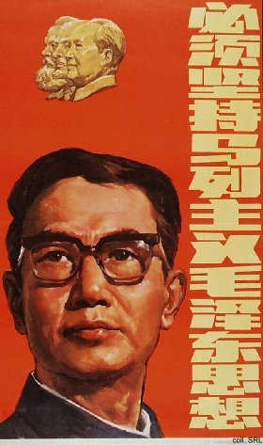
Post-Mao Propaganda (1979)
Deng Xiaoping introduced "Four Basic Principles in March 1979.
We must keep to the socialist road
We must uphold the dictatorship of the proletariat
We must uphold the leadership of the Communist Party
We must uphold Marxism-Leninism-Mao Zedong Thought

Slide 44
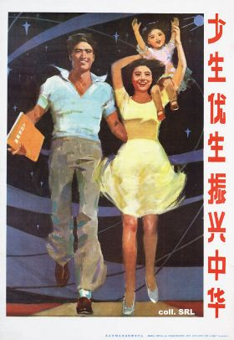
Post-Mao Propaganda (1988)
“Less births, better births to develop China vigorously”

Slide 45
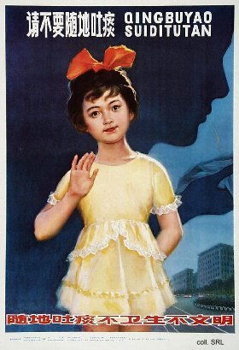
Post-Mao Propaganda, (1986)
“Do not spit freely. Spitting is neither hygienic nor civilized”

