Slide 1
LOUIS XIV “The Sun King” (5 September 1638 – 1 September 1715)
“L’ état, c’est moi” ~ “I am the state”

Slide 2
Lecture Outline Centralization of Absolute Power
Introduction
Brief Timeline
Le Fronde
Law & Order
Control Nobles
Economic Reform
Patronage of the Arts
Versailles
The Church
Army
Foreign Policy

Slide 3
Thesis
Through his ambitious political, economic, cultural and religious pursuits, Louis XIV brought built on the legacy of his Capetian predecessors to achieve the centralization of France, French influence in the world, and a perfect absolute monarchy.

Slide 4
Brief Timeline
1638: Louis born, son of Louis XIII and Anne of Austria
1643: Louis XIII dies, Anne and Mazarin took the regency for the four year old Louis
1648-1653 Wars of the Fronde
1654: At 18, Louis crowned, becomes Louis XIV
1661: Cardinal Mazarin dies => at 23 Louis has personal control over France
1661–1715: Develops Perfect Absolute Monarchy

Slide 5
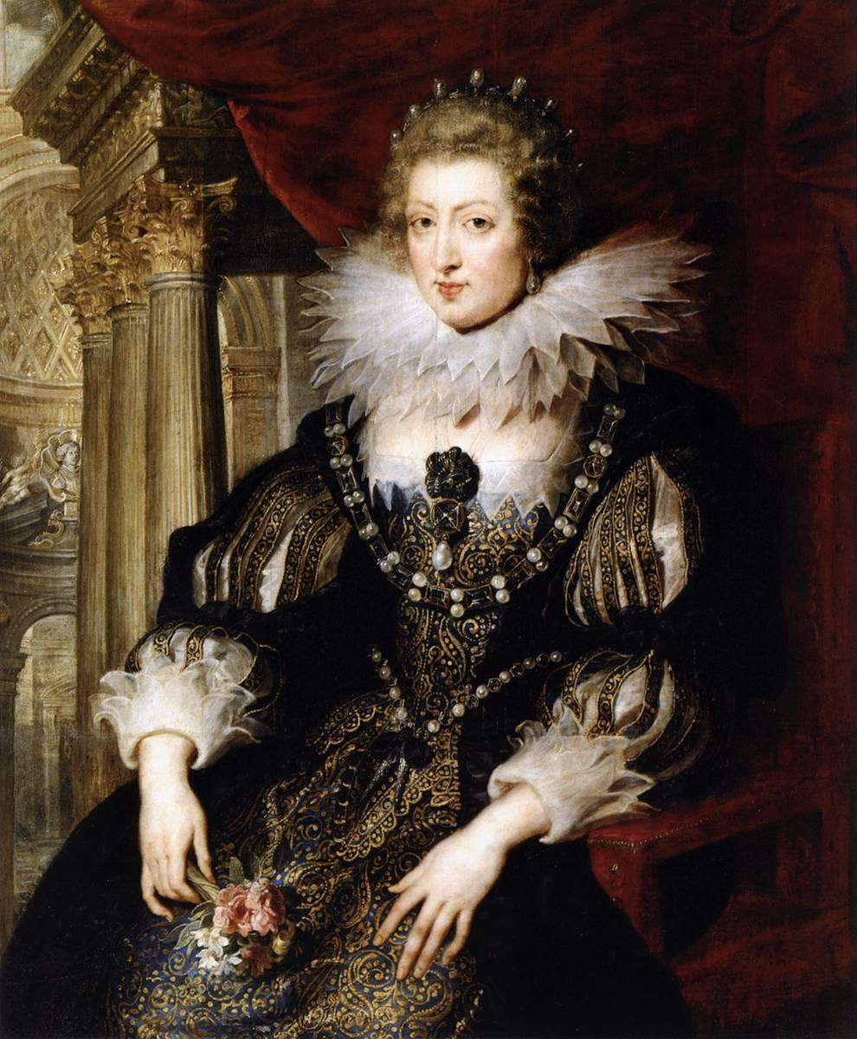
Louis XIII and Anne of Austria

Slide 6
The Fronde
Causes:
Dissatisfaction with taxes- In 1648 Mazarin attempted to tax members of the Parlement de Paris
Protest against their political demotion from vassals to courtiers
Feudal Nobility was threatened by Mazarin and wanted more of a voice in the government. Mazarin fled to Germany
Fear of centralized gov
Disrespect for bureaucracy (the Noblesse de Robe)

Slide 7
The Fronde
Effects:
→ Fronde was defeated
→ Disorder from the Fronde: Years of fighting, riots and disorder leaves the peasants weary of troubled times. In this way, they are perfectly ready to accept the iron rule of an absolute monarch
→ Left Louis XIV with distrust of nobles…

Slide 8
Law & Order: Intendants
Intendants administered France – country was divided into 32 districts
Job of an Intendant
recruit men for army
supervise collection of taxes
preside over administration law
check on local nobility
regulate economic activities
Enforce corvée: forced labor that required peasants to work a month per year on public projects

Slide 9
Law & Order: Advisors
3 main advisors
Jean Baptiste Colbert - Finance & Navy
Michel de Telier – Military
Hughes de Lionne – Foreign Affairs
Grande Ordonnance de Procédure Civile of 1667, the Code Louis - comprehensive legal code attempting a uniform regulation
Law of State / Law of Church
Basis for Code Napoleon

Slide 10
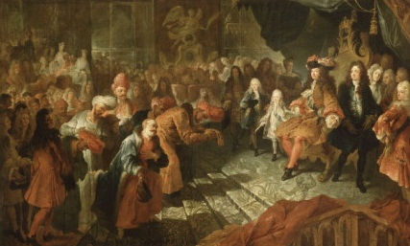
Control the Nobility
Nobles tried to gain favor at Versailles
Created Secret Police:
- spied on nobles
- went through mail
Compromise with the Nobility
He doesn’t tax them
They can’t complain about how money is spent
More and more power to the King

Slide 11
Economic Reform
1661, treasury verged on bankruptcy
Colbert - Contrôleur général des Finances.
Louis first had to eliminate Nicolas Fouquet, the Surintendant des Finances. Fouquet charged with embezzlement.
Mercantilism as means to self sufficiency
Colonies in North America
Customs & Taxes
Inventions
Manufacturing (esp. glass, shipbuilding, and iron)
Infrastructure
Army & Navy

Slide 12
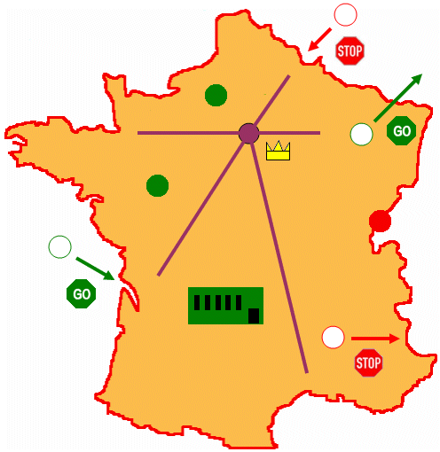
Mercantilism
1.Intervene in the economy, to protect home products, by taxes and tariffs
7.Increase tariffs, taxes, and duties to pay for the military and royal estate.
8. Maintain traditional farming
1
2.Export of finished products to achieve a positive balance of trade
(Revenue for military, arts, infrastructure, etc.)
9
7
2
8
6.Develop strong infrastructure - roads and canals
6
5
4
3
5.Reduction of tolls for national traffic
3.Entrepreneurs est. manufacturing base.
4.Est. colonies and trading partners

Slide 13
Patronage of the arts
Changes Art
No Longer to Glorify God – Middle Ages
No Longer to Glorify Human Potential – Renaissance
Glorify King and Absolute Rule
The Louvre
Painters (mostly Italian Baroque): Charles Le Brun, Pierre Mignard, Antoine Coysevox, and Hyacinthe Rigaud
Composers: Lully, Chambonnières and François Couperin
Writers: Molière (comedies), Racine (tragedies), and La Fontaine (fables)

Slide 14
Academies
Académie Française
Academy of inscriptions and belles-lettres 1663
Academy of Science 1666
Academy of moral and political Sciences 1795
Academy of architecture 1695
Academy of Royale de Musique 1680
→ Funds from Finance Ministry

Slide 15
Palace at Versailles
Fronde allegedly caused Louis to hate Paris, which he abandoned for a country retreat. But he beautifies Paris also. So why?
Patronage: Entire French nobility was expected to be present in ceremonies, festivals and dinners – nobles danced and tried to gain favor of the King
Watch for potential Rivals
To leave something glamorous for next generations
Ultimate show of Divine Right, power, and elegance…

Slide 16
Palace at Versailles
2,000 acres of grounds
12 miles of roads
27 miles of trellises
200,000 trees
210,000 flowers planted every year
80 miles of rows of trees
55 acres surface area of the Grand Canal
12 miles of enclosing walls
50 fountains and 620 fountain nozzles
21 miles of water conduits
3,600 cubic meters per hour: water consumed
26 acres of roof
51,210 square meters of floors
2,153 windows
700 rooms
67 staircases
6,000 paintings
1,500 drawings and 15,000 engravings
2,100 sculptures
5,000 items of furniture and objects d'art
150 varieties of apple and peach trees in the Vegetable Garden

Slide 17
Palace at Versailles

Slide 18
Palace at Versailles
Gallery of Battles
Hall of Mirrors

Slide 19
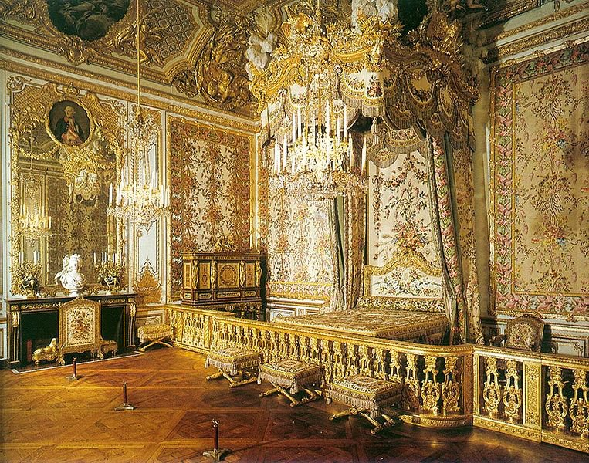
Palace at Versailles
The Gardens
Bedroom of the Queen

Slide 20
Religion: One Faith
Devout Catholic
Head of the Gallican Church (French Catholic Church)
Anti – Huguenot Campaign
Closing of schools and churches
Excluded from public office
Job Discrimination

Slide 21
Religion: One Faith
Edict of Fountainbleau (1685)
Repealed Edict of Nantes – rel. toleration to Huguenots
200,000+ (of 2 million) Huguenots fled to England, Holland, and New England
Many Huguenots belonged to the merchant and artisan classes, they took their knowledge and skills with them…
Huge error - weakened France's economic position (and immoral)

Slide 22
The Army
Size
1635: 25,000
1659: 250,000
Loyal to King, not nobles
Modernize
Organize
Professionalize
Discipline
Morale

Slide 23
Expansion of French Empire
Wanted control of modern Belgium and Holland
Rhine River as eastern border of France
Louis’ longest war was the War of the Spanish Succession- lasted from 1701- 1714
almost led to France’s defeat
bankrupted the country
Wars made him unpopular

Slide 24
Expansion of French Empire

Slide 25
Discussion Questions
What methods did Louis XIV use to consolidate his rule?
Identify and describe the Sun King’s successes.
Identify and describe the Sun King’s excesses.
"One King, one law, one faith”. Mission accomplished? To what extent did Louis XIV achieve the perfect Absolute Monarchy?

