Slide 1
The Industrial Revolution: 1780-1850
Mr. Daniel Lazar

Slide 2
Lecture Outline
Overview of the IR
Proto IR
Why England?
Spread of the IR
German IR
Effects of the IR
Proletarian Responses
Government Responses
Questions

Slide 3
Overview of the Industrial Revolution
IR fundamentally revolutionized western civilization:
Capitalism
Liberalism
Unionism
Marxism
Utopianism
Nationalism
Imperialism

Slide 4
Roots of the Industrial Revolution
Scientific Rev - first wave of inventions
Age of Exploration begat Commercial Revolution (1500-1700) - economic growth of Europe
Rise of Global Capitalism
Price Revolution (inflation) stimulated production as producers could get more money for their goods
Agricultural Rev & Enclosure Mvmt
Increase in Europe’s population

Slide 5
Proto-industrialization: Cottage Industry
Rural industry was a major pillar of Europe’s growing economy in 18th century
Merchants sought cheap rural labor rather than paying guild members in towns higher fees
Cottage industry - Merchant-capitalist would provide raw materials (e.g. raw wool). Home manufacturers would “put out”
Workers sent it back finished
Family enterprise
Paid by piece (piecework)
Textiles, knives, forks, housewares, buttons, gloves, clocks, and musical instruments

Slide 6
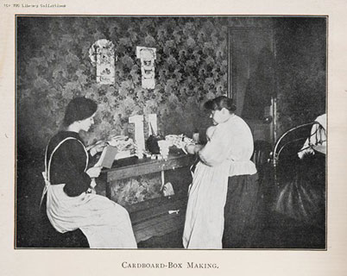
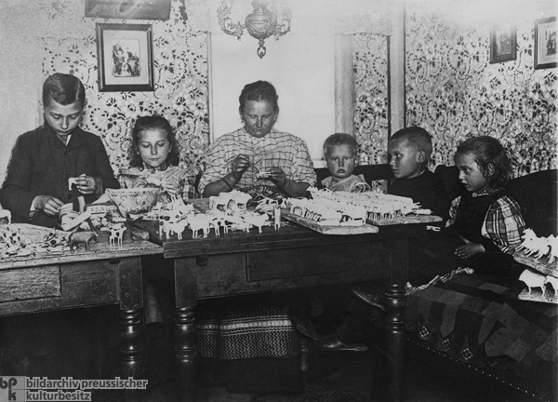
Problems with the cottage industry
Constant disputes b/w cottagers and merchants over weights of materials and quality of cloth
Rural labor disorganized & unpredictable

Slide 7
Proto-industrial technology
1733, John Kay: flying shuttle enabled weaver to throw shuttle back and forth between threads with one hand
1764, James Hargreaves invented the spinning jenny which mechanized the spinning wheel

Slide 8
Proto-industrial technology
1779, Samuel Crompton invented the spinning mule
1769, Richard Arkwright invented the water frame, which improved thread spinning

Slide 9
Why
England?

Slide 10
England was First
Began in 1750s - no impact on continental Europe until after Napoleonic Wars
Why England?
Enclosure & Ag Rev
Waterways offered a source of alternate power for factories and navigable transport
Geographic isolation offered protection
Supply of coal and iron
Royal Navy
Banking
Atlantic economy

Slide 11
England was First: Agricultural Rev
Supply of cheap and abundant labor emerged as the enclosure movement forced many landless farmers to move to towns and cities
Enclosure Movement: Taking over and fencing/hedging off land formerly shared by peasants
Industrial Farming. Jethro Tull & Seed Drill
Eugenic animal breeding
Fewer farmers can now feed more people
British population doubled in the 18th century
Demand for goods ↑

Slide 12
England was First: Capital Supply
2 centuries of profitable commercial activity
England avoided many costly continental wars
Bank of England in 1694
Banking Rev & Capitalism
Insurance companies, like Lloyd’s of London, provided some protection from commercial failure

Slide 13
England was First: Entrepreneurialism
Risk takers with know-how
Middle class emerged from business wealth
Challenged nobility
“Protestant work ethic”
Biblical revisionism

Slide 14
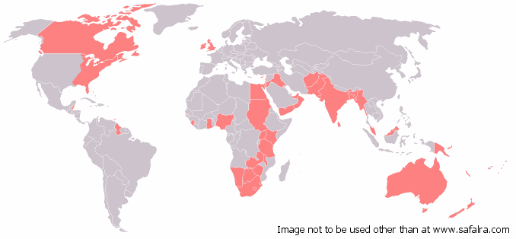
England was First: Colonial Empire
Raw materials
Markets

Slide 15
England was First: Steam engines and coal
From wood-burning to coal-burning
By 1850, England produced 2/3 of world's coal
The steam engine
James Watt in 1769
replaced mechanical pumps powered by animals
iron industry was radically transformed
rise to heavy industry - manufacture of machinery and materials used in production

Slide 16
England was First: Transportation Rev
Made possible by steam power
New canal systems
Hard-surfaced roads pioneered by John McAdam 1807, Robert Fulton’s steamboat (NY)
2-way river travel
1838, first steamship crossed the Atlantic
1803, first steam wagon
1812, steam wagon was adapted for use on rails…

Slide 17
England was First: The Rails
1825, George Stephenson made railway locomotive commercially successful
1830, his locomotive, the Rocket, traveled the Liverpool-Manchester Railway at 16mph
Private companies quickly organized
Gov subsidized and protected (?)
Reduced cost of shipping freight on land
Facilitated growth of urban working class
Travel on rails looking for work

Slide 18
England was First: “Liberal” Government
Gov’t sympathetic to industrial development
Limited monarchy meant that gov’t did not stifle the growth and expansion of the middle class
Not the case in France & Russia
Rise of the House of Commons became an instrument of the middle class to gain gov’t cooperation and secured middle class loyalty.
In contrast, the French middle classes led rev movements
Lowes Act: Allowed for limited liability for business owners
Repeal of the Navigation Acts and the Corn Laws decreased mercantilism’s stifling effect & promoted open international trade

Slide 19
Great Britain in 1850
1. Produced 2/3 of world’s coal
2. Produced more than ½ of world’s iron
3. Produced more than ½ of world’s cotton cloth
4. GNP rose between 1801 and 1850 350%
· 100% growth between 1780 and 1800
· Population ↑: 9mil = 1780, 1851 = 21mil
5. Per capita income ↑ almost 100% 1801 to 1851
6. Economy increased faster than population growthcreating higher demand for labor

Slide 20
Spread of the Industrial Revolution
Until 1825, it was illegal for artisans and skilled mechanics to leave Britain
Until 1843, export of textile machinery forbidden
Tariff policies est. to protect native industries
1834, the Zollverein - tariff on imports
Free trade zone among member states

Slide 21
Spread of the Industrial Revolution
Studied Britain’s successes and failures
Belgium, Holland, France, and U.S. in 1820’s
Germany, Austria, and Italy in mid-19th C.
E. Europe and Russia near end of the 19th C.
By 1900, Germany was the most powerful
Banks in France and Germany
Crédit Mobilier of Paris

Slide 22
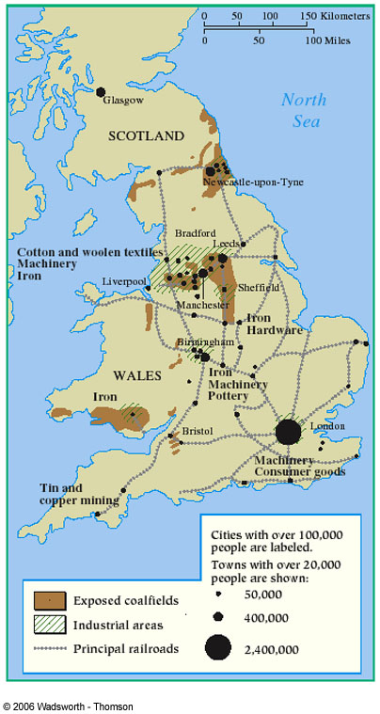
Spread of the Industrial Revolution

Slide 23
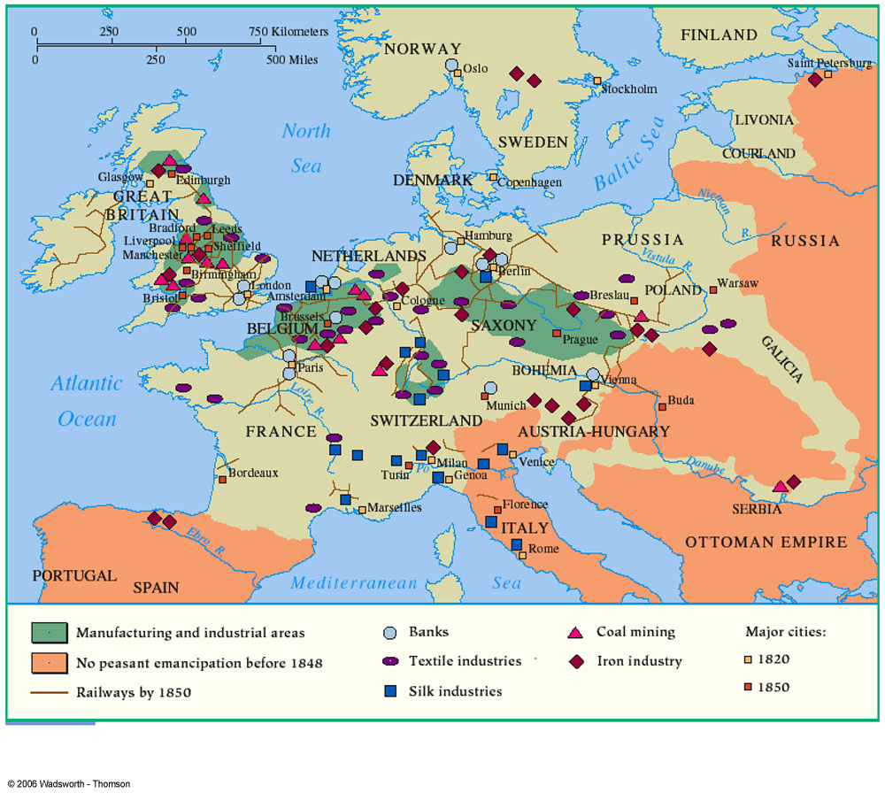
Spread of the Industrial Revolution
…U.S.A.

Slide 24
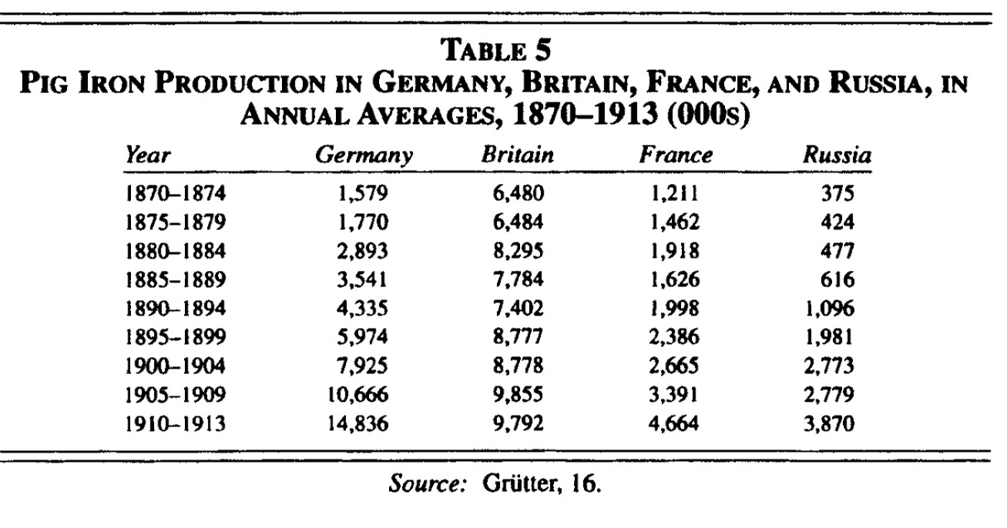

Slide 25
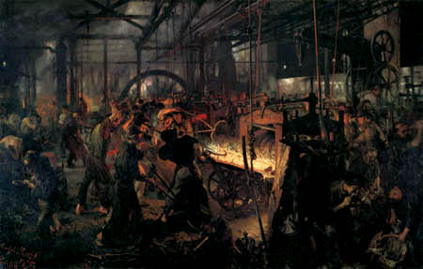
The Second IR: Germany’s First Economic Miracle

Slide 26
Blood & Iron
“The great questions of our day cannot be solved by speeches and majority votes but by iron and blood.”
-- Otto von Bismarck, Speech to the Prussian Landtag, 30 Sept. 1862

Slide 27
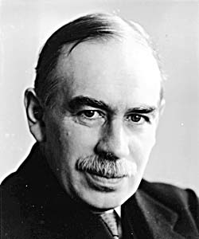
Blood & Iron Revisited
“The German Empire was built more truly on coal and iron than on blood and iron.”
J. M. Keynes

Slide 28
Germany’s First Economic Miracle
Until midcentury, the guilds, the landed aristocracy, the churches, and the government bureaucracies had so many rules and restrictions that entrepreneurship was held in low esteem, and given little opportunity to develop
German cartel system (Konzerne), being significantly concentrated, made more efficient use of capital
Bankers, industrialists, mercantilists, the military, and the monarchy joined forces
Germany was not weighed down with Empire
Annexation of Alsace-Lorraine in 1871 = France's industrial base
By 1900 , German chemical industry dominated the world market for synthetic dyes.
BASF & Bayer controlled 90%!

Slide 29
Germany’s First Economic Miracle
German Social Democratic Party (SPD)
Founded 1875
Kept Marxist socialism alive
Divided b/w reform advocates/revolutionaries
Bismarck’s Repression of the SPD
Thought socialism would undermine politics/society,
Antisocialist laws
Yet SPD ↑ rep. in Reichstag
Repression didn’t work, so…
Bismarck tried social welfare legislation
accident insurance/old age/disability pensions

Slide 30
Germany’s First Economic Miracle
William II forced Bismarck’s resignation
Allowed antisocialist legislation to expire
SPD needed to decide attitude towards empire
Erfurt Program
1891, declared imminent doom of capitalism
Necessity of socialist/collective ownership
decided to accomplish through legal participation, not Rev activity
But thought revolution was inevitable

Slide 31
Famous companies/industrialists
Stumm
Krupp
Thyssen
Bosch
Siemens
Daimler
Benz
AEG - Rathenau
Bayer
BASF

Slide 32
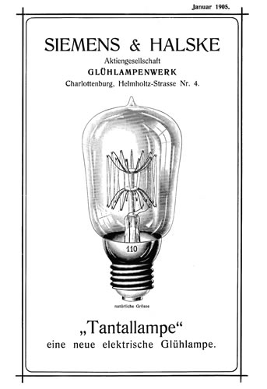
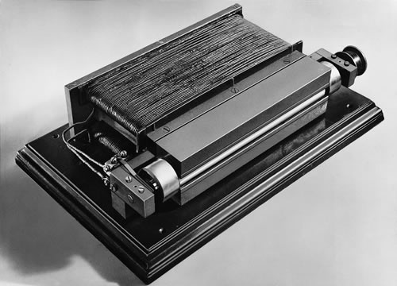
Electrical industry - Siemens
Siemens pointer telegraph, 1847
Electrical dynamo, 1866

Slide 33
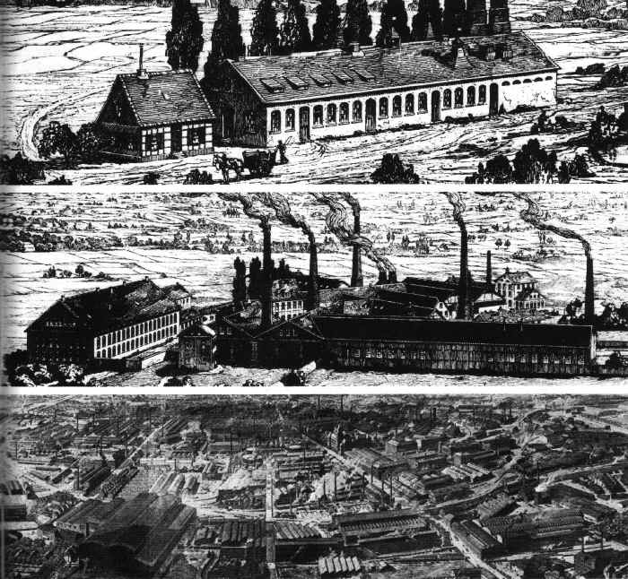
Steel – Krupp of Essen
Alfred Krupp, 1812-87, the ‘Cannon King’
Pioneered seamless railway wheels
Developed Bessemer process for purifying steel
Close contacts with arms industry
Krupp steelworks, Essen, stages of growth 1819, 1852, 1912

Slide 34
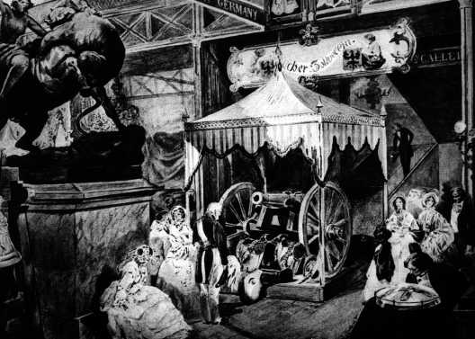
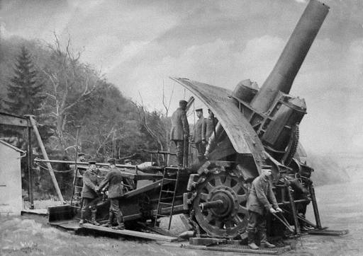
Krupp & munitions
Krupp’s cast-steel cannon at the 1851 Exhibition in London
Krupp’s 42cm ‘Dicke Bertha’ siege gun (used to reduce Liege in 1914 and later shell Paris)

Slide 35
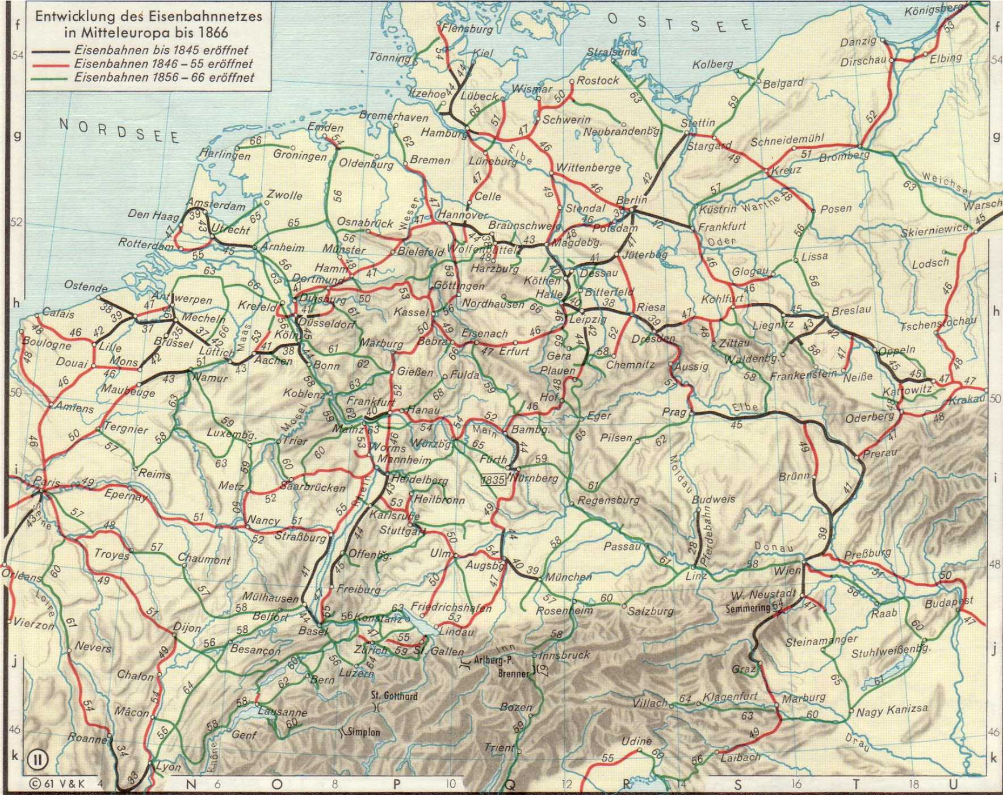

Slide 36
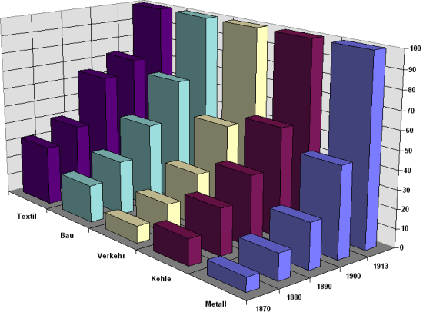
(1913 ~ 100) | Metal | Coal | Transport | Building | Textile
1870 | 7,5 | 13,9 | 8,9 | 20,1 | 31,9
1880 | 13,9 | 24,7 | 16,1 | 29 | 40,1
1890 | 23,8 | 36,9 | 27,9 | 45,6 | 65
1900 | 47,5 | 57,5 | 50,1 | 67 | 72,8
1913 | 100 | 100 | 100 | 100 | 100
Hans-Ulrich Wehler, Deutsche Gesellschaftsgeschichte, vol. 3 (Munich, 1995)

Slide 37
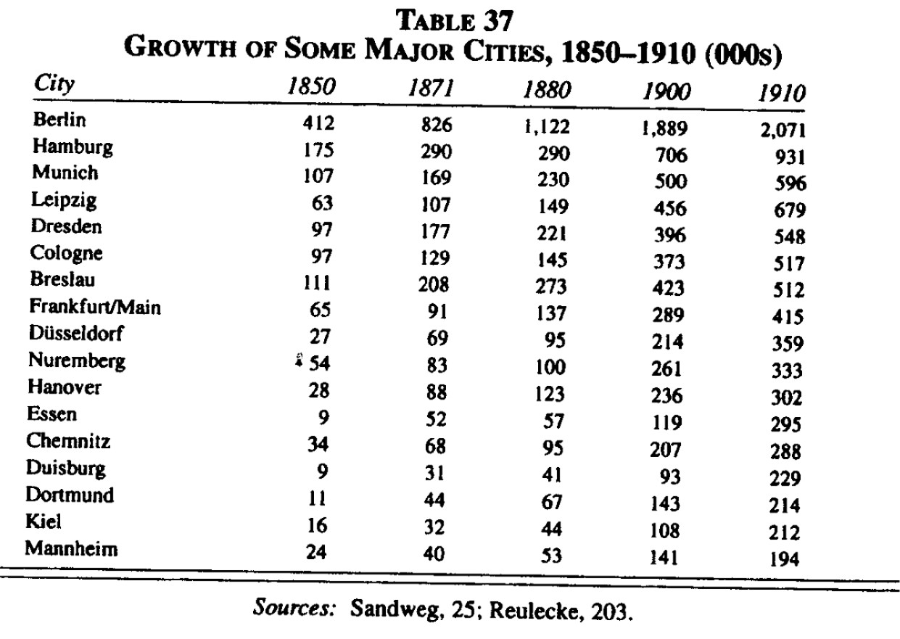

Slide 38
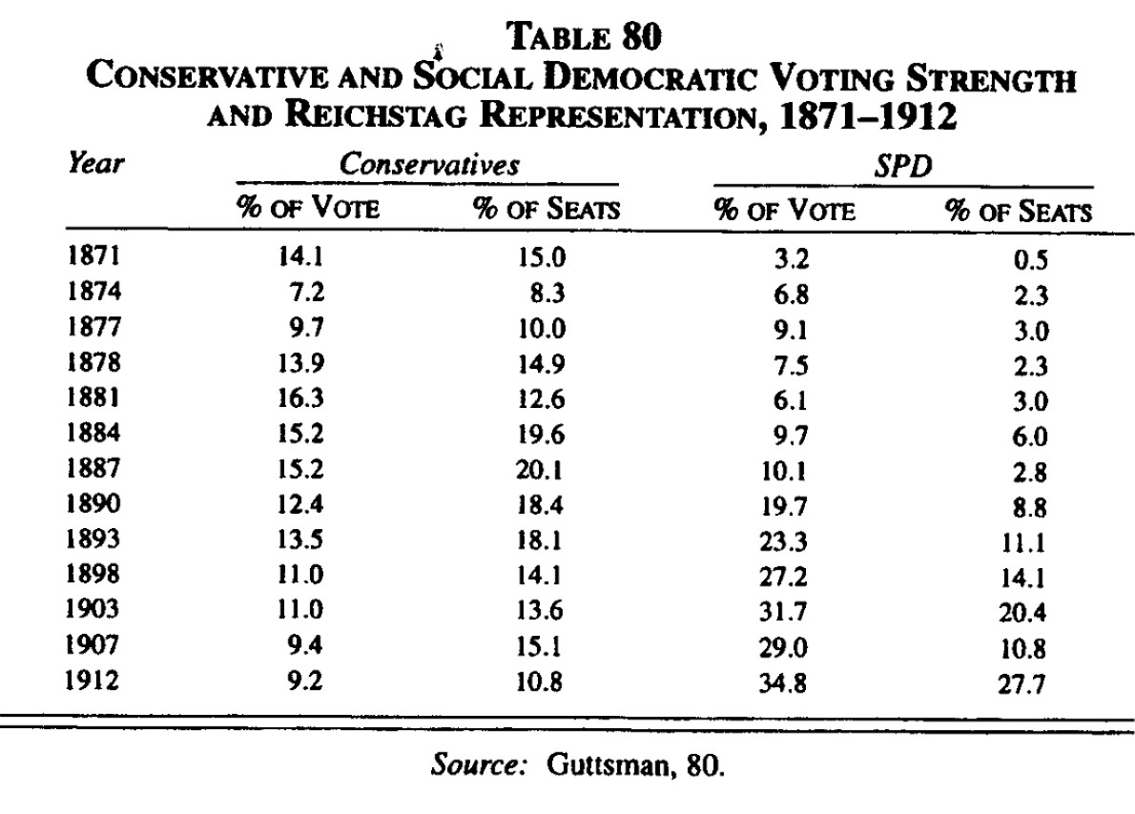

Slide 39
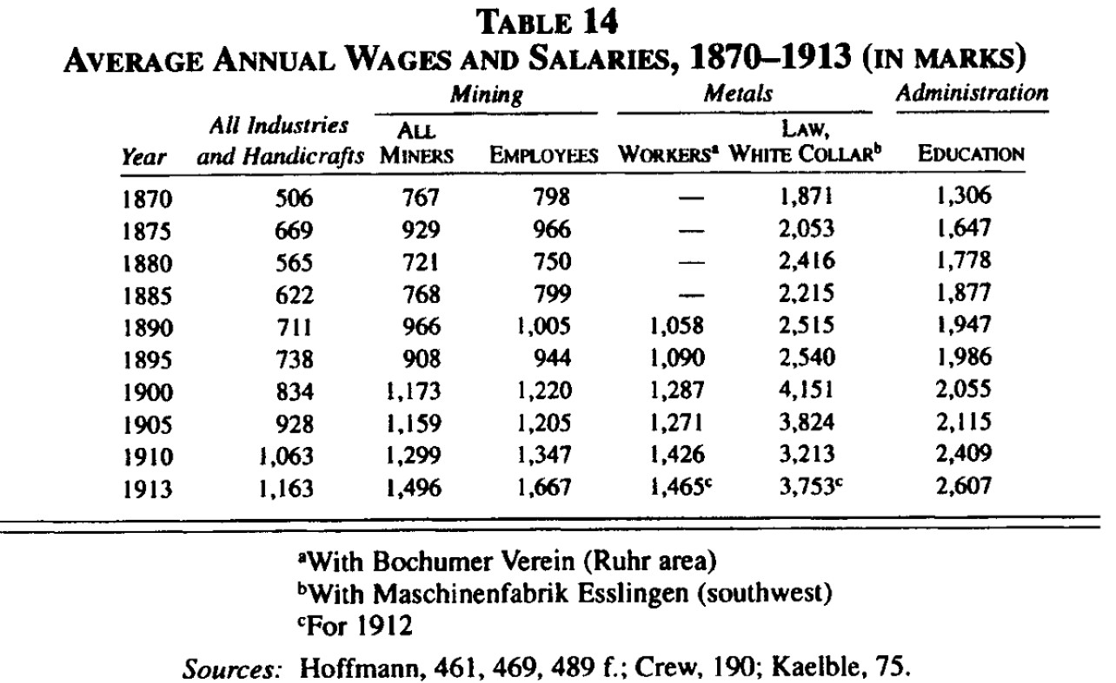

Slide 40
Associations, lobbyism and trade unions
Centralverband Deutscher Industrieller 1876 (Central Union of German Industrialists)
Bund der Industriellen 1895 (Union of Industrialists)
Hansabund 1909
Vereinigung der deutschen Arbeitgeberverbände 1913 (Union of German Employers’ Associations)
Socialist “Generalkommission” general commission
Christian “Gesamtverband”
Organizing the working class, representing interests of workers
Successes – state intervention and “welfare state”
Exert pressure on the government and Reichstag deputies
Successes: Tariffs 1878/79

Slide 41
Effects of the IR
New Class Structure
Replaced the traditional social hierarchy
Rise of the bourgeoisie
Upper bourgeoisie: great bankers, merchants, and industrialists who demanded free enterprise and high tariffs.
Lower bourgeoisie (petite bourgeoisie): small industrialists, merchants, and professional men who demanded stability and security from the government
New opportunities for certain groups
Protestants and Jews - banking in France
Quakers and Scots in England, then U.S.

Slide 42
Effects of the IR
Social Mobility
Demise of the skilled artisan
Skilled vs. Unskilled Laborers
Demand for education vs. cost of education
In England by 1830 and Germany in 1860, leading industrialists were more likely to have inherited their businesses.

Slide 43
Effects of the IR
Producer → Consumer Society
Between 1820 and 1850, real wages and consumption of average worker rose by 50%
Only 5% between 1780 and 1820
Vast amounts of food, clothing and energy were produced and distributed to the workers of the world
Luxuries more commonplace
But…average work week ↑

Slide 44
Effects of the IR
Urbanization
1785, 3 British cities > 50,000
1820, 31 British cities > 50,000
Largest population transfer in human history
Environmental Damage
Life-expectancy increased

Slide 45
Effects of the IR
Wage economy
Family structure and gender roles
Factory towns
Travel
Clearer distinction between ‘work’ and ‘leisure’.

Slide 46
Effects of the IR
Alienation
Class consciousness
Workers began to unite for political action…
Imperialism…

Slide 47
Effects of the IR: Proletarian Reactions
S & D of labor
14 hours a day
Working conditions
Low wages, particularly for women and children
Poorhouses emerged
Friedrich Engels (1820-1895) lashed out in The Condition of the Working Class in England (1844)
“I charge the English middle classes with mass murder, wholesale robbery, and all the other crimes in the calendar.”

Slide 48
Effects of the IR: Proletarian Reactions
Combination Acts (1799) - Parliament prohibited labor unions
Fear of radicalism in the French Rev
Repealed in 1824
Robert Owen in 1834 - Grand National Consolidated Trades Union in Scotland
Health, safety, hours
Experimented with utopian cooperative/socialist communities
Failed
Craft Unions for skilled laborers

Slide 49
Effects of the IR: Proletarian Reactions
Chartists sought universal male suffrage.
Unions campaigned
10 hour days
Duty free imports
Cheap bread
Safety
Child labor (even though children were doing much of same work they did in the cottage industry, conditions in factories were worse). Coal mines!
Saddler Commission investigation…

Slide 50
Effects of the IR: Gov Response
Factory Act of 1833
Limited workday for children 9-13 to 8/day
14-18 to 12 hours
Prohibited hiring children < 9
Children to elementary schools that factory owners required to establish
Ironically, helped destroy the pattern of families working together

Slide 51
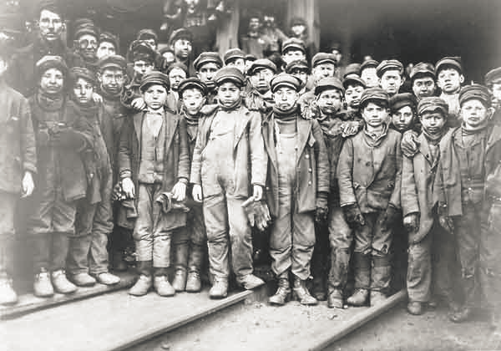
Effects of the IR: Gov Response
Mines Act of 1842: prohibited all boys and girls < 10 from working underground

Slide 52
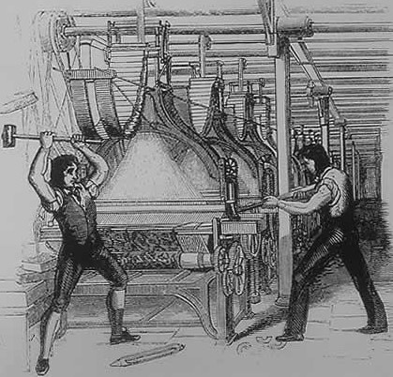
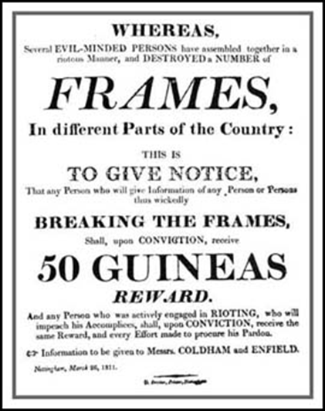
Effects of the IR: Luddite Reactionaries
Violent group of irate workers who blamed industrialism for threatening their jobs
Attacked factories in northern England

Slide 53
Intellectual Impact of IR: Socialism
French scholar Charles Fourier, in his 1808 book The Social Destiny of Man
"truth and commerce are as incompatible as Jesus and Satan.“
Karl Marx called him "utopian“
Robert Owen, Welsh manager of spinning factory in Manchester
Married into an industrial family and became owner of several mills
Employed children as young as 5
Est. schools and reformed child labor, eliminating harsh punishments.
Demanded a "new moral order“

Slide 54
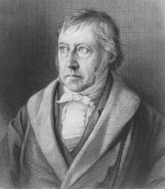
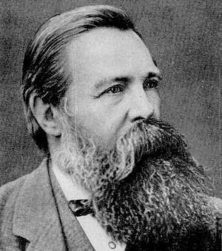
Intellectual Impact of IR: Socialism

Slide 55
Intellectual Impact of IR: Socialism
Demand for Democracy
Scientific Thinking & Fetishization of Science
Man can control nature
Man can control his nature: psychology and sociology born
Man can control his life: Pasteur & Germ Theory…The rise of modern medicine
Darwin
Quasi Scientific Thinking: Social Darwinism
Realism and Naturalism in art & lit
Monet
Zola, Tolstoy, Dostoyevsky

Slide 56
Intellectual Impact of IR: Socialism
Relativism: Einstein
Psychological Uncertainty
Freud: human behavior was irrational, unconscious, and instinctual
Social Uncertainty
Nietzsche & Disenchantment: “God is dead” and “Society”, also dead, will not save you
Fear and Social Disintegration: Durkheim
industrial society weakened social ties

Slide 57
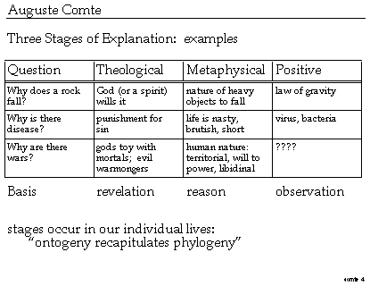
Intellectual Impact of IR: Positivism
Humanity is moving through three stages: 1. Theological: humans attribute all phenomena to gods or the supernatural 2. Metaphysical: humans attribute things to abstract ideas 3. Positive: humans attribute things to scientific fact

Slide 58
Discussion Questions
1. Why was England the first country to industrialize?
2. Analyze the role proto-industrialization played in setting the stage for the
Industrial Revolution.
3. Compare and contrast the Industrial Revolution in England with the industrial countries on the continent.
4. Analyze ways in which the Industrial Revolution altered the social fabric of
European society.
5. Analyze the impact of the Industrial Revolution on the following groups:
· Women
· Children
· Middle Class
· Proletariat
· Peasantry

