Slide 1
The Gilded Age and Urbanization
Through those who recorded and reacted

Slide 2
Timeline
1820-1860: Period of Manifest Destiny
Territorial expansion, extension of slavery
1861-1865: American Civil War
Fought over states’ rights, control of industry, and slavery
1865-1877: Period of Reconstruction
Reunify the U.S., aid Freedmen, extend railroad
1866-1898: Period of the Gilded Age
Growth of industry, unchecked immigration, political corruption

Slide 3
Mark Twain
While considered one of the most popular American authors, Mark Twain was also the one deme the era The Gilded Age.
"The golden gleam of the gilded surface hides the cheapness of the metal underneath.”
-Twain, The Gilded Age

Slide 4
The Gilded Age?
Termed by Mark Twain satirizing the period
Claimed that the period was not as wealthy as it looked
Political parties were the same: laissez-faire and corrupt
Political offices given through spoils system
Local government run by political bosses

Slide 5
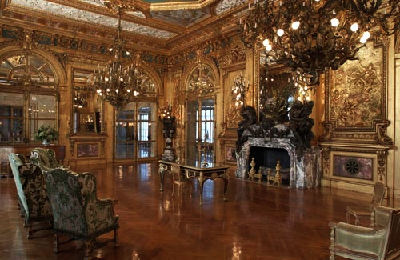
What is in a name?
Gilded, meaning opalescent, gleaming or gold plated as evidenced in the ornate style of the capitalists…
Built in 1892 by Richard Morris Hunt for William K. Vanderbilt.

Slide 6
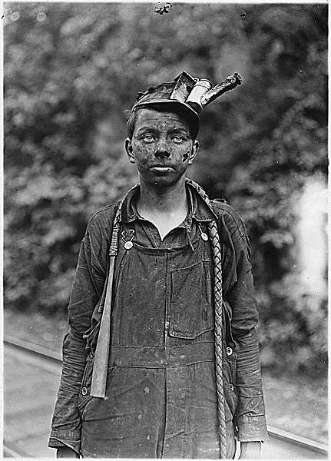
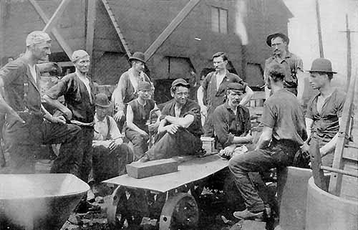
What is in a name?
The cheapness of the metal underneath= the oppressed and taken advantage of working class laborers (the majority)

Slide 7
The Gilded Age System
URBANIZATION
INDUSTRIALISM
IMMIGRATION

Slide 8
IMMIGRATION

Slide 9
By the Numbers
Between 1870 and 1920-aprox. 20 million Europeans immigrated
In the 1890’s increasing numbers came from southern and eastern Europe
Between 1880 and 1920 about 260,000 immigrants from the West Indies
1851-1883, about 300,000 Chinese arrived
By 1920 more than 200,000 Japanese lived on the West Coast

Slide 10
“Push” to U.S. Immigration
Europeans:
1840-50: Irish Potato Famine – mostly Irish Catholics come
Escape religious persecution (Jewish driven out of Russia by programs)
1848 Revolutions create turmoil
Population in Europe doubles to nearly 400 million
Later, WWI generates Italian, Slav, Greek, Polish, Jewish immigrants (Southern Europe)

Slide 11
“Push” to U.S. Immigration
Chinese
1839-42: Opium War with Britain
Loss of Hong Kong to Britain
Taiping Rebellion 1850-64
Agricultural crisis and rice shortage
Mexicans
Relatively open boarders until 1920
Political turmoil

Slide 12
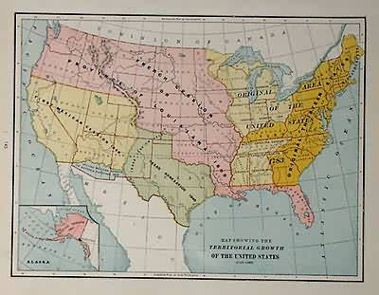
Why America?
Large tracts of open land
Abundance of natural resources
Excellent soil
“Can do” attitude
Eager population
A government that encouraged rugged individualism and free enterprise

Slide 13
“Pull” of Immigrants
Immigrants satisfy US economic needs
1864: 1st comprehensive federal immigration law to work frontier (RR, mining, farming, e.g., Chinese recruited for California gold rush 1848-1882).
1870s: Companies recruit in Mexico in part to replace Chinese, but mostly seasonal.
1901 National Reclamation Act irrigated new farmland in Western States
Japanese recruited by Hawaiian Planters. Once Hawaii was annexed in 1898, Japanese immigrated to the West Coast.

Slide 14
Business Supports Immigration
Throughout the 1800s (as today), immigration had been most staunchly supported by Big Business and the professional class, and most fiercely resisted by the wage-earner. Commons, in 1907: “It is an easy and patriotic matter for the lawyer, minister, professor, employer, or investor, placed above the arena of competition, to proclaim the equal right of all races to American opportunities; to avow his own willingness to give way should even a better Chinaman, Hindu, or Turk come in to take his place; and to rebuke the racial hatred of those who resist this displacement. His patriotism and world-wide brotherhood cost him and his family nothing, and indeed they add to his profits and leisure.”

Slide 15
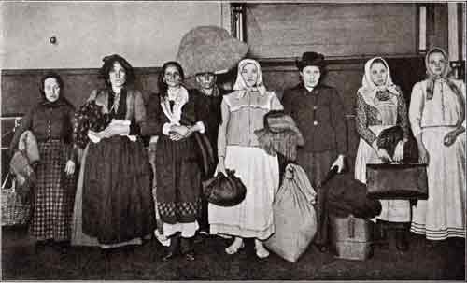
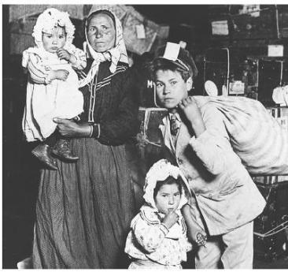
Elis Island
Ellis Island: 1892 – 1924:
5000 enter daily, maybe 1 in 50 rejected
12 million had entered by 1954 when closed

Slide 16
Elis Island

Slide 17
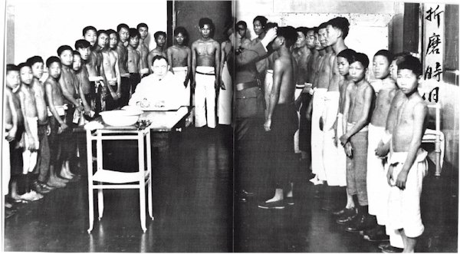
Angel Island
Between 1910 and 1940 about 50,000 Chinese immigrants entered the United States through Angel Island in the San Francisco Bay.
Immigrants at Angel Island faced harsh questioning and long detention in filthy buildings before finding out if they could immigrate.

Slide 18
Angel Island

Slide 19
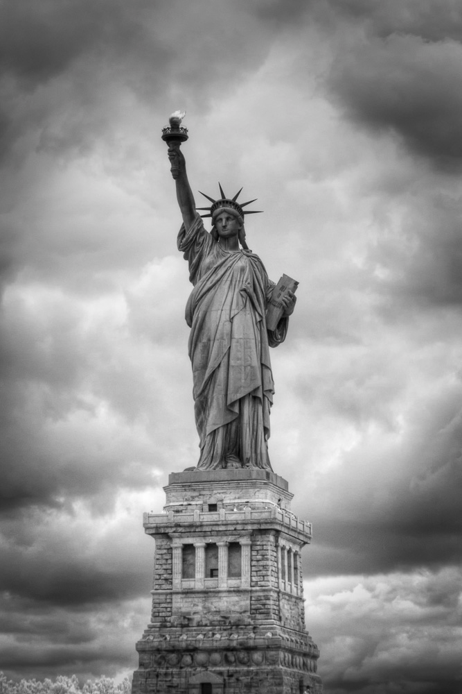
"Give me your tired, your poor, your huddled masses yearning to breathe free.”
– Emma Lazarus
Engraved on Statue of Liberty

Slide 20
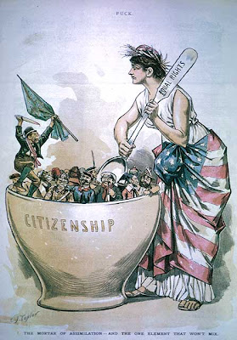
Challenges to the Melting Pot Theory
Immigrants would give up their cultural identities and assimilate to “American” culture
Cooperation for survival meant many groups remained in communities of origin
Some immigrants did not want to give up their cultural identity
Anti-immigrant feelings emerged

Slide 21
Rise of Nativism
Overt favoritism toward native born Americans
Rise in anti-immigrant groups that demanded immigration reform
Anglo-Saxon supremacy (English, Scandinavian and Germans were superior to Slavic, Latin and Asian races

Slide 22
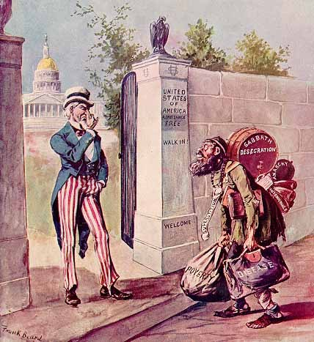
The American Protective Association
Nativist group founded in 1887
Launched various anti-Catholic attacks
Many colleges, social clubs and business refused to admit Jews

Slide 23
Anti-Immigrant Legislation
1897- Congress passed a bill requiring a literacy test for immigrants that would refuse entry to those who could not read 40 words either in English or in their native language
Vetoed by President Cleveland
Represented a powerful statement of public sentiment
Attempts at voting immigration caps, finally passed in 1921 and sealed by the 1924 Immigration Act (reducing non-NW Euro entries to a mere drip). The doors would not be opened again until 1965.

Slide 25
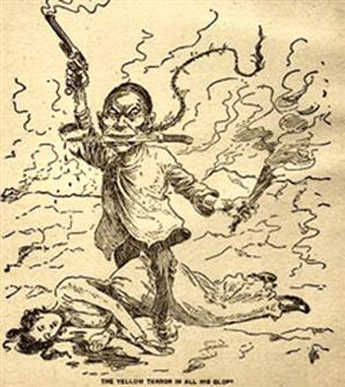
Anti-Asian Sentiment
Anti-Chinese sentiment intensified in 1873 as work was scarce
1882 Chinese Exclusion Act slammed the door shut on Chinese immigration for 10 years (with the exception of students, teachers, government officials merchants and tourists)
Extended for another 10 years in 1892
1902 the law was extended indefinitely
Only repealed in 1943 (WWII)

Slide 26
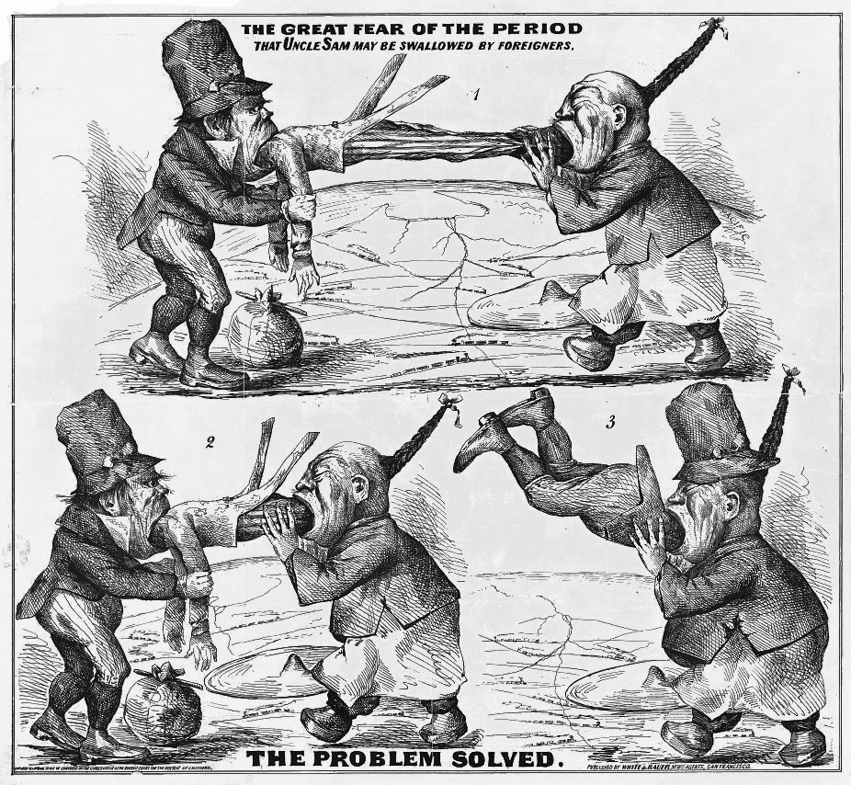

Slide 27
The Gentleman's Agreement
Anti-Chinese fears were extended to Japanese and other Asians in 1900
1906 local board of education segregated Japanese children by putting them in separate schools
Japan protested angrily
President T. Roosevelt created a deal in the 1907-1908 Gentleman’s Agreement
Japan’s government limited immigration of unskilled workers
In exchange the San Francisco segregation order was repealed

Slide 28
In 1815, mathematician Elkanah Watson predicted census numbers for the following century. Here are his estimates, alongside the real totals from between 1790 et 1900:

Slide 31
We see the spike in the 1850s, heavily Irish and German, which led to the nativist Know-Nothing movement, followed by a huge dip during the Civil War. The 1870s and 1890s Depressions both led to big slumps. When J.R. Commons published this map, in 1907, Slavic and Mediterranean immigration was exploding.

Slide 33
Urbanization

Slide 35
Urbanization
Natural and economic disasters made industrial jobs attractive
Growth primarily in the Northeast and Midwest
Revitalized cities but also created serious problems
Cities were cheap and convenient
Offered unskilled laborer steady jobs in mills and factories

Slide 36
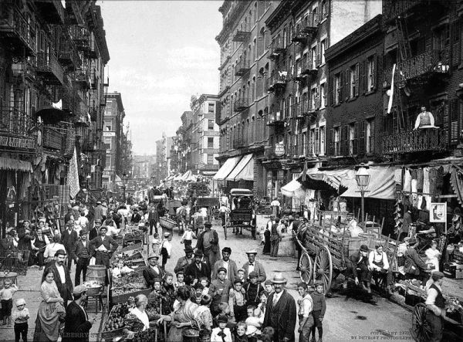
By the Numbers
Urban population: 10 million to 54 million between 1870 and 1920
By 1890 twice as many Irish residents in NY as Dublin
By 1910 immigrant families made up more than half the total population of 18 major American cities
Between 1890 and 1910 about 200,000 African Americans moved to cities such as Detroit and Chicago

Slide 37
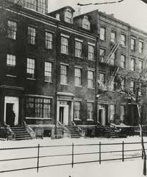
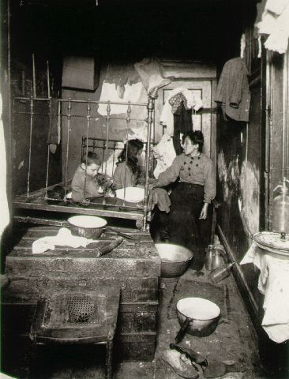
Urban Problems
Housing-
Tenements –multiple families in one residence, dark, poorly ventilated, vermin ridden
Row Houses- built in an effort to fit many families into a single city block
Slums- neighborhoods crowed with people living in poor conditions
1879 NY passed a law that set minimum standards for pluming and ventilation in apartments

Slide 38
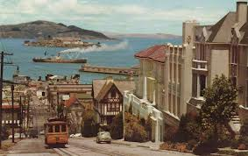
Urban Problems
Transportation- innovations in mass transit were developed to move people from home to factories
1873 Street (Cable) Cars in San Francisco
1897 Electric Subways in Boston
By 1900 most cities had a system connecting the inner city to outlying neighborhoods.

Slide 39
Urban Problems
Water- Cities faced the problem of supplying safe drinking water
1840s and 1850s cities built public waterworks to handled the demand but often inadequate
Typhoid fever and cholera occurred when access to water was poor
1870s Filtration introduced
1908 Chlorination
Access to water a continuing problem into the 20th Century

Slide 40
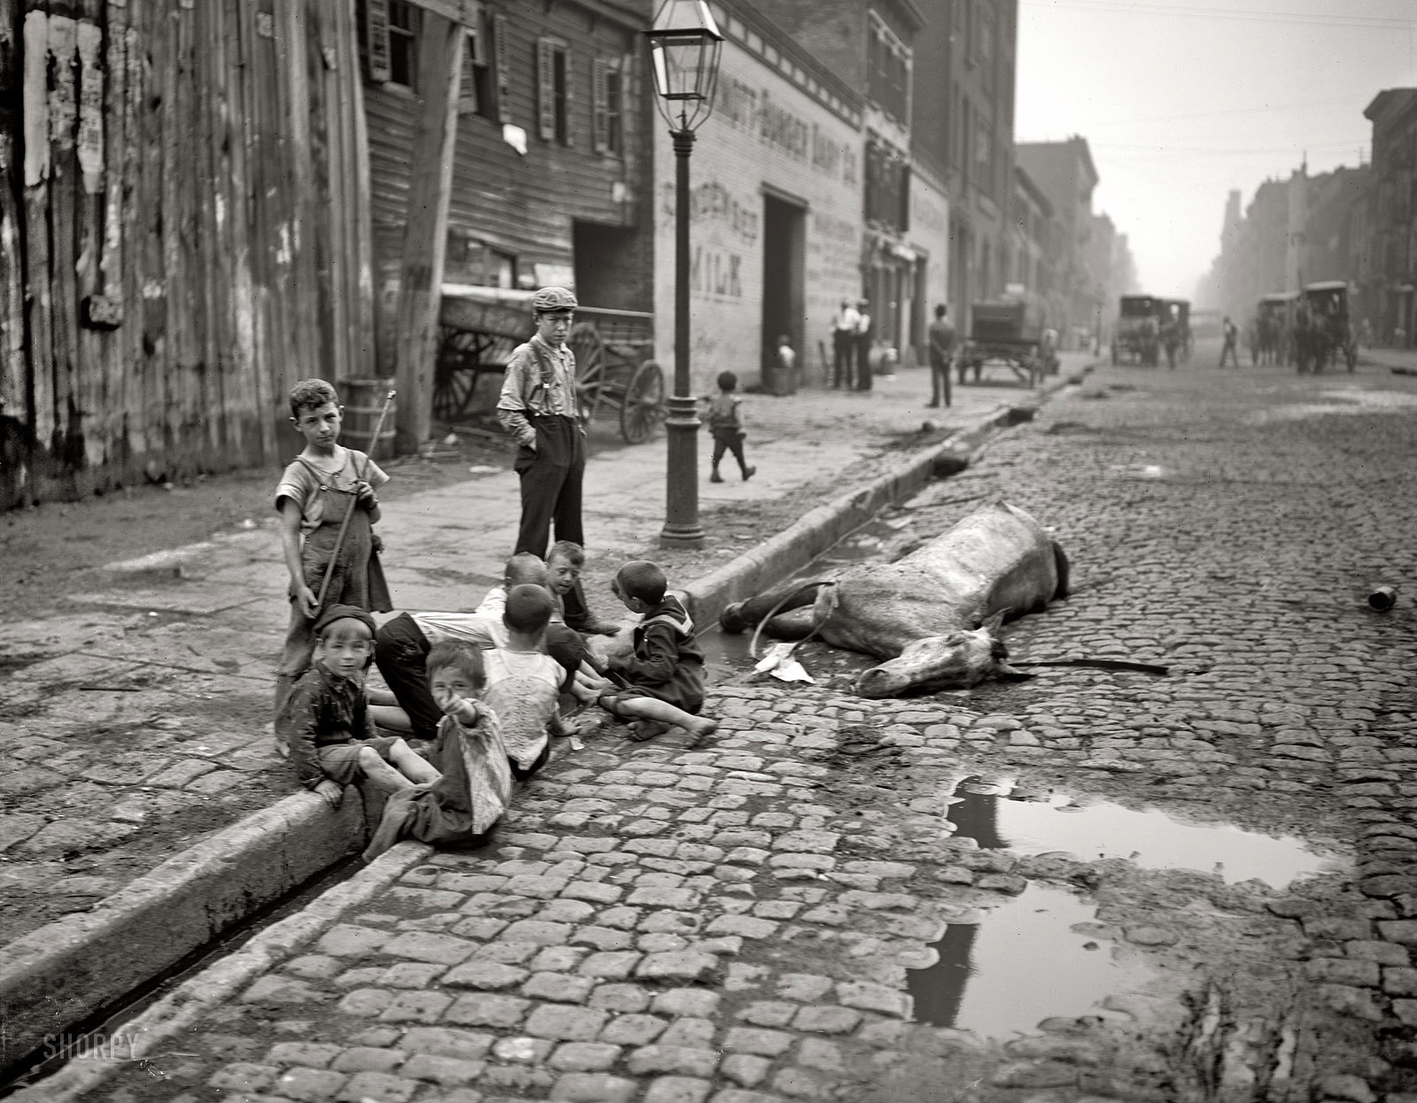
Urban Problems
Sanitation-Challenged to keep the cities clean
Horse manure piled up, disposal for garbage a problem, sewage flowed through open gutters, factories spewed foul smoke into the air
Scavengers- private contractors hired to keep the streets clean often did not do their jobs properly
By 1900 many cities developed sewer lines
Ongoing challenge for urban leaders

Slide 41
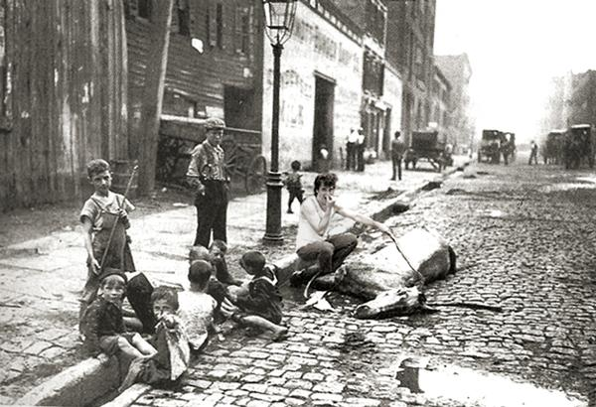

Slide 42
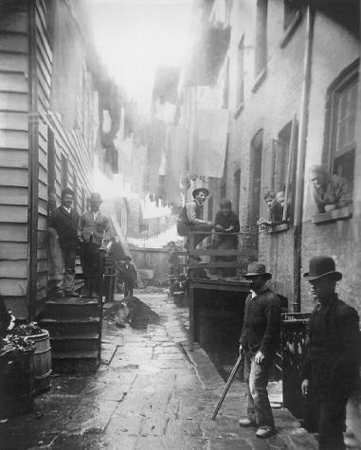
Urban Problems
Crime- Pickpocketing increased, thieves flourished
Gangs developed
1844 NY first to organize a full-time salaried police force
Still, police forces were small in NY and other cities and made little impact on crime

Slide 43
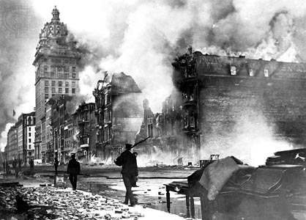
Urban Problems
Fire- Limited water supply lead to the spread of fires
Candles and kerosene lamps also posed a fire threat
Many buildings were wooden and acted as kindle to fire outbreaks
Most firefighter services were volunteer and not always available
1871 Chicago Fire-17,500 buildings destroyed
1906 San Francisco Earthquake and Fire- 28,000 buildings destroyed

Slide 44
Americanization Movement
Designed to assimilate people of a wide-range of cultures into the dominant culture
Schools and voluntary associations provided programs to teach skills for citizenship such as:
Literacy
American history and government
Cooking
Social Etiquette
Many groups did not want to assimilate and were comfortable within their ethnic communities

Slide 45
Racism Amongst Immigrants
Both Irish and Italians were often seen as a violent menace: “[Italians] soon acquired a reputation as bloodthirsty criminals. Since southern Italians had never learned to fight with their fists, knives flashed when they brawled among themselves or jostled with other immigrants. Soon a penologist was wondering how the country could build prisons which Italians would not prefer to their own slum quarters. On the typical Italian the prison expert commented: "The knife with which he cuts his bread he also uses to lop off another 'dago's' finger or ear. . . . He is quite as familiar with the sight of human blood as with the sight of the food he eats."

Slide 46
Racial Tensions
The severe ethnic balkanization of cities led to a general rise in street gangs:
"The Jewish gangs that grew up to protect the Jew against the Irish, the Italian gangs later in conflict with the Jewish gangs, the old comment in certain parts of Chicago that "Every Irish kid was raised to kill a Swede," the conflict between Negro and white that led to race riots in Chicago and East St. Louis, all trace the long-time irritation and conflict that contributed to the habit of violence, that led to coalescence of groups practicing violence against their neighbors,...”

Slide 47
Muckrakers
Name applied to American journalists, novelists, and critics who in the first decade of the 20th cent. attempted to expose the abuses of business and the corruption in politics.
The term derives from the word muckrake used by President Theodore Roosevelt in a speech in 1906, in which he agreed with many of the charges of the muckrakers but asserted that some of their methods were sensational and irresponsible.
The muckraking movement lost support in about 1912. Historians agree that if it had not been for the revelations of the muckrakers the Progressive movement would not have received the popular support needed for effective reform.

Slide 48
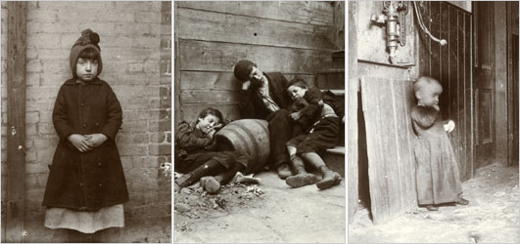
Tenement Life Exposed
Exposed by muckraker Jacob Riis using “flash power” a new photography technique.
Later wrote a book depicting life of various ethic groups entitled, The Other Half.

Slide 49
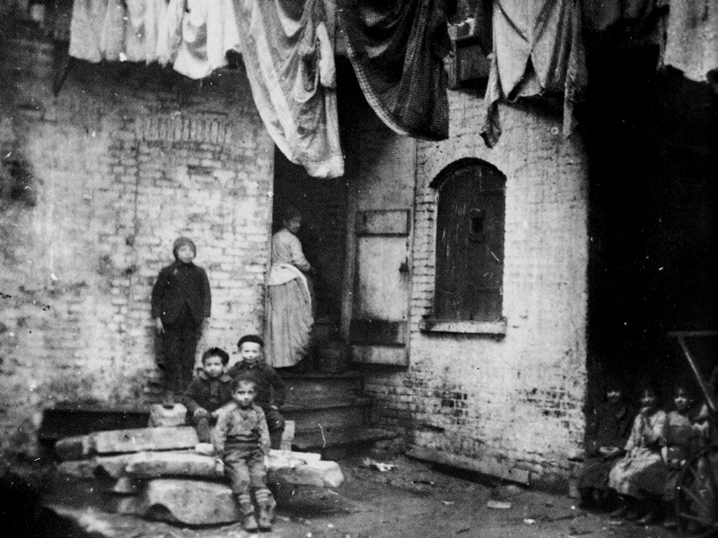

Slide 50
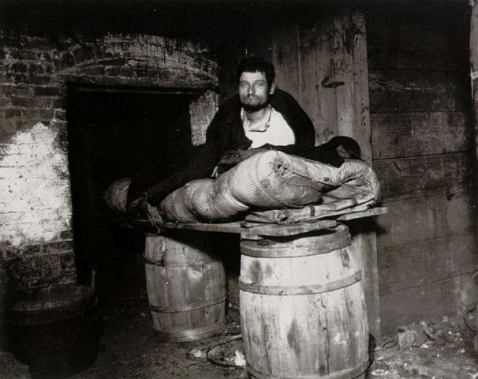

Slide 51
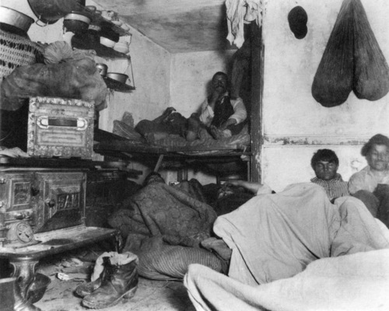
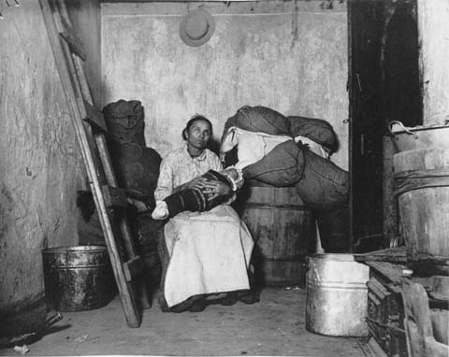

Slide 52
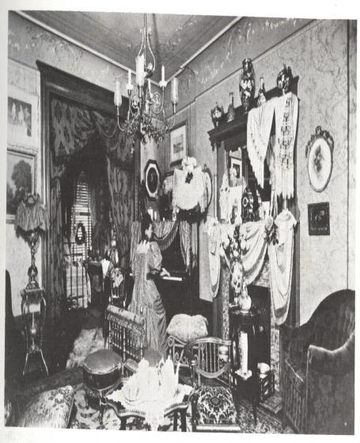
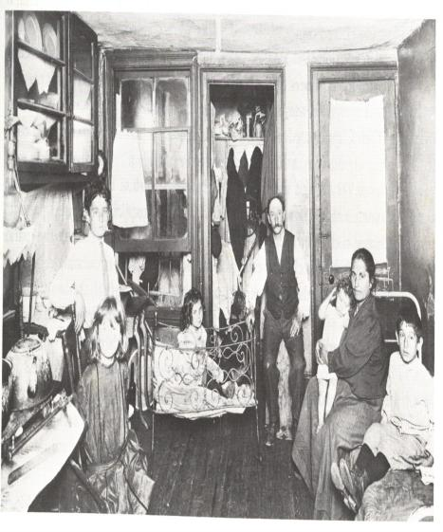
NYC Upper Middle Class Parlor NYC Tenement Room

Slide 53
Reformers

Slide 54
Who were the reformers? What did they want?
Mostly middle class people concerned with social issues of the times.
Issues such as:
Immigrants - old comers and newcomers
City life- poor and needy, and prohibition
Crime and corruption
Strikes, Workman's compensation, minimum wage
Political bosses
City/state governments- direct democracy, tax laws
Giant business corporations
Women’s Suffrage
Child Labor

Slide 55
“In self-defence, you know, all life eventually accommodates itself to its environment, and human life is no exception.” ― Jacob A. Riis, How the Other Half Lives
"The slum is the measure of civilization.”-Jacob Riis

Slide 56
Social Gospel Movement
The movement applied Christian ethics to social problems, and salvation through service to the poor
Especially issues of social justice such as wealth perceived as excessive, poverty, alcoholism, crime, racial tensions, slums, bad hygiene, child labor, inadequate labor unions, poor schools, and the danger of war.
Social Gospel leaders were predominantly associated with the liberal wing of the Progressive Movement

Slide 57
Reforming Society
Growing cities could not provide people necessary services like garbage collection, safe housing, and police and fire protection.
Reformers, many of whom were women activist, saw this as an opportunity to expand public health services.
Progressives scored an early victory in New York State with the passage of the Tenement Act of 1901, which forced landlords to install lighting in public hallways and to provide at least one toilet for every two families, which helped outhouses become obsolete in New York slums.
These simple steps helped impoverished New Yorkers, and within 15 years the death rate in New York dropped dramatically.
Reformers in other states used New York law as a model for their own proposals.

Slide 58
Reformers
The“Settlement”House Movement
European examples:
England’s first - Toynbee Hall 1884
American imitation:
New York’s Stanton Hall 1886
Chicago’s Hull House and many others

Slide 59
The Three R’s
In 1892, Jane Addams published her thoughts on what has been described as, "the three R's" of the settlement house movement: residence, research, and reform.
These involved "[c]lose cooperation with the neighborhood people, scientific study of the causes of poverty and dependence, communication of [these] facts to the public, and persistent pressure for [legislative and social] reform..."

Slide 60
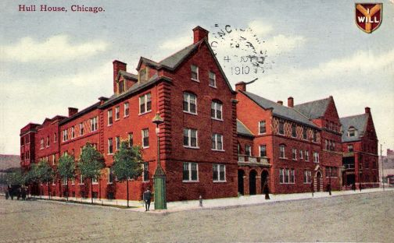
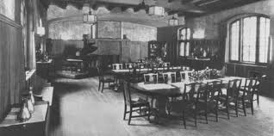
The Hull House
Daycare and one meal a day for young children
Kindergarten and a boy’s club for older youth
Coffee shop for adult men to socialize
Established the city's first public playground and bathhouse
Extensive social, educational, and artistic programs
Medical clinic

Slide 61
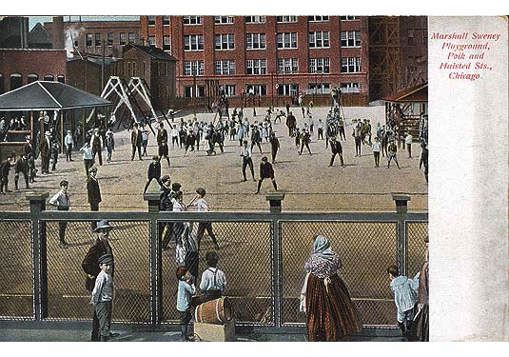
Jane Adam’s Hull House
The Hull house provided a place for immigrants to gain access to resources.
Recreation for the working classes
Art for the people

Slide 62
Beyond the Hull House
In 1899, partly because of Addams launched a campaign against the sweatshops and for better working conditions.
In 1893, Illinois passed a workshop and factories bill, which banned the exploitation of minors in the workplace.
Jane Addams also pushed for the creation of a juvenile-court system. Because they were cold and hungry, immigrant children sometimes broke the law.
Addams' efforts, the Juvenile Court of Chicago was set up.
During World War I (1914-18) she organized the Women's International League for Peace and Freedom, which worked to end the war.
She won the Nobel Peace Prize in 1931 for her work with the peace organization.

Slide 63
Politics of the Gilded Age

Slide 64
POLITICAL MACHINES
During late 1800’s, many cities run by a Political machine.
This was an organized group, headed by a city boss, that controlled activities of a political party in a city.
Offered services to voters & businesses in exchange for political or financial support.
Organized like a pyramid with workers on the bottom and the “boss” on the top

Slide 65
Political Machine Organization

Slide 66
Political Bosses
Ran local business and politics
Controlled access to municipal jobs, business licenses and influenced the courts
Some bosses, like Roscoe Conkling in NY built parks, waterworks and provided support to schools, hospitals and orphanages
Able to gain voter loyalty through providing the city with municipal benefits

Slide 67
Immigrants and the Machine
Many precinct captains and prescient bosses were 1st or 2nd generation immigrants
They could speak the immigrants language and provide support locating jobs and accessing recourses
Help with: Naturalization (gaining citizenship), housing and jobs
In return: votes

Slide 68
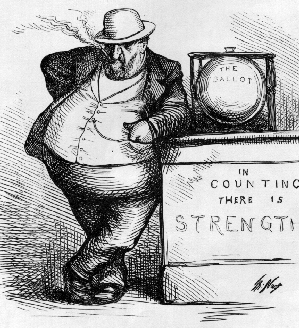
Political bosses cartoon by Thomas Nast

Slide 69
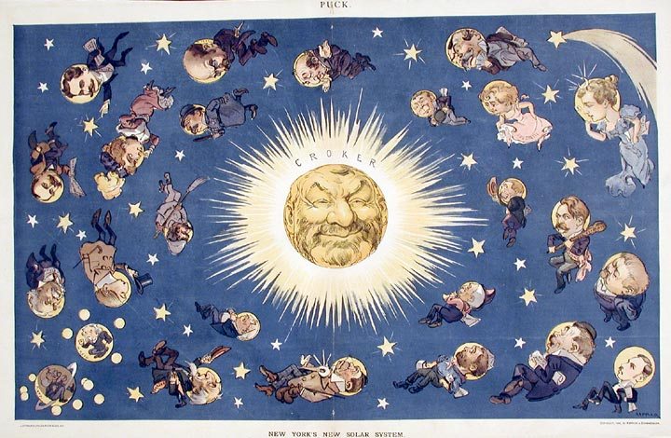
The New York Solar System: Boss Richard Croker of NYC. Croker organized NYC politics for nearly twenty years. It was nearly impossible to win an election without his support: local or national.

Slide 70
GRAFT
Many Bosses got rich through GRAFT-the illegal use of political influence for personal gain.
Also gained money through “kickbacks” or part of a persons income in exchange for placing them at a job
Granted favors to business in exchange for cash bribes
Allowed illegal activities like gambling to flourish
Until about 1890 police forces were hired and fired by city bosses

Slide 71
Voting Fraud at Elections
Voting fraud was common at elections
There were little restrictions on voter identification
Men would often shave their beard and vote a second time
Votes were placed for the machine under which a man earned benefits from

Slide 73
Review
'Going Through the Form of Universal Suffrage', 1871
Picture depicts innocent voters dropping their ballots into a garbage basket while Tweed and his gang stands around innocently.
Caption: (Boss) "You have the Liberty of Voting for any one you please; but we have the Liberty of Counting in any one we please."

Slide 74
Thomas Nast Brings Down Tweed and Tammany Hall

Slide 75
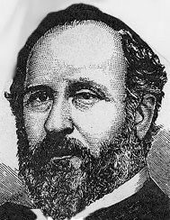
BOSS TWEED & TAMMANY HALL
William Marcy Tweed, a.k.a. “Boss Tweed”, one of the most powerful political bosses.
Became head of Tammany Hall, New York City’s most powerful Democratic machine

Slide 76
Boss Tweed
The record for brassiness goes to Boss William Tweed, who swindled New York out of a fortune when he headed NY’s Tammany Hall in the 1860s and 1870s.
Tweed’s masterpiece of graft was a chunky three-story courthouse in Lower Manhattan originally budgeted at $250,000. When Tweed was through, the city had spent more than $13 million – and the building was still not finished.

Slide 77
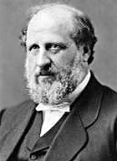
William Marcy Tweed known as “Boss” Tweed 1823- 1878
Boss Tweed was an American politician who, with his "Tweed ring" cronies, systematically plundered New York City of sums estimated at between $30 million and $200 million.
(that would be worth between $365 million and $2.4 billion today)

Slide 78
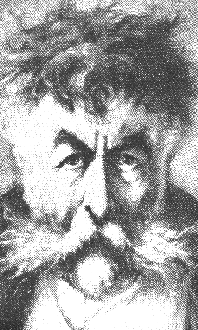
Thomas Nast 1840- 1902
American cartoonist, best known for his attack on the political machine of William M. Tweed in New York City in the 1870s.
Many of Nast's most effective cartoons were virulent attacks on Tammany Hall, led by "Boss" Tweed. His cartoons were probably one of the chief factors in the machine's downfall. Nast's caricature of the fleeing political boss led to Tweed's identification and arrest.

Slide 79
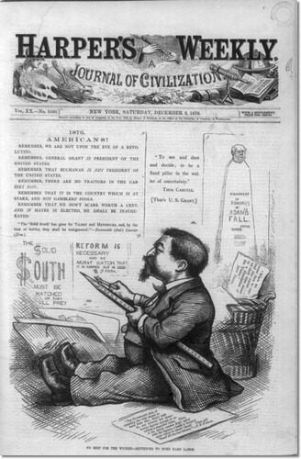
Nast’s Persuasion
Nast had used his “power of the pencil” to influence past Presidential elections such as the election of 1877 that resulted in the “corrupt bargin” and Ruthaford B. Hayes ellected as president.
Here you can see Nast sharpening his pencil for Hayes.

Slide 80
The Tweed Ring
In 1852, Tweed was elected to a term in Congress. He gradually strengthened his position in Tammany Hall (the executive committee of New York City's Democratic Party organization), and held other important positions in the city government.
Meanwhile he managed to have his cronies named to other key city and county posts, thus establishing what became the Tweed ring.

Slide 81
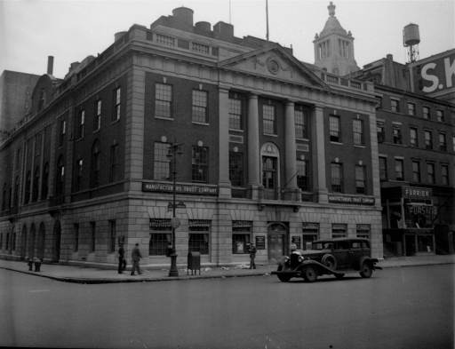
Tammany Hall

Slide 82
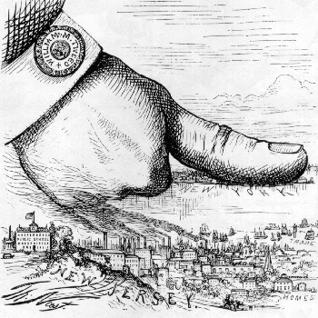
Political Control
By 1860 Tweed controlled the Democratic Party's nominations to all city positions. He became a state senator in 1868. Tweed dominated the Democratic Party in both the city and state and had his candidates elected mayor of New York City, governor, and speaker of the state assembly.

Slide 83
Fraud!
By 1870, the Tweed ring was able to milk the city through such devices as faked leases, padded bills, false vouchers, unnecessary repairs, and overpriced goods and services bought from suppliers controlled by the ring.
Examples of the flagrant abuse of the public’s money were:
40 old chairs and three tables: $179,792.60 (about $2 million today)
2) Repairing fixtures: $1,149,874.50 (about $14 million today)
3) A plasterer's wages during a nine month period: $2,870,464.06 (about $34 million today)
4) 30 months of advertising paid to a Tweed-controlled printing company: $7,168,212.23 (about $87 million today)

Slide 84
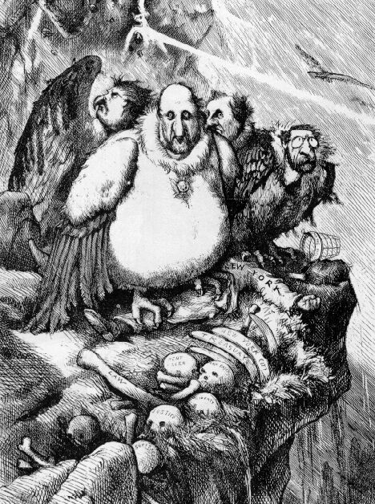
After the disclosure of some of the financial scandals, Tweed and his gang were hopeful that things would boil down. Nast made sure this would not happen when he drew: "A Group of Vultures Waiting For The Storm to 'Blow Over'"

Slide 85
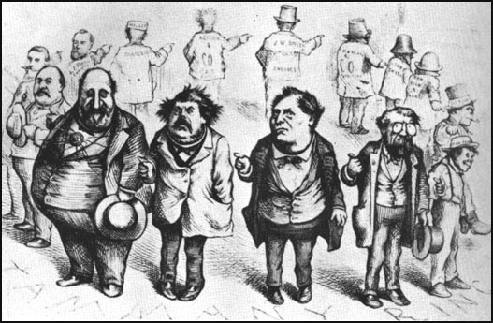
Caption (not pictured says):“Who Stole the People’s Money? -- Do Tell.‘TWAS HIM.”

Slide 86
Review
Thomas Nast, also drew the very effective: "Who Stole the People's Money?" in which each character points to the man on his right forming a circle of liars.

Slide 87
Tweed Tries to Bribe Nast
Tweed decided to buy off Nast, and sent someone to inform Nast that some admirers of his work wanted to send him to Europe to study art.
When Nast, suspicious, replied that he could not possibly afford to leave his work at Harper's, the reply was that $100,000 was set aside for him. Nast responded it would take more than that to make it worth his while. When the figure was raised to half a million, Nast said he'd rather see Tweed and his gang in jail first.
"Be careful Mr. Nast," his caller replied, "that you do not find yourself in a coffin first." Not long after that, suspicious looking characters were seen outside of Nast's home in Manhattan, so he moved his family to suburban Morristown, New Jersey.

Slide 88
Tweed Tries to Influence Nast’s Publisher
With the unsuccessful campaign to bribe Nast, next Tweed tried to intimidate Harper’s Brothers by threatening to have the Board of Education throw out all Harper textbooks and never buy any more. This would be a severe blow to the publisher; the board of directors voted to stand by their artist and the battle with Tweed continued.

Slide 89
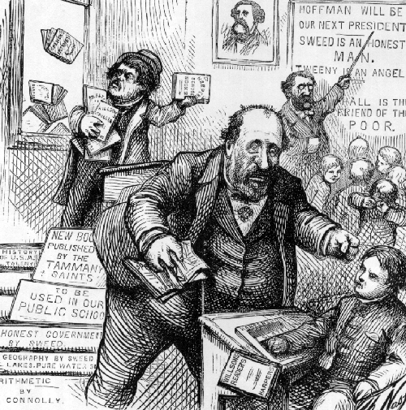
Following the threats against himself and Harper’s, Nast published "The New Board of Education.”

Slide 90
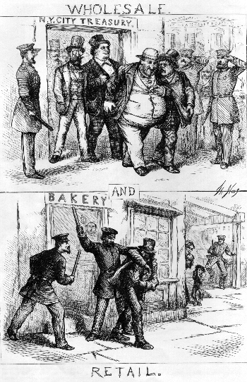
Then followed a barrage of cartoons depicting Tweed and his gang as many thieves.
One emphasized the difference between "Wholesale and Retail Thievery."

Slide 91
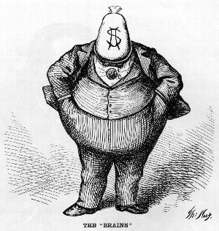
One of Nast’s most famous cartoons speaks for itself on the brains of Tammany Hall.

Slide 92
On the eve of the municipal elections in New York City in November 1871, there appeared in Harper's Weekly "The Tammany Tiger Loose-What Are You Going to Do About It?" considered to be one of the most powerful political cartoons of all time.

Slide 93
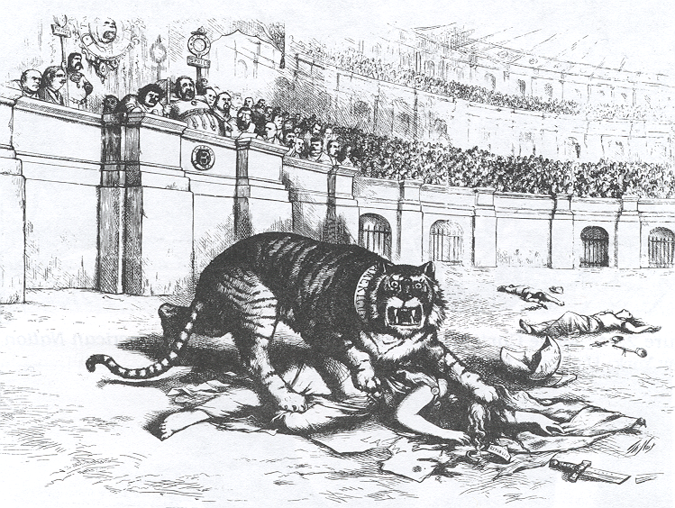
Caption says: “The Tammany Tiger Loose-What Are You Going to Do About It?”

Slide 94
Result
The Tweed Ring was swept from power by angry voters. The young artist, Thomas Nast, was given the major credit.

Slide 95
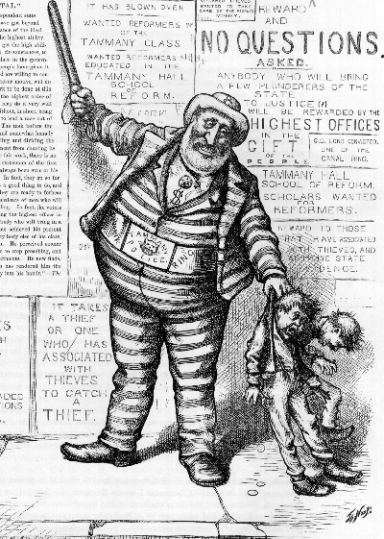
All of the Tammany Ring were convicted and sent to prison, but Tweed escaped to Spain. He was later recognized, thanks to a Nast cartoon. The cartoon was one Nast drew earlier showing Tweed in prison garb apprehending two small culprits while his crimes went unpunished. The Spanish police interpreted the cartoon to mean that Tweed was wanted for kidnapping and the word "REWARD" caught their eye. Tweed was extradited to the United States and re-imprisoned.

Slide 96
Review Question
How did political cartoons help put an end to the corruption of Boss Tweed and Tammany Hall?

Slide 97
Movie Suggestions
This Era:
Far and Away (NY and the West)
Gangs of New York (NY)
Iron Jawed Angels (Wash. DC)
Modern Urban/Immigrant Struggles:
Boyz n the Hood (LA)
The Departed (Boston)
Freedom Writers (LA)
Under the Same Moon (LA)
Almanya - Willkommen in Deutschland (Germany)
The Joy Luck Club (San Francisco)

Slide 98
Federal Government and Big Business

Slide 99
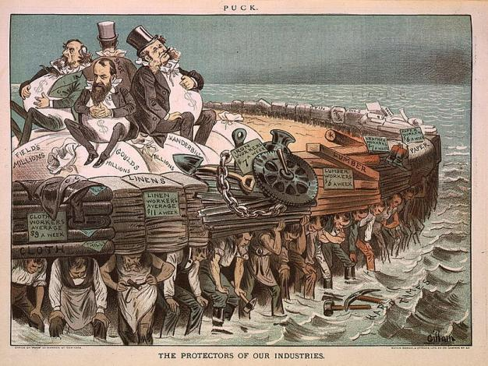
The Titans of Business
Private investors and businessmen contributed money to elections and campaigns in exchange for a “hands off” approach
Emphasis on business and making money over reform

Slide 100
Political Scandal
Federal government known for constant scandal
Credit Mobilier Scandal
Pres. Grant ignored a private contract to a railroad company, V.P. made a ton of money
Whiskey Ring
Cabinet stole money from whiskey excise tax
Sec. of War sold junk to Indians for profit
Panic of 1873
Economic depression due to over-speculation in industry and inflation
Pres. Garfield assassinated by office-seeker

Slide 101
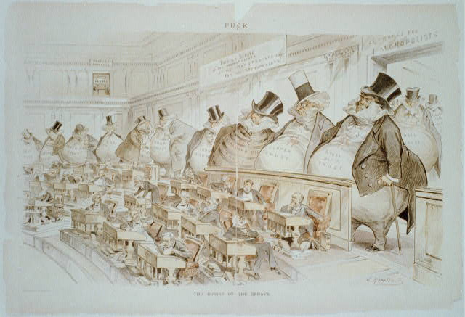
Cartoon from Puck: “Bosses of the Senate”

Slide 102
Patronage
Giving of government jobs to people who helped a candidate get elected
Andre Jackson-Spoils System
Often put people in positions they were not qualified for
Reformers replaced this system with merit based hiring
Jobs in civil service would go to the most qualified, regardless of political affiliation
Rutherford B. Hayes employed independents in lieu of being able to convince Congress to reform.

Slide 103
Pendleton Civil Service Act 1883
Installed after the assassination of President James A. Garfield by a Stalwart (for spoils system) lawyer who was angry over giving of patronage jobs to reformers.
Urged by VP turned Pres. Chester A. Arthur
Authorized bipartisan civil service commission to make appointments for federal jobs based on a candidates performance on an exam
By 1901 more than 40% of federal jobs were classified as civil service positions
Politicians turned to business to provide campaign contributions as they could no longer pressure employees for contributions

Slide 104
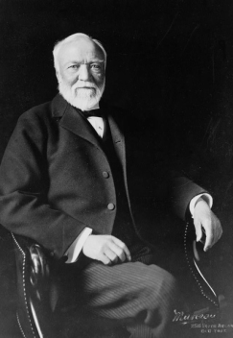
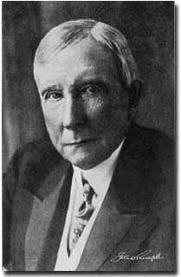
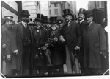
The Men
The Titans
J.D. Rockefellar--Standard Oil
J.P. Morgan--Investment banking and financier
Andrew Carnegie--U.S. Steel
Cornelius Vanderbilt, Jay Gould, and Jay Fiske--Railroads

Slide 105
The Influence of Business
Powerful individuals forced and intimidated Americans and politicians
Used tactics similar to mafia
Targeted immigrants for labor exploitation and votes
Used bribery, violence, and extortion to get job done

Slide 106
Business Buys Influence
1884 Grover Cleveland (D) first Democrat in 28 years
Cleveland tried to lower tariff rates but Congress refused to support him
1888 Benjamin Harrison won with a campaign supported by big business that wanted tariffs higher than they already were
McKinley Tariff Act 1890 signed by Harrison raised tariffs
Failed attempts to reduce the tariff again in 1894 and1897

Slide 107
Coming Soon…. “Cleaning Up” The Progressive Era

