Slide 1
APUSH REVIEW
TOPIC: Immigration

Slide 2
THEMES
Identity
• In what ways and to what extent have gender, class, ethnic, religious, regional, and other group identities changed in different historical eras?!
Peopling
• HOW and why have people have migrated to, from, and within North America?
• In what ways and to what extent have changes in migration and population patterns affected American life?
Politics and Power
• In what ways and to what extent have Americans agreed on or argued over the values that guide the political system, as well as who is a part of the political process?

Slide 3
Period 1
1491 – 1607
Notes:
Period 1: 1491-1607!
1. The arrival of Europeans in the Western Hemisphere in the 15th and 16th centuries
triggered extensive demographic and social changes on both sides of the Atlantic.!

Slide 4
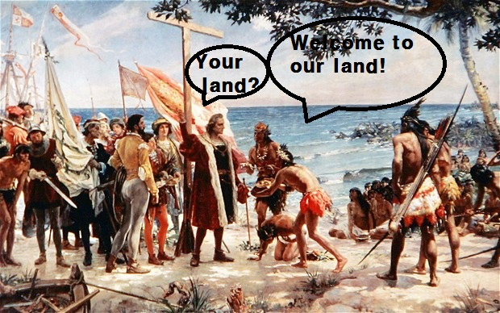
Demographic changes
Notes:
https://kyeongbin.wordpress.com/2012/08/10/out-of-class-essay-2/

Slide 5
Period 2
1607 – 1754
Notes:
Period 2: 1607-1754!
2. The increasing political, economic, and cultural exchanges within the “Atlantic World” had a
profound impact on the development of colonial societies in North America.! !
3. Great Migration of Puritans, 1630s and 1640s!

Slide 6
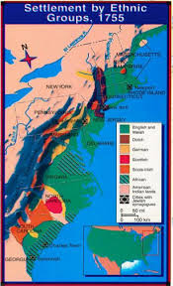
Colonial
Societies
Notes:
http://imgarcade.com/1/middle-colonies-ethnic-diversity/

Slide 7
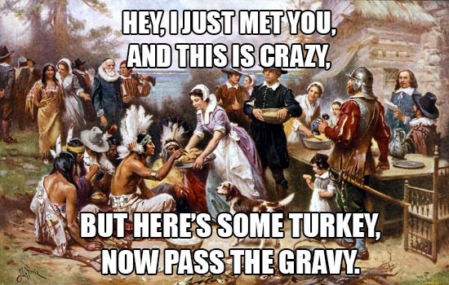
Puritans
Notes:
https://www.flickr.com/photos/neontommy/10930139005/

Slide 8
Period 3
1754 – 1800
Notes:
Period 3: 1754-1800!
4. English population growth and expansion into the interior disrupted existing French-Indian
fur trade networks and caused various Indian nations to shift alliances among competing
European powers. ! !
5. Migrants from within North America and around the world continued to launch new
settlements in the West, creating new distinctive backcountry cultures and fueling social and
ethnic tensions.! !
6. Scots-Irish! !
7. Alien and Sedition Acts, 1798!

Slide 9
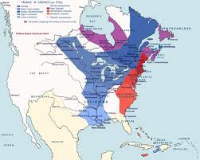
More and More English
Notes:
http://www.ccis.edu/courses/HIST359mtmcinneshin1/wk05.htm

Slide 10
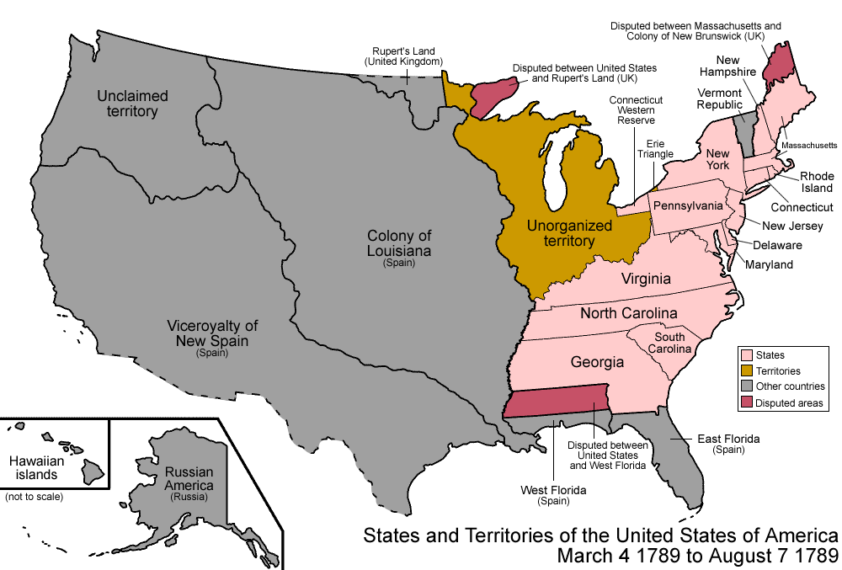
Going West?
Notes:
http://en.wikipedia.org/wiki/American_frontier

Slide 11
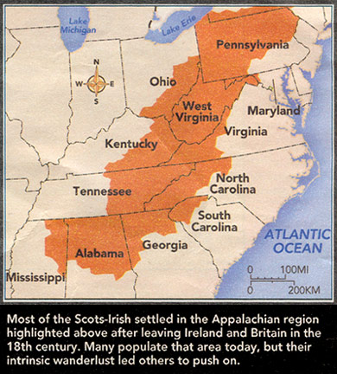
Scots – irish
Notes:
http://www.monarchbear.org/directors/roots.html

Slide 12
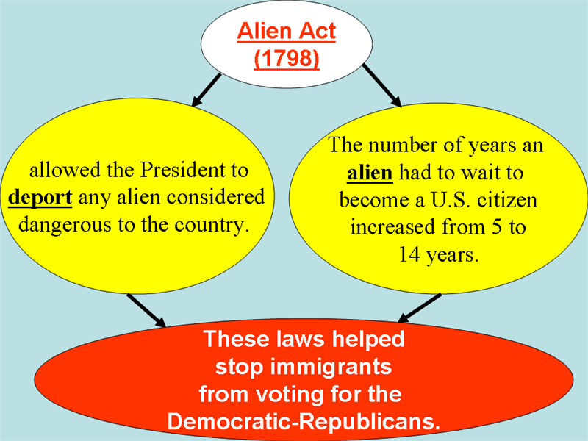
Alien and sedition acts 1798
Notes:
http://dmshistory8.weebly.com/john-adams-presidency.html

Slide 13
Period 4
1800 – 1848
Notes:
Period 4: 1800-1848!
8. Efforts to exploit the nation’s natural resources led to government efforts to promote free and
forced migration of various American peoples across the continent, as well as to competing
ideas about defining and managing labor systems, geographical boundaries, and natural
resources.! !
Developed by James L. Smith

Slide 14
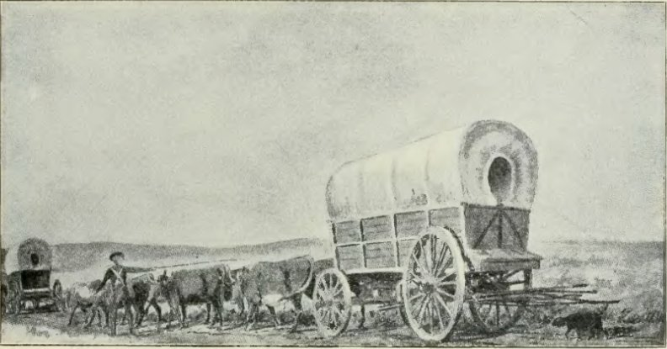
Natural resources
Notes:
https://familysearch.org/learn/wiki/en/Iowa_Emigration_and_Immigration

Slide 15
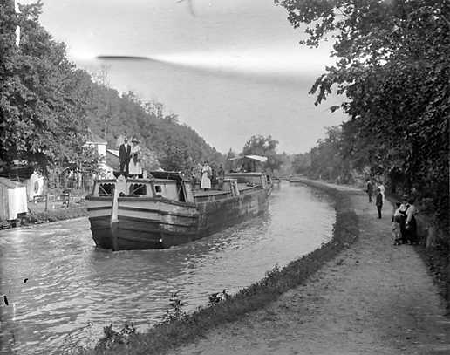
Canals and roads oh my!
Notes:
http://en.wikipedia.org/wiki/Chesapeake_and_Ohio_Canal

Slide 16
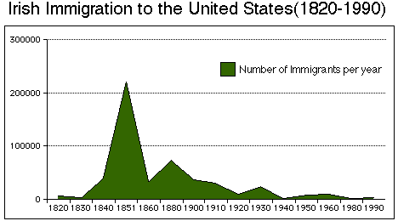
European migrants
Notes:
http://www.tahg.org/module_display.php?mod_id=19&review=yes

Slide 17

1840s Irish immigration
Notes:
http://www.celticshamrock.com/m3/3043--no-irish-need-apply-sign.html

Slide 18
Period 5
1844 – 1877
Notes:
12. Asian, African American, and white peoples sought new economic opportunities or religious
refuge in the West, efforts that were boosted during and after the Civil War with the passage
of new legislation promoting national economic development.! !
13. As the territorial boundaries of the United States expanded and the migrant population
increased, U.S. government interaction and conflict with Hispanics and American Indians
increased, altering these groups’ cultures and ways of life and raising questions about their
status and legal rights.! !
14. Substantial numbers of new international migrants — who often lived in ethnic communities
and retained their religion, language, and customs — entered the country prior to the Civil
War, giving rise to a major, often violent nativist movement that was strongly anti-Catholic
and aimed at limiting immigrants’ cultural influence and political and economic power. ! !
15. nativism! !
16. Know Nothings!

Slide 19
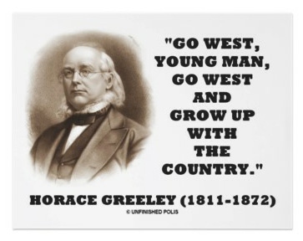
West as refuge
Notes:
http://istandardproducers.com/istandard-blog/gowest/

Slide 20
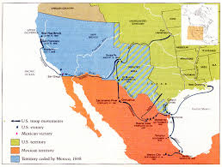
Hispanic and indian populations
Notes:
http://www.latinamericanstudies.org/mexican-war-maps.htm

Slide 21
International migrants

Slide 22
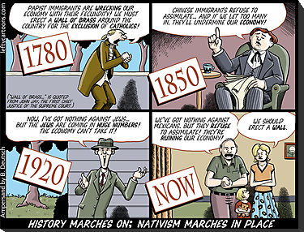
Nativism
Notes:
http://www.glogster.com/leidvsq/nativism/g-6l9ksko828po1m02gbrdka0

Slide 23
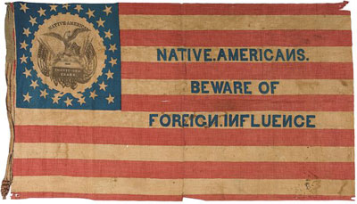
Know nothings
Notes:
https://www.weareoneamerica.org/blog/feb-11/thoughts-presidents-day-know-nothing-party

Slide 24
Period 6
1865 – 1898
Notes:
17. The industrial workforce expanded through migration across national borders and internal
migration, leading to a more diverse workforce, lower wages, and an increase in child labor.! !
18. Increased migrations from Asia and from southern and eastern Europe, as well as African
American migrations within and out of the South, accompanied the mass movement of
people into the nation’s cities and the rural and boomtown areas of the West. ! !
19. Immigrants sought both to “Americanize” and to maintain their unique identities; along with
others, such as some African Americans and women, they were able to take advantage of
new career opportunities even in the face of widespread social prejudices.! !
20. In a urban atmosphere where the access to power was unequally distributed, political
machines provided social services in exchange for political support, settlement houses
helped immigrants adapt to the new language and customs, and women’s clubs and selfhelp
groups targeted intellectual development and social and political reform.! !
21. Post–Civil War migration to the American West, encouraged by economic opportunities and
government policies, caused the federal government to violate treaties with American Indian
22. Increasingly prominent racist and nativist theories, along with Supreme Court decisions such
as Plessy v. Ferguson, were used to justify violence, as well as local and national policies of
discrimination and segregation.! !
23. Old Immigrants ! !
24. New Immigrants ! !
25. Ellis Island ! !
26. assimilation ! !
27. Chinese Exclusion Act, 1882 ! !
28. Jane Addams!
nations in order to expand the amount of land available to settlers. !

Slide 25

Melting pot
Notes:
http://www.regentsprep.org/regents/ushisgov/themes/immigration/theories.htm

Slide 26
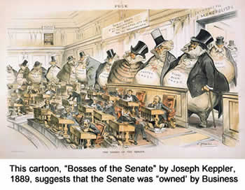
Political machines
Notes:
http://www.saylor.org/site/wp-content/uploads/2013/09/Politics-in-the-Gilded-Age-1865-1900-COMPLETE2.html

Slide 27
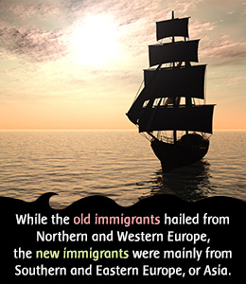
Old vs new immigrants
Notes:
http://www.buzzle.com/articles/new-immigrants-vs-old-immigrants.html

Slide 28
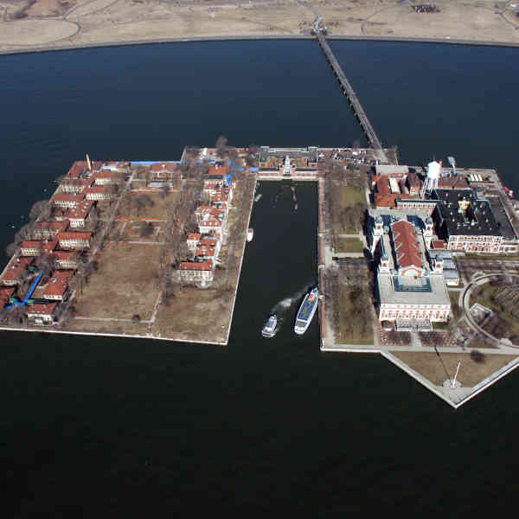
Ellis island
Notes:
http://www.saveellisisland.org/gallery/aerial-views-of-ellis-island/

Slide 29
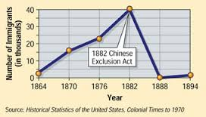
Chinese exclusion act 1882
Notes:
http://atelophobia.edublogs.org/

Slide 30
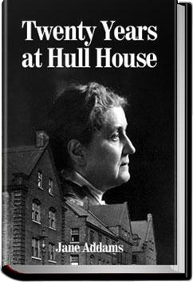
Jane addams
Notes:
http://www.allyoucanbooks.com/ebook/twenty-years-hull-house-jane-addams

Slide 31
Period 7
1890 – 1945
Notes:
Period 7: 1890-1945!
29. In its transition from a rural, agricultural society to an urban, industrial society, the U.S.
offered new economic opportunities for women, internal migrants, and international migrants
who continued to flock to the United States.! !
30. Although most African Americans remained in the South despite legalized segregation and
racial violence, some began a “Great Migration” out of the South to pursue new economic
opportunities offered by World War I.! !
31. As labor strikes and racial strife disrupted society, the immediate period after World War I
witnessed the first American “Red Scare,” which legitimized attacks on radicals and
immigrants.! !
32. Several acts of Congress during the 1920s established highly restrictive immigration quotas,
while national policies continued to permit unrestricted immigration from nations in the
Western Hemisphere, especially Mexico, in order to guarantee an inexpensive supply of
labor.! !
33. Technological change, modernization, and changing demographics led to increased political
and cultural conflict on several fronts: tradition versus innovation, urban versus rural,
fundamentalist Christianity versus scientific modernism, management versus labor, nativeborn
versus new immigrants, white versus black, and idealism versus disillusionment.! !
34. Many Americans migrated during the Great Depression, often driven by economic
difficulties, and during World Wars I and II, as a result of the need for wartime production
labor.! !
35. Many Mexicans, drawn to the U.S. by economic opportunities, faced ambivalent government
policies in the 1930s and 1940s.! !
36. Gentleman’s Agreement, 1907! !
37. Palmer Raids, 1919-1920!
38. National Origins Act, 1924 ! !
39. Ku Klux Klan! !
40. Sacco and Vanzetti, 1927 ! !
41. Mexican Repatriation, 1929-1939 ! !
42. Bracero Program, 1942

Slide 32
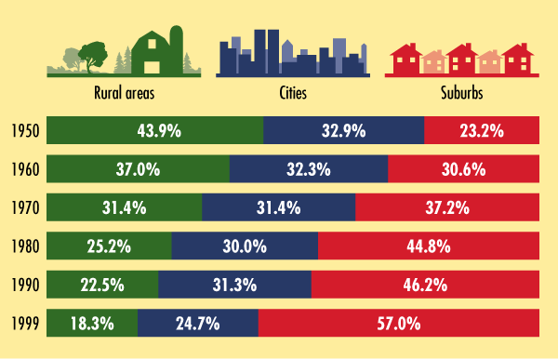
Rural to urban
Notes:
http://wps.ablongman.com/wps/media/objects/18/19102/thumbs/gree043.html

Slide 33
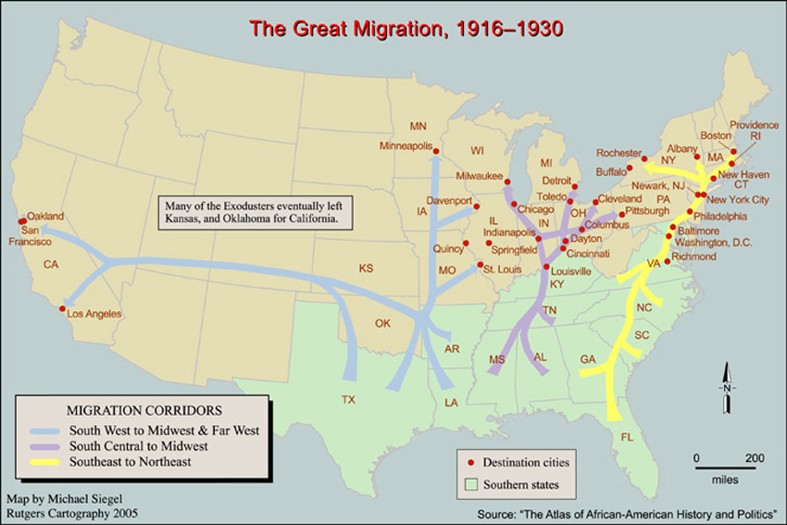
Great migration
Notes:
https://www.centerstage.org/marainey/DigitalDramaturgy/TheGreatMigration/TheGreatMigrationMap.aspx

Slide 34

Great Depression migration
Notes:
http://www.amazon.com/The-Grapes-Wrath-Ricky-Gordon/dp/tracks/B00182Z7F2

Slide 35
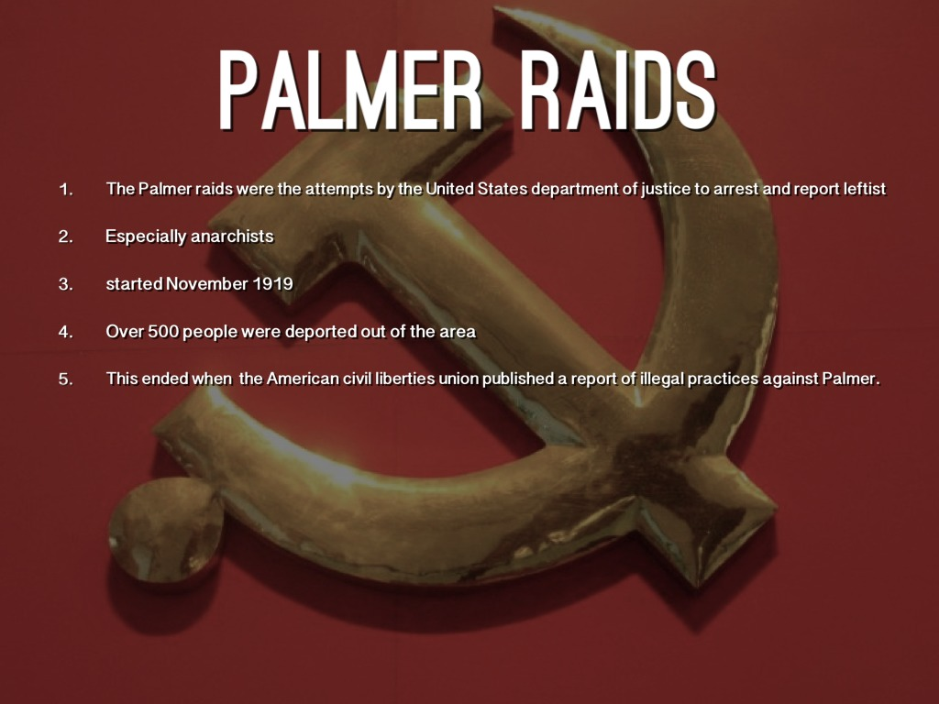
Palmer raids 19-20
Notes:
http://imgkid.com/palmer-raids-and-red-scare.shtml

Slide 36
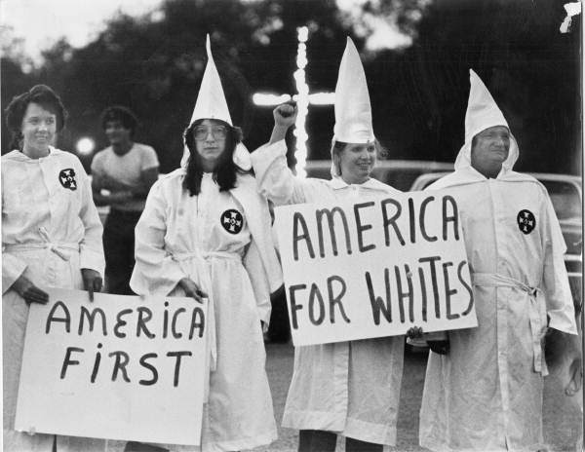
Ku klux klan
Notes:
https://lansingworkerscenter.files.wordpress.com/2012/10/kkk.jpg?w=60

Slide 37

Sacco and vanzetti 1927
Notes:
http://ziruc.deviantart.com/art/Sacco-e-Vanzetti-film-92743403

Slide 38
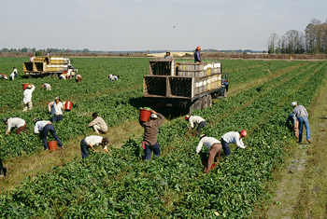
Bracero program 1942
Notes:
http://www.waukeshareads.org/index.php/2013/10/14/the-bracero-program/

Slide 39
Period 8
1945 – 1980
Notes:
43. Internal migrants as well as migrants from around the world sought access to the economic
boom and other benefits of the United States, especially after the passage of new
immigration laws in 1965. ! !
44. McCarran-Walter Act, 1952! !
45. Immigration and Nationality Act of 1965!

Slide 40
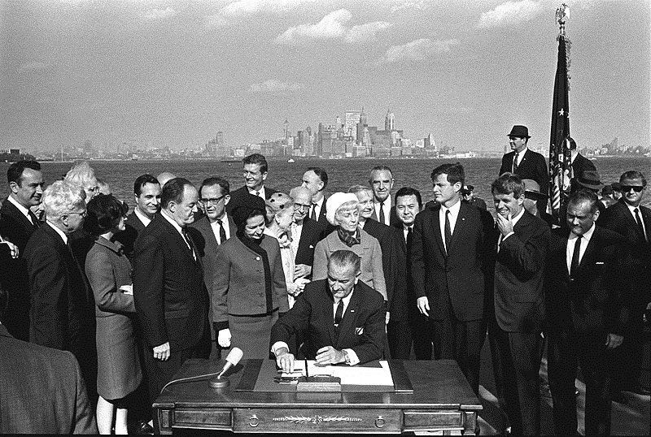
Immigration and nationality act of 1965
Notes:
https://www.stormfront.org/forum/t781341/

Slide 41
Period 9
1980 – Present
Notes:
46. After 1980, the political, economic, and cultural influences of the American South and West
continued to increase as population shifted to those areas, fueled in part by a surge in
migration from regions that had not been heavily represented in earlier migrations,
especially Latin American and Asia. The new migrants affected U.S. culture in many ways
and supplied the economy with an important labor force, but they also became the focus of
intense political, economic, and cultural debates. ! !
47. Immigration Reform and Control Act of 1986 ! !
48. Immigration Act of 1990

Slide 42
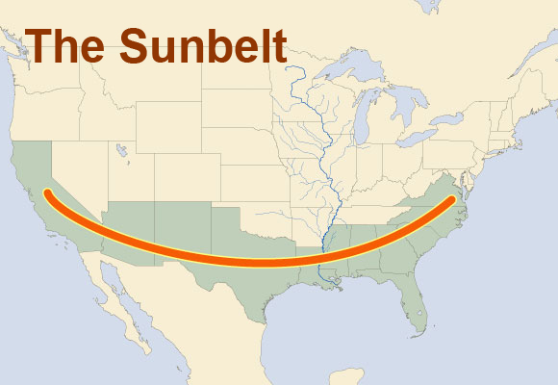
Sun Belt shift
Notes:
http://aventalearning.com/courses/GEOGx-HS-A09/a/unit01/GEOG_1.B.13.html

Slide 43
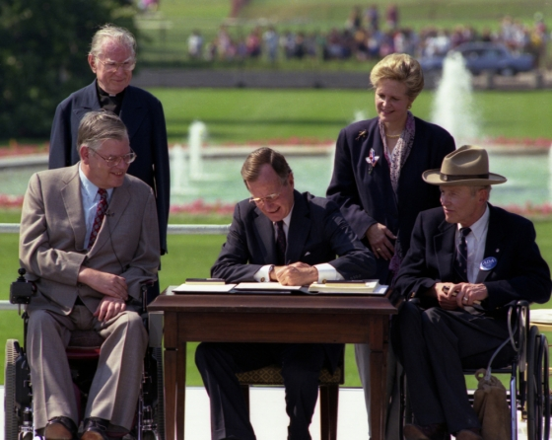
Immigration act of 1990
Notes:
http://pixgood.com/immigration-act-of-1990.html

